Slide 1
Accessing Google Android API
~Google Maps API~

Slide 2

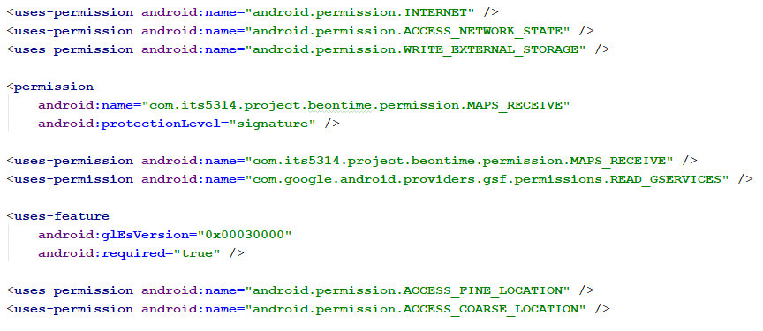
Edit AndroidManifest.xml

Slide 3
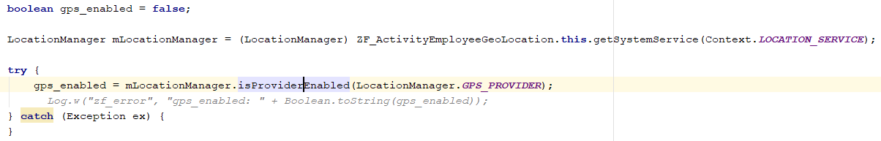
Start
GoogleApiClient.ConnectionCallbacks
Google Play Services Available?
No
Ask User to Enable.
Yes
Is GPS Enable?
No
Ask User to Enable.
Yes
1

Slide 4
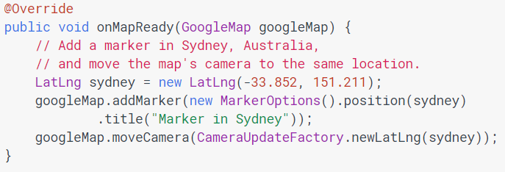
1
OnMapReadyCallback
Initialise Google Map fragment
End

