Slide 2
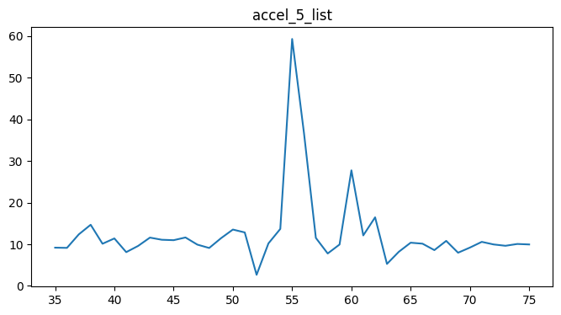
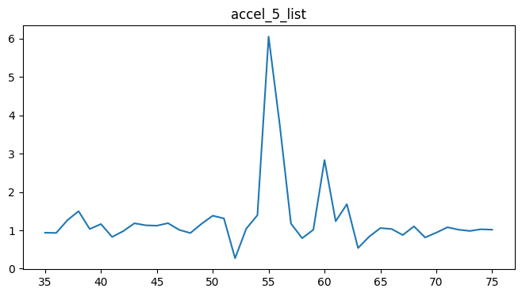
Acceleration(g)
Time(1/10s)

Slide 3







fully
Conv
Pool
Flatten
connected
fully
Conv
Pool
Flatten
connected
1
1
f
f
*
=
k
k
n, n, 1
k, k, f
(n-k+1), (n-k+1), f

Slide 4
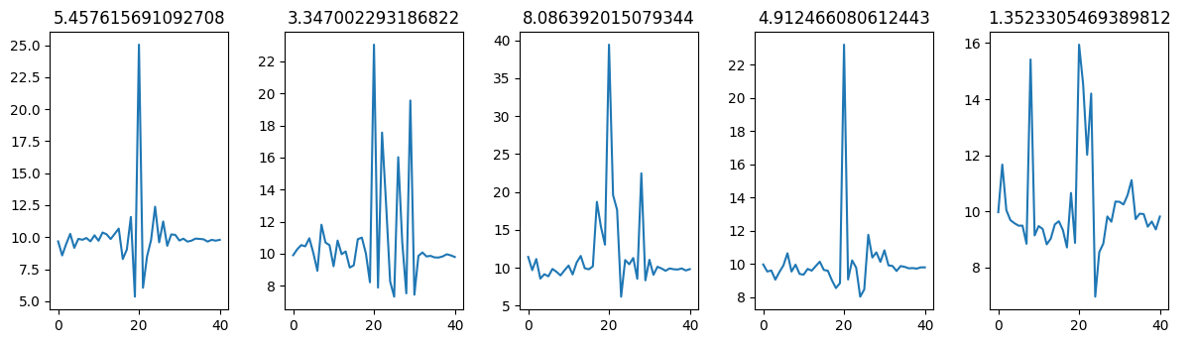
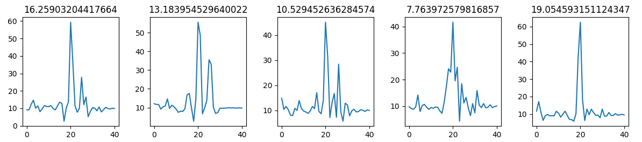

Slide 5
Data preparation
Train_test_split
Standardize
MaxPooling1D
Dropout
Conv1D*2
Flatten
Neural Network
Binary output

Slide 6
Accuracy(%)
Algorithms

Slide 7
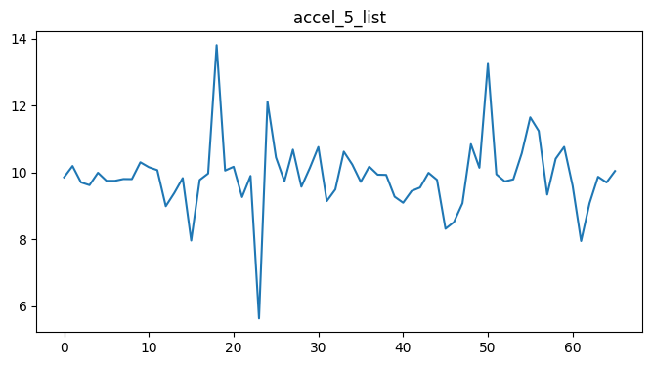
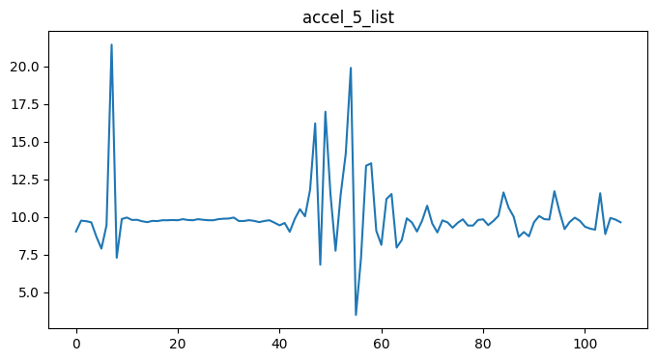
Acceleration(1/g)
Time(1/10s)
Acceleration(1/g)
Time(1/10s)

Slide 8
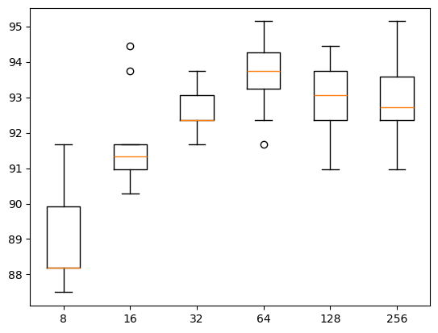
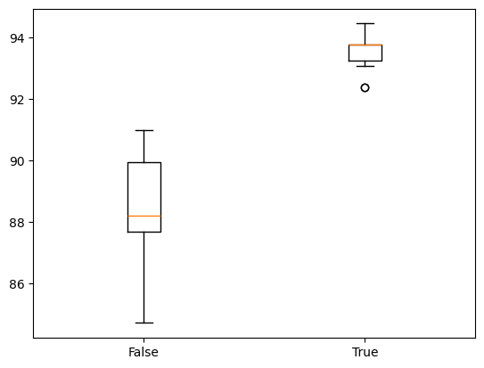
Accuracy(%)
Accuracy(%)
Number of filters
Standardized

Slide 9
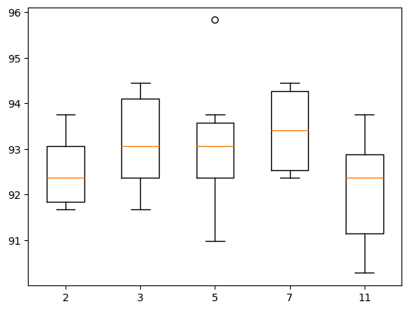
Accuracy(%)
Kernel size

