Slide 1

Php-Mysql-app demo
Simple login register with a user profile page

Slide 2

Introduction about myself
I am Md Saef Ullah Miah, you can call me saef.
I am doing my PhD study at FKOM.
I am working as a teaching assistant at your web programming course.
Contact# +60105328096
More about me at, https://ping543f.github.io/

Slide 3
Lab workflow
App setup
App structure
Code explanation

Slide 4
App setup
Download the app folder as zip format from https://github.com/ping543f/login-register-php-mysql-bs
Unzip the folder and copy it to the xampp/htdocs/ folder
Open browser and open phpMyAdmin ( localhost/phpMyAdmin)
Import the database named login_db.sql
Make a dry run of the app (localhost/app_folder_name)
Sample login credential user-email : spider@man.com | password : 1234

Slide 5
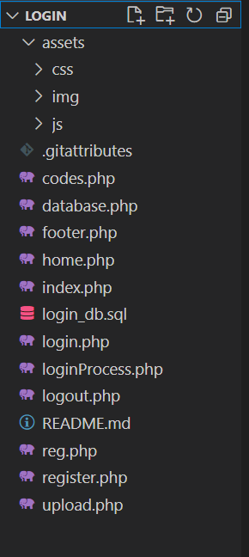
App structure
Application folder name
Static object folder
Displaying code examples
Database connection
Footer contents
User profile page
Application landing page
Application database export
Login form front end
Login process back end
Logout process
Registration form front page
Registration process backend
User photo upload back end
Folder
Front end
Back end

Slide 6
Code explanation
Let's dive into the codes!!!
I will use visual studio code as code editor, you can use anything you are comfortable with. For example, Notepad++, notepad, phpstorm, webstorm and so on..

