Slide 1
ICS 460 – Introduction
2017
Damodar Chetty

Slide 2
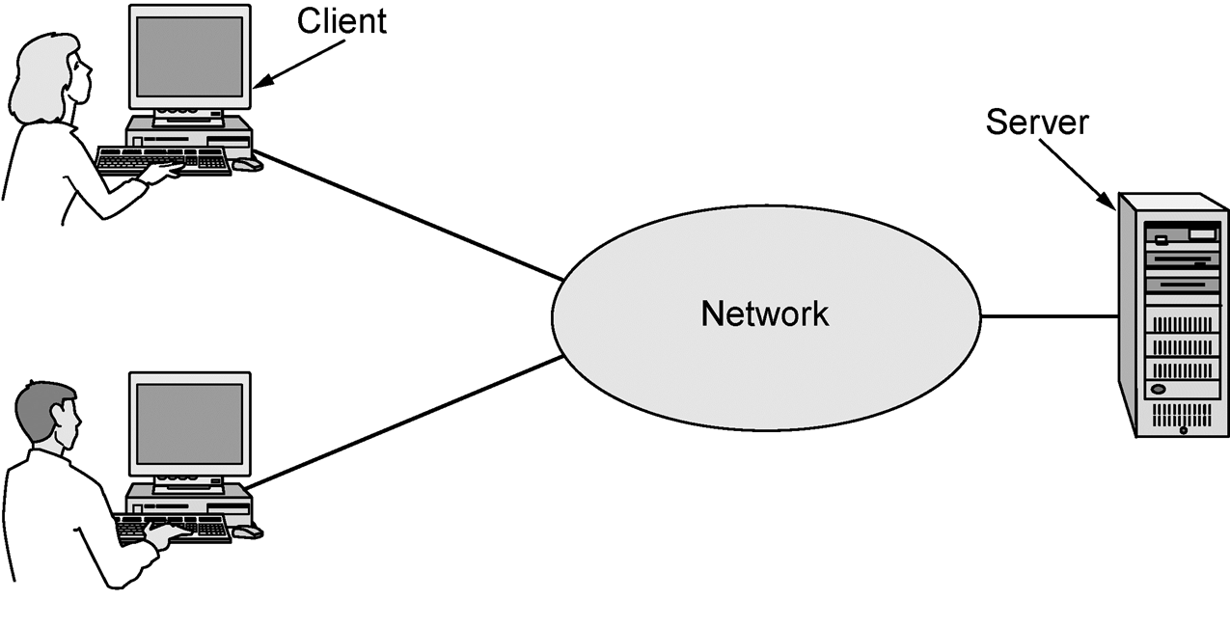
Focus of the course

Slide 3
Focus of the course
Distributed systems
Networking
Communications
Communications: The land of electrical engineering. how we use signals to carry information in bits across networks.
Networking: The realm of computer science. Builds on communications - how packets are carried across networks
Distributed systems: the applications that can be built on top of networks – which use their services. E.g., the World Wide Web, or an Oracle Real Application Cluster.

Slide 4
Course Goals
Learn the fundamentals of computer networking
Techniques to solve the hard problems that we encounter with networks
Reliability How to ensure that a message you send arrives at the destination, and arrives correctly?
Failures happen all the time – nodes fail (computers crash), and messages are corrupted (electrical interference)
The challenge - any mechanism you add to prevent failures can itself fail!
Techniques include
routing strategies that can route around failed components – allowing the network to continue to work using the parts that are still functional.
codes to detect and correct errors

Slide 5
Course Goals
Learn the fundamentals of computer networking
Techniques to solve the hard problems that we encounter with networks
network growth and evolution: accommodate applications that we haven’t thought up yet, and grow millions times larger than the initial system.
Techniques include
Addressing, protocol layering

Slide 6
Course Goals
Learn the fundamentals of computer networking
Techniques to solve the hard problems that we encounter with networks
Bandwidth allocation: The main resource of a network bandwidth. It must share this resource across its different users.There are people constantly getting on and off the network, and each one must get the bandwidth that they need.
Techniques include
Multiple Access, Congestion Control
Security open and easy for everyone to use, but secure enough that it is hard to abuse.
Techniques include
Confidentiality, Integrity, Authentication

Slide 7
Course Goals
To learn how the Internet works
what really happens when you browse the web? What are TCP/IP, DNS, NAT, etc.
The Internet is not static – it is constantly being reinvented.
Emergence of the Web -> CDNs
Digital media -> Peer to Peer file sharing
Falling cost/bit -> Voice-over-IP calling
Many Internet hosts -> IPv6
Wireless advances - > mobile devices
But the fundamentals remain the same. Understanding these fundamentals gives you long term knowledge that will help you understand the Internet of the future.

Slide 8
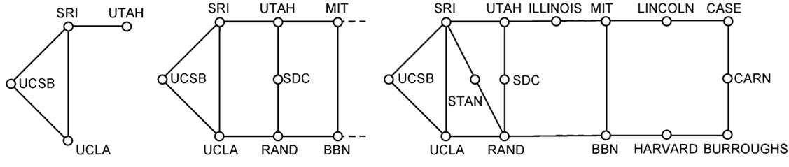
Why do we care?
From
(a) Dec. 1969. (b) July 1970. (c) March 1971.

Slide 9
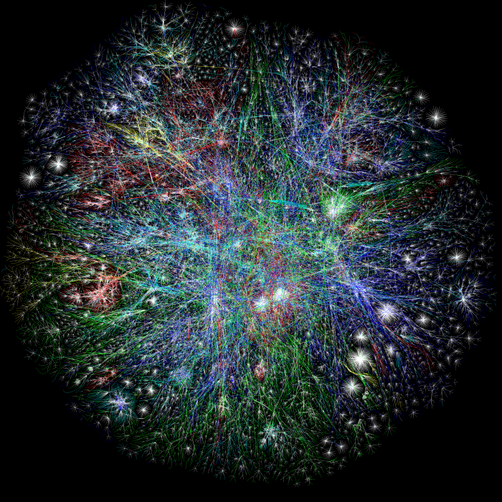
Why do we care?
Barrett Lyon / The Opte Project Visualization of the routing paths of the Internet.
http://www.opte.org/the-internet/
To

Slide 10
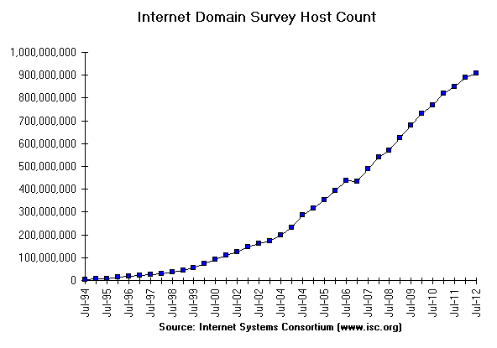
Why do we care?

Slide 11
Goals of computer networks
Person to Person communication
Email, telephone calls (VoIP), video conferencing, destktop sharing, etc.
Doing business electronically
e-commerce, reservations, business process integration
Ubiquitous computing
gathering sensor data and manipulating the world.

Slide 12
Goals of computer networks
Sharing of Resources (programs, data, equipment)
high volume networked device is cheaper, faster, and easier to maintain, than a large collection of individual devices (e.g., 3D printers)
employees using simpler machines may be geographically separated from data, but should be able to access it as if they were local.
share network bandwidth between users, via statistical multiplexing multiplexing == sharing of the network’s bandwidth statistical == based on when a user might choose to use the network
This is useful because users are mostly idle, and their traffic is mostly bursty
I.e., we can combine the traffic from multiple users, and get a pattern that uses the network more efficiently
Computing the binomial distribution indicates that most of the time not all users compete for bandwidth, so we can accommodate more

Slide 13
Network Components
app
router
link
host
App: uses the network
Link: a channel that provides connectivity between nodes to get messages from one node to another. (e.g., wired/wireless channels)
Node: generic term for any device on the network.
Host: provides services to applications, at the edge of the network (e.g., laptop, mobile phone, desktop)
Router: relays messages to other nodes over links (e.g., cable/DSL modem)

Slide 14
Network Components
app
router
link
host
Types of links
Full duplex: bidirectional. Can be used to send messages in both directions, at the same time.
Half duplex: bidirectional. Can be used to send messages in both directions, but not at the same time. E.g., with wireless, only one transmitter can use that frequency at a given time.
Simplex: unidirectional. very uncommon.

Slide 15
Network Components
app
router
link
host
The network includes:
hosts, routers, and links – but NOT the apps
The ISP provides:
routers and links
the hosts at the edge of the network are your own.

Slide 16
Terminology
Network:
can be of any size (2 devices, to thousands)
a collection of machines linked using a common networking technology and interconnection devices (switches/bridges)
Internetwork:
a collection of smaller networks connected together using routers (gateways)
networks may use different technologies and be owned by different parties
pass IP datagrams between networks
the Internet is a specific internetwork

Slide 17
Types of Networks
By Transmission technology
Point to Point
links connect individual pairs of machines.
To go from the source to a destination, the packet visits one or more intermediate machines
Multiple routes are possible, so finding good ones is important
E.g., modern Switched Ethernet
Broadcast
communications channel is shared by all machines on the network
packets sent by any one machine are received by all the others
each packet has an address, and recipients discard those not addressed to them
E.g., in a wireless network, communication is shared over a coverage region that depends on the wireless channel and the transmitting device

Slide 18
Types of Networks – By Scale
Different technologies are used at different scales.
Vicinity: Personal Area Network (e.g., Bluetooth)
wireless network that connects devices within the range of one person
uses the master-client paradigm: master tells its clients what address to use, when they can broadcast, how long they can transmit, frequencies they can use, etc.
Building: Local Area Network (e.g., WiFi, Ethernet)
privately owned network that operates within a room, building, or campus
IEEE 802.3 for Ethernet (wired LAN) or 802.11 (WiFi)
Wired LANs are better than wireless LANs in all dimensions of performance (fast speeds, low delay, few errors)
A single LAN may be broken into smaller virtual (logical) LANs

Slide 19
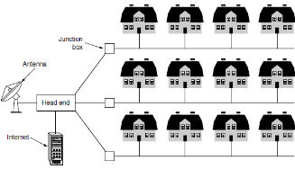
Types of Networks
City: Metropolitan Area Network (e.g., Cable, DSL)
connects all the houses in a city
grew from earlier CATV systems used in areas with poor OTA reception
followed by carrying television programming for cable only and 2-way Internet service in unused parts of the spectrum

Slide 20
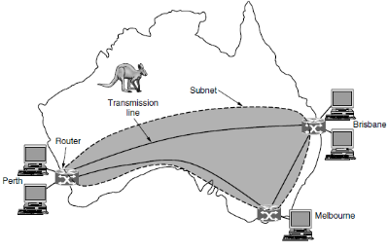
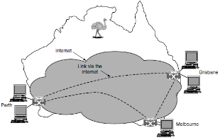
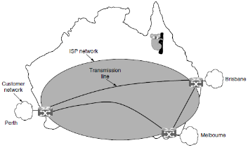
Types of Networks
Country or Continent: Wide Area Network (e.g., Large ISP)
Connects nodes between cities spread across a country or continent
network = hosts + subnet
“subnet” connects hosts and consists of
transmission lines (copper, optical fiber, radio links)
switching elements (switches, routers) that connect links
Note: this term is overloaded with CIDR in IPv4
Subnet options
lease lines from telecom companies for guaranteed, dedicated capacity
virtual over the Internet (VPN) but capacity depends on your Internet service
pay a separate network service provider to run the subnet
ISP connects your offices to each other and to hosts/networks of its other customers.

Slide 21
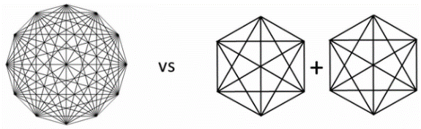
Types of Networks
Planet: The Internet (a network of networks)
when you join two networks, you get an internetwork
The Internet is a special internet
Rationale:
Metcalfe’s law. Bob Metcalfe, inventor of Ethernet
“The value of a network is proportional to the square of the number of users because this is roughly the number of different connections that may be made”
large networks are more valuable than smaller ones
Single full mesh network of 12 nodes gives 12x11 = 132 connections
Two 6-node networks – with 2 * 6x5 = 60 connections
We have more connectivity on the left. And, hence it has greater value.

Slide 22
Network Interfaces
app
app
host
host
Between the apps and the network
defines how applications are allowed to use the network
lets apps talk to each other via hosts, hiding the details of the network
E.g., Sockets is a widely used network abstraction
part of all major OSes and languages
Supports reliable byte streams as well as unreliable datagrams
Sockets use a data structure called a socket to let an app attach to the network. Sockets have a port number, which provides a form of addressing which allows us to multiplex different applications on a single host – because we can distinguish between them.

Slide 23
Network Interfaces
app
app
???
host
host
Between the various network components (hosts and routers, and between routers)
defines how nodes work to get packets across the network
We can’t see these from the edge of the network (tracert probes successive hops along the path from source to destination)

Slide 24
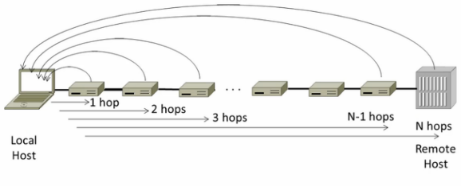
Traceroute
tracert probes successive hops to find the network path between
host that is doing the probing and
the destination
successively probes deeper into the network by specifying number of hops

Slide 25
Transport Layer – Reliable Stream service - TCP
Streams: reliably send a stream of bytes from one app to another
TCP is like the phone system
Before you can send info across a network, you must set up a connection, and make sure that someone is there to receive the data on the other end.
you are guaranteed that the other party hears your words in the right order
Socket data structure representing a connection endpoint
lets an app attach to the network
combines an address (identify a host) and a port number (identify an application)

Slide 26
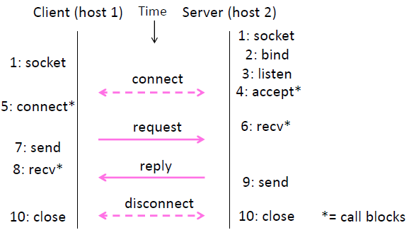
Socket API

Slide 27
Socket Programming – Client Side (java.net.Socket)
Program creates a new socket for a given IP and port
Socket attempts to connect to the remote host
Once the connection is established
client gets input/output streams from the socket
client sends a request to its output stream
client reads a response from its input stream
client closes its connection

Slide 28
Socket Programming – Server Side (java.net.ServerSocket)
Server program creates a new ServerSocket
ServerSocket is told to listen on a particular port (accept())
when a client connects to the server
accept() returns a Socket representing that connection
server obtains input/output streams from that socket
server communicates with client on these streams
server closes the connection
server returns to step 2 to wait for the next connection

Slide 29
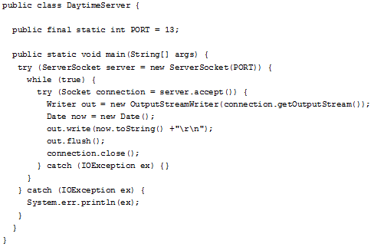
Socket Programming Example – ServerSocket

Slide 30
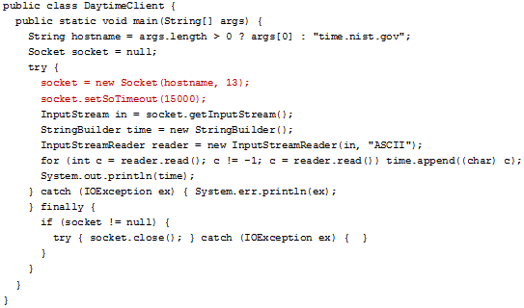
Socket Programming Example – Client Side Socket

Slide 31
Transport Layer – Unreliable Datagram service - UDP
Datagrams: unreliably send a message to another
UDP is like the postal system
send packets of mail to an address
most arrive, but some may be lost, or arrive out of order
any reliability would need a protocol to be established with the recipient
you number the envelopes
recipient sends you mail regarding lost/delayed envelopes
you resend
BUT: the post office does not do this for you
Unreliable does not mean it has no uses
when raw speed is more important than getting every bit right
when the application is responsible for reliability (e.g., DNS)
DatagramSocket
used to send/receive DatagramPacket instances
DatagramPacket
holds data to be sent or data received

Slide 32
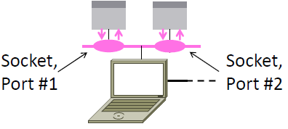
Socket API
Sockets let apps attach to the local network at different ports
API primitives cause a trap to kernel mode which turns over control to OS
create a new communication endpoint (SOCKET)
Associate a local address with a socket (BIND)
announce a willingness to accept connections (LISTEN)
establish an incoming connection (ACCEPT)
request a connection (CONNECT)
send data over a connection (SEND)
receive data over a connection (RECEIVE)
release the connection (CLOSE)

Slide 33
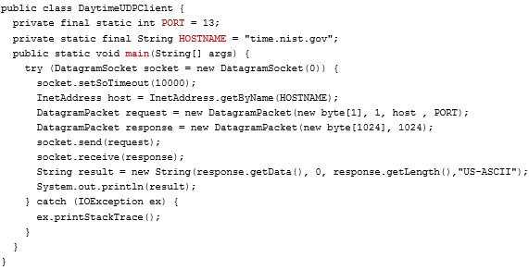
UDP Example - Client

Slide 34
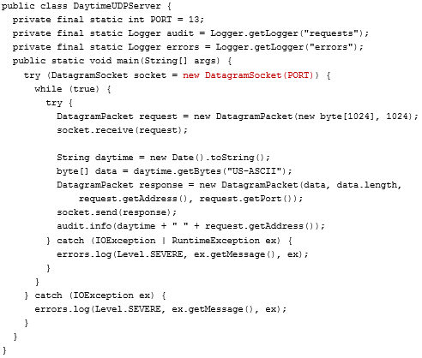
UDP Example - Server

Slide 35
Standards
Different vendors have their own ideas of how things should be done.
Standards allow
different computers to communicate
increase the market for products adhering to the standards
leads to economies of scale in manufacturing, better implementations, etc. that decrease price and further increase acceptance.

Slide 36
Standards
Proprietary standards
owned by one company, and not shared with others
customers must buy company-built hardware to use this technology
results in market fragmentation with products that don’t work together
Open standards
Available to anyone interested in using it
promoted by non-profit trade association, in cooperation with for-profit companies
approval sought from standards organizations (e.g., ISO and IEEE)
give customers more choice, and improves interoperability
De facto standards
used as a universal standard just because it has been widely used – not because it was approved by a standards organization
HTTP was part of early www browsers developed by Tim Berners-Lee, and its use took off and it was picked up by the IETF.
Bluetooth was developed by Ericsson but now everyone is using it.

Slide 37
Key International Networking Standards Organizations
Institute of Electrical and Electronics Engineers (IEEE)
largest professional organization in the world
IEEE’s 802 committee has standardized many kinds of LANs:
802.3 Ethernet, 802.11 Wireless LANs (WiFi), 802.15 Personal area networks (Bluetooth, Zigbee), 802.16 Broadband wireless (WiMAX)
International Organization for Standardization (ISO)
Biggest standards organization in the world
federation of standards organizations from dozens of nations.
Best known for its OSI Reference Model.
International Telecommunication Union—Telecommunication Standardization Sector (ITU-T)
develops telecommunications standards.
Formerly named the International Telephone and Telegraph Consultative Committee (CCITT)
ISO and ITU-T often cooperate (ISO is a member of ITU-T.)

Slide 38
Internet Standards Organizations
Open standards are a critical factor in the success of the Internet
Internet Society (ISOC)
responsible management and development of the Internet
Internet Architecture Board
develops Internet standards
publishes RFCs and oversees the IETF and IRTF
Internet Engineering Task Force (IETF)
responsible for short-term engineering issues with Internet and TCP/IP technologies
Internet Research Task Force (IRTF)
responsible for longer term research on Internet and TCP/IP technologies

Slide 39
Internet Centralized Registration Authorities
Internet Corporation for Assigned Names and Numbers (ICANN)
DNS domain name assignment and protocol parameters
assigns TLDs (.com, .org, etc.) and controls domain name registries
delegates to domain name registrars around the world who register your names
Responsible for the IANA
Internet Assigned Numbers Authority (IANA)
manages IP address blocks, delegates large blocks to RIRs
actual handing out of IP addresses done by Regional Internet Registries
ARIN (American Registry for Internet Numbers), RIPE NCC for Europe, APNIC for Asia Pacific, LACNIC for Latin America, and AfriNIC for Africa.
Hand out sub-blocks to ISPs, who ultimately assign blocks to companies and individuals
manages parameters (numbers that define different options, or TCP port numbers)

Slide 40
OPTIONAL SLIDES

Slide 41
Socket Programming – Server Side – Multiple threads
Server program creates a new ServerSocket
ServerSocket is told to listen on a particular port (accept())
when a client connects to the server
accept() returns a Socket representing that connection
server spawns a new Thread to handle that connection
server returns to step 2 to wait for the next connection
New Thread
obtains input/output streams from that socket
communicates with client on these streams
closes the connection and exits

Slide 42
Socket Programming – Server Side – Thread pooling
Server program creates a ServerSocket and a Thread Pool
ServerSocket is told to listen on a particular port (accept())
when a client connects to the server
accept() returns a Socket representing that connection
server instantiates a new Callable to handle that connection
server hands off the Callable to the thread pool for execution
server returns to step 2 to wait for the next connection
Thread from Pool
obtains input/output streams from that socket
communicates with client on these streams
closes the connection and returns to the pool

Slide 43
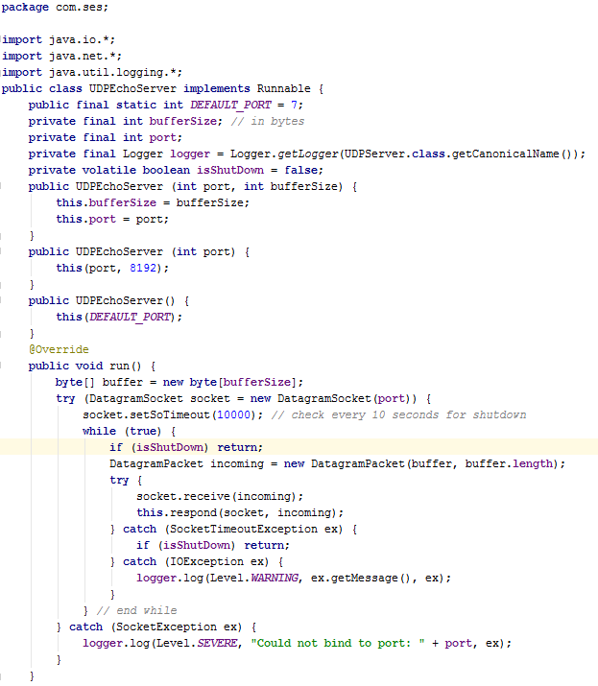
Echo Server

Slide 44
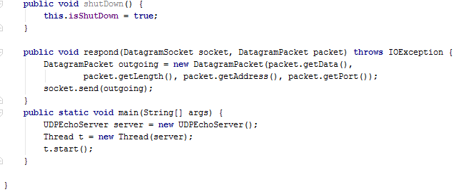
Echo Server

Slide 45
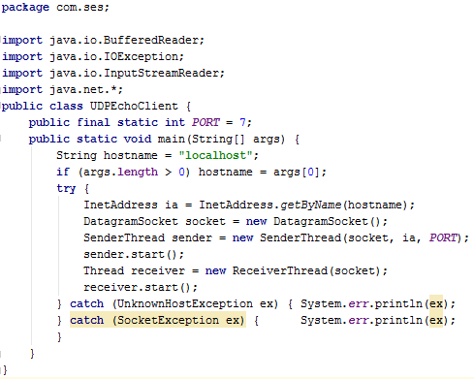
UDPEcho Client

Slide 46
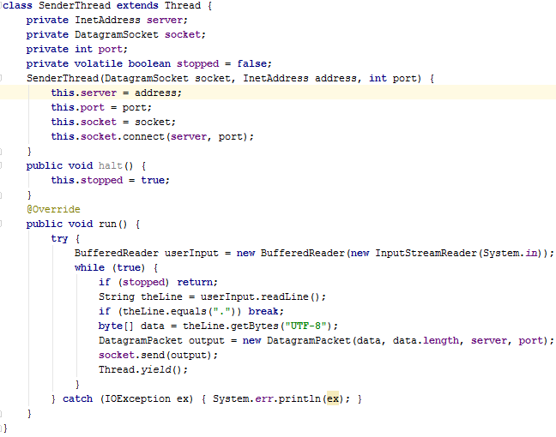
UDP Echo Client

Slide 47
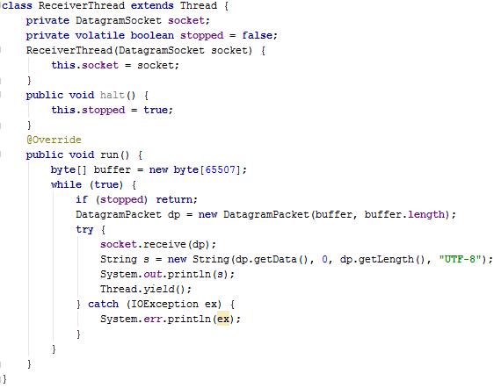
UDP Echo Client

