Slide 1
ICS 460 – Network Layer
Application
Transport
Network
Link
Damodar Chetty
Physical

Slide 2
Routing vs Forwarding
Forwarding
process of sending a packet on its way
local process
for each incoming packet determine the outgoing line
uses a rourting tabl
Routing
process of deciding in which direction to send traffic (future packets)
global process
talk to all neighbors
work out network topology
determine the best route to each destination
Forward!
packet
Which way?
Which way?
Which way?

Slide 3
Improves on the spanning tree
Spanning tree provides basic connectivity
e.g., some path B→C
Routing uses all links to find “best” paths
e.g., use BC, BE, and CE
Unused
A
B
C
A
B
C
D
E
F
D
E
F

Slide 4
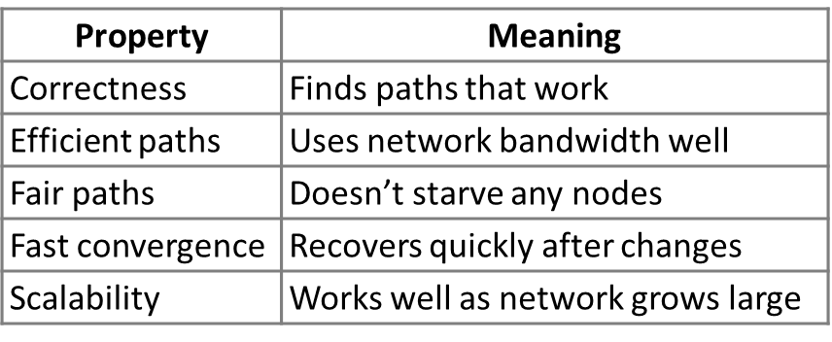
Goals of routing algorithms
Several properties are needed from a routing algorithm

Slide 5
Types of Algorithms
Non Adaptive algorithms (Static)
routes between node pairs are computed offline and downloaded to routers
only useful where routing choice is fixed
Adaptive algorithms (Dynamic)
routes are chosen based on changes in topology and traffic
Differ in terms of
how they get topology information (locally, from adjacent routers, or from all routers
when they change routes
when topology changes, or every T seconds as load changes
what cost function/optimization metric is used
Geographic Distance (propagation delay) or Bandwidth (transmission delay)
Number of Hops: reduces processing and switching (latency)
Mean packet delay: measure round trip time between adjacent routers
Money: avoid expensive links

Slide 6
Source and Sink Trees
Sink Tree for a node: union of shortest paths to that node
Source Tree for a node: union of shortest paths from that node
Link costs
provided by a cost function
If costs are the same in both directions,
sink tree is the same as the source tree,
except paths point in the other direction.
Implications:
next hop depends only on destination and not the origin of the packet
Forwarding table at a node
lists next hop for each destination
routing table may need to know more
F
4
2
Sink tree
for E
E
G
3
3
10
2
4
1
D
A
4
B
2
2
H
3
C
F
Source tree
for E
4
2
3
E
G
10
3
2
4
1
D
A
4
B
2
2
H
3
C

Slide 7
Computing Shortest Paths with Dijkstra’s Algorithm
Find single-source shortest paths, given network with non negative link costs (Dijkstra, 1953)
Assume:
All links are bidirectional
Links have equal costs in both directions (can extend model to unequal costs)
Algorithm
Mark all nodes tentative, set “distance from source” to zero (for source), and infinity for all other nodes
While tentative nodes remain
extract N, a node with the lowest distance
add the link to N to the shortest path tree
relax the distances of neighbors of N by lowering any better distance estimates
Find Source Tree for Node A

Slide 8
Dijkstra’s algorithm
Initialization
Mark all nodes tentative
set distanceFromSource for source to 0,
and for all other nodes to infinity (we don’t know how to reach them yet)
F
∞
4
2
∞
E
3
∞
G
10
3
2
4
∞
0
1
D
∞
A
4
B
We’ll compute shortest paths from A
2
2
H
∞
∞
3
C

Slide 9
Dijkstra’s algorithm
while tentative nodes remain:
extract the node with the lowest distance (N) – here A (distance=0)
add that node (A) to the source tree by the shortest path (mark it as permanent)
Relax the distances of neighbors of A (i.e., B and E)
F
∞
4
2
∞
E
3
10
G
10
3
2
4
∞
0
1
D
4
A
4
B
2
2
H
∞
∞
3
C

Slide 10
Dijkstra’s algorithm
while tentative nodes remain:
extract the node with the lowest distance (N) – here B (distance=4) that has not been visited yet
add that node (B) to the source tree by the shortest path (mark it as permanent)
Relax the distances of neighbors of B (C, E, F, G)
F
Distance fell!
7
4
2
7
E
3
8
G
10
3
2
∞
0
4
D
4
1
A
4
B
2
2
H
6
∞
3
C

Slide 11
Dijkstra’s algorithm
while tentative nodes remain:
extract the node with the lowest distance (N) – here C (distance=6) that has not been visited yet
add that node (C) to the source tree by the shortest path (mark it as permanent)
Relax the distances of neighbors of C (D, E, H)
F
Distance fell
again!
7
4
2
7
E
3
7
G
10
3
2
8
0
4
D
4
1
A
4
B
2
2
H
6
9
3
C

Slide 12
Dijkstra’s algorithm
while tentative nodes remain:
extract the node with the lowest distance (N), (E, F or G) that has not been visited yet - we pick G at random
add that node (G) to the source tree by the shortest path (mark it as permanent)
Relax the distances of neighbors of G (F), which does not change
F
Didn’t fall …
7
4
2
7
E
3
7
G
10
3
2
8
0
4
D
4
1
A
4
B
2
2
H
6
9
3
C

Slide 13
Dijkstra’s algorithm
while tentative nodes remain:
extract the node with the lowest distance (N), (E or F) that has not been visited yet - we pick F at random
add that node (F) to the source tree by the shortest path (mark it as permanent)
Relax the distances of neighbors of F (E), which does not change
F
Relax has no effect
7
4
2
7
E
3
7
G
10
3
2
8
0
4
D
4
1
A
4
B
2
2
H
6
9
3
C

Slide 14
Dijkstra’s algorithm
while tentative nodes remain:
extract the node with the lowest distance (N), (E) that has not been visited yet
add that node (E) to the source tree by the shortest path (mark it as permanent)
Relax the distances of neighbors of E (D), which does not change
F
7
4
2
7
E
3
7
G
10
3
2
8
0
4
D
4
1
A
4
B
2
2
H
6
9
3
C

Slide 15
Dijkstra’s algorithm
while tentative nodes remain:
extract the node with the lowest distance (N), (D) that has not been visited yet
add that node (D) to the source tree by the shortest path (mark it as permanent)
Relax the distances of neighbors of D (none)
F
7
4
2
7
E
3
7
G
10
3
2
8
0
4
D
4
1
A
4
B
2
2
H
6
9
3
C

Slide 16
Dijkstra’s algorithm
while tentative nodes remain:
extract the node with the lowest distance (N), (H) that has not been visited yet
add that node (H) to the source tree by the shortest path (mark it as permanent)
Relax the distances of neighbors of H (none) . DONE!
F
7
4
2
7
E
3
7
G
10
3
2
8
0
4
D
4
1
A
4
B
2
2
H
6
9
3
C

Slide 17
Dijkstra’s algorithm characteristics
Finds shortest paths in order of increasing distance from source
Runtime increases with increase in network size
Requires knowledge of complete topology – a centralized setting The network is a very distributed setting

Slide 18
Networks are Distributed Settings
Decentralized, distributed setting
all nodes are alike; no controller
nodes only know what they learn by exchanging messages with neighbors
Nodes know only the cost to their neighbors; not the topology
Nodes can talk only to their neighbors using messages
All nodes run the same algorithm concurrently
Nodes and links may fail, messages may be lost

Slide 19
Distance Vector Routing Approach to computing shortest paths
Simple, early routing approach (used in ARPANET)
Routing Information Protocol (RIP) DV protocol
with hop count as metric; and infinity is 16 hops which limits network size
Routers send vectors every 30 sec, with timeout in 180 secs to detect failures
runs on top of UDP
Each node works in a distributed setting
Each node maintains a vector of distances (and next hops) to all destinations
Initialize vector with zero cost to self, infinity to other destinations
Periodically send vector to neighbors
Update vector for each destination by selecting the shortest distance heard, after adding cost of neighbor link
use the best neighbor for forwarding

Slide 20
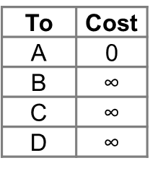
Distance Vector Example
Initialize vector with 0 cost to self, and ∞ to all other destinations.
Vector contains one entry for each router in the network
each entry holds the preferred outgoing line to use and an estimate of distance (hops, length / delay, etc.)
Each router knows the distance to its adjacent neighbors
D
7
2
A
C
A’s initial
vector
3
3
6
B

Slide 21
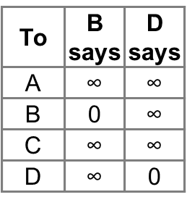
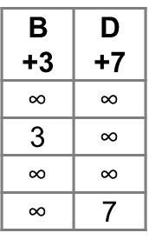
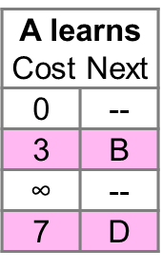
Distance Vector Example
Each router sends its vector to all its neighbors, periodically
As it receives vectors from its neighbors, updates its own distance vector
choose the shortest path to each destination you’ve heard about, after adding the cost of the link to that neighbor.
use the best neighbor for forwarding.
D
7
2
A
C
3
3
6
= learned better route
B

Slide 22
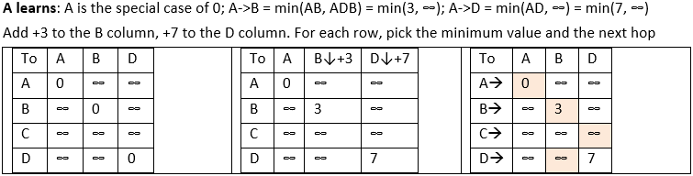
Distance Vector Example
First exchange, A sends its DV to B and D, and gets DVs from B and D
A updates its DV: for B: min(0+3, ∞), for C: min(∞, ∞ ), for D: min (0+7, ∞)
D
7
2
A
C
3
3
6
= learned better route
B

Slide 23
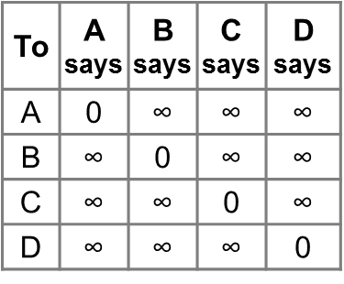
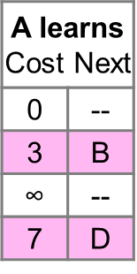
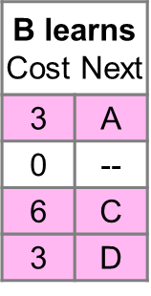
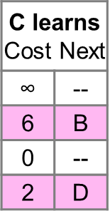
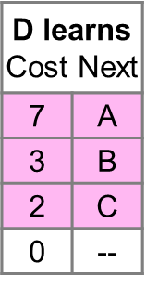
Distance Vector Example
First exchange for all nodes to find best 1-hop routes
E.g., B learns min(A+3, C+6, D+3)
D
7
2
A
C
3
3
6
B
= learned better route

Slide 24
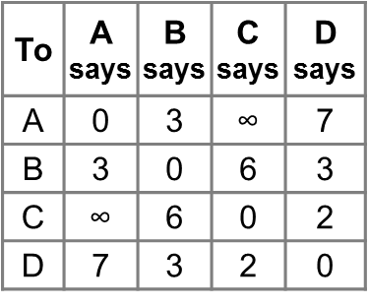
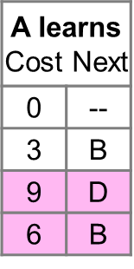
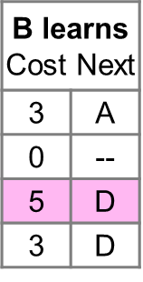
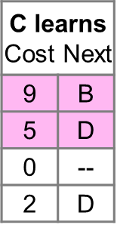
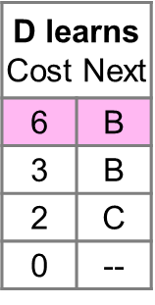
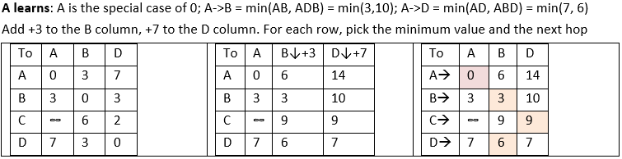
Distance Vector Example
Second exchange for all nodes to find best 2-hop routes
D
7
2
A
C
3
3
6
B
= learned better route

Slide 25
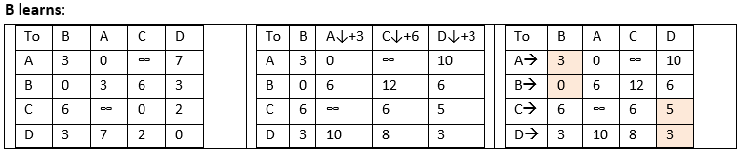
Distance Vector Example
Second exchange for all nodes to find best 2-hop routes
D
7
2
A
C
3
3
6
B
= learned better route

Slide 26
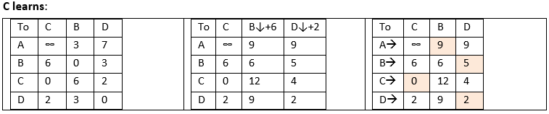
Distance Vector Example
Second exchange for all nodes to find best 2-hop routes
D
7
2
A
C
3
3
6
B
= learned better route

Slide 27
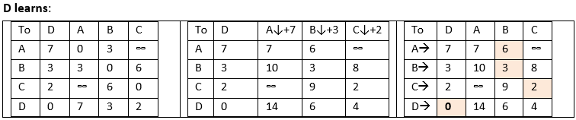
Distance Vector Example
Second exchange for all nodes to find best 2-hop routes
D
7
2
A
C
3
3
6
B
= learned better route

Slide 28
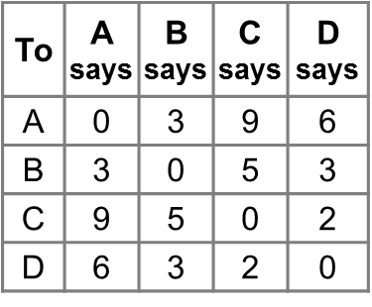
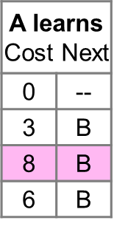
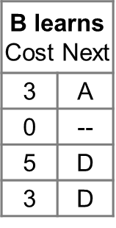
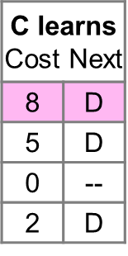
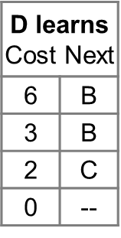
Distance Vector Example
Third exchange for all nodes to find best 3-hop routes
D
7
2
A
C
3
3
6
B
= learned better route

Slide 29
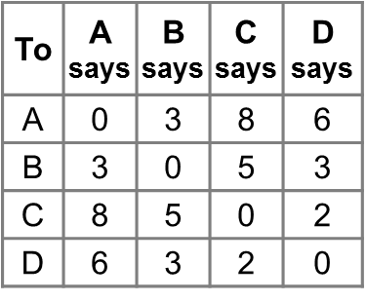
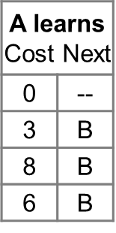
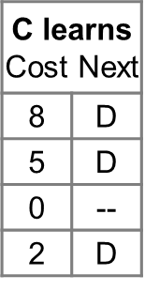
Distance Vector Example
Fourth and subsequent exchanges; converged
D
7
2
A
C
3
3
6
B
= learned better route

Slide 30
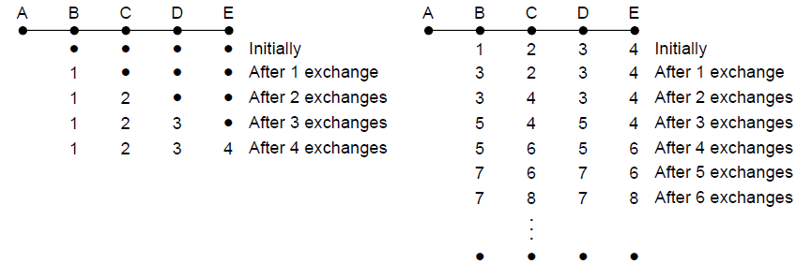
Distance Vector Problem
Partitions (unreachable nodes in divided network) are a problem
Count to Infinity scenario
No known heuristic is effective
Link-state is now favored in practice
X
Desired convergence
“Count to infinity” scenario

Slide 31
Link-State routing
Widely used in large enterprise and ISP networks
Trades more computation than Distance Vector for better dynamics
used in the Internet/ARPANET from 1979
Modern networks use variants
IS-IS :intermediate system to intermediate system
OSPF: open shortest path first
Works in a distributed setting (same as Distance Vector)
2 Phases
Phase 1: nodes flood topology in the form of link-state packets
each node learns full topology
Phase 2: each node computes its own forwarding table
by running Dijkstra or equivalent

Slide 32
Phase 1: Flooding
Consider a flood from A; first reaches B via AB, E via AE
F
E
G
D
A
B
H
C

Slide 33
Phase 1: Flooding
Next, B floods BC, BE, BF, BG and E floods EB, EC, ED, EF
F
F gets 2 copies
E
E and B send to each other
G
D
A
B
H
C

Slide 34
Phase 1: Flooding
C floods CD, CH; D floods DC; F floods FG; G floods GF
F
F gets another copy
E
G
D
A
B
H
C

Slide 35
Phase 1: Flooding
H has no one to flood ... done!
This was very inefficient
could have omitted many duplicate message sends.
gets worse when multiple nodes are flooding at the same time.
F
Each link carries the message, and in at least one direction
E
G
D
A
B
H
C

Slide 36
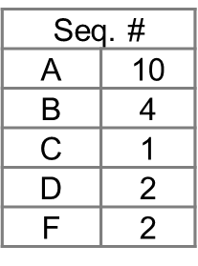
Phase 1: Link-State flooding
Each node floods link-state packets (LSP)
LSP describes their local portion of the topology
Each node discovers full topology by combining all the LSPs it receives
F
4
2
E
Node E’s LSP flooded to A, B, C, D, and F
G
3
10
3
2
4
D
1
A
4
B
2
2
H
3
C

Slide 37
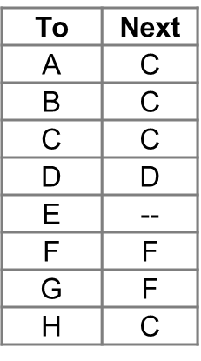
Link-State routing – Phase 2
Each node runs Dijkstra
some complicated computation, but finds required routes directly
compile forwarding table from sink/source tree
Source Tree for E (from Dijkstra)
E’s Forwarding Table
F
4
2
E
G
3
10
3
2
4
D
1
A
4
B
2
2
H
3
C

Slide 38
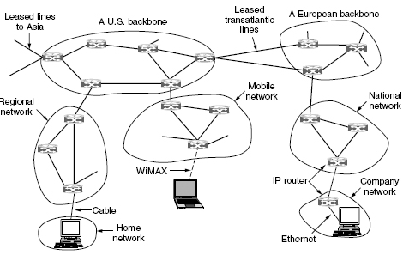
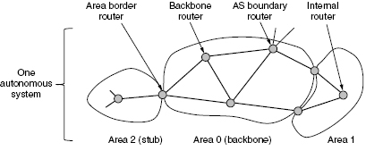
Structure of the Internet
To the network layer, the Internet is a collection of Autonomous Systems (AS)
independent, interconnected networks operated by different organizations
Major backbones are constructed from high bandwidth lines and fast routers
biggest backbones are called Tier 1 Networks
ISPs and regional networks connect to Tier 1 networks
Smaller ISPs, university/company LANs ,etc. connect to the regional networks

Slide 39
Structure of the Internet
Each AS is comprised of numbered, non overlapping areas
area is 1+ contiguous networks
outside an area, its destinations are visible, but not its topology – to scale routing
comprised of
a backbone area (area 0)
all other areas are connected to this backbone
a stub area has only one router connecting it to the backbone.

Slide 40
Structure of the Internet
Internal Router: lies fully within an area
calculates routes from itself to every other router in its AS (uses OSPF or IS-IS)
Backbone Router: an internal router within Area 0 (the backbone)
Area border Router: connects 1 or more Areas to the backbone
summarizes destination prefixes within its Area, and floods it to connected Areas
AS Boundary Router: connects the backbone to another AS.
summarizes destinations in its AS to the other AS’ (uses BGP)

Slide 41
Effects of Independent Parties
Problem beyond routing within an individual network
each party gets to use its own preferences (policies) on how to choose “best” routes to satisfy their own interests.
e.g., use shortest path within an AS, to avoid wasting its resources
What path will be chosen for A2→B1, and B1→ A2
policy: shortest path within an ISP
ISP A
ISP B
Prefix A1
Prefix B1
Prefix A2
Prefix B2

Slide 42
Effects of Independent Parties
Selected paths are longer than overall shortest path
and asymmetric too
a consequence of independent goals and decisions, not hierarchy
ISP A
ISP B
Prefix A1
Prefix B1
Prefix A2
Prefix B2

Slide 43
Common Routing policies - Transit
One party (customer) gets TRANSIT service from another party (ISP)
ISP accepts traffic from customer to deliver to rest of the Internet
ISP accepts traffic from the rest of the Internet for delivery to customer
Customer pays ISP for the privilege
ISP
Rest of
Internet
Customer 1
Non-
customer
Customer 2

Slide 44
Common Routing Policies - Peering
Both parties (here, ISPs) get PEER service from each other
Each ISP accepts traffic from the other ISP only for their customers
ISPs do not carry traffic to the rest of the Internet for each other
ISPs don’t pay each other
ISP A
ISP B
Customer A1
Customer B1
Customer A2
Customer B2

Slide 45
Border Gateway Protocol
a Path Vector protocol (related to DV) used to compute interdomain routes
AS boundary router floods announcements to other connected Boundary routers
Path Vector: [<IP prefix in this AS>, <list of AS’ on path to prefix>, <next hop router>]
Does not send cost estimates – route will be based on AS’ to traverse, not cost(!)
Each router that forwards an announcement, prepends its AS number to the AS path
actual packet traffic travels in opposite direction to announcements
Two steps
Learn all possible routes to all possible destinations
Apply Policies to pick the “best” route to the destination
Prefix B1
ISP B
To prefix F1 use path
(ISP B, Net F) at IXP
Prefix A1
IXP
ISP A
Net F
Prefix A2
Prefix F1

Slide 46
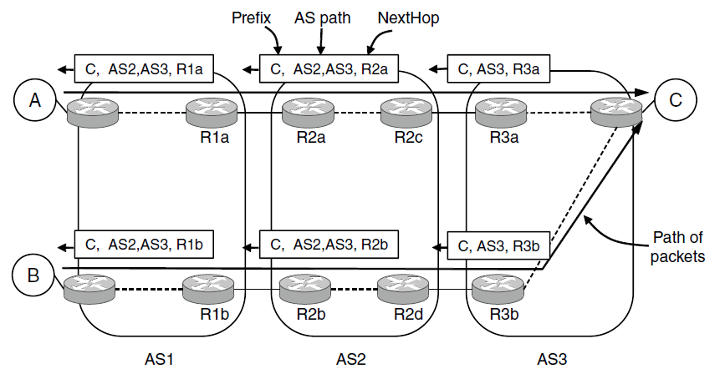
BGP – Learn Routes
AS2 provides TRANSIT service to AS1 and AS3
delivers traffic from AS1 and AS3 to each other and rest of the Internet, and from the Internet to AS1 to AS3, who pay AS2 for the service
C is a destination prefix accessible via AS3
Announcements propagate out from Prefix C, along the dotted lines, up to R1b.
AS3 advertises this prefix to AS2 as <C, (AS3), R3a>
AS2 advertises this to AS1 as <C, (AS2, AS3), R2a>
within AS1, this looks like <C, (AS2, AS3), R1a>
announcement cannot propagate out of AS1 (exchanged only at AS Boundary Routers)

Slide 47
BGP – Learn Routes
AS can make multiple decisions for routes towards each prefix
Different routes for same prefix propagate in different parts of the AS
C is a destination prefix accessible via AS3
Announcements propagate out from Prefix C, along the dotted lines, up to R1b.
AS3 advertises this prefix to AS2 as <C, (AS3), R3b>
AS2 advertises this to AS1 as <C, (AS2, AS3), R2b>
within AS1, this looks like <C, (AS2, AS3), R1b> - next hop router is within AS1
A host in the lower portion of AS1 will go via R2b to reach C – even though the AS sequence is the same

Slide 48
BGP – Learn Routes
BGP routes must be propagated from one end of an AS to another, so they can be sent on to the next AS.
Instead of OSPF, handled by internal-BGP (iBGP)
If one AS Boundary Router learns of the prefix C
all of the other Boundary Routers for this AS, also learn of C I.e., R2b learns about both <C, (AS3), R2c> as well as <C, (AS3), R2d>
ensures that prefix C is reachable from any entry point into the AS

Slide 49
BGP – Apply Policies
Each AS Boundary Router learns of a set of routes to a given destination prefix
from other boundary routers (who may have heard of it from other boundary routers)
Boundary Router uses policy definitions to pick one route from this set, to use
shorter AS paths are better: (AS4, AS8) is better than (AS4, AS5, AS7, AS8)
early exit routing: take shortest path out of our AS (avoid wasting our own resources)
prefer routes over peer networks: peered routes are free, transit providers charge fees

Slide 50
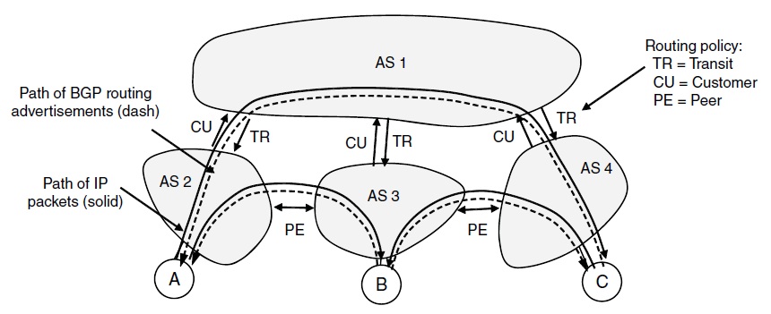
BGP: Example
AS1 is a big ISP. It provides TRANSIT service to its customers (AS2, AS3, AS4)
AS2, AS3, AS4 pay AS1 for connections to each other
AS2 PEERs with AS3, and AS3 PEERs with AS4 Prefixes on one peer can directly connect with prefixes on their peer.
Find Paths that are consistent with TR and PE policies

Slide 51
Step 1: Learn Routes
Customer Route announcements (CU) … next hop is omitted
Each customer advertises routes to destinations on its own network, to its provider
AS2 sends <A, (AS2)> to AS1 to say prefix A exists within me.
AS3 sends <B, (AS3)> to AS1, and AS4 sends <C, (AS4) to AS1
Provider will send traffic to each customer only for their advertised prefixes
AS2 only advertises routes to A, so AS1 will direct any traffic bound for prefix A, to AS2
Transit Routing Announcements (TR)
AS1 is providing transit to AS2, AS3, and AS4 so it tells them about the prefixes it knows
to AS2: <B, (AS1, AS3)>, <C, (AS1, AS4)> to AS3: <A, (AS1, AS2)>, <C, (AS1, AS4)> to AS4: <A, (AS1, AS2)>, <B, (AS1, AS3)>
this notifies AS1’s customers of known prefixes, giving them a route to those prefixes
when source prefix A sends to destination prefix C, the packets travel from A->AS2->AS1->AS4->C

Slide 52
Step 1: Learn Routes
Peer Routing Announcements (PE)
Peering AS’ send routing advertisements to each other for the prefixes they manage
AS2 sends <A, (AS2)> to AS3 … tells AS3 that it can send to A over this link via AS2 AS3 sends <B, (AS3)> to AS2 … tells AS2 that it can send to B over this link via AS3
AS3 sends <B, (AS3)> to AS4 AS4 sends <C, (AS4)> to AS3
Peering allows traffic from a prefix on one peer (B) to be sent to a prefix on another, directly – without going through the transit provider.
Peering is not transitive
if A wants to communicate with C, packets follow the path (AS1, AS4) and not (AS3, AS4)
AS3 does not want to carry traffic from AS2 to AS4 as it is not being paid to do so

Slide 53
Step 2: Apply Policies
Announcements sent/received by AS2
sent <A, (AS2)> to AS1 and <A, (AS2)> to AS3
heard <B, (AS1, AS3)> and <C, (AS1, AS4)> from AS1, and <B, (AS3)> from AS3
A needs to send to C
there is only one option to get to C: via (AS1, AS4)
A needs to send to B
there are 2 possible routes: (AS1, AS3) via Transit; and (AS3) via Peer
AS2 can choose either path, but it uses its policy rules to make a routing decision
It uses its policy which states “Prefer Peering over Transit”, and chooses (AS3)

Slide 54
Border Gateway Protocol
Policy is implemented in two ways
AS boundary routers
only announce paths to other parties who may use those paths - filters out paths that others can’t use
select the best path of the ones they hear using policies

Slide 55
Equal Cost Multi Path routing (ECMP)
More on shortest path routes
allow multiple shortest paths
F
Use ABE as well as
ABCE from A→E
E
G
D
A
B
H
C

Slide 56
Multi-path routing
Allow multiple routing paths from node to destination to be used at once
Topology has them for redundancy
using them can improve performance
Questions:
how do we find multiple paths?
how do we send traffic along them?

Slide 57
Equal-Cost multipath routes
One form of multipath routing
extends shortest path model by keeping set if there are ties
Consider A→E
ABE = 4 + 4 = 8
ABCE = 4 + 2 + 2 = 8
ABCDE = 4 + 2 + 1 + 1 = 8
Use them all!
F
4
2
E
G
3
10
3
1
4
D
2
A
4
B
2
1
H
3
C

Slide 58
Source Trees
With ECMP, source/sink tree is a directed acyclic graph
each node has a set of next hops
still a compact representation
Tree
DAG

Slide 59
Source Trees
Find the source tree for E
procedure is Dijkstra, simply remember set of next hops
compile forwarding table similarly, may have set of next hops
Straightforward to extend DV too
just remember set of neighbors
F
4
2
E
G
3
10
3
1
4
D
2
A
4
B
2
1
H
3
C

Slide 60
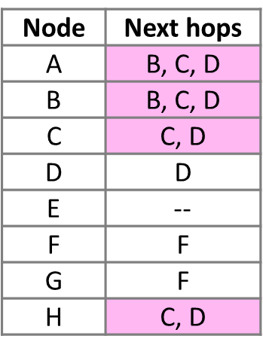
Source Trees
Source Tree for E
F
E’s Forwarding Table
4
2
New for
ECMP
E
G
3
10
3
1
4
D
2
A
4
B
2
1
H
3
C

Slide 61
Forwarding with ECMP
Could randomly pick a next hop for each packet based on destination
balances load, but adds jitter
Instead, try to send packets from a given source/destination pair on the same path
source/destination pair is called a flow
map flow id to single next hop
no jitter within flow, but less balanced

Slide 62
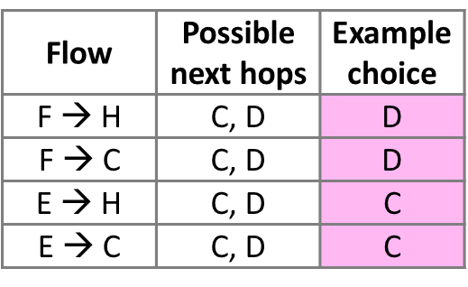
Forwarding with ECMP
Multipath routes from F/E to C/H
E’s Forwarding Choices
F
4
2
E
G
3
10
3
1
4
D
2
A
4
B
2
1
Use both paths to get
to one destination
H
3
C

Slide 63
Routing Protocols with IP
In the Internet
Hosts on the same network have IP addresses in the same IP Prefix
Hosts just send off-network traffic to the nearest router to handle
Routers discover the routes to use
Routers use longest prefix matching to send packets to the right next hop
Hosts attach to routers as IP prefixes
router needs table to all hosts
Single network
(One IP prefix “P”)
IP router
“A”
Rest of
network
LAN switch

Slide 64
Network topology for routing
Group hosts under IP prefix connected directly to router
one entry for all hosts
Routing now works as before
Routers advertise IP prefixes for hosts
Router addresses are /32 prefixes
Lets all routers find a path to hosts
Hosts find by sending to their router
E
10
P
0
A
4
B

Slide 65
Scaling routing with hierarchy
Scaling routing with hierarchy in the form of regions
route to regions, not individual nodes
Internet growth translates into routing table growth (even using prefixes)
To the West!
West
East
Destination

Slide 66
Impact of Routing Growth
Forwarding tables grow
larger router memories, may increase lookup time
Routing messages grow
need to keeps all nodes informed of larger topology
Routing computation grows
shortest path calculations grow faster than the size of the network

Slide 67
Techniques to scale routing
IP prefixes – route to blocks of hosts
Network hierarchy – route to network regions
IP prefix aggregation – combine, and split, prefixes

Slide 68
Hierarchical Routing
Introduce a larger routing unit
IP Prefix (hosts) ← from one host
Region, e.g., ISP network
Route first to the region, then to the IP prefix within the region
Hide details within a region from outside of the region

Slide 69
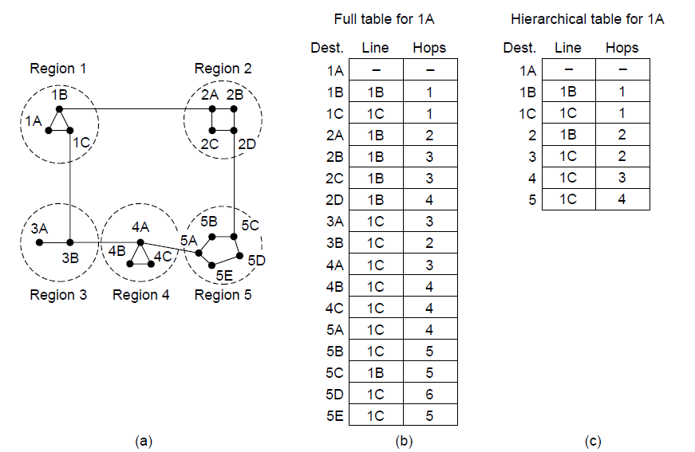
Hierarchical Routing

Slide 70
Hierarchical Routing

Slide 71
Hierarchical Routing
Penalty is longer paths
1C is best route to region 5, except for destination 5C

Slide 72
Observations
Outside a regions, nodes have one route to all hosts within the region
This gives savings in table size, messages, and computation
However, each node may have a different route to an outside region
Routing decisions are still made by individual nodes; there is no single decision made by a region

Slide 73
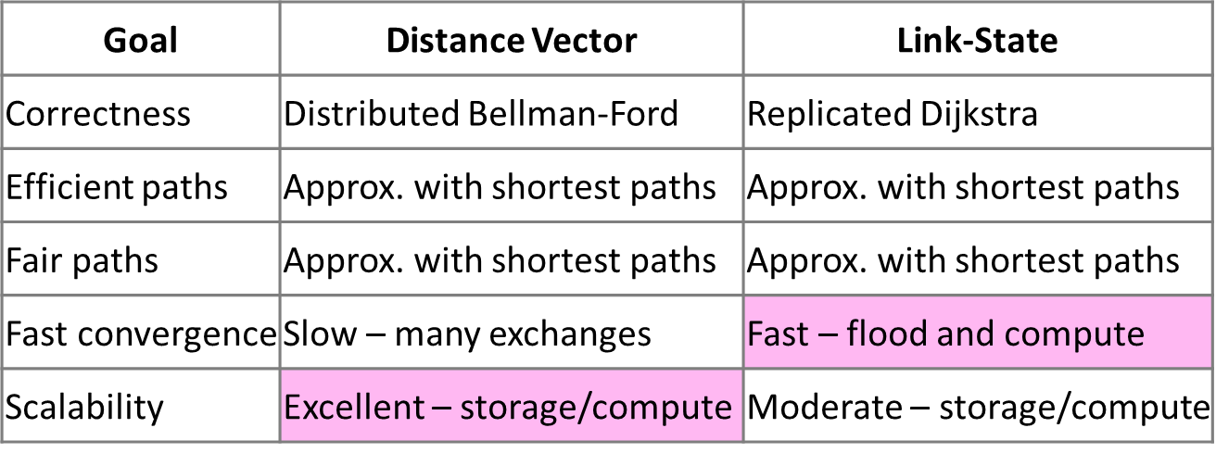
DV vs LS comparison

Slide 74
Routing with Multiple Parties
Structure of the Internet
Networks (ISPs, CDNs, etc.) group hosts as IP prefixes
Networks are richly interconnected, often using IXPs
Prefix B1
Prefix D1
Prefix C1
ISP B
CDN D
IXP
CDN C
Prefix E1
IXP
Prefix A1
Net E
IXP
IXP
Net F
ISP A
Prefix E2
Prefix F1
Prefix A2

