Slide 1
ICS 460 – Transport Layer
Application
Transport
Network
Link
Damodar Chetty
Physical

Slide 2
Overview
Builds on the network layer
network layer: end-to-end packet delivery using datagrams or virtual circuits
transport layer: data transport across networks from a process on a source host (app) to one on the destination host with the desired reliability or quality independent of the physical networks in use
the user of the transport layer is an application
app
app
TCP
TCP
IP
IP
IP
IP
802.11
802.11
Ethernet
Ethernet
Host
Router
Host

Slide 3
Transport Layer need
Reason for existence
Users have no control over network layer services
run on routers which are operated by ISPs, etc.
cannot solve service problems there (lossy network, crashes, etc.) or at lower layers
Only option
put another layer on top which is responsible for improved quality of service
Benefits:
can hide failures in the underlying network (for reliable models)
Connectionless network: uses timeouts and retransmissions
Connection-oriented network: if connection abruptly terminated, reestablish and resume
hides complexity of underlying networking technology
Applications are programmed to the Transport Layer services
provides a uniform API that abstracts out the differences between specific networking technology in use (connectionless Ethernet or connection oriented WiMax)

Slide 4
Overview
Encapsulation
first layer whose data is not examined by nodes internal to the network
routers and switches examine packets and frames
Segments are encapsulated within packets, within frames
Segments contain
TCP header (control information) and a Payload (application data)
Segment
802.11
IP
TCP
App, e.g., HTTP
Packet
Frame

Slide 5
Socket API - revisited
Simple abstraction to use the network
The “network” API (really Transport Service) used to write all Internet apps
Part of all major OSes and languages (originally BSD Unix 1983)
Supports both Internet transport services
streams and datagrams
Lets apps attach to the local network at different ports
Socket,
Port #1
Socket,
Port #2

Slide 6
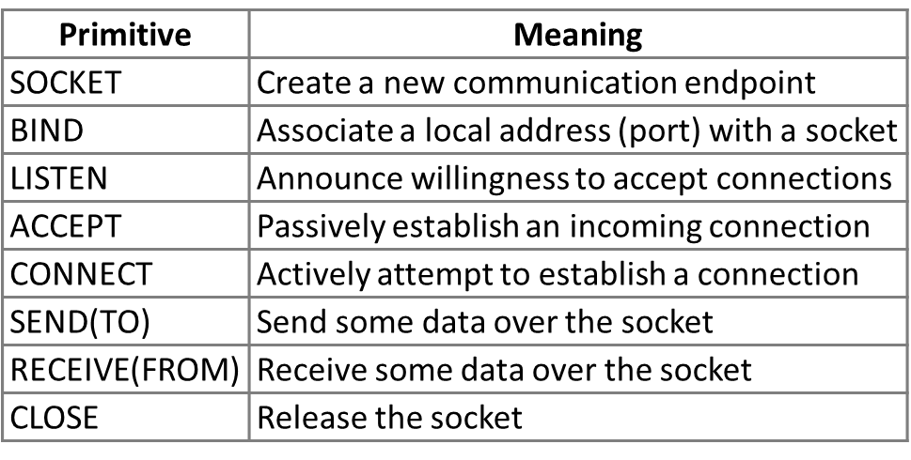
Socket API
Same API used for both streams and datagrams
Only needed for Streams
To/From forms for
Datagrams

Slide 7
Ports
Application process is identified by the tuple:
{ IP address, protocol, and port }
Ports
16-bit integers representing local “mailboxes” that a process leases
Servers bind to well-known ports
< 1048, requires admin privileges
E.g., FTP:20, 21; SSH:22; SMTP:25; HTTP:80; HTTPS:443; etc.
Clients are assigned ephemeral ports
chosen by the OS, used temporarily

Slide 8
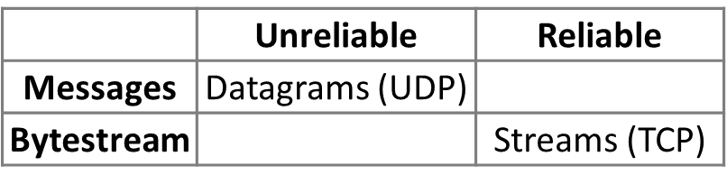
Transport Layer Services
Provides two different data delivery/transport options
Reliability dimension
Unreliable:
packets lost in the network are exposed to the transport’s user (the application)
Reliable:
packets can still be lost, but the transport layer handles it, so the application is unaware
Data transfer dimension
Message oriented: transfers self contained messages (like a post office)
Bytestream: an infinite stream of bytes
For the Internet, this layer provides
TCP: a bidirectional reliable bytestream between applications
UDP: a datagram model to send messages If an app wants reliable messaging (e.g., DNS), it must do the work itself
Nothing between these extremes

Slide 9
User Datagram Protocol (UDP)
UDP
UDP is a glorified packet transporter (adds very little to the network layer)
a datagram is just a packet
messages can be lost/reordered/duplicated, have a limited size, and there is neither flow control nor congestion control
used by apps that don’t want reliability or bytestreams
VoIP (don’t want reliability)
DNS (prefer message oriented exchanges)
DHCP (for bootstrapping the network – prefer not to need complexity of TCP)
if an application wants reliability using messages, it must implement it itself

Slide 10
Datagram sockets
client and server both have sockets
server: bind it to a well known port
server calls receiveFrom() –blocks until message arrives
client calls sendTo() to send a message On server, recvFrom() unblocks and server retrieves the message
client calls recvFrom() for the response
server responds using sendTo() Client’s receiveFrom() unblocks and it processes the response
Both call close() to tidy up
Note: no connection needed
Client (host 1)
Time
Server (host 2)
1: socket
1: socket
2: bind
request
3: recvfrom*
4: sendto
5: recvfrom*
reply
6: sendto
7: close
7: close
*= call blocks

Slide 11
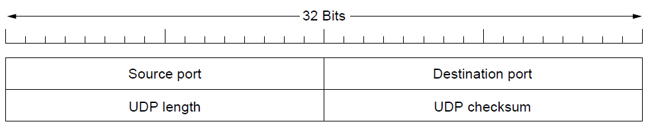
UDP Header
Ports identify sending and receiving application processes
presence of ports is the key difference between just raw packets
without ports, receiving layer would not know which application to send to
with ports
on receipt, its payload is handed to the process attached to the destination port
source port is needed when a reply must be returned
Datagram length of 8 byte header + payload (size limit of 65,515 bytes)
16-bit checksum for reliability (optional)
zero means no checksum

Slide 12
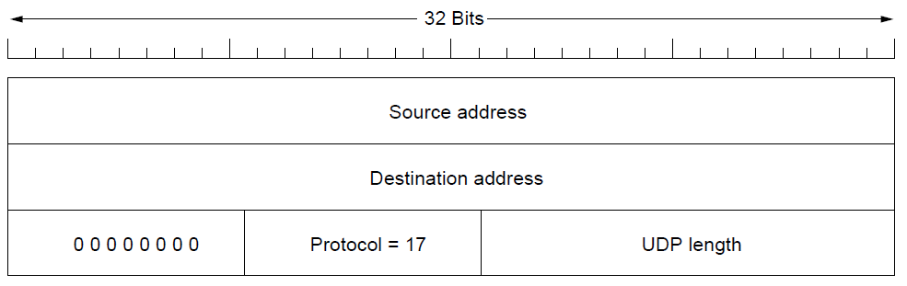
UDP Header
Checksum, if present, includes
IP pseudoheader prepended to the UDP segment (UDP header + payload)
also checks key IP fields (addresses) to detect misdelivered packets
Not a layering violation, since the transport layer already knows these details

Slide 13
UDP service
UDP provides
a common interface to the IP protocol (Sockets)
(de)mux of multiple processes (via ports) accessing the single network
optional end-to-end error detection (via the checksum)
UDP does not provide
flow control, congestion control, retransmission on receipt of a bad segment
If application needs these, it must implement it in its own code
Best for client/server type applications (e.g., DNS)
client sends a short request (lookup hostname), and server returns a short response (IP address)
if either is lost, client times out and retries
code is simple (no setup/tear down), and fewer messages than with TCP

Slide 14
Transport Layer - Transmission Control Protocol
TCP provides reliable end-to-end bytestream over an unreliable internetwork
Bytes are delivered once, reliably, and in order;
supports arbitrary length content
Supports flow control (match sender to receiver) and congestion control (match sender to the network)
TCP in the Transport layer
accepts user datastreams from local processes
breaks them up into pieces not exceeding 64KB (in practice 1460 data bytes to fit in an Ethernet frame)
sends each piece as a separate segment
Receiving layer reconstructs the original byte stream (reliably, in order)
Connection oriented
connection must be explicitly established between a socket on one host and a socket on another

Slide 15
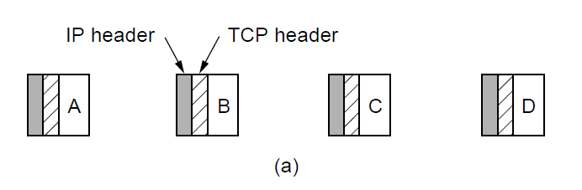
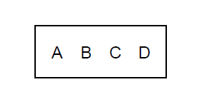
Transmission Control Protocol (TCP)
Reliable bytestream
a TCP connection is a bytestream – not a message stream
message boundaries are not preserved end-to-end
if sender does four 512-byte writes, can be delivered as one 2048-byte chunk
no way for receiver to detect the units in which the data were written
Sender
Receiver
Four segments, each with 512 bytes of data and carried in an IP packet
2048 bytes of data delivered to app in a single recv() call

Slide 16
TCP – Reliable Bytestream
Bidirectional data transfer
control information (ACKs) piggyback on data segments in reverse direction
data segment from A→B is also carrying an ACK for the reverse stream from B→A
Every byte on a TCP connection has its own 32-bit sequence number
Segment consists of 20 byte header followed by 0+ data bytes
Each segment must fit in the 65,515 byte IP payload
each segment must fit in the link’s MTU (Ethernet: 1500 bytes)
ack b→a
ack a→b
data a→b
A
B
data b→a

Slide 17
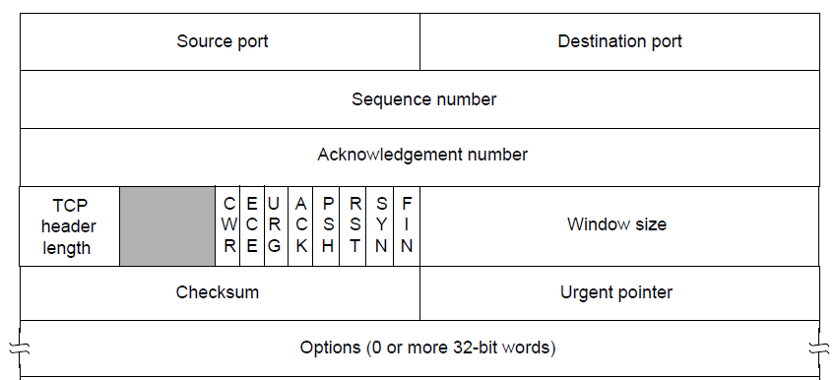
TCP Header
Fixed Format 20-byte header
16-bit Ports identify applications
SEQ number, ACK number (next in-order byte expected, if ACK flag is set)
cumulative ACK: summarizes the received data with a single number
Both are 32-bits because every byte of data is numbered
TCP Header length: needed because Options are of variable length
Flags for congestion control, connection setup, etc.

Slide 18
TCP Header
Fixed Format 20-byte header
Window size for flow control (relative to ACK, and in bytes)
indicates the buffer space available at the receiver
lets the receiver control how many bytes the sender may transmit
Checksum of the header, data, and a pseudoheader (with protocol=6 for TCP)
Options: lets each host specify the Maximum Segment Size it can accept, etc.

Slide 19
TCP Connection Establishment
Sender and receiver must prepare for data transfer
Signaling is used to agree on parameters (e.g., max segment size)
segments that carry control information are exchanged
Three way handshake
opens connection for data in both directions
initiated by an active party (the client) on a passive party (the server)

Slide 20
Three way handshake
Server waits for an incoming connection
Client executes a CONNECT with the IP address and port and parameters
Process (happy path):
Client sends TCP SYN segment with SYN=1, ACK=0, and picks ISN=x
Server replies with SYN(y), a fresh ISN; and ACK(x+1), since SYN takes up 1 byte and we ACK the next expected byte (x+1)
Client sends back SEQ=x+1, and ACK for y+1. The connection is now open.
If either SYN is lost, it is retransmitted
Side effect: both agree on sequence numbers to use for data (need not start at 1)
Active party
(client)
Passive party
(server)
1
SYN (SEQ=x)
2
SYN (SEQ=y, ACK=x+1)
3
(SEQ=x+1, ACK=y+1)
Time

Slide 21
TCP Connection Release
Releasing the connection
delivers all pending data, and cleans up state in sender and receiver
Two styles of connection release
Asymmetric: any party can simply hang up to terminate the connection
Problem: what if one party is sending data when the other abruptly hangs up?
Symmetric: each party controls closing their own end of the connection
each can continue to transmit data and close down when they are finished
avoids data loss by ensuring that all pending data is delivered before connection is released
but: connections can now be half-open, with one side closed, and the other is finishing up
Either the client or the server could initiate closing of the connection
which goes first depends on the application protocol

Slide 22
TCP Connection Release
Active sends FIN(SEQ=x), x is the current sequence number for that connection
TCP segment with FIN bit set indicates no more data to send
Passive ACKs(x+1) the FIN. Active endpoint is closed and cannot send new data
Passive may continue to send data in the other direction
Passive sends FIN(y)
Active ACKs(y+1) the FIN
when both directions are shut down, the connection is released
FINs are retransmitted, if lost
Active party
Passive party
FIN (SEQ=x)
1
(SEQ=y, ACK=x+1)
FIN (SEQ=y, ACK=x+1)
2
(SEQ=x+1, ACK=y+1)

Slide 23
Flow Control Overview
Error Control: ensures that data is delivered without errors
Flow Control: ensures that a fast sender cannot overrun a slow receiver
Transport layer uses the same mechanisms as for the data link layer
frame carries an error detecting code (checksum)
Sliding window protocol
Automatic Repeat reQuest (ARQ):
frame carries a sequence number to identify itself,
is retransmitted until it receives an ACK of successful receipt
Stop and Wait
sender allows only a max number of frames to be outstanding at any time.
supports bidirectional data transfer

Slide 24
Flow Control Overview
mechanisms are the same, but:
differ in function
link layer checksum protects a frame as it crosses a single link
valuable for performance (else a corrupt packet can be send along the entire path unnecessarily)
transport layer checksum protects a segment as it crosses an entire network path: a faulty router can cause segments to be corrupted, even though they were correct according to the checks at each link
end-to-end check is essential for correctness
differ in degree
most wireless links (eg. 802.11) have a low BD product, and so can use stop-and-wait
TCP connections have high BD product that is much larger than a single segment, so it needs a large sliding window.

Slide 25
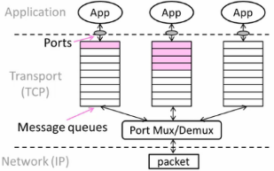
Buffering inside the Transport Layer
Used for
arriving segments: wait until application calls receive()
leaving segments: placed when application calls send()
Port mux/demux uses port number to assign segments to the right queue
Host may have many connections
so may need substantial buffering

Slide 26
Sliding Window - Receiver
Modification to sliding window for receiver to slow an over enthusiastic sender
In addition to pipelining to keep the network busy, wish to avoid overloading receiver
Consider receiver with W buffers for out-of-order packets
LAS = LAST ACK SENT, app pulls in-order data from buffer with recv()
Suppose next 2 segments arrive but app is overwhelmed and does not call recv() LAS rises, but we can’t slide window!
Sliding
Window
W=5
5
6
7
5
5
5
5
5
2
3
..
3
..
Finished
Acceptable
Too high
..
LAS
W=5
Acceptable
seq. number
5
6
7
4
5
5
5
5
5
2
3
..
3
4
..
Finished
Acked
Too high
..
LAS
seq. number

Slide 27
Sliding Window - Receiver
If further segments arrive, we can fill the buffer
must drop segments until app calls recv()
App recv() takes 2 segments – window slides!
with a slow receiver, we could have lost packets
W=5
Nothing
Acceptable
5
6
7
4
4
4
4
..
Finished
5
4
5
2
3
..
3
..
Acked
Acked
Too high
LAS
seq. number
W=5
Acceptable
5
6
7
5
5
4
4
4
..
Finished
5
5
5
2
3
..
3
..
Acked
Too high
LAS
seq. number

Slide 28
Flow Control
Avoid loss at receiver
tell sender the available buffer space
Flow control window (WIN) = #Acceptable, not W (measured from LAS)
Sender uses lower of sliding window and flow control window (WIN) as the effective window size
W=5
Acceptable
5
6
7
4
5
5
5
5
5
2
3
..
3
..
Finished
4
..
Acked
Too high
LAS
seq. number
WIN=3
5
6
7
4
5
5
5
5
5
2
3
..
3
..
Finished
4
..
Acked
Too high
LAS
seq. number

Slide 29
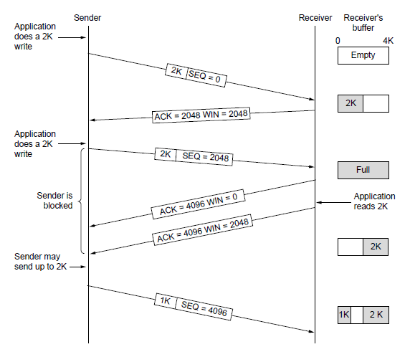
Flow Control (TCP)
Flow control with WIN: SEQ + length < ACK + WIN
4KB circular buffer at receiver

Slide 30
TCP Three Way Handshake
Edge case:
setup packets from a client were duplicated and delayed
connection was established using original packets and ended
delayed packets arrive
Does not establish a connection:
duplicate SYN(SEQ=x) arrives at the server
Server sends SEQ=y, ACK=x+1
client rejects this: it has not sent a SYN recently that corresponds to this ACK
other (SEQ=1, ACK=z+1) arrives at the server
Server rejects it as the ACK number is not the expected y+1
Requires different ISNs to be picked each time
Active party
(client)
Passive party
(server)
SYN (SEQ=x)
SYN (SEQ=y, ACK=x+1)
X
REJECT
(SEQ=x+1,
ACK=z+1)
X
REJECT

Slide 31
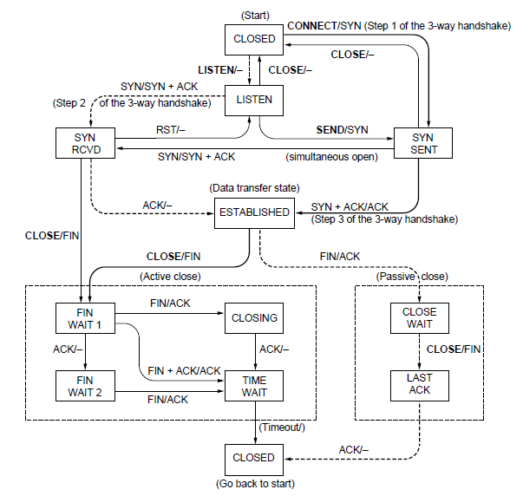
TCP Connection state machine
Finite State machine captures states (rectangles) and transitions (arrows)
A/B means
event A triggers the transition (e.g., a socket API being called, or a packet arriving)
the action B is done in response to the trigger (e.g., a SYN packet is sent)
useful tool to specify and check the handling of all cases that may occur
both client and server run their own independent instance of this FSM
Client side is shown using solid lines, and Server side shown using dashed lines

Slide 32
TCP Connection state machine – Client instance
Client starts in CLOSED state (Active party)
Transition event=call CONNECT, action=send SYN. New state=SYN SENT
Client is in SYN SENT state
event=SYN+ACK arrives from Server, action=send ACK. New state=ESTABLISHED

Slide 33
TCP Connection state machine – Server instance
Server starts in CLOSED state (Active party)
event=call LISTEN. action=<none>. New state=LISTEN (wait for incoming call)
Server is in LISTEN state
event=SYN arrives from Client. action=send SYN+ACK. New state=SYN RCVD
Server is in SYN RCVD state
event=ACT from Client. action=<none>. New state=ESTABLISHED

Slide 34
TCP Connection State Machine – Client Instance
Client is in ESTABLISHED state (Active party)
event=call CLOSE. action=send FIN. New state=FINWAIT1 (wait for ACK)
Client is in FIN WAIT 1 state
event=ACK from Server. action=<none>. New state=FIN WAIT 2
Client end of connection is closed, and all state is cleaned up
Client is in FIN WAIT 2 state
event=FIN. action=ACK. New state=TIME WAIT
gives time for resend of FIN, if our ACK was lost
Client waits for timeout, and goes to CLOSED
waits for straggling packets to arrive before closing the connection

Slide 35
TCP Connection State Machine – Server Instance
Server is in ESTABLISHED state (Passive party)
event=receive FIN. action=send ACK. New state=CLOSEWAIT1
the transport layer waits for the application to realize that this is a closed connection
Server is in CLOSE WAIT state
event=call CLOSE. action=send FIN. New State = LAST ACK
application realizes that the connection is closed, and issues a CLOSE call
Server is in LAST ACK
event=ACK received. action=<none> New state=CLOSED

