Slide 1
ICS 460 – Application Layer
Application
Transport
Network
Link
Damodar Chetty
Physical

Slide 2
Application Layer
Builds distributed “network services” (DNS, Web) on Transport services
Application layer protocols are often part of an “app”
app
User-level
HTTP
OS
TCP
IP
(NIC)
802.11

Slide 3
DNS
DNS (Domain Name System)
Naming service to map between host names and their IP addresses
www.uwa.edu.au → 130.95.128.140
Human-readable names
Names are higher-level identifiers for resources
Addresses are lower-level locators for resources
Resolution (or lookup) is mapping a name to an address
Goals:
Easy to manage (esp. with multiple parties)
Efficient (good performance, few resources)
Approach:
Distributed directory based on a hierarchical namespace
Automated protocol to tie pieces together
www.uw.edu?
128.94.155.135
Network

Slide 4
Top Level Domains (TLDs)
Run by ICANN (Internet Corp. for Assigned Names and Numbers)
22+ generic TLDs
Initially .com, .edu , .gov., .mil, .org, .net
Added .aero, .museum, etc. from ’01 through .xxx in ’11
Different TLDs have different usage policies
~250 country code TLDs
Two letters, e.g., “.au”, plus international characters since 2010
Widely commercialized, e.g., .tv (Tuvalu)
Many domain hacks, e.g., instagr.am (Armenia), goo.gl (Greenland)

Slide 5
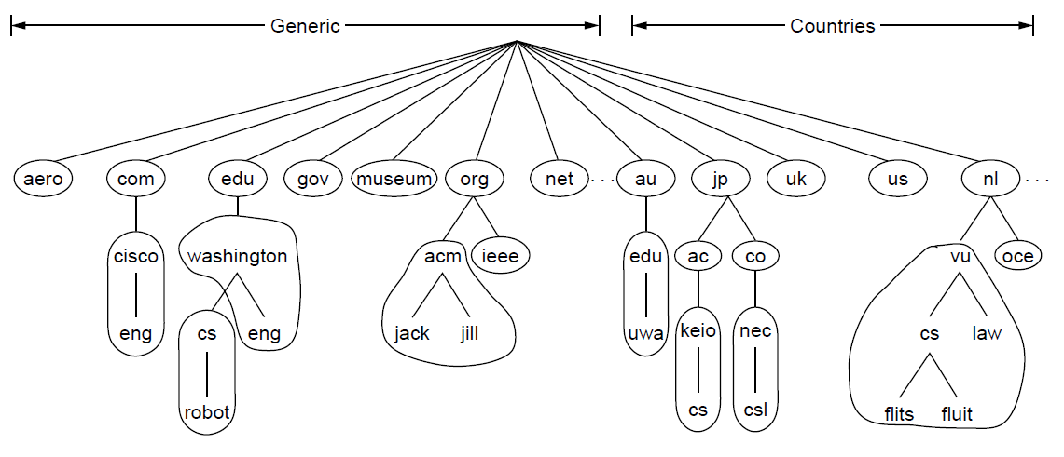
DNS Namespace
Hierarchical, starting from “.” (dot, typically omitted)
A zone is a contiguous portion of the namespace
basis for distribution
EDU registrar administers .edu
UW administers washinton.edu
CS&E administers cs.washington.edu
Delegation
A zone

Slide 6
DNS Namespace
Each zone has a nameserver to contact for information about it
Zone must include contacts for delegations, e.g., .edu knows nameserver for washington.edu
is comprised of DNS resource records that give information for its domain names
A record: IPv4 address of a host
CNAME record: alias name
NS record: nameserver of domain or delegated subdomain
Delegation
A zone

Slide 7
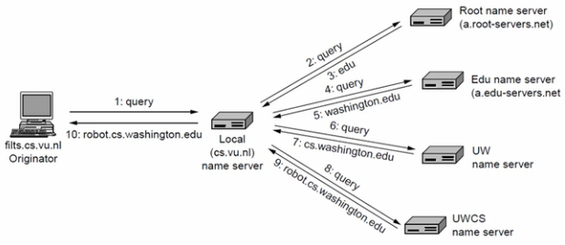
DNS Mechanics
Originator (filts.cs.vu.nl) wants to resolve robot.cs.washington.edu Assume: local NS uses recursive query, and does not know robot’s IP address
originator queries its local name server (a configured address)
local name server begins at the root name server
root server does not know robot, but replies with the NS of .edu
local name server contacts .edu NS for robot.cs.washington.edu

Slide 8
DNS Mechanics
.edu’s NS does not know robot, but replies with NS for washington.edu
local name server contacts washington.edu NS for robot
washington.edu’s NS does not know robot, but replies with NS for cs.washington.edu
local name server contacts cs.washington.edu for robot
cs.washington.edu’s NS returns the IP address for robot.
local NS returns the IP address to originator

Slide 9
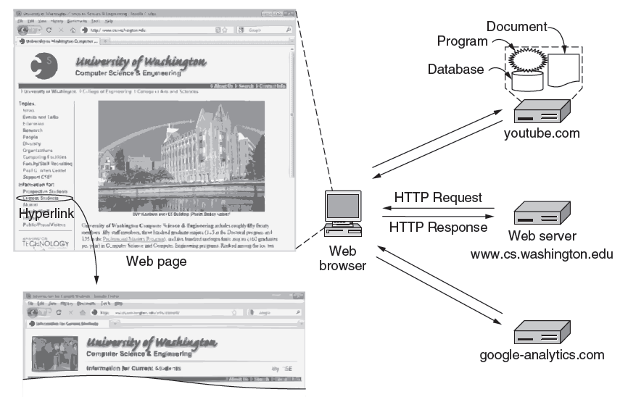
Web
Page as a set of related HTTP transactions
HTTP request
HTTP response

Slide 10
Web Protocol
HTTP is a request/response protocol for fetching Web resources
Runs on TCP, typically port 80
Part of browser/server app
browser
request
server
HTTP
HTTP
response
TCP
TCP
IP
IP
802.11
802.11

Slide 11
Fetching a Web page with HTTP
Start with the page URL:
http://en.wikipedia.org/wiki/Vegemite
Steps:
Resolve the server to IP address (DNS)
Set up TCP connection to the server
Send HTTP request for the page
(Await HTTP response for the page) **Execute / fetch embedded resources / render
Clean up any idle TCP connections
Protocol
Server
Page on server

Slide 12
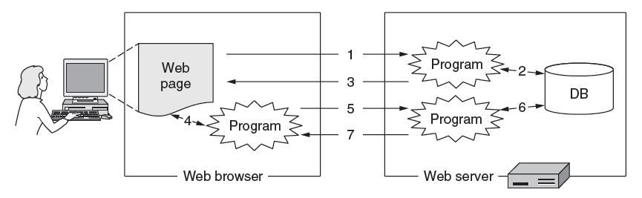
Static vs Dynamic Web pages
Static web page is a file contents, e.g., image
Dynamic web page is the result of program execution
Javascript on client, PHP on server, or both

Slide 13
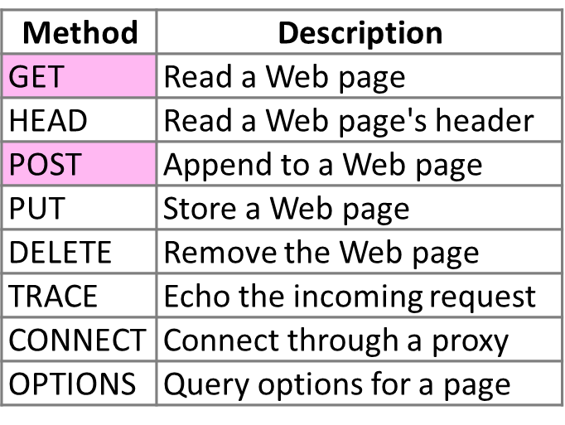
HTTP Protocol
Request commands
Fetch
page
Upload
data

Slide 14
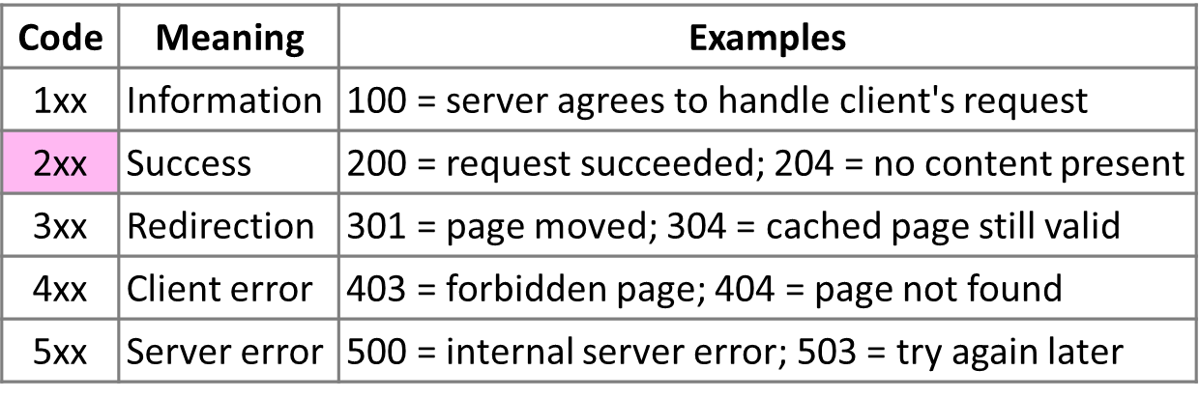
HTTP Protocol
Codes returned with the response
Yes!

Slide 15
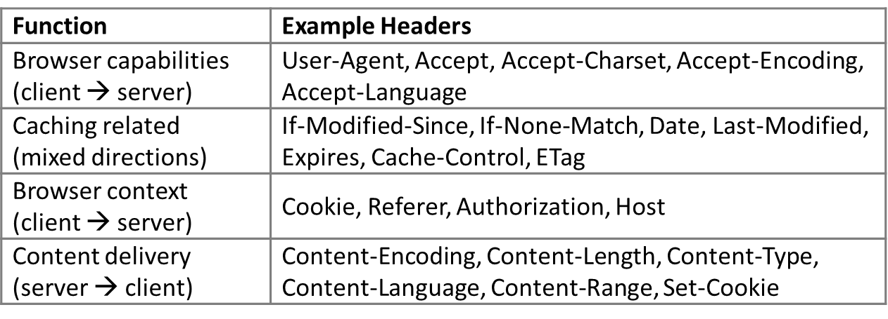
HTTP Protocol
Many header fields specify capabilities and content
E.g., Content-Type: text/html, Cookie: lect=8-4-http

Slide 16
HTTP Performance
Page Load Time
key measure of web performance
time from click until user sees page
Ways to decrease PLT:
reduce content size for transfer (smaller files, compression)
change HTTP to make better use of available bandwidth
caching/proxies to avoid repeated transfer of the same content
move content closer to the client (CDNs)

Slide 17
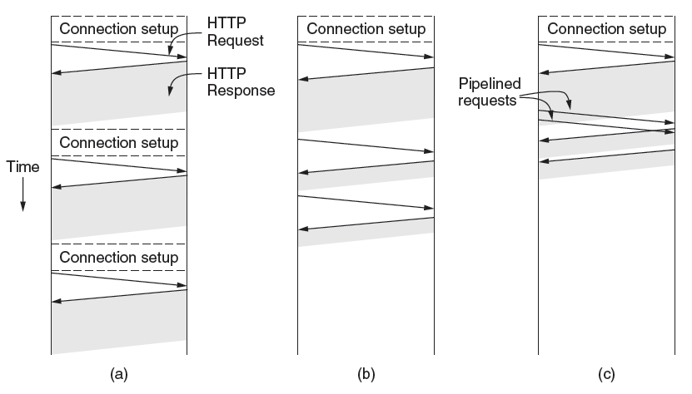
Persistent Connections
Parallel connections: browser runs multiple HTTP instances in parallel
but connections compete with each other for network resources
Persistent connections: use 1 TCP connection for multiple HTTP requests
Pipeline requests (optional)
Pipelined requests per connection
Sequential requests per connection
One request per connection

Slide 18
HTTP Web Caching
Users often revisit web pages
Big win from reusing local copy!
How to determine if local copy is still valid?
Local copies
Cache
Network
Server

Slide 19
Web Caching
Locally determine copy is still valid
Based on expiry information such as “Expires” header from server
Or use a heuristic to guess (cacheable, freshly valid, not modified recently)
Content is then available right away
Revalidate copy with remote server
Based on timestamp of copy such as “Last-Modified” header from server
Or based on content of copy such as “Etag” header from server
Content is available after 1 RTT
Cache
Network
Server
Cache
Network
Server

Slide 20
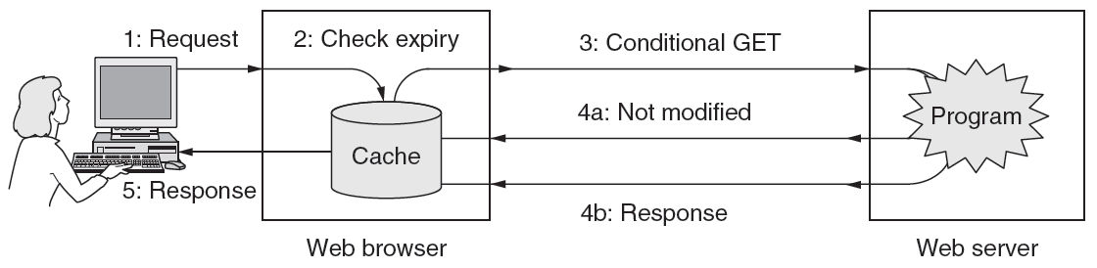
Web Caching
Putting the pieces together:

Slide 21
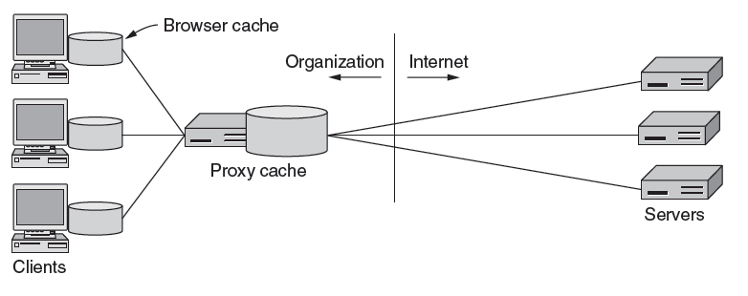
Web Proxies
Place intermediary between pool of clients and external web servers
Clients benefit from
larger, shared cache
security checking,
enforces organizational access policies
Benefits limited by secure / dynamic content, as well as “long tail”
Clients contact proxy; proxy contacts server
Cache
Near client
Far from client

