Slide 1
Introduction
Companion slides for
The Art of Multiprocessor Programming
by Maurice Herlihy & Nir Shavit

Slide 2
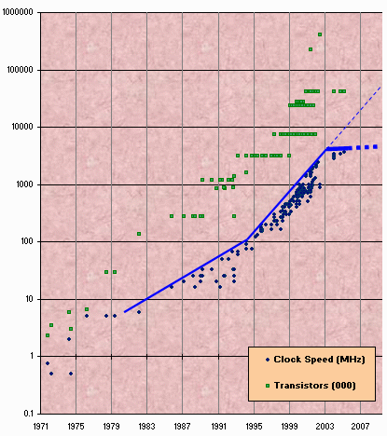
Moore’s Law
Transistor count still rising
Clock speed flattening sharply
Art of Multiprocessor Programming
‹#›

Slide 3
Still on some of your desktops: The Uniprocesor
cpu
memory
Art of Multiprocessor Programming
‹#›

Slide 4
In the Enterprise: The Shared Memory Multiprocessor (SMP)
cache
cache
cache
Bus
Bus
shared memory
Art of Multiprocessor Programming
‹#›
Notes:
‹#›
Here is our course overview. (at the end, we aim to give you a basic understanding of the issues, not to make you exerts) [[Lecturer can tell
Mongolian Expert on the Montain Joke]].
In this course, we will study a variety of synchronization algorithms,
with an emphasis on informal reasoning about correctness.
Reasoning about multiprocessor programs is different in many ways from the more
familiar style of reasoning about sequential programs.
Sequential correctness is mostly concerned with safety properties,
that is, ensuing that a program transforms each before-state to the correct
after-state.
Naturally, concurrent correctness is also concerned with safety,
but the problem is much, much harder,
because safety must be ensured despite the vast number of ways steps of
concurrent threads can be be interleaved.
Equally important, concurrent correctness encompasses a variety of
\emph{liveness} properties that have no counterparts in the sequential world.
The second part of the book concerns performance.
Analyzing the performance of synchronization algorithms is also different
in flavor from analyzing the performance of sequential programs.
Sequential programming is based on a collection of well-established and
well-understood abstractions.
When you write a sequential program,
you usually do not need to be aware that underneath it all,
pages are being swapped from disk to memory,
and smaller units of memory are being moved in and out of a hierarchy of
processor caches.
This complex memory hierarchy is essentially invisible,
hiding behind a simple programming abstraction.
In the multiprocessor context, this abstraction breaks down,
at least from a performance perspective.
To achieve adequate performance,
the programmer must sometimes ``outwit'' the underlying memory system,
writing programs that would seem bizarre to someone unfamiliar with
multiprocessor architectures.
Someday, perhaps, concurrent architectures will provide the same degree of
efficient abstraction now provided by sequential architectures,
but in the meantime, programmers should beware.
We start then with fundamentals, trying to understand what is and is not computable before we try and write programs. This is similar to the process you have probably gone through with sequential computation of learning computability and complexity theory so that you will not try and solve unsolvable problems. There are many such computational pitfals when programming multiprocessors.

Slide 5
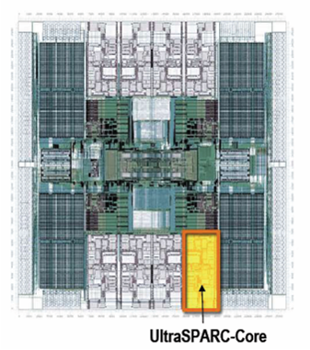
Your New Desktop: The Multicore Processor (CMP)
All on the
same chip
Sun T2000
Niagara
cache
cache
cache
Bus
Bus
shared memory
Art of Multiprocessor Programming
‹#›

Slide 6
Multicores Are Here
“Intel's Intel ups ante with 4-core chip. New microprocessor, due this year, will be faster, use less electricity...” [San Fran Chronicle]
“AMD will launch a dual-core version of its Opteron server processor at an event in New York on April 21.” [PC World]
“Sun’s Niagara…will have eight cores, each core capable of running 4 threads in parallel, for 32 concurrently running threads. ….” [The Inquierer]
Art of Multiprocessor Programming
‹#›

Slide 7
Why do we care?
Time no longer cures software bloat
The “free ride” is over
When you double your program’s path length
You can’t just wait 6 months
Your software must somehow exploit twice as much concurrency
Art of Multiprocessor Programming
‹#›

Slide 8
Traditional Scaling Process
7x
Speedup
3.6x
1.8x
User code
Traditional
Uniprocessor
Time: Moore’s law
Art of Multiprocessor Programming
‹#›

Slide 9
Multicore Scaling Process
7x
3.6x
Speedup
1.8x
User code
Multicore
Unfortunately, not so simple…
Art of Multiprocessor Programming
‹#›

Slide 10
Real-World Scaling Process
Speedup
2x
2.9x
1.8x
User code
Multicore
Parallelization and Synchronization
require great care…
Art of Multiprocessor Programming
‹#›

Slide 11
Multicore Programming: Course Overview
Fundamentals
Models, algorithms, impossibility
Real-World programming
Architectures
Techniques
Art of Multiprocessor Programming
‹#›

Slide 12
Multicore Programming: Course Overview
Fundamentals
Models, algorithms, impossibility
Real-World programming
Architectures
Techniques
We don’t necessarily
want to make
you experts…
Art of Multiprocessor Programming
‹#›

Slide 13
Sequential Computation
thread
memory
object
object
Art of Multiprocessor Programming
‹#›

Slide 14
Concurrent Computation
threads
memory
object
object
Art of Multiprocessor Programming
‹#›

Slide 15
Asynchrony
Sudden unpredictable delays
Cache misses (short)
Page faults (long)
Scheduling quantum used up (really long)
Art of Multiprocessor Programming
‹#›

Slide 16
Model Summary
Multiple threads
Sometimes called processes
Single shared memory
Objects live in memory
Unpredictable asynchronous delays
Art of Multiprocessor Programming
‹#›

Slide 17
Road Map
We are going to focus on principles first, then practice
Start with idealized models
Look at simplistic problems
Emphasize correctness over pragmatism
“Correctness may be theoretical, but incorrectness has practical impact”
Art of Multiprocessor Programming
‹#›

Slide 18
Concurrency Jargon
Hardware
Processors
Software
Threads, processes
Sometimes OK to confuse them, sometimes not.
Art of Multiprocessor Programming
‹#›

Slide 19
Parallel Primality Testing
Challenge
Print primes from 1 to 10¹⁰
Given
Ten-processor multiprocessor
One thread per processor
Goal
Get ten-fold speedup (or close)
Art of Multiprocessor Programming
‹#›

Slide 20
Load Balancing
1
10⁹
2·10⁹
…
10¹⁰
P₀
P₁
…
P₉
Split the work evenly
Each thread tests range of 10⁹
Art of Multiprocessor Programming
‹#›

Slide 21
Procedure for Thread i
void primePrint {
int i = ThreadID.get(); // IDs in {0..9}
for (j = i*10⁹+1, j<(i+1)*10⁹; j++) {
if (isPrime(j))
print(j);
}
}
Art of Multiprocessor Programming
‹#›

Slide 22
Issues
Higher ranges have fewer primes
Yet larger numbers harder to test
Thread workloads
Uneven
Hard to predict
Art of Multiprocessor Programming
‹#›

Slide 23
Issues
Higher ranges have fewer primes
Yet larger numbers harder to test
Thread workloads
Uneven
Hard to predict
Need dynamic load balancing
rejected
Art of Multiprocessor Programming
‹#›

Slide 24
Shared Counter
19
each thread takes a number
18
17
Art of Multiprocessor Programming
‹#›
Notes:
‹#›

Slide 25
Procedure for Thread i
int counter = new Counter(1);
void primePrint {
long j = 0;
while (j < 10¹⁰) {
j = counter.getAndIncrement();
if (isPrime(j))
print(j);
}
}
Art of Multiprocessor Programming
‹#›
Notes:
‹#›

Slide 26
Procedure for Thread i
Counter counter = new Counter(1);
void primePrint {
long j = 0;
while (j < 10¹⁰) {
j = counter.getAndIncrement();
if (isPrime(j))
print(j);
}
}
Shared counter
object
Art of Multiprocessor Programming
‹#›
Notes:
‹#›

Slide 27
Where Things Reside
void primePrint {
int i = ThreadID.get(); // IDs in {0..9}
for (j = i*10⁹+1, j<(i+1)*10⁹; j++) {
if (isPrime(j))
print(j);
}
}
Local
variables
code
cache
cache
cache
Bus
Bus
shared
memory
1
shared counter
Art of Multiprocessor Programming
‹#›
Notes:
‹#›

Slide 28
Procedure for Thread i
Counter counter = new Counter(1);
void primePrint {
long j = 0;
while (j < 10¹⁰) {
j = counter.getAndIncrement();
if (isPrime(j))
print(j);
}
}
Stop when every value taken
Art of Multiprocessor Programming
‹#›
Notes:
‹#›
We want to understand what we can and cannot compute before we try and write code. In fact, as we will see there are problems that are Turing computable but not asynchronously computable.

Slide 29
Procedure for Thread i
Counter counter = new Counter(1);
void primePrint {
long j = 0;
while (j < 10¹⁰) {
j = counter.getAndIncrement();
if (isPrime(j))
print(j);
}
}
Increment & return each new value
Art of Multiprocessor Programming
‹#›

Slide 30
Counter Implementation
public class Counter {
private long value;
public long getAndIncrement() {
return value++;
}
}
Art of Multiprocessor Programming
‹#›
Notes:
‹#›
We will use the terms above, even though there are also terms like strands, CPUs, chips etc also…

Slide 31
Counter Implementation
public class Counter {
private long value;
public long getAndIncrement() {
return value++;
}
}
OK for single thread,
not for concurrent threads
Art of Multiprocessor Programming
‹#›
Notes:
‹#›
We want to look at the problem of printing the primes from 1 to 10^10 in some arbitrary order.

Slide 32
What It Means
public class Counter {
private long value;
public long getAndIncrement() {
return value++;
}
}
Art of Multiprocessor Programming
‹#›
Notes:
‹#›
Split the range ahead of time

Slide 33
What It Means
public class Counter {
private long value;
public long getAndIncrement() {
return value++;
}
}
temp = value;
value = value + 1;
return temp;
Art of Multiprocessor Programming
‹#›

Slide 34
Challenge
public class Counter {
private long value;
public long getAndIncrement() {
temp = value;
value = temp + 1;
return temp;
}
}
Art of Multiprocessor Programming
‹#›

Slide 35
Challenge
public class Counter {
private long value;
public long getAndIncrement() {
temp = value;
value = temp + 1;
return temp;
}
}
Make these steps atomic (indivisible)
Art of Multiprocessor Programming
‹#›
Notes:
‹#›

Slide 36
Hardware Solution
public class Counter {
private long value;
public long getAndIncrement() {
temp = value;
value = temp + 1;
return temp;
}
}
ReadModifyWrite()
instruction
Art of Multiprocessor Programming
‹#›
Notes:
‹#›

Slide 37
An Aside: Java™
public class Counter {
private long value;
public long getAndIncrement() {
synchronized {
temp = value;
value = temp + 1;
}
return temp;
}
}
Art of Multiprocessor Programming
‹#›
Notes:
‹#›

Slide 38
An Aside: Java™
public class Counter {
private long value;
public long getAndIncrement() {
synchronized {
temp = value;
value = temp + 1;
}
return temp;
}
}
Synchronized block
Art of Multiprocessor Programming
‹#›
Notes:
‹#›
Time goes from left to right. The Blue thread might read 1 from \fValue{}, but before
it sets \fValue{} to 2, the Red thread would go through the
increment loop several times, reading 1 and setting to 2, reading
2 and setting to 3. When the Blue thread finally completes its
operation and sets \fValue{} to 2, it will actually be setting
the counter back from 3 to 2.

Slide 39
An Aside: Java™
public class Counter {
private long value;
public long getAndIncrement() {
synchronized {
temp = value;
value = temp + 1;
}
return temp;
}
}
Mutual Exclusion
Art of Multiprocessor Programming
‹#›
Notes:
‹#›

Slide 40
Mutual Exclusion or “Alice & Bob share a pond”
A
B
Art of Multiprocessor Programming
‹#›
Notes:
‹#›

Slide 41
Alice has a pet
A
B
Art of Multiprocessor Programming
‹#›

Slide 42
Bob has a pet
A
B
Art of Multiprocessor Programming
‹#›
Notes:
‹#›
We now present a sequence of fables, illustrating some of the basic problems.
Like most authors of fables, we retell stories mostly invented by others. The following story was told by a famous
Multiprocessing pioneer, Leslie Lamport.
See story outline in the Introduction Chapter of the Book.

Slide 43
The Problem
A
B
The pets don’t
get along
Art of Multiprocessor Programming
‹#›
Notes:
‹#›

Slide 44
Formalizing the Problem
Two types of formal properties in asynchronous computation:
Safety Properties
Nothing bad happens ever
Liveness Properties
Something good happens eventually
Art of Multiprocessor Programming
‹#›
Notes:
‹#›

Slide 45
Formalizing our Problem
Mutual Exclusion
Both pets never in pond simultaneously
This is a safety property
No Deadlock
if only one wants in, it gets in
if both want in, one gets in.
This is a liveness property
Art of Multiprocessor Programming
‹#›
Notes:
‹#›

Slide 46
Simple Protocol
Idea
Just look at the pond
Gotcha
Trees obscure the view
Art of Multiprocessor Programming
‹#›
Notes:
‹#›
Notice that we use the term deadlock and not livelock though some people would use both to describe the
Requirement. They are not the same thing. Deadlock is used to denote that Alice and Bob are stuck and no amount of retry (backoff) will help, while livelock means backoff can help. In any case both are different from “no starvation” which is the stronger requirement that means that every request always succeeds.

Slide 47
Interpretation
Threads can’t “see” what other threads are doing
Explicit communication required for coordination
Art of Multiprocessor Programming
‹#›
Notes:
‹#›
In the following versions of the protocol, we try and show the students which solutions will not work.
Can ask students for help in the solution by showing the first part of the slide (the Idea part) and then show the
Gotcha part once they have suggested solutions. This is true for all the next set of suggested solutions.

Slide 48
Cell Phone Protocol
Idea
Bob calls Alice (or vice-versa)
Gotcha
Bob takes shower
Alice recharges battery
Bob out shopping for pet food …
Art of Multiprocessor Programming
‹#›
Notes:
‹#›

Slide 49
Interpretation
Message-passing doesn’t work
Recipient might not be
Listening
There at all
Communication must be
Persistent (like writing)
Not transient (like speaking)
Art of Multiprocessor Programming
‹#›
Notes:
‹#›

Slide 50
Can Protocol
cola
cola
Art of Multiprocessor Programming
‹#›
Notes:
‹#›

Slide 51
Bob conveys a bit
A
B
cola
Art of Multiprocessor Programming
‹#›
Notes:
‹#›

Slide 52
Bob conveys a bit
A
B
cola
Art of Multiprocessor Programming
‹#›
Notes:
‹#›

Slide 53
Can Protocol
Idea
Cans on Alice’s windowsill
Strings lead to Bob’s house
Bob pulls strings, knocks over cans
Gotcha
Cans cannot be reused
Bob runs out of cans
Art of Multiprocessor Programming
‹#›
Notes:
‹#›
Notice that the point here is that it can be used as a solution but takes an unbounded number of inturrupt bits. This is not the case with the next solution…

Slide 54
Interpretation
Cannot solve mutual exclusion with interrupts
Sender sets fixed bit in receiver’s space
Receiver resets bit when ready
Requires unbounded number of inturrupt bits
Art of Multiprocessor Programming
‹#›
Notes:
‹#›
Here is a solution that does not suffer from the problems of the former ones…

Slide 55
Flag Protocol
A
B
Art of Multiprocessor Programming
‹#›
Notes:
‹#›

Slide 56
Alice’s Protocol (sort of)
A
B
Art of Multiprocessor Programming
‹#›
Notes:
‹#›

Slide 57
Bob’s Protocol (sort of)
A
B
Art of Multiprocessor Programming
‹#›
Notes:
‹#›

Slide 58
Alice’s Protocol
Raise flag
Wait until Bob’s flag is down
Unleash pet
Lower flag when pet returns
Art of Multiprocessor Programming
‹#›
Notes:
‹#›

Slide 59
Bob’s Protocol
Raise flag
Wait until Alice’s flag is down
Unleash pet
Lower flag when pet returns
danger!
Art of Multiprocessor Programming
‹#›
Notes:
‹#›
This intuitively explains implies why at least one of them will not
enter the critical section if both are trying at the same time. Many coordination protocols use falg raising and
The flag principle to guarantee that threads notice each other.
The following proof of mutual exclusion will not be
presented in class, but we provide it just to give you some intuition
about how one reasons about concurrent programs. Lets prove that if
they follow the algorithm the dogs will never be together in the yard.
Assume by way contradiction that this is not the case. We are assuming
that both dogs are in the yard. Therefore both Alice and Bob had a
last ``looking'' action before they let their dog enter the yard. Lets
take a look at the one who finished this looking action first. When he
(she) looked, he (she) saw that the other one's flag was down. Without
loss of generality let's assume it was Bob, so he had {\tt (=
Alice-flag 'down)} as true, otherwise he couldn't have entered the
critical section. So it follows that Alice's flag was up {\em after}
Bob finished his looking action. Therefore, Alice's looking was {\em
completely after} the end of Bob's raising of his flag, so Alice must
have seen this flag up and could not have entered the critical
section, a contradiction.

Slide 60
Bob’s Protocol (2nd try)
Raise flag
While Alice’s flag is up
Lower flag
Wait for Alice’s flag to go down
Raise flag
Unleash pet
Lower flag when pet returns
Art of Multiprocessor Programming
‹#›

Slide 61
Bob’s Protocol
Bob defers to Alice
Raise flag
While Alice’s flag is up
Lower flag
Wait for Alice’s flag to go down
Raise flag
Unleash pet
Lower flag when pet returns
Art of Multiprocessor Programming
‹#›

Slide 62
The Flag Principle
Raise the flag
Look at other’s flag
Flag Principle:
If each raises and looks, then
Last to look must see both flags up
Art of Multiprocessor Programming
‹#›

Slide 63
Remarks
Protocol is unfair
Bob’s pet might never get in
Protocol uses waiting
If Bob is eaten by his pet, Alice’s pet might never get in
Art of Multiprocessor Programming
‹#›
Notes:
‹#›

Slide 64
Moral of Story
Mutual Exclusion cannot be solved by
transient communication (cell phones)
interrupts (cans)
It can be solved by
one-bit shared variables
that can be read or written
Art of Multiprocessor Programming
‹#›
Notes:
‹#›
The protocol is unfair. Another property of compelling interest above no-deadlock is no-starvation:
if a pet wants to enter the yard, will it eventually succeed?
Here, Alice and Bob's protocol performs poorly. Whenever Alice and
Bob conflict, Bob defers to Alice, so it is possible that Alice's
pet can use the pond over and over again, while Bob's pet becomes
increasing uncomfortable. Later on, we will see how to make
protocols prevent starvation.
Waiting is problematic in terms of performance as we will explain in more detail later in the lecture

Slide 65
The Fable Continues
Alice and Bob fall in love & marry
Art of Multiprocessor Programming
‹#›
Notes:
‹#›
Notice that when Alice or Bob look at the otehrs flag, it might be in the process of being raised, which
Means we need to decide from what point on the flag is up or down. We essentially want to turn a continuous process of raising the flag into a discrete process in which it only has two states and we never have an intermediate “undefined” state. The same issue arises in memory. Bits of memory are in many cases electrical units called flip-flops. If a current representing a bit of either 0 or 1 is entered into a flip-flops input wires, we would like to think of the output as either 0 or 1. But this process takes time, and the current coming out of the
flip-flop is not discrete, if we measure it at different times, especially if we measure it before the output current has stabilized, we will not get a guaranteed correct behaviour. In other words, as with the flags, we might be catching it while the bit is being raised or lowered. What hardware manufacturers do is decide on a time when they believe the current on the output will be stable. However, as the lower figure shows, picking such a point is a probabilistic event, that is, if we test the gate after 5 nano-seconds, there is always a probability that it will not give us the correct corresponding output given the inputs because the gate is unstable. However, this time is chosen so that the probability is small enough that other failure probabilities (like the probability that a spec of dust will neutralize a flip-flop) are higher.

Slide 66
The Fable Continues
Alice and Bob fall in love & marry
Then they fall out of love & divorce
She gets the pets
He has to feed them
Art of Multiprocessor Programming
‹#›
Notes:
‹#›

Slide 67
The Fable Continues
Alice and Bob fall in love & marry
Then they fall out of love & divorce
She gets the pets
He has to feed them
Leading to a new coordination problem: Producer-Consumer
Art of Multiprocessor Programming
‹#›
Notes:
‹#›

Slide 68
Bob Puts Food in the Pond
A
Art of Multiprocessor Programming
‹#›
Notes:
‹#›

Slide 69
Alice releases her pets to Feed
mmm…
B
mmm…
Art of Multiprocessor Programming
‹#›
Notes:
‹#›
Many coordination problems are producer consumer problems, in fact, whenever an algorith involves the word “buffer” chances are high that we are talking about a producer consumer algorithm.

Slide 70
Producer/Consumer
Alice and Bob can’t meet
Each has restraining order on other
So he puts food in the pond
And later, she releases the pets
Avoid
Releasing pets when there’s no food
Putting out food if uneaten food remains
Art of Multiprocessor Programming
‹#›
Notes:
‹#›

Slide 71
Producer/Consumer
Need a mechanism so that
Bob lets Alice know when food has been put out
Alice lets Bob know when to put out more food
Art of Multiprocessor Programming
‹#›
Notes:
‹#›

Slide 72
Surprise Solution
A
B
cola
Art of Multiprocessor Programming
‹#›
Notes:
‹#›

Slide 73
Bob puts food in Pond
A
B
cola
Art of Multiprocessor Programming
‹#›
Notes:
‹#›

Slide 74
Bob knocks over Can
A
B
cola
Art of Multiprocessor Programming
‹#›
Notes:
‹#›

Slide 75
Alice Releases Pets
yum…
A
B
B
yum…
cola
Art of Multiprocessor Programming
‹#›
Notes:
‹#›

Slide 76
Alice Resets Can when Pets are Fed
A
B
cola
Art of Multiprocessor Programming
‹#›
Notes:
‹#›

Slide 77
Pseudocode
while (true) {
while (can.isUp()){};
pet.release();
pet.recapture();
can.reset();
}
Alice’s code
Art of Multiprocessor Programming
‹#›
Notes:
‹#›
Mutual Exclusion: Bob and the pets are never in the yard together.

Slide 78
Pseudocode
while (true) {
while (can.isUp()){};
pet.release();
pet.recapture();
can.reset();
}
Bob’s code
while (true) {
while (can.isDown()){};
pond.stockWithFood();
can.knockOver();
}
Alice’s code
Art of Multiprocessor Programming
‹#›
Notes:
‹#›
Again, waiting si problematic as one delays all causing the computation to proceed in a sequential manner.

Slide 79
Correctness
Mutual Exclusion
Pets and Bob never together in pond
Art of Multiprocessor Programming
‹#›
Notes:
‹#›

Slide 80
Correctness
Mutual Exclusion
Pets and Bob never together in pond
No Starvation
if Bob always willing to feed, and pets always famished, then pets eat infinitely often.
Art of Multiprocessor Programming
‹#›
Notes:
‹#›
One tile at a time.

Slide 81
Correctness
safety
Mutual Exclusion
Pets and Bob never together in pond
No Starvation
if Bob always willing to feed, and pets always famished, then pets eat infinitely often.
Producer/Consumer
The pets never enter pond unless there is food, and Bob never provides food if there is unconsumed food.
liveness
safety
Art of Multiprocessor Programming
‹#›
Notes:
‹#›

Slide 82
Could Also Solve Using Flags
A
B
Art of Multiprocessor Programming
‹#›
Notes:
‹#›

Slide 83
Waiting
Both solutions use waiting
while(mumble){}
Waiting is problematic
If one participant is delayed
So is everyone else
But delays are common & unpredictable
Art of Multiprocessor Programming
‹#›
Notes:
‹#›

Slide 84
The Fable drags on …
Bob and Alice still have issues
Art of Multiprocessor Programming
‹#›
Notes:
‹#›

Slide 85
The Fable drags on …
Bob and Alice still have issues
So they need to communicate
Art of Multiprocessor Programming
‹#›
Notes:
‹#›
This is a classical problem that captures how our machines memory really behaves. Memory consists of individual words that can be read or written one at a time, want if we read what is being written one word at a time while others are writing memory one word at a time, how can we guarantee to see correct values.

Slide 86
The Fable drags on …
Bob and Alice still have issues
So they need to communicate
So they agree to use billboards …
Art of Multiprocessor Programming
‹#›
Notes:
‹#›
Its also easy with producer-consumer interrupt bit based solution if we have one producer and one consumer.
Using Mutex for large chunks of memory introduces performance problems. The surprising thing is that we can actually provide a “snapshot” of memory by reading memory locations one at a time, and while others are continuously writing it, all this WITHOUT mutual exclusion. Stay tuned to see how we do this.

Slide 87
Billboards are Large
B
D
Letter
Tiles
From Scrabble™ box
A
C
2
3
E
1
3
1
Art of Multiprocessor Programming
‹#›

Slide 88
Write One Letter at a Time …
W
A
S
4
1
1
H
4
B
D
A
C
2
3
E
1
3
1
Art of Multiprocessor Programming
‹#›

Slide 89
To post a message
W
A
S
H
T
H
E
C
A
R
4
1
1
4
1
4
1
3
1
1
whew
Art of Multiprocessor Programming
‹#›

Slide 90
Let’s send another message
L
A
S
E
L
L
L
A
V
A
1
1
S
1
1
1
1
1
1
4
1
M
P
3
3
1
Art of Multiprocessor Programming
‹#›

Slide 91
Uh-Oh
S
E
L
L
T
H
E
C
A
R
1
1
1
1
1
4
1
3
1
1
L
1
OK
Art of Multiprocessor Programming
‹#›

Slide 92
Readers/Writers
Devise a protocol so that
Writer writes one letter at a time
Reader reads one letter at a time
Reader sees
Old message or new message
No mixed messages
Art of Multiprocessor Programming
‹#›

Slide 93
Readers/Writers (continued)
Easy with mutual exclusion
But mutual exclusion requires waiting
One waits for the other
Everyone executes sequentially
Remarkably
We can solve R/W without mutual exclusion
Art of Multiprocessor Programming
‹#›

Slide 94
Why do we care?
We want as much of the code as possible to execute concurrently (in parallel)
A larger sequential part implies reduced performance
Amdahl’s law: this relation is not linear…
Art of Multiprocessor Programming
‹#›

Slide 95
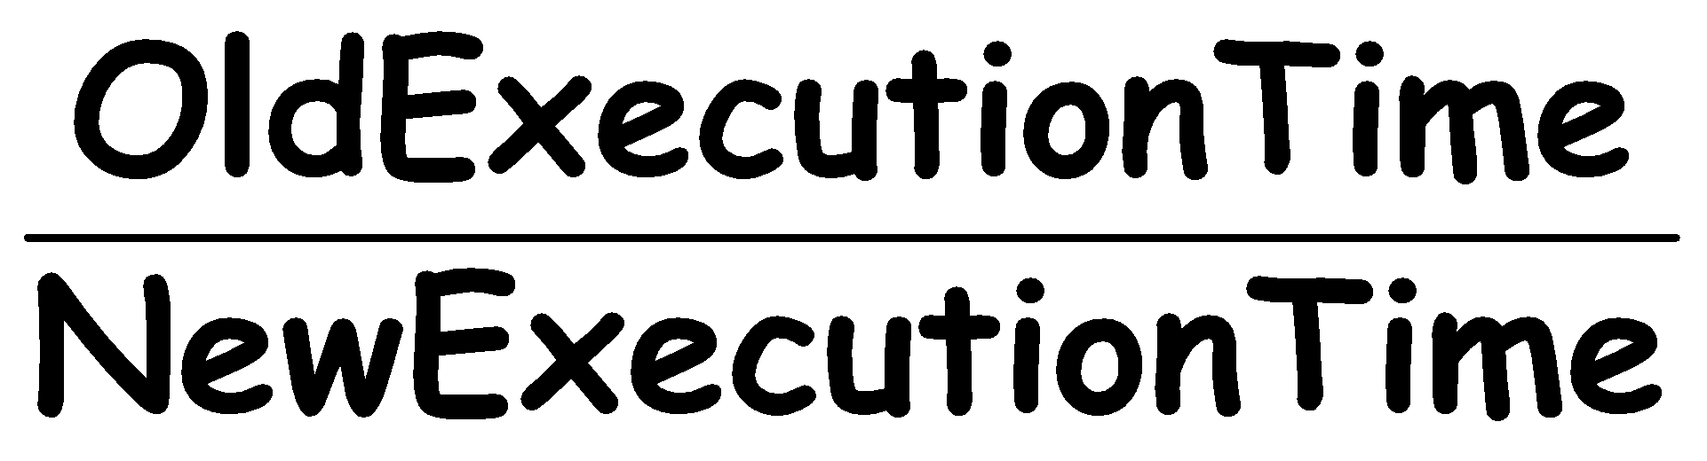
Amdahl’s Law
Speedup=
…of computation given n CPUs instead of 1
Art of Multiprocessor Programming
‹#›

Slide 96
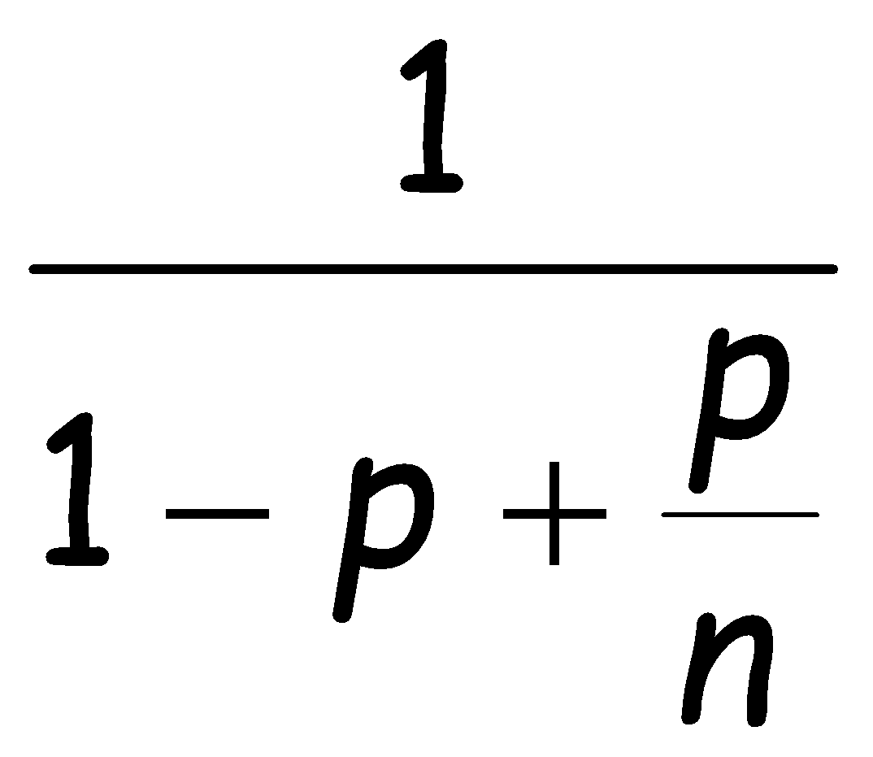
Amdahl’s Law
Speedup=
Art of Multiprocessor Programming
‹#›
Notes:
‹#›
Code matches code in Chapter 1 of book.

Slide 97
Amdahl’s Law
Parallel fraction
Speedup=
Art of Multiprocessor Programming
‹#›

Slide 98
Amdahl’s Law
Sequential fraction
Parallel fraction
Speedup=
Art of Multiprocessor Programming
‹#›
Notes:
‹#›

Slide 99
Amdahl’s Law
Sequential fraction
Parallel fraction
Speedup=
Number of processors
Art of Multiprocessor Programming
‹#›

Slide 100
Example
Ten processors
60% concurrent, 40% sequential
How close to 10-fold speedup?
Art of Multiprocessor Programming
‹#›

Slide 101
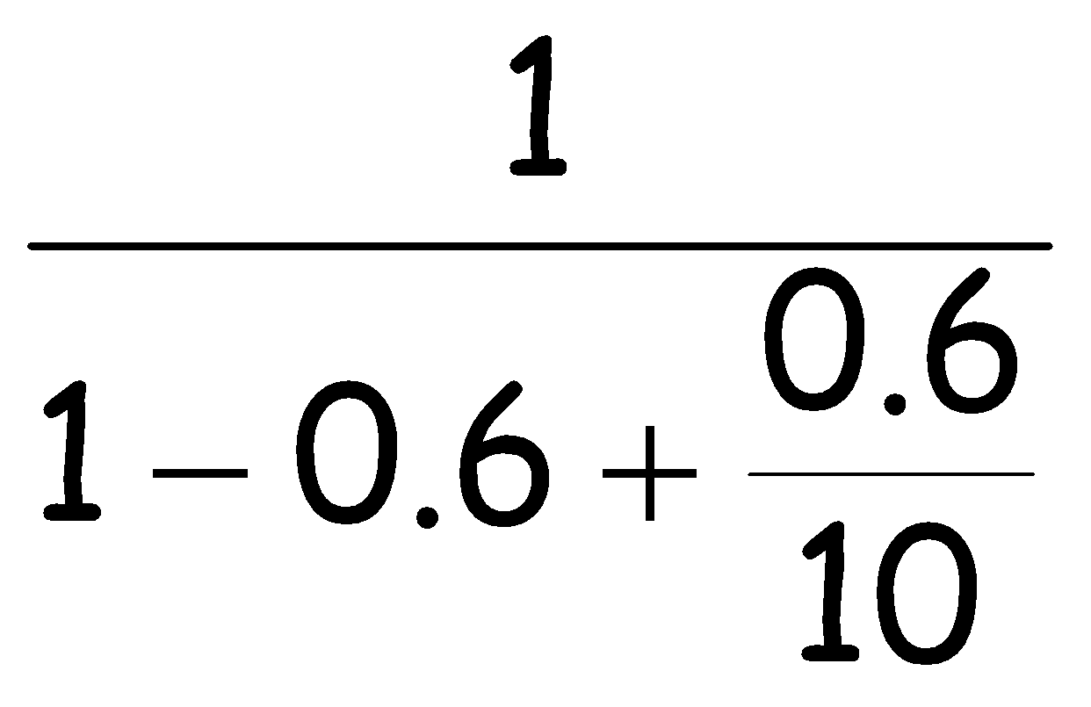
Example
Ten processors
60% concurrent, 40% sequential
How close to 10-fold speedup?
Speedup=2.17=
Art of Multiprocessor Programming
‹#›

Slide 102
Example
Ten processors
80% concurrent, 20% sequential
How close to 10-fold speedup?
Art of Multiprocessor Programming
‹#›

Slide 103
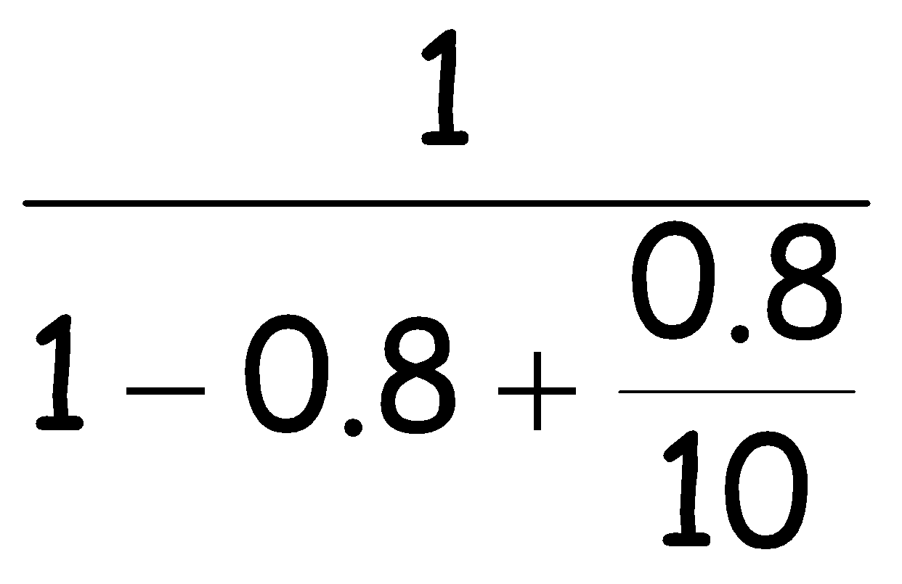
Example
Ten processors
80% concurrent, 20% sequential
How close to 10-fold speedup?
Speedup=3.57=
Art of Multiprocessor Programming
‹#›

Slide 104
Example
Ten processors
90% concurrent, 10% sequential
How close to 10-fold speedup?
Art of Multiprocessor Programming
‹#›

Slide 105
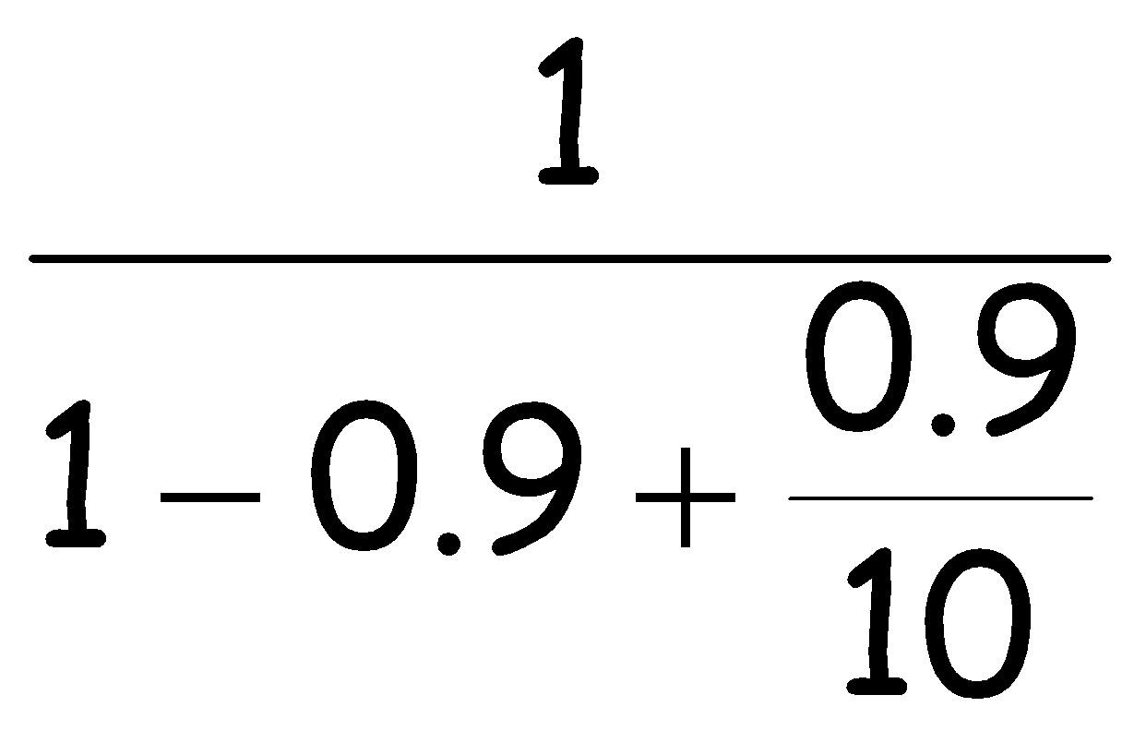
Example
Ten processors
90% concurrent, 10% sequential
How close to 10-fold speedup?
Speedup=5.26=
Art of Multiprocessor Programming
‹#›

Slide 106
Example
Ten processors
99% concurrent, 01% sequential
How close to 10-fold speedup?
Art of Multiprocessor Programming
‹#›

Slide 107
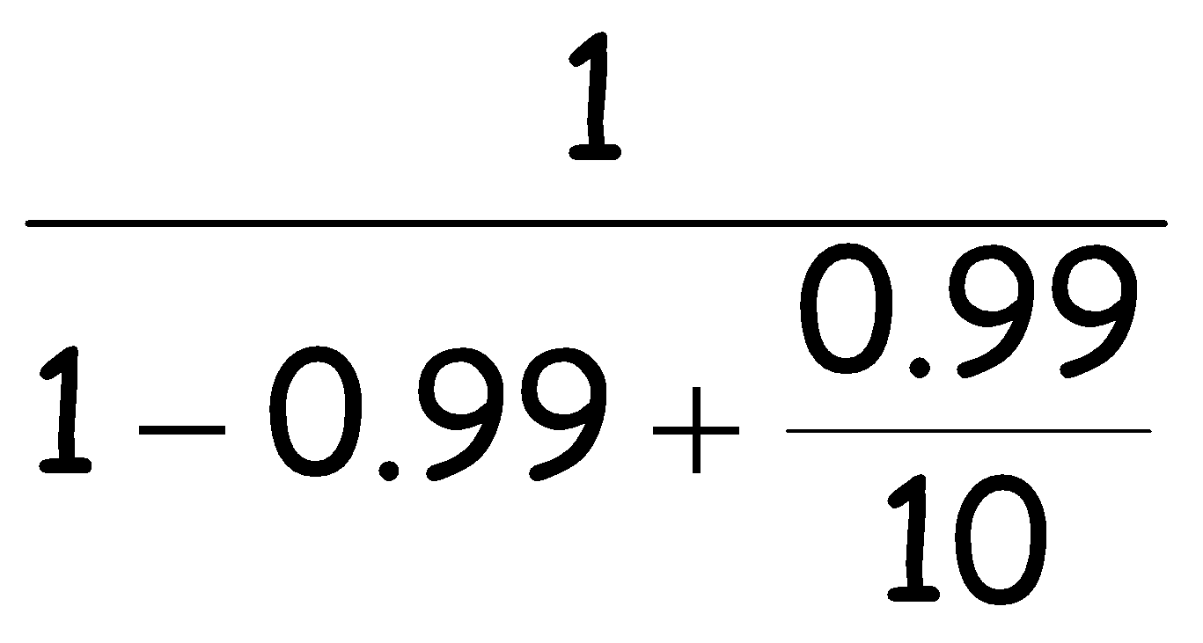
Example
Ten processors
99% concurrent, 01% sequential
How close to 10-fold speedup?
Speedup=9.17=
Art of Multiprocessor Programming
‹#›

Slide 108
The Moral
Making good use of our multiple processors (cores) means
Finding ways to effectively parallelize our code
Minimize sequential parts
Reduce idle time in which threads wait without
Art of Multiprocessor Programming
‹#›

Slide 109
Multicore Programming
This is what this course is about…
The % that is not easy to make concurrent yet may have a large impact on overall speedup
Next week:
A more serious look at mutual exclusion
Art of Multiprocessor Programming
‹#›
Notes:
‹#›
Most of you have probably heard of Moore’s law, which states that the number of transistors on a chip tends to double about every two years. Moore’s law has been the engine of growth for our field, and the reason you can buy a laptop for a few thousand dollars that would have cost millions a decade earlier. The green dots on this graph show

Slide 110
This work is licensed under a Creative Commons Attribution-ShareAlike 2.5 License.
You are free:
to Share — to copy, distribute and transmit the work
to Remix — to adapt the work
Under the following conditions:
Attribution. You must attribute the work to “The Art of Multiprocessor Programming” (but not in any way that suggests that the authors endorse you or your use of the work).
Share Alike. If you alter, transform, or build upon this work, you may distribute the resulting work only under the same, similar or a compatible license.
For any reuse or distribution, you must make clear to others the license terms of this work. The best way to do this is with a link to
http://creativecommons.org/licenses/by-sa/3.0/.
Any of the above conditions can be waived if you get permission from the copyright holder.
Nothing in this license impairs or restricts the author's moral rights.
Art of Multiprocessor Programming
‹#›
Notes:
‹#›
Not only Sun in Building CMPs, everyone is, and Intel is shipping 4-core chips.

