Slide 1
ICS-499 Software Engineering and capstone project
Spring 2022
Siva.Jasthi@metrostate.edu
Amazon Web Services Cloud Certifications

Slide 2
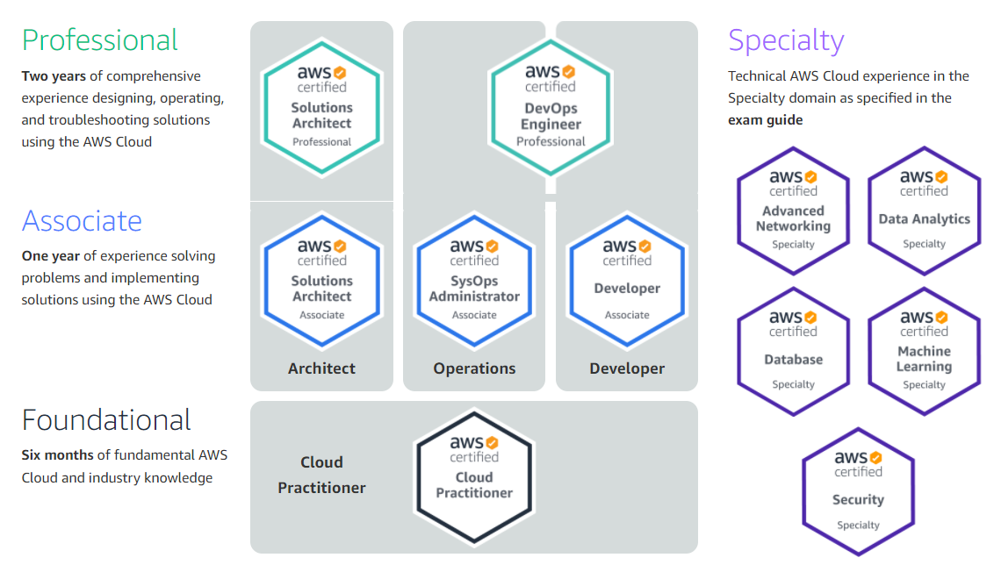
https://aws.amazon.com/certification/

Slide 3
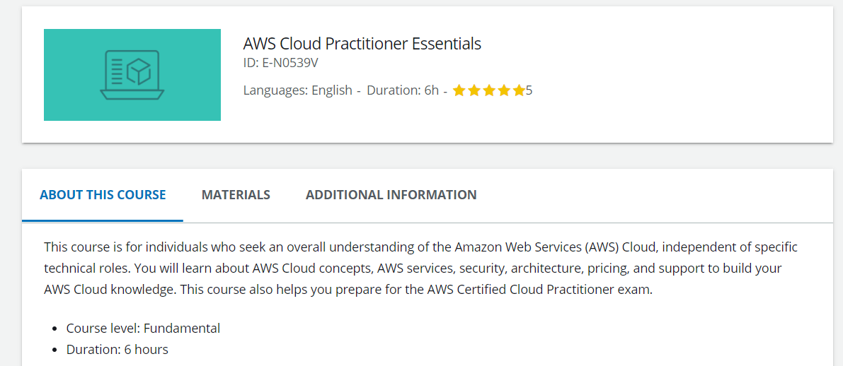
https://explore.skillbuilder.aws/learn/course/external/view/elearning/134/aws-cloud-practitioner-essentials?dt=tile&tile=fdt

Slide 4
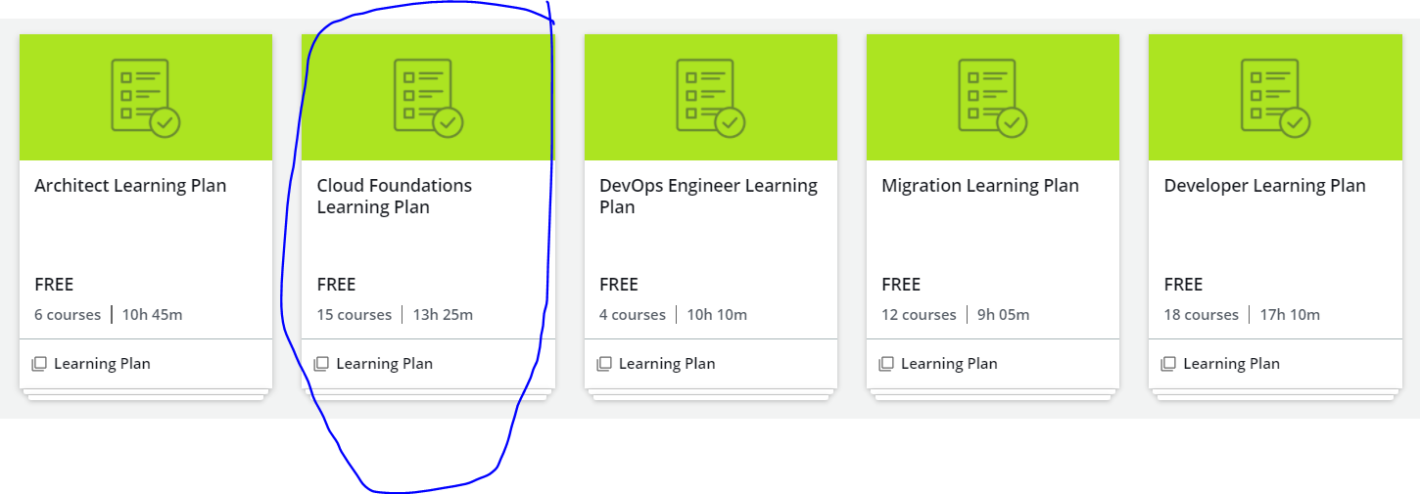
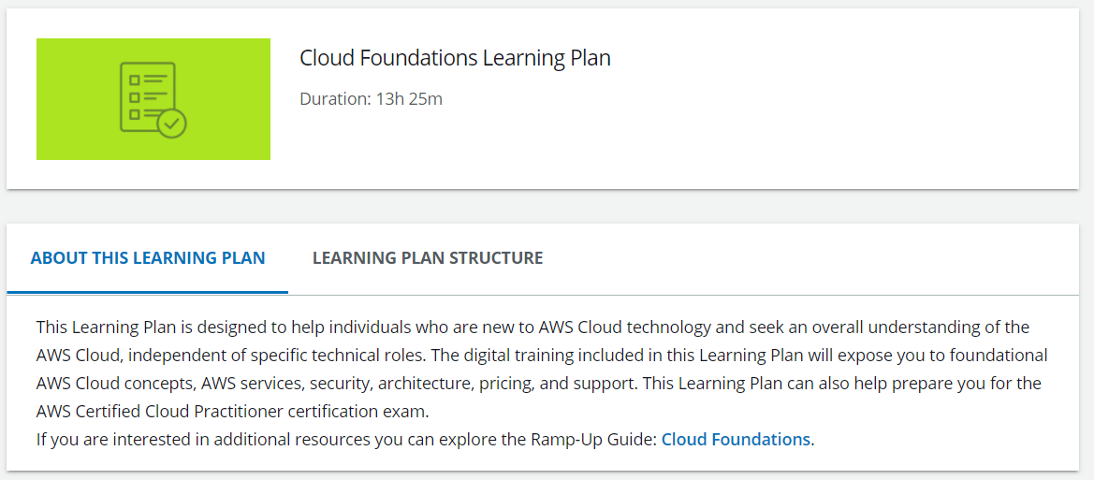
https://explore.skillbuilder.aws/learn/public/learning_plan/view/82/cloud-foundations-learning-plan

Slide 5
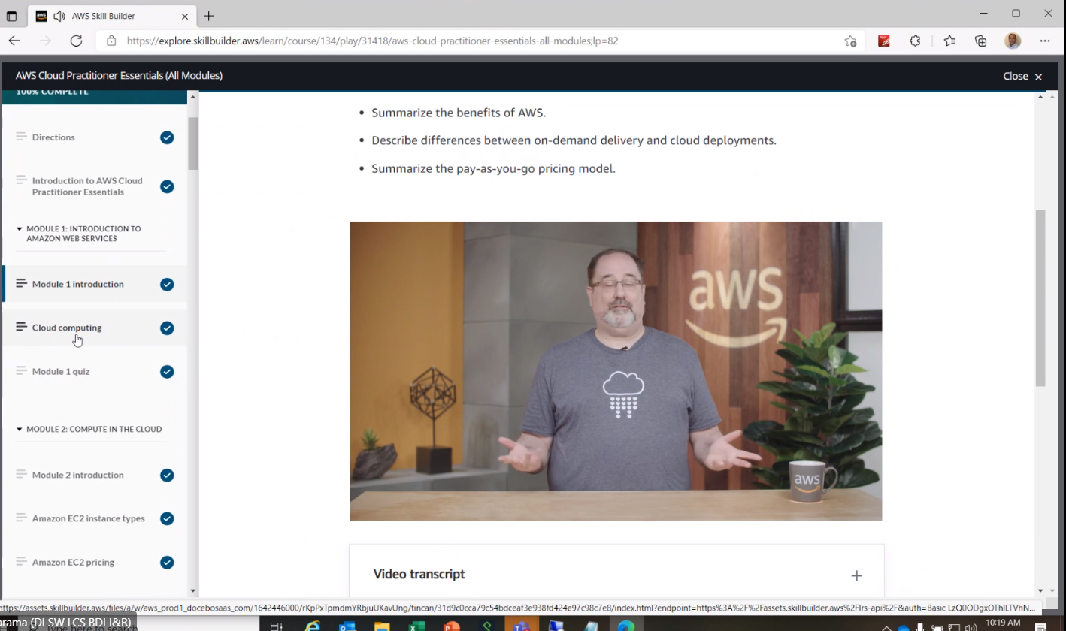

Slide 6
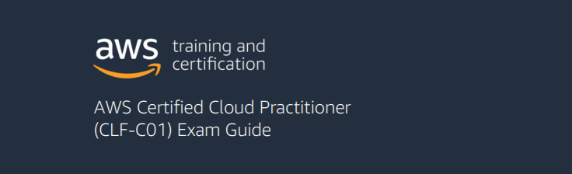
AWS Certified Cloud Practitioner Exam Guide
https://d1.awsstatic.com/training-and-certification/docs-cloud-practitioner/AWS-Certified-Cloud-Practitioner_Exam-Guide.pdf
AWS Ramp-Up Guide: Cloud Foundations
https://d1.awsstatic.com/training-and-certification/ramp-up_guides/Ramp-Up_Guide_CloudPractitioner.pdf

Slide 7

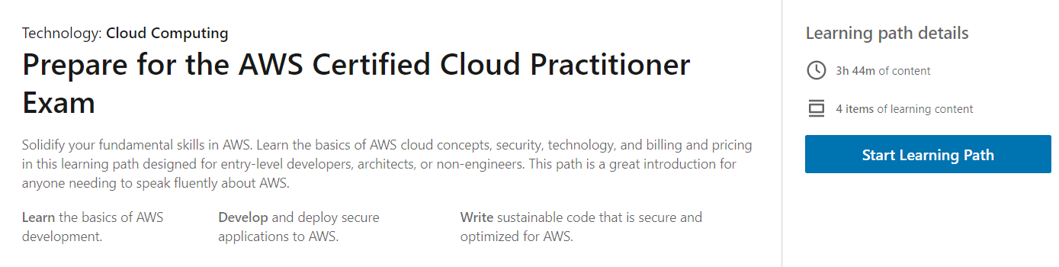
As Metrostate employee or student, you have access to “Linkedin Learning”
You can follow this track to prepare the certification.
https://www.linkedin.com/learning/paths/prepare-for-the-aws-certified-cloud-practitioner-exam

Slide 8

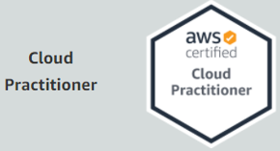
ICS499 Final Test (on SE Topics) - 75 Points
If you can acquire “AWS Cloud Practitioner” certification by our last class (04/27), you do not have to take the final test. I can take your “AWS Cloud Practitioner Certification” in lieu of the final test and you earn full credit (75 points).

