Slide 1

ICS499 – Software Engineering and Capstone Project
Spring 2022
Test Drive Development
Siva Jasthi
Computer Science and Cybersecurity
Metropolitan State University

Slide 2
Outline
QA vs Qc
Software Testing – Types
Test Driven Development (TDD)
Test First vs. Test Last
TDD Benefits and Limitations
Summary

Slide 3
Software Quality
Quality Assurance
Quality Control

Slide 4
Software Quality
Quality Assurance
Do things right to produce the right thing
Assure that we are following the proper processes
Quality Control
Is it right?
After-the-fact

Slide 5
Software Testing: Types
Accessibility testing
Acceptance testing
Black box testing
End-to-end testing
Functional testing
Interactive testing
Integration testing
Load testing
Non functional testing
Performance testing

Slide 6
Software Testing: Types (Contd.)
Regression testing
Sanity testing
Security testing
Single user performance testing
Smoke testing
Stress testing
Unit testing
White box testing
Alpha Testing
Beta Testing

Slide 7
Software Testing: Types (Contd.)
System testing
Scalability testing
Static testing (of code)
Dynamic testing (of code)
https://www.perfecto.io/resources/types-of-testing

Slide 8
Manual Vs Automated
All of the previous types testing can be performed either Manually or through Automated testing.
Manual testing doesn’t scale for large-scale enterprise products.
Dedicated teams support the creation of the automated tests.

Slide 9
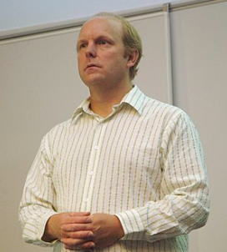
Test Driven Development: Quotes
Kent Beck said “Test-first code tends to be more cohesive and less coupled than code in which testing isn’t a part of the intimate coding cycle”
“If you can’t write a test for what you are about to code, then you shouldn’t even be thinking about coding”
https://en.wikipedia.org/wiki/Kent_Beck

Slide 10
TDD Introduction
Made popular by Extreme Programming
Method of developing software not just testing software
Software is Developed in short iterations
Unit Tests are developed FIRST before the code

Slide 11
TDD : How does it work?
Add a Test
Use Cases / User Stories are used to understand the requirement clearly
Run all tests and see the new one fail
Ensures test harness is working correctly
Ensures that test does not mistakenly pass
Write some code
Only code that is designed to pass the test
No additional functionality should be included because it will be untested

Slide 12
TDD Overview (contd)
Run the automated tests and see them succeed
If tests pass, programmer can be confident code meets all tested requirements
Refactor code
Cleanup the code
Rerun tests to ensure cleanup did not break anything

Slide 13
Test First vs. Test Last
Test First
Pick a piece of functionality
Write a test that expresses a small task that fails
Write production code until test passes
Run all tests
Rework code until all tests pass
Test Last
Pick a piece of functionality
Write production code that implements entire functionality
Write tests to validate all functionality
Run all tests
Rework code until all tests pass

Slide 14
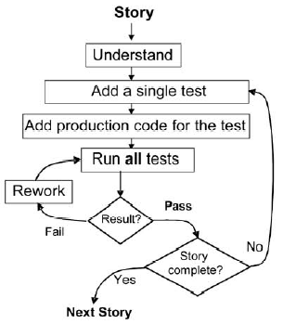
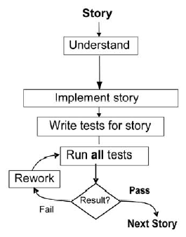
Test First vs. Test Last
https://www.researchgate.net/figure/Test-first-versus-test-last-development-10_fig1_220772711

Slide 15
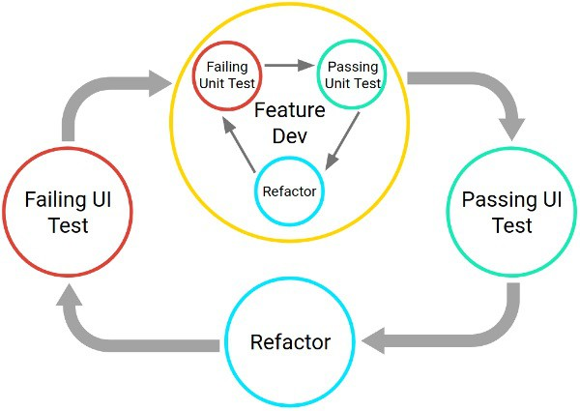
Refactoring the code to make the tests pass
https://www.bmc.com/blogs/testing-frameworks-unit-functional-tdd-bdd/

Slide 16
Benefits of TDD
Instant Feedback
Developer knows instantly if new code works and if it interferes with existing code
Better Development Practices
Encourages the programmers to decompose the problem into manageable, formalized programming tasks
Provides context in which low-level design decisions are made
By focusing on writing only the code necessary to pass tests, designs can be cleaner and clearer than is often achieved by other methods

Slide 17
TDD Benefits (2 of 3)
Quality Assurance
Having up-to-date tests in place ensures a certain level of quality
Enables continuous regression testing
TDD practices drive programmers to write code that is automatically testable
Whenever a software defect is found, unit test cases are added to the test suite prior to fixing the code

Slide 18
TDD Benefits (3 of 3)
Lower Rework Effort
Since the scope of a single test is limited, when the test fails, rework is easier
Eliminating defects early in the process usually avoids lengthy and tedious debugging later in the project
“Cost of Change” is that the longer a defect remains the more difficult and costly to remove

Slide 19
TDD Limitations
Difficult in Some Situations
GUIs, Relational Databases, Web Service
Requires mock objects
TDD does not often include an upfront design
Focus is on implementation and less on the logical structure
TDD blurs distinct phases of software development
design, code and test

Slide 20
Summary
TDD is effective
Not only in Software Testing
But also in understanding the goals/scope of what needs to be done.
Technology Driven
Based on the language, technology in your project, you can explore different frameworks/tools to use TDD

Slide 21

Q&A
Notes:
21

