Slide 1

Programming in Python
Siva Jasthi
Web Apps in Python

Slide 2

Which web framework?

Slide 3







Which GUI framework?
https://webpy.org/
https://bottlepy.org/docs/dev/
https://docs.python.org/3/library/tkinter.html
https://flask.palletsprojects.com/en/2.0.x/
https://www.djangoproject.com/
https://trypyramid.com/
https://falcon.readthedocs.io/en/stable/

Slide 4

Flask Documentation
https://flask.palletsprojects.com/en/2.0.x/

Slide 5
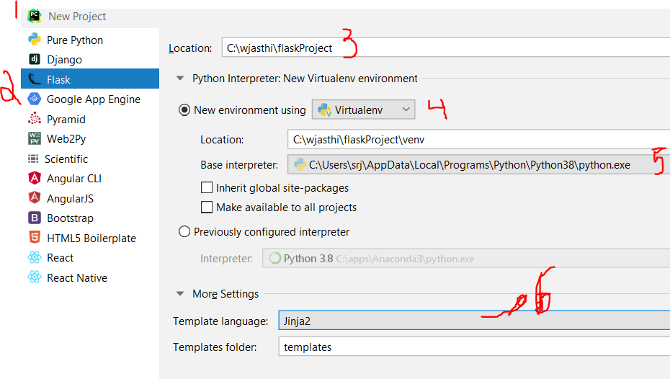
Creating a Flask project in PyCharm
https://www.jetbrains.com/help/pycharm/creating-flask-project.html

Slide 6
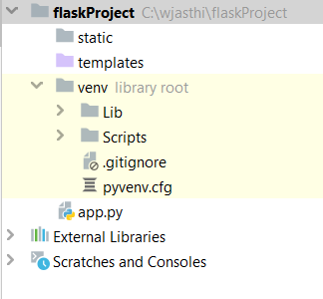
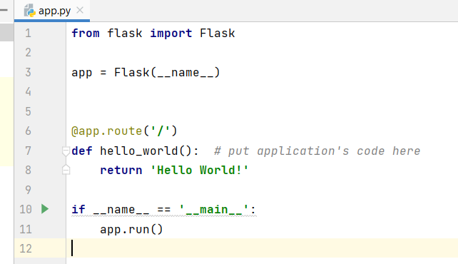
Flask Project setup
PyCharm creates the virtual environment and folder structure.
Creates a starter file called “app.py” (simple ‘Hello World’ Example)

Slide 7
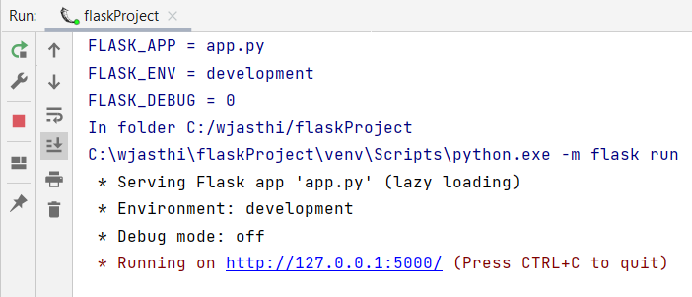
Running the Flask web app
Shift + F10 (or Edit Configuration → Run)
You click on the hyper-link to see the web application

Slide 8
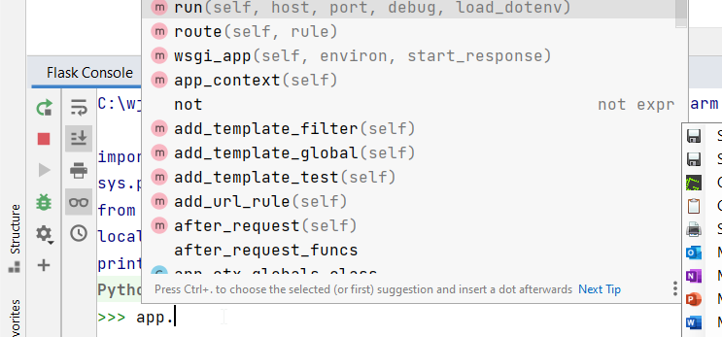
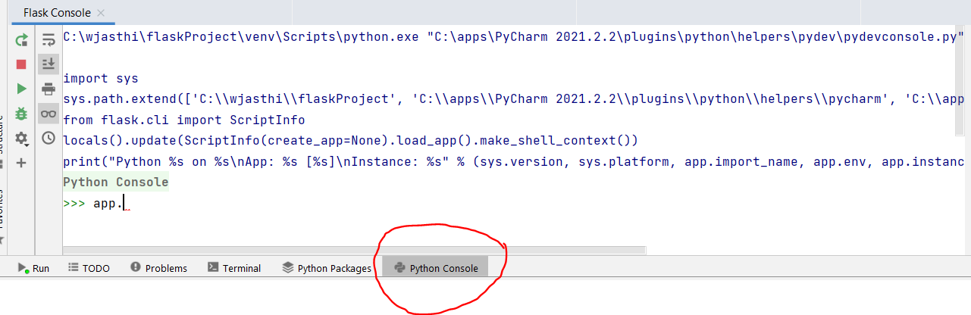
Python console = Flask console
When you've enabled Flask support in your project, the Python console starts acting as a Flask console.
You can use code completion to enter and execute Flask-specific commands.

Slide 9
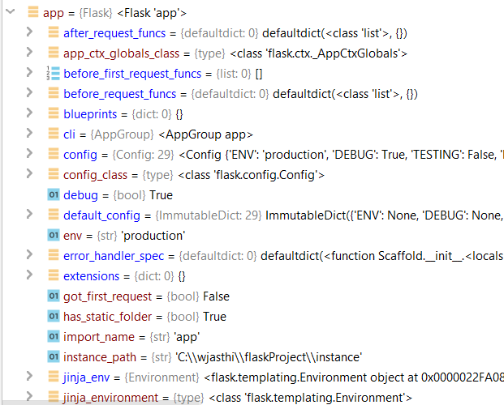
Python console = Flask console
You can see the current configuration of the FLASK app in the python console

Slide 10
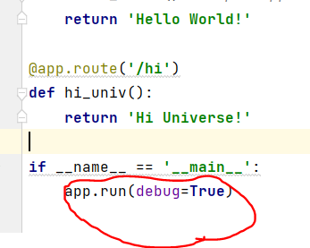
Setting the debug flag
You do not have to restart the server each time you make some changes in the code.

Slide 11
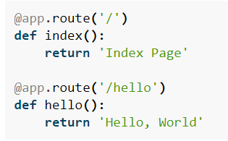
Basic routing
Success Criteria: Hosting it on bluehost/godadday
tordle.telugupuzzles.com
Animalkingdom.telugupuzzles.com
Route(‘/’)
Route(‘/help’)
Route(‘/admin’)

Slide 12
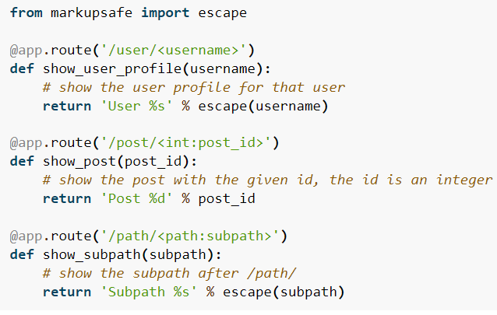
Variable routing
You can add variable sections to a URL by marking sections with <variable_name>. Your function then receives the <variable_name> as a keyword argument.
Optionally, you can use a converter to specify the type of the argument like <converter:variable_name>.
<variable_name>
<converter:variable_name>

Slide 13
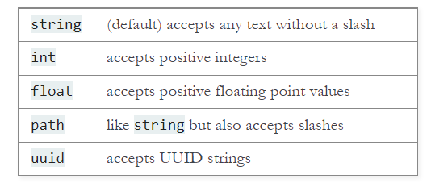
Converter Types: Variable routing
Converter types for URL arguments
<converter:variable_name>

Slide 14
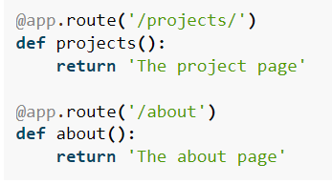
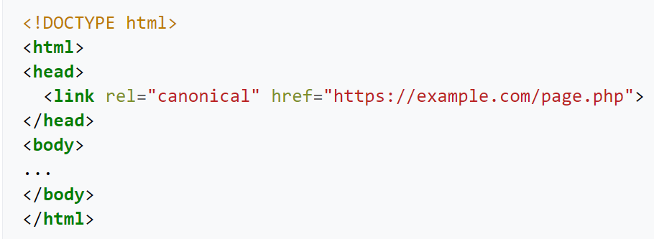
Unique URLs / Redirection behavior
<host>/projects will redirect to <host>/projects/
<host>/about/ will get a 404 error
Example.com/page.php?parameter=1 may list the canonical URL as meta data.
This helps the search engines to crawl only canonical URLs (and ignore this page)

Slide 15


References and Resources
https://github.com/humiaozuzu/awesome-flask
https://stackshare.io/flask

Slide 16


