Slide 1
ICS 460 –Networks and Security
Security
Damodar Chetty

Slide 2
Network Attacks
Availability based
Denial of Service
rely on flooding devices with traffic
problem: require huge amounts of bandwidth at the hacker solution: use an amplification attack (small request, results in large response)
problem: easy to block the IP addresses of the attacker solution: DDoS using botnets
SYN flood attack creates thousands of partially open TCP connections
attacker sends SYN packets, but never answers the SYN-ACK packet!
MAC flood attack causes switch to flood the network
attacker floods different MAC addresses to a switch
attack overflows switch’s MAC address table
Smurf attack
sends ping requests to third party servers, with forged source address

Slide 3
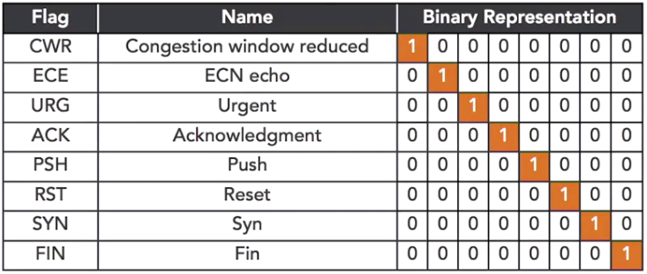
Network Attacks
Availability based
Christmas tree attack
send packet with all flag bits set (lit up like a Christmas tree)
causes network stack failure in some cases

Slide 4
Network Attacks
Integrity based
Poisoning attacks
DNS poisoning
attacker inserts incorrect DNS records to redirect traffic to the attacker’s system
ARP poisoning
attacker’s system spoofs the gateway’s address
tricks user traffic to be sent to the attacker’s system
Typo Squatting
attacker registers hundreds of typo variations of official web sites
user mistypes the site’s address and is taken to the attacker’s site.

Slide 5
Network Attacks
Confidentiality based
Man in the middle attack
Reconfigure a network device using DNS or ARP poisoning
sending system is tricked into connecting to the malicious system
malicious system relays packets to the legitimate server
Replay attack
attacker steals a session token that serves to authenticate the valid user
attacker creates a separate connection to the server
attacker uses that stolen token to impersonate the valid user

Slide 6
Transport Encryption
Transport Layer Security
uses digital certificates to facilitate secure communication over public networks
IPSec
provides security for the IP headers and payload

Slide 7
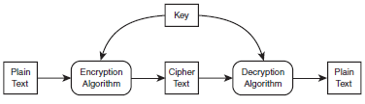
Encryption
Algorithm to transform plaintext to ciphertext
E.g., RSA, Data Encryption Standard, Triple DES
may not be reversible

Slide 8
Encryption Types – Secret Key
Symmetric or Secret Key or Private Key
Authorized people know a secret key
Flaw: Key must be transmitted to receivers
Algorithms
DES (obsolete)
Triple DES – encrypted with key 1, decrypted with key 2, and encrypted with key 3

Slide 9
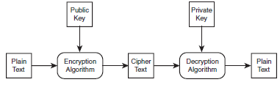
Encryption Types – Public Key
Uses a key pair
Public key is shared, but private key is a secret
Communication
A sender uses your public key to encrypt plaintext
You use your private key to decrypt it.
Expensive – 1000 times slower

Slide 10
Digital Signatures
Using Public Key Encryption
Reverses the role of public and private keys
Sender encrypts using private key before sending
Receiver decrypts it with the sender's public key
Works well for non repudiation.
Only sender has access to his secret key

Slide 11
Digital Signatures
Using a hash function algorithm (MD5/SHA)
Message Digest is calculated for a message
Algorithm must be fast and deterministic
Sender
generates a Message Digest for the message
encrypts the message digest with his private key
sends message digest along with the message.
Receiver
decrypts the message digest with the public key
computes a message digest for the message
compares them to verify message was not altered

Slide 12
Digital Certificates
Associates a public key to a real legal entity
Uses a trusted third party (Verisign, Thawte)
verifies individuals and companies
using its private key to sign a digital certificate thereby vouching for that party
A "circle of trust"
If you trust a Certification Authority (CA), you can trust the the people that they trust, and then trust those that the certified party trusts, and so on.
Used with SSL connections from your browser. Each browser has the public keys of its trusted CAs

Slide 13
Web Server Security
Use Secure Sockets Layer (SSL)
URL starts with https://
All data is encrypted before it is sent
Slower than regular HTTP
Use Transport Layer Security
Newer version of SSL but is more advanced
Only supported by newer browsers

Slide 14
Web Server Security
SSL/TLS connector listens on a separate port
Obtain a digital certificate
Generate a key pair
Generate a Certificate Signing Request
Send it to a CA with fees and legal documents
CA signs the certificate
Install the certificate on your web server
When a browser connects to your site using HTTPS, your certificate will be automatically send to the browser

Slide 15
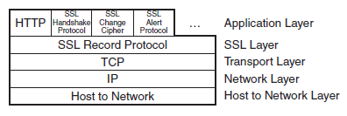
Using SSL
Network protocols are layered
Application layer includes HTTP/SMTP/FTP
Transport layer protocols include TCP/UDP
SSL adds a transparent layer in between
provides secure transmission to application layer - incl. handshaking, encryption and decryption

Slide 16
HTTPS Handshaking
Browser asks the server to authenticate itself
Server sends its digital certificate
Server might ask browser to authenticate itself
Browser sends list of encryption algorithms and hash functions it supports
Server picks strongest one that it also supports
Both negotiate a secret key for the session
browser sends an encrypted random number
server responds with random data
encryption key is generated using hash functions

