Slide 1
ICS 460 – Layering
Damodar Chetty

Slide 2
Network Design - Modularity
The network does much for apps:
Makes and breaks connections
Finds a path through the network
Transfers information reliably
Transfers arbitrary length information
Sends as fast as the network allows
Shares bandwidth among users
Secures information in transit
…
Modularization helps manage complexity and supports reuse of functionality
achieves this using protocols and layering
networks are organized as a stack of layers, each one built upon the one below it

Slide 3
Network Design – Modularity using Protocols and Layers
Protocols and layers are used to structurally divide network functionality
Each instance of a protocol uses a message format that conforms to that protocol to talk virtually to its peer instance on a different host on the network
no direct connection between the two instances of that protocol
To do this a protocol instance can only use the services of a lower layer protocol on the same host

Slide 4
Network Design – Modularity using Protocols and Layers
Instance of protocol X
Peer instance
Protocol X
X
X
Service provided by Protocol Y
Lower layer instance (of protocol Y)
Y
Y
Node 1
Node 2
An instance of Protocol X wants to talk to a peer instance on another host
it generates a message with a format compatible with Protocol X
there is no direct connection between the peer instances – so it relies on the service provided by a lower layer protocol instance (Protocol Y).

Slide 5
Network Design – Modularity using Protocols and Layers
Instance of protocol X
Peer instance
Protocol X
X
X
Service provided by Protocol Y
Lower layer instance (of protocol Y)
Y
Y
Node 1
Node 2
Protocols are layered vertically
each instance talks only to its lower or higher layer protocol instance
Each layer defines an interface that describes the services it makes available
physical connections are shown by solid lines
Protocols are designed horizontally
each protocol specifies interoperability between two different systems
virtual connections are shown by dotted lines

Slide 6
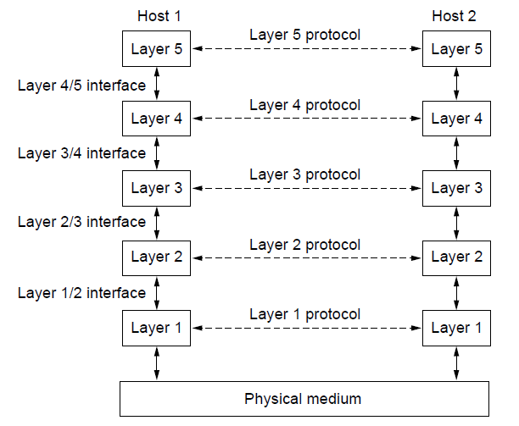
Network Design – Modularity using Protocols and Layers
This continues all the way to the bottom –
each layer uses a lower layer’s services to communicate virtually
until at the bottom, a physical connection carries the raw electrical signals

Slide 7
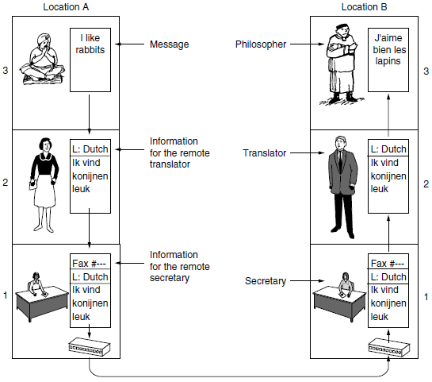
Network Design – Modularity using Protocols and Layers
Philosphers speak
English and Urdu; and
French and Chinese
no common language
need a translator on each side
Translators agree on a common language (Dutch)

Slide 8
Network Design – Modularity using Protocols and Layers
Two layer 3 peer processes (philosophers)
Two layer 2 peer processes (translators)
Two layer 1 peers processes (secretary)
Protocols are
designed horizontally
each peer instance talks virtually to its peer on another host
using its protocol (common language)
layered vertically
each process is only allowed to use services of
a lower layer protocol
on the same host

Slide 9
Network Design – Modularity using Protocols and Layers
Each communicating pair (peers)
is independent of the others
translators can switch from Dutch to Finnish
provided both agree and neither changes its interface with either layer 1 or layer 3
secretaries can switch from email to telephone without even informing the other layers
Each process may add control information intended only for its peer
stripped before passing it to layer above

Slide 10
Network Design – Modularity using Protocols and Layers
Peer process abstraction is crucial to network design
allows network design to be broken into smaller, manageable design problems

Slide 11
Reference Models
So far we have:
a number of layers on each host
each layer has one or more protocols
We need:
help on assigning functionality to each layer (or each protocol)
e.g., where should routing (find a path through the network) be implemented?
No definitive answers – it is a matter of preference for network engineers

Slide 12
Reference Models
A reference model
provide guidelines for mapping functionality to layers/protocols
they are not strict (purely a conceptual construct)
it does not define the protocols themselves
defined by different standards bodies
goal is for interoperability across devices made by different manufacturers
implementation of the protocols is done by the manufacturers
competitive advantage for efficient implementations
you can even devise new protocols

Slide 13
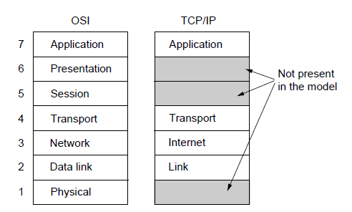
OSI “7 layer” Reference Model
ISO standard, to connect systems
Influential, and model is still valid, but its protocols are not used any more
Physical Layer:
transmission of raw bits, as signals, across a physical medium
considerations:
what electrical signal represents a 0 or 1?
is transmission uni- or bi-directional?
how the connection is established and torn down
how many pins does the network connector have;
what each is used for; etc.
deals with mechanical, electrical, and timing interfaces as well as the physical transmission medium (below the physical layer)

Slide 14
OSI “7 layer” Reference Model
Data Link Layer:
Transforms a raw transmission facility into a line that can detect transmission errors
Input data is broken into frames that are transmitted sequentially
If the service is reliable, the receiver ACKs each frame
Uses traffic regulation to keep a fast transmitter from drowning out a slow receiver
For broadcast networks, the medium access control sublayer deals with controlling access to the shared channel
Network Layer:
Determines how packets are routed from source to destination
Routes can be updated dynamically to avoid failed components
Handles congestion in the network and QoS
Can interconnect heterogeneous networks
e.g., hide differences in packet sizes, addressing, protocols, etc.

Slide 15
OSI “7 layer” Reference Model
Transport Layer
splits data into packets and ensures that the pieces all arrive correctly at the other end, in the right order
True end-to-end layer – carries data from a program on the source machine to a program on the destination machine
Lower layers only carry from one node to the next hop node
Session Layer
allows users on different machines to establish sessions –a series of requests and responses between the hosts
Presentation Layer
responsible for the format of the data transferred
for outgoing messages, converts to a generic format
for incoming messages, converts to appropriate format for use
handles cryptography, compression, encodings, formats, etc.
Application Layer
contains protocols needed by users (HTTP, SMTP, NNTP, etc.)

Slide 16
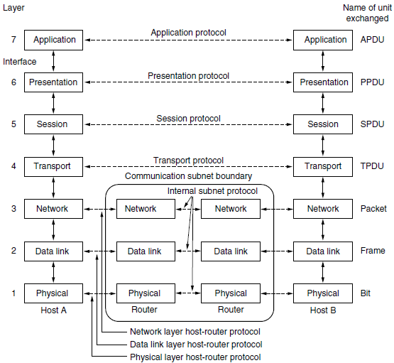
OSI Reference Model

Slide 17
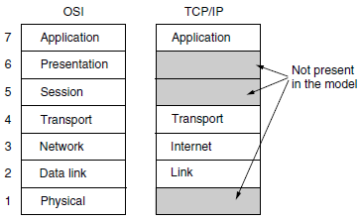
Internet Reference Model
Based on experience (Cerf and Kahn ’74, ARPANET)
based on what was implemented as the Internet was being built
omits some layers and uses IP as the network layer
Model is simplistic, but its protocols are widely used

Slide 18
Internet Reference Model
Link layer: (OSI layers 1 and 2)
describes what a link must do to support the connectionless Internet layer
sends frames across a link. Includes technologies used to connect nodes
Internet Layer (OSI Layer 3)
Accepts packets from hosts and has them travel independently to the destination (Higher layers must rearrange them)
E.g., person can drop letters into a mailbox in one country
most will be delivered to the destination in another country (some will be lost)
may traverse international mail gateways along the way
Hides differences in addressing, stamps, delivery rules, etc
Application
Transport
Internet
Link

Slide 19
Internet Reference Model
Transport Layer: OSI Layer 4
TCP supports a reliable connection-oriented protocol
byte stream is delivered without error from one host to another, over the network
segments the byte stream into messages, and reassembles/rearranges them at the destination
handles flow control to ensure a fast sender does not overwhelm a slow receiver
UDP supports an unreliable connectionless protocol
one shot client/server style request-reply queries
where prompt delivery is more important than accurate delivery (speech, video)
Application Layer: OSI Layer 7
implements any session and presentation layer features
contains all high level protocols (TELNET, FTP, SMTP, HTTP, DNS, etc.)
Application
Transport
Internet
Link

Slide 20
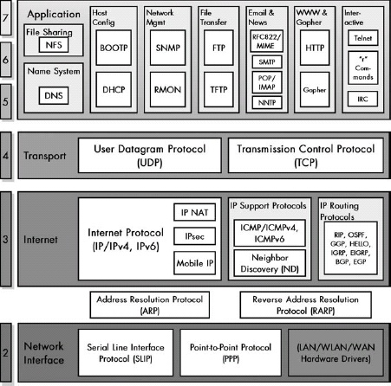
Network Design – Modularity using Protocols and Layers
Network architecture:
a set of layers and the protocols at each layer (HTTP, TCP, IP, 802.11, ...)

Slide 21
Network Design – Modularity using Protocols and Layers
Protocol stack:
A stack selects one protocol from each layer for a given communication
E.g., protocol stack for a web browser on a wirelessly connected host
Browser
HTTP
TCP
IP
802.11

Slide 22
Network Design – Implementing Layering - Encapsulation
Encapsulation is used to implement layering
Lower layer wraps a message by adding control information
places its headers/trailers around the payload from the upper layer
does not inspect its payload (treats it as opaque)
HTTP
HTTP
HTTP
HTTP
TCP
HTTP
TCP
TCP
TCP
HTTP
IP
TCP
HTTP
IP
IP
IP
TCP
HTTP
802.11
IP
TCP
HTTP
802.11
802.11
802.11
IP
TCP
HTTP
(medium)
802.11
IP
TCP
HTTP

Slide 23
Network Design – Implementing Layering – Encapsulation
Each lower layer
adds its own control information (header at the front, optional trailer at the end)
transforms the upper layer’s payload - compression or encryption
segments into smaller messages and reassemble at the other end
802.11
IP
TCP
HTTP
First bits on the wire
Last bits

Slide 24
Network Design – Implementing Layering – Demultiplexing
Each layer can have different protocols
Incoming message must be passed to the right protocol instance
control information in each layer (demux key) determines the protocol instance
SMTP
HTTP
DNS
TCP port number
TCP
UDP
IP protocol field
IP
ARP
Ethertype value
Ethernet
Incoming
message
Host
Ethernet
IP
TCP
HTTP

Slide 25
Network Design – Implementing Layering – Demultiplexing
Process of Demultiplexing
E.g., all messages are sent to the Ethernet layer (for an Ethernet network)
Ethernet header indicates that this message is intended for IP
IP header has a protocol field that indicates TCP
TCP header has a port field that identifies the application layer protocol.
SMTP
HTTP
DNS
TCP port number
TCP
UDP
IP protocol field
IP
ARP
Ethertype value
Ethernet
Incoming
message
Host
Ethernet
IP
TCP
HTTP

Slide 26
Advantage of Layering - Reuse
Information hiding allows software reuse
software reuse: same browser can run on different protocol stacks
alternative is to write separate browser implementations based on the protocol stack used
Browser
Server
Browser
Server
HTTP
HTTP
HTTP
HTTP
TCP
TCP
TCP
TCP
or
IP
IP
IP
IP
802.11
802.11
Ethernet
Ethernet

Slide 27
Advantage of Layering - Interconnection
Information hiding allows interconnection
can interconnect systems running on different networking technology
the client is using 802.11, and the server is running on Ethernet
Browser
Server
HTTP
HTTP
TCP
TCP
IP
IP
802.11
Ethernet

Slide 28
Advantage of Layering - Interconnection
Implementing Interconnection with a common layer
802.11 layer on client, communicates virtually to that on the intermediary
Intermediary’s 802.11 layer converts packet and passes it up to IP layer
Intermediary’s IP layer converts packet and passes it down to Ethernet layer
Server’s Ethernet layer passes it up the protocol stack on the server
Browser
Server
HTTP
HTTP
IP
TCP
HTTP
TCP
TCP
IP
IP
IP
IP
802.11
802.11
Ethernet
Ethernet
802.11
IP
TCP
HTTP
Ethernet
IP
TCP
HTTP

Slide 29
Advantage of Layering - Interconnection
Implementing Interconnection with a common layer
802.11 headers are removed and replaced with Ethernet addresses
IP header control information is altered as it traverses the network
Portion in blue is passed unaltered
giving us virtual communication between client and server
Protocols, Layering, and IP enable interconnection across different networking technologies!
Browser
Server
HTTP
HTTP
IP
TCP
HTTP
TCP
TCP
IP
IP
IP
IP
802.11
802.11
Ethernet
Ethernet
802.11
IP
TCP
HTTP
Ethernet
IP
TCP
HTTP

Slide 30
Advantage of Layering - Interconnection
works as long as we have a common layer all the way across
we can use a diversity of technologies below (existing and even new), and
we can use a diversity of applications above
and, we can change any of these – and the IP layer will bridge this diversity
the narrow waist insulates us from change!
7 Application
SMTP
HTTP
RTP
DNS
4 Transport
TCP
UDP
3 Internet
IP
2/1 Link
Ethernet
3G
Cable
DSL
802.11

Slide 31
Disadvantage of Layering
Adds overhead
if our protocol stack was fixed (HTTP->Ethernet), we could design a custom shorter header. But this overhead is small, for long messages
Hides information
App might care whether it is running over wired or wireless
E.g., on wireless, your bandwidth is more variable

Slide 32
Reference model gives us Layer-based Names
For units of data
Layer | Unit of Data
Application | Message
Transport | Segment
Network | Packet
Link | Frame
Physical | Bit

Slide 33
Intermediary Devices
Networked devices do not have to implement all the layers.
implements only those layers it needs to perform its processing.
Repeater
operates at the physical layer
does not touch information at any higher layer
Switch
operates at the link layer
connects different instances of a link using the same technology
Router
operates at the network layer
connects different networks (with different link layers)
Proxy or Gateway
operates at the transport or application layers
Physical
Physical
Link
Link
Physical
Physical
Network
Network
Link
Link
Physical
Physical

Slide 34
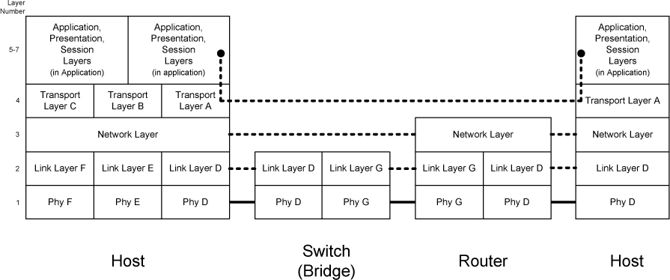
Intermediary Devices
Internetwork with 2 hosts, a switch, and a router
Hosts implement all layers
3 link layer protocols, corresponding physical layer, and 3 transport-layer protocols that run on a single network layer protocol.

Slide 35
Intermediary Devices
Switches implement up to layer 2
it is not an intermediary device as it is invisible to routers and end-systems

Slide 36
Intermediary Devices
Routers implement up to layer 3
interconnects different types of link-layer networks
implements the link- and network-layer protocols for each network type it interconnects
has 2+ network interface cards, one for each network it connects (a multihomed device)

Slide 37
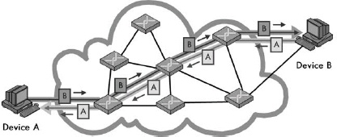
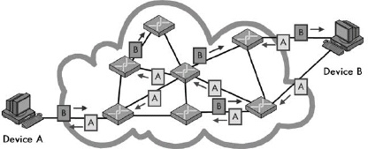
Types of Networking technology
How to setup the path between 2 devices over which data will flow?
Circuit Switching
a specific path (circuit/connection) is setup before communication can begin
even if many paths through intermediate devices exist, only one is used for this dialog
same circuit is used for the whole communication
Phone system – setup a circuit, use it, and terminate. Next time new one is allocated.
Packet Switching
no specific path (circuit) is setup
data is chopped into packets and sent
each packet may take any number of paths to the destination
receiver reassembles the packets to form the original data
Postal system

Slide 38
Types of network service
Closely related to packet vs circuit switching
Protocols are divided into 2 categories based on use of connections
Connection Oriented Protocols (e.g., FTP and TCP)
need a logical connection to be established between parties, before data transfer occurs
one device sends a request to open a connection, and other responds
parties negotiate parameters to use (max message size, QoS, etc.)
Phone system
connection acts like a tube – sender pushes bytes in, receiver pulls them out - order is preserved
Circuit switched networking technologies are connection-oriented, but not all connection-oriented protocols use circuit-switching technologies
Logical connection-oriented protocols can be implemented over packet-switched networks
Connectionless Protocols (e.g., IP)
no connection established – device sends to other as soon it has data ready to send
Postal system
each message carries the destination address
each message is routed independently of others, and can arrive out of order

Slide 39
Types of network service
Reliable
never lose data (receiver ACKs each message).
but: delays can occur.
Unreliable
no delays but data may be lost/damaged in transit
Higher level protocols must handle this problem

Slide 40
Message Addressing and Transmission methods
Differentiates messages based on how they are addressed and how many recipients will receive them
Unicast messages
sent from one device to another, and not intended for others
message is addressed to a specific recipient
Broadcast messages
sent to every device on a network
also used when a sender doesn’t know the address of the receiver
message is addressed to a special broadcast address, that all hosts recognize
Multicast messages
send to some subset of hosts, but needs a way to manage groups of hosts
address identifies a subset of hosts

Slide 41
Structural Models
Networks use 2 structural models to share resources
Peer-to-Peer Networks
every computer is an equal peer (runs the same software)
none has a special role
each shares resources with every other machine
Advantage: simplicity and low cost
Client-Server Networks
few powerful hosts act as servers, and provide services to many client hosts
interactions are mostly between clients and servers, not between clients
servers run special software, designed to respond efficiently to requests
most common model today
Advantage: performance, scalability, security, and reliability
Disadvantage: complicated and expensive

Slide 42
History of the Internet
Estimated Hosts
10⁹
3: Modern
Internet & Web
10⁶
2: NSFNET
10³
1: ARPANET
Year
1969
1982
1995
2013
The Internet is not a network
it is a collection of different networks that use common protocols
it was not planned by anyone
it is not controlled by anyone
There are three main phases of its development

Slide 43
The Beginning – ARPANET
ARPANET by U.S. DoD - the precursor to the Internet
Motivated for resource sharing – access to powerful computers
Launched with 4 nodes in 1969, grew to hundreds of hosts
First “killer app” was email
Influences
Packet Switching
different from circuit switching that was common at the time
organizes data into small packets that are sent over the network
worked better for computers since traffic was bursty – dedicating a circuit would be wasteful, since there often are no packets
packets give benefit of statistical multiplexing to use links better

Slide 44
The Beginning – ARPANET
Influences
Decentralized control
Hierarchical networks are paralyzed by taking out a hub
ARPANET worked even if part was lost – could handle nuclear war
Implementation
Interface Message Processors were connected by 56Kbps lines
each IMP was connected to at least two others
If some links and IMPs were destroyed, messages were automatically rerouted along alternative paths

Slide 45
The Beginning – ARPANET
Influences
Internetworking (TCP/IP)
Goal: connect networks using different technologies, into a single larger network.
unacceptable to mandate a single networking technology
Relies on a higher layer of interconnection
eventually became the TCP and IP protocols

Slide 46
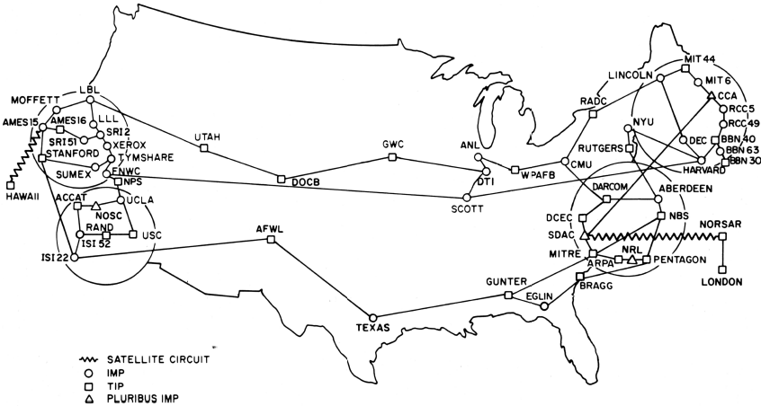
ARPANET Geographical Map (Dec. 1978)
56 kbps links
“IMPs” were
early routers
Source: ARPANET Information Brochure, DCA 1979

Slide 47
Growing Up – NSFNET
NSFNET ’85 supports educational networks
Initially connected supercomputer sites, but soon became the backbone for all networks
Classic Internet protocols we use emerged
TCP/IP (transport), DNS (naming), Berkeley sockets (API) in ’83, BGP (routing) in ’93
Much growth from PCs and Ethernet LANs
Campuses, businesses, then homes
1 million hosts by 1993 …

Slide 48
Early Internet Architecture
Hierarchical, with NSFNET as the backbone
Two customers on different customer networks (e.g., university) –
customer sends packets to regional network, which forwards to NSF backbone
Backbone carries them to the destination regional network
regional network delivers to customer network
customer network delivers packets to destination customer host
56 kbps links in ‘85
1.5 Mbps links in ‘88
45 Mbps links in ‘91
NSFNET Backbone
Regional
Network
Regional
Network
Regional
Network
Customer
Customer
Customer
Customer
Customer
Customer

Slide 49
Modern Internet – Birth of the Web
>’95 connectivity provided by ISPs who are competitors
no longer a single backbone
ISPs connect at Internet eXchange Point (IXP) facilities to exchange traffic with each other, and get it to anywhere on the Internet
Large content providers connect to these IXPs to distribute their content
Web bursts on the scene in ’93
Growth leads to CDNs, ICANN in ‘98
Most bits are video (soon wireless)
Content is driving the Internet

Slide 50
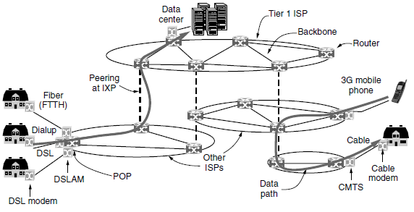
Internet Architecture
ISP network
regional, national, or international in scope
provides routers at Points of Presence (POP) to allow customers to connect to the ISP
ISP’s backbone is comprised of these routers, connected via transmission lines

Slide 51
Internet Architecture
Customers pay to connect to an ISP via its POP
If the ISP is a telephone company, customer uses telephone lines to connect
Digital Subscriber Line (DSL) modem converts between digital packets and analog signals
If the ISP is a cable company, customer uses a cable modem and the cable TV system
If the ISP is a wireless company, customer uses 3G or 4G mobile phone networks
On the ISP network, the system is fully digital and packet switched
Last Mile: speeds are limited by the cabling from the ISP to the residence

Slide 52
Internet Architecture
Moving packets between the POPs of a single ISP
destination is a host served directly by the ISP
packet is routed over the backbone, and delivered to the host directly

Slide 53
Internet Architecture
Moving packets between the POPs of different ISPs
destination is a host not served directly by the ISP
packet is routed over the backbone to an IXP
packet is handed over to the destination (or next) ISP for delivery to its customer

Slide 54
Internet Architecture
Internet eXchange Point
independently owned facility
a room full of connected routers – one per ISP connecting at that IXP
the connected ISPs are said to “peer with” each other
allows packets from one ISP backbone to be forwarded onto another backbone
hundreds of ISPs connect at the Amsterdam IXP, to exchange hundreds of Gbps of traffic

Slide 55
Internet Architecture
Peering relationships
a small ISP pays a larger ISP to reach distant hosts on the Internet (transit peering)
Just like a home customer buying Internet access service from an ISP
two large ISPs exchange traffic so they can deliver for each other without paying
Tier 1 ISPs – AT&T and Sprint – form the backbone of the Internet
thousands of routers connected by high bandwidth fiber optic links
Do not pay for transit. Everyone else must connect to them to reach the entire Internet

Slide 56
Internet Architecture
Content Providers
companies that provide a lot of content (Google, Netflix, etc.) locate their computers in data centers that are well connected to the Internet
Put equipment directly at the ISP’s POPs for fast connections with the ISP backbones

