Slide 1
ICS 460 – Physical Layer
Application
Transport
Network
Link
2019
Damodar Chetty
Physical

Slide 2
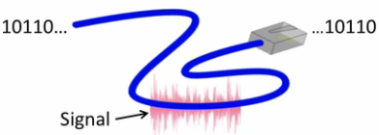
Scope of the Physical Layer
Lowest layer in the protocol model
Goal is to convey bits across a physical channel (e.g., wires, air)
But:
A physical channel only carries analog signals
we need a way to represent bits using analog signals
Signal
10110…
…10110

Slide 3
Simple Link Model
Channel’s physical properties determine
Performance
Rate (bandwidth, capacity, speed, throughput) in bits/second rate at which bits can be sent across the channel
Delay (latency) in seconds, time taken for a signal to cross the physical channel
Error rate number of bits that arrive garbled (very high for wireless channels)
Other properties:
Whether broadcast or point-to-point
cost, ease of installation, and maintenance
Message
Delay D, Rate R

Slide 4
Message Latency
Latency is the delay to send a message over a link:
Transmission delay: time to put M-bit message “on the wire”
T-delay = M (bits) / Rate (bits/sec) = M/R seconds
Propagation delay: time for bits to propagate across the wire
P-delay = Length / speed of signals in the medium
= Length / ⅔c ... use c for wireless; 2/3 c for wires = D seconds
Combining the two terms we have: L = D + M/R

Slide 5
Metric Units
The main prefixes we use:
Use powers of 10 for rates, 2 for storage
1 Mbps = 1,000,000 bps, 1 KB = 2¹⁰ bytes
“B” is for bytes, “b” is for bits
Prefix | Exp. | prefix | exp.
K(ilo) | 10³ | m(illi) | 10⁻³
M(ega) | 10⁶ | μ(micro) | 10⁻⁶
G(iga) | 10⁹ | n(ano) | 10⁻⁹

Slide 6
Latency Examples
Dialup modem link within a city (short distance over a slow link):
R = 56 kbps, M = 1250 bytes D = 5 ms ... short link, with a small propagation delay
L = D + M/R = 5 ms + (1250x8)/(56 x 10³) sec = 5 ms+ 179 ms= 184 ms
Broadband cross-country link (long distance over a fast link):
R = 10 Mbps, M = 1250 bytes ... fast link D=50ms ... long link, with a large propagation delay
L = 50 ms + (1250x8) / (10 x 10⁶) sec = 51 ms
A long link or a slow rate means high latency

Slide 7
Bandwidth-Delay Product
Intuition: messages take up space on the wire
sender has dropped bits in one end, but have not arrived yet at the receiver
appear as if “stored” in the wire – just like drops of water in a pipe
Amount of stored data is the bandwidth-delay product
BD = R x D
Measure in bits, or fractions of messages or packets
Small for LANs (e.g., wifi), big for “long fat” pipes (e.g., 1 Gbps cross country link)

Slide 8

Bandwidth-Delay Product Example
Fiber at home, cross-country
R=40 Mbps, D=50 ms
BD = 40 x 10⁶ x 50 x 10⁻³ bits
= 2000 Kbit
= 250 KB
a lot of data “in the network”!
110101000010111010101001011

Slide 9
Types of Media
Media propagate signals that carry bits of information
categories of media
guided (wires, fiber optic or coaxial cable)
unguided (wireless)

Slide 10
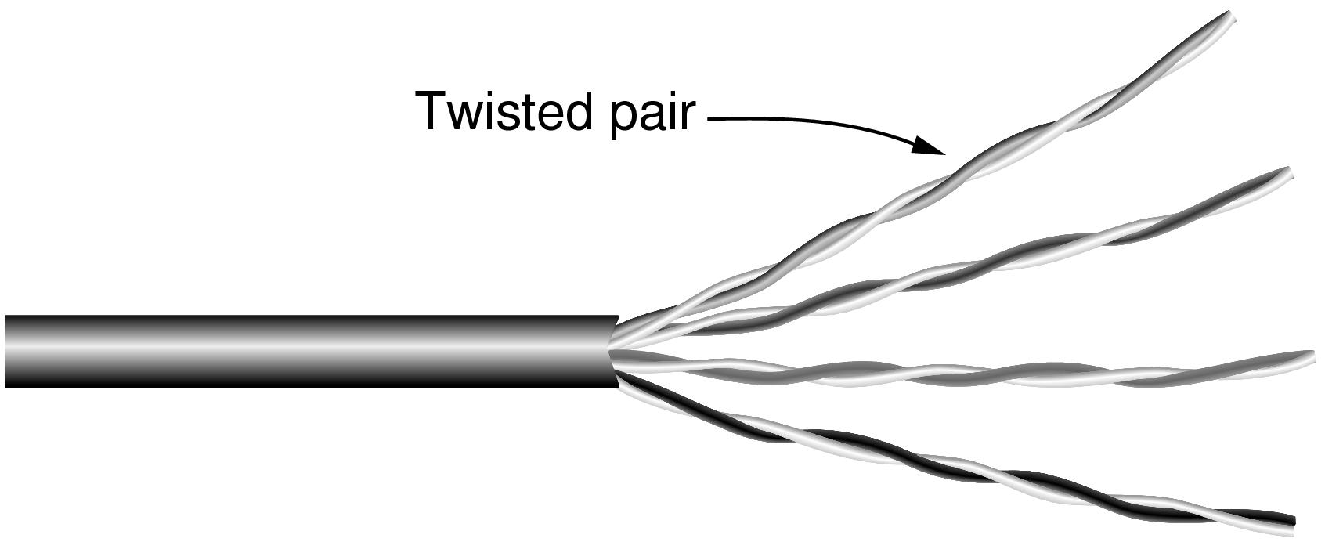
Wires – Twisted Pair
Most common; used in LANs and telephone lines. Can run for long distances.
Bandwidth depends on the thickness of the wire and the distance traveled.
Twisting
cancels out electrical interference produced by adjacent wires (crosstalk)
reduces tendency of wire to act as an antenna
Shielding
Unshielded: 4 pairs of wires, relies on twisting for protection
Shielded: adds shielding around each pair, and around the entire cable for added protection. More expensive.
Advantages: provides high bandwidth at a low price and is easy to install.
Category 5 UTP cable with four twisted pairs

Slide 11
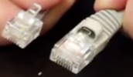
Wires – Twisted Pair
Cat ratings describe shielding as well as twists per meter
as shielding and twists go up, so does cost, and overall diameter (volume/weight/flexibility)
CAT3: used for older 10Mbps networks and telephone lines
CAT5: supports 1Gbps up to 100m. Increased twists for better quality signal
CAT 5E revised standard to fixes problem with CAT 5.
CAT6/CAT6A: adds more twists/m and a central divider barrier, to support up to 10Gbps
CAT 6A: supports 10Gbps over a longer distance. Twists wires into double helix configuration.
CAT7: Shielded Twisted Pair
Terminated using RJ45 jacks
Come in 3 types
Riser: used for standard patch cables, as well as in cabinets and racks
Plenum: releases fewer toxins when burned, so can be used in space that circulates air
Outdoor: thicker jacketed and UV protected.
Category 5 UTP cable with four twisted pairs

Slide 12

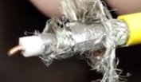
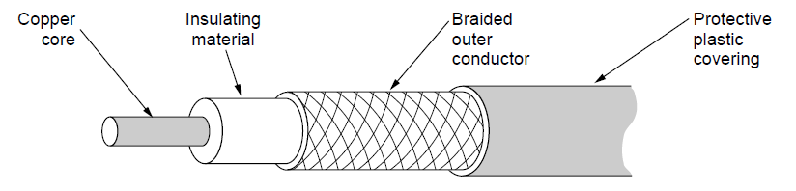
Wires – Coaxial
Termed coaxial because it has two conductive materials centered around a single axis
stiff copper wire is surrounded by insulation, encased in a braided mesh conductor
Rated on a system called "radio guide" (RG).
"RG“ number loosely determines center conductor size (RG6 is commonly used.)
Coaxial cables for data uses a compression- or crimp-style BNC connector.
Bandwidth depends on cable quality and length.
Advantages
construction and shielding give it high bandwidth and excellent noise immunity.
Coaxial cables have been replaced by fiber on long haul routes.

Slide 13


Wires – Fiber Optics
Long, thin strand of glass
light from one end (LED or laser), bounces until it comes out the other end
detected at the other end by a photodetector
Enormous bandwidth over long distances (100km+) with low attenuation
Types
multi-mode (shorter links, cheaper) – multiple light rays at different angles
single-mode (up to ~100 km at 100Gbps): light propagates in a straight line without bouncing
Construction
center glass core surrounded by glass cladding that keeps all the light in the core.
plastic jacket protects the cladding.
Fibers are grouped in bundles, protected by an outer sheath.
Optical fiber
Light source
(LED, laser)
Light trapped by
total internal reflection
Photo-detector

Slide 14
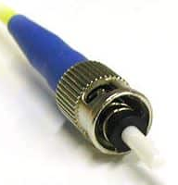
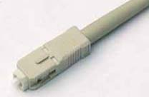
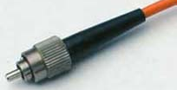
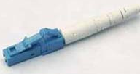
Wires – Fiber Optics
Some connectors
ST connector – oldest type, BNC-like punch in and twist operation
SC (standard Connector) – a snap-in connector
FC (Ferrule Connector) – threaded-on. Replaced by SC and LC
LC (Lucent Connector): small form factor (half the size of SC)
LC to LC patch cable, duplex

Slide 15
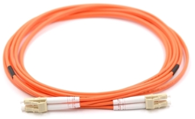
Wires – Fiber Optics
Advantages
bandwidth available is very large (many GHz)
low attenuation – so fewer repeaters needed
not affected by EMI, power surges, etc.
thin – so needs less capacity in ducts
light – reducing the cost of mechanical support systems 1000 UTP 1 km long weighs 8000kg. 2 fibers have more capacity and weighs 100 kg.
difficult to wiretap
Disavantages
easily damaged by being bent too much
essentially unidirectional – so duplex communication requires 2 fibers (e.g., LC-to-LC duplex)
fiber interfaces cost more

Slide 16

Wireless
Sender radiates signal over a region
In many directions, unlike a wire, to many receivers
Advantage: can reach many different receivers at the same time
Drawback: signals from nearby transmitters sent on the same frequency, interfere at a receiver; which can garble messages. Hence must coordinate how the wireless spectrum is used.

Slide 17
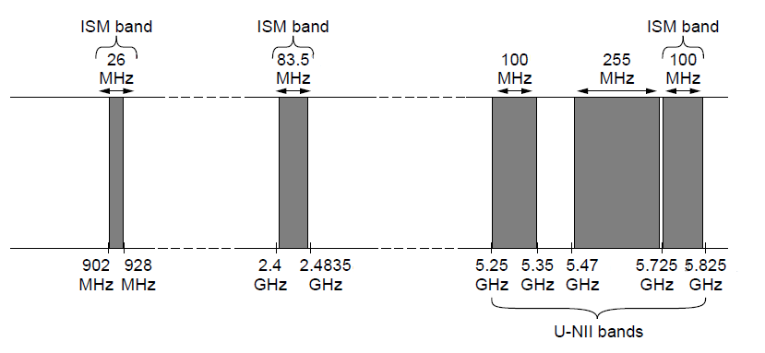
Wireless – US Frequency Allocation chart
Government allocates frequencies to radio, TV, police bands, aircraft, and computer communications
Wifi uses the ISM frequencies (unlicensed – no license fees)
But: computers using these frequencies must coordinate amongst themselves (the government is not explicitly allocating us a frequency)
And: must compete with other devices (e.g., cordless phones)
802.11
b/g/n
802.11a/g/n

Slide 18
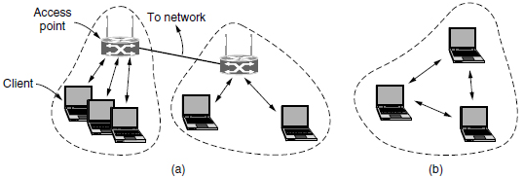
Wireless – 802.11 modes
Infrastructure mode:
Basic Service Set: WAP and its associated stations – identified by a Service Set ID
WAPs broadcast a wireless signal and are connected to a wired network
Each WAP and its clients communicate on a single channel
Extended SSID:
Multiple connected BSS’
Several WAPs can be connected by a wired network called a distribution system
Connect WAPs to same switch, and use same SSID, for campus-wide access
Ad hoc mode
Not common. Clients directly send frames to each other - no WAP/Distribution System

Slide 19
Wireless – 802.11 Standards
802.11 Wifi, 1997: ran at 2Mbps.
802.11b, 1999: ran at 11 Mbps on the 2.4GHz ISM band
802.11a, 1999: ran at 54Mbps on the 5GHz ISM band
802.11g, 2003: ran at 54Mbps on the 2.4GHz band
backwards compatibility with 802.11b
802.11n, 2009: multiple input/multiple output (MIMO) uses multiple antennas between WAP and client at the same time.
802.11ac: 1Gbps. MU-MIMO - WAP uses its multiple antennas to transmit to multiple clients simultaneously.
Multiple clients cannot send to the WAP at the same time
Speeds up downloads

Slide 20
Topology
Bus topology
oldest network technology - each node connects to a single backbone cable (bus)
if one node sends data, everyone else hears it, and either process it or throw it away
requires a way to detect/avoid collisions
Ring topology
all nodes connect to a single backbone cable, and cable is connect to itself – as a ring
Token is passed around the network, giving each node a chance to send a signal
Heavy traffic can slow it down
Hierarchical Star topology
all nodes connect to a central switch
more expensive than bus – needs more cables
BUT damaged cable will not bring down the entire network, and is easy to troubleshoot
central switch is a SPoF, but easy to troubleshoot
Point to Point topology
two nodes directly interconnected with no intervening device (two sites in a WAN connected over a dedicated leased line, or virtual connection over the Internet)

Slide 21
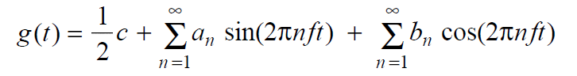
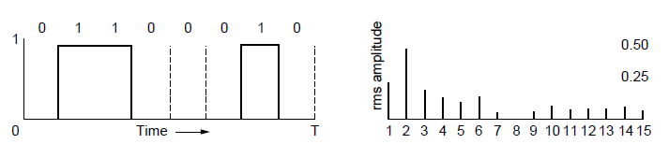
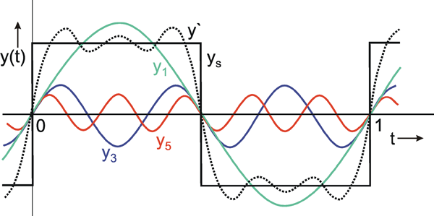
Signals - Frequency Representation
Fourier analysis
A signal can be represented by an infinite number of sine waves of a fundamental frequency and its harmonics
=
Signal over time
weights of harmonic frequencies

Slide 22
Signals - Frequency Representation
Fourier analysis
=
amplitude
Signal over time
weights of harmonic frequencies

Slide 23
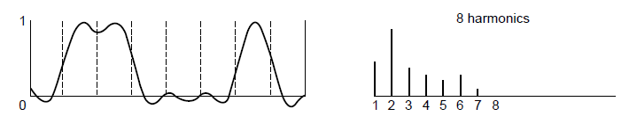
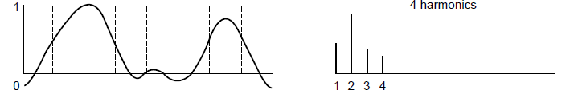
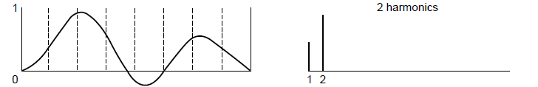
Signals - Effect of Less Bandwidth (EE)
every channel attenuates the signal
if all components equally diminished, resulting signal is reduced in amplitude but not distorted
BUT different harmonics are attenuated by different amounts
Wire transmits up to cutoff frequency - its “bandwidth” (overloaded term!!!); higher frequencies are attenuated
Lost!
Bandwidth
Lost!
Lost!

Slide 24
Signals - Effect of Less Bandwidth (EE)
Goal: retain a signal with just enough fidelity to reconstruct the bits sent
for networks, 8 harmonics are sufficient; additional fidelity is wasteful
for hifi stereo, need higher bandwidth signal to retain additional harmonics
Key Idea: fewer frequencies degrade the signal by making it more rounded
Lost!
Bandwidth
Lost!
Lost!

Slide 25
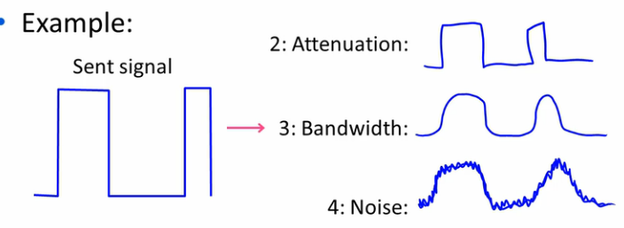
Signals over a Wire
What happens to a signal as it passes over a wire?
The signal is delayed (propagates at ⅔c)
The signal is attenuated (goes for m to km)
Frequencies above a cutoff are highly attenuated
Noise is added to the signal (later, causes errors)

Slide 26
Key channel properties: Bandwidth (EE)
Transmitted Signal bandwidth (EE)
Analog Bandwidth
range of frequencies present in the signal (measured in Hz)
width of frequency band (in Hz) that wire allows without significant attenuation
a physical property of the channel
depends on construction, thickness, and length
Impact
Limits the rate of transitions
determines Digital Bandwidth (CS), Channel Capacity, Maximum Data Rate (bps)
larger the range, the quicker the signal transitions, and conveys more information. E.g., doubling the fundamental frequency, doubles the data rate
But:
cannot increase signal bandwidth indefinitely – data rate is limited by noise

Slide 27
Fundamental limits
Information is conveyed by change in value of the signal over time
Change of value over time == frequency
sharper transitions are a function of the width of the band of frequencies in a signal
I.e., to double data rate, double the signal bandwidth
BUT
cannot increase signal bandwidth indefinitely – link and standards limit bandwidth
Achievable data rate is limited by Link’s bandwidth + Noise at the receiver
Nyquist theorem, 1924 – only consider link’s bandwidth
max data rate (capacity), C = 2B transitions/sec = 2B log₂V bits/sec
2B samples per second
V different transition levels (symbols) per sample – or, bits encoded into each transition
a noiseless link of bandwidth B only permits frequencies up to 2B transitions/second
I.e., higher frequencies are filtered out, so no point in sampling > 2B times/sec
For a 3KHz channel, with binary signaling, C = 6Kbps. Link cannot transmit faster

Slide 28
Fundamental Limits: Nyquist theorem
Max data rate for a noiseless channel of bandwidth B Hz
C = 2B symbols/sec (baud rate) = 2 B log₂ V bits/sec (bit rate) = 2B (if V=2)
V is the number of symbols (represents 1+ bits)
Converse: to achieve transmission rate of 2B symbols/sec, the channel must allow signals with frequencies up to B Hz.
Implications
In theory, increasing V, increases C.
I.e., by increasing V infinitely, we could infinitely increase channel capacity, C
In practice, V is limited by the SNR

Slide 29
Key Channel Properties: SNR
Strength of Signal and Noise at the receiver
Number of different signaling levels (symbols) we can distinguish
depends on relative strength of the signal to the noise
Higher the SNR, the more levels we can distinguish
Here we can distinguish 4 different levels
even if noise muddies our signal, we can still reconstruct the actual value as long as the noise does not shift it so that it looks like a different symbol
S+N
0
N
1
Bandwidth B
Signal S,
Noise N
2
3

Slide 30
Fundamental Limits: Shannon’s theorem
Max data rate for a noisy channel of bandwidth B Hz depends on received power (SNR):
C = B log₂ (1+S/N) bits/sec, where SNR is in decibels as 10*log₁₀(S/N)
SNR of 10 is 10dB, 100 is 20dB, and 1000 is 30dB, etc.
Example:
for ADSL: B=1MHz; SNR=40dB for short lines (1-2km) C = 1*10⁶*log₂(1+10000) = 13.3*10⁶ = 13.3 Mbps.
for a typical phone line (SNR of 30dB and B=3khz): C=3*10³* log₂(1+1000) = 30 kbps (approx.)
Implications
To increase capacity of a channel.
not possible to simply infinitely increase V (line encoding technique)
we need more bandwidth OR must improve SNR

Slide 31
Engineering to the fundamental limits
Wires, and Fiber
Can design the link for a certain data rate
bandwidth of the wire is fixed by the quality of the wire
SNR is controlled by limiting the link to a certain length (limits attenuation)
Wireless
Might be able to fix the bandwidth,
But SNR can vary greatly: up to 60 dB (a factor of 1 million!)
depends on distance of client from the Access Point
cannot design the system for worst case, or we’ll always run at a slow rate
Instead, must dynamically update the data rate to actual conditions

Slide 32
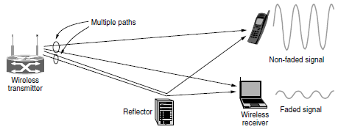
Signals over Wireless
Multipath fading
signals are reflected so multiple echoes reach a receiver along different paths
receiver sees a superimposed signal
some add to get a stronger signal, others cancel each other out for a faded signal
difficult to deal with – can change within a very small distance (cms)
solution: transmit along multiple independent paths

Slide 33
Signals over Wireless
Spatial reuse
Different senders may transmit on the same frequency
a receiver will see superimposed signals - which interfere with each other
But, signal attenuates faster than 1/dist²
leads to the idea of spatial reuse (of the same frequency)
transmitters can reuse the same frequency as long as they are far enough spatially
Signal
strength
Interference
No interference
A
C
B
Distance

Slide 34
Modulation
Representing digital bits using analog signals
This is the topic of modulation
channels carry analog signals, continuously varying voltage or light intensity
signal encodes 1s and 0s using a modulation sheme
wires use positive and negative voltage
optical fiber uses presence and absence of light
Signal
10110…
…10110

Slide 35
Modulation
Baseband modulation
signal bandwidth occupies 0 to B Hz.
signal is sent directly on the medium (e.g., over a wire)

Slide 36
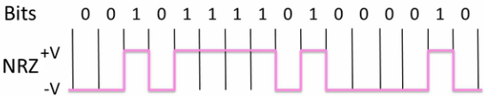
Baseband modulation - Non Return to Zero
Sender represents 1 and 0
Receiver decodes the signal
maps the signal samples to closest symbols

Slide 37
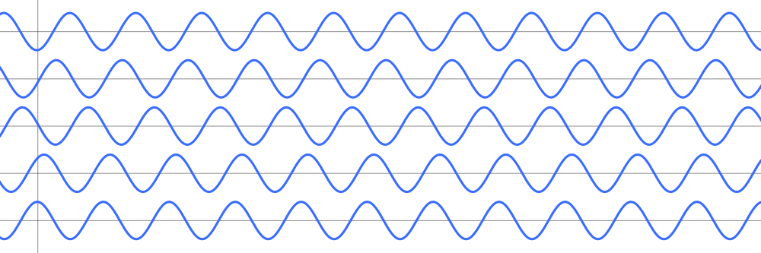
Baseband modulation - Bandwidth Efficiency
To run NRZ faster, we need either
more bandwidth
but bandwidth is a limited resource
use more than two signaling levels
with 4 signaling voltages (V=4), each symbol represents 2 bits at once
reduces the bandwidth needed
works if the signal at the receiver is strong to distinguish the 4 levels
1 0 1 0 1 0 1 0 1 0 1 0 1 0 1 0 1

Slide 38

Baseband modulation - Clock Recovery
For all modulation schemes
Receiver must know when one symbol ends and the next begins
Receiver needs frequent signal transitions to decode bits
With NRZ, a long run of 0s or 1s leaves the signal unchanged, making it hard to work out how many there are
Strategy
introduce frequent transitions in the signal itself – Manchester encoding

Slide 39
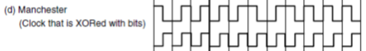
Baseband modulation - Manchester encoding
clock runs at twice the bit rate ,so it makes a transition in every bit time
XOR the data signal with a clock signal
When XORed with the 0 level, it makes a low-to-high transition
When XORed with the 1 level, it makes a high-to-low transition
Downside: requires twice as much bandwidth as NRZ (a scarce resource)

Slide 40
Baseband modulation - Clock Recovery – 4B/5B
Every 4 bits is mapped into a 5-bit pattern
uses a fixed translation table
0000 → 11110, 0001 → 01001, 1110 → 11100, … 1111 → 11101
5-bit pattern is chosen so there will be at most 3 zeros in a row
adds 25% overhead, but better than 100% overhead of Manchester encoding
But: it does not prevent long runs on 1s
can use NRZ Inverted to invert the signal level on a 1
Code a 1 as a transition and 0 as no transition – fixes long runs of 1s
Data Bits:
1 1 1 1 0 0 0 0 0 0 0 1
Coded Bits:
1 1 1 0 1 1 1 1 1 0 0 1 0 0 1
Signal:

Slide 41
Passband Modulation
Passband modulation
for fiber or wireless, can’t use baseband modulation.
must encode it onto a carrier signal that is operating at a higher frequency
size of an antenna must be a fraction of the signal wavelength
multiplexing by frequency band allows multiple signals to coexist on the channel
carrier signal is simply a signal oscillating at a given frequency
carrier signal (amplitude, frequency, phase) is modified to convey the signal
Arbitrary band of frequencies is used to pass the signal
Baseband signal is shifted to occupy a passband of S to S+B Hz
does not change the information carried, but changes how it looks
receiver shifts it back to baseband

Slide 42
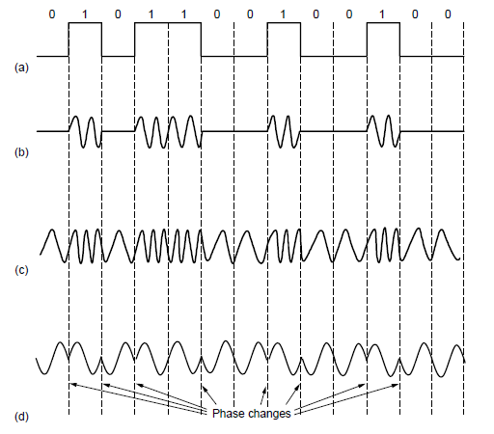
Passband Modulation
NRZ signal of bits
Amplitude shift keying
Frequency shift keying
Phase shift keying

Slide 43
Multiplexing
Sharing of a link’s bandwidth across users
costs the same to install a high bandwidth line as a low bandwidth line
multiplexing shares each line among many signals

Slide 44
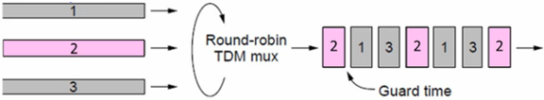
Time Division Multiplexing
Sharing over time
users take turns over a fixed schedule (round robin)
comparable to pairs of people in a room taking turns speaking
each user gets the full bandwidth of the link for a small amount of time
they get no bits for a while, while the others send
while they send, they send at the max rate
aggregate stream runs at the sum rate of the individual streams
complicated: requires synchronization of when to send
small guard time intervals accommodate small timing variations
widely used in telephone and cellular networks

Slide 45
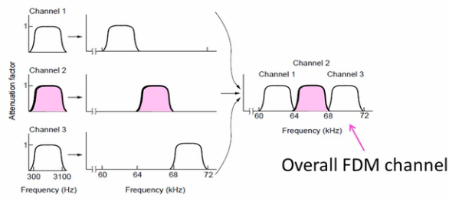
Frequency Division Multiplexing
uses passband transmission to share a channel
spectrum is divided into frequency bands
each user uses one band to send their signal – simultaneously
pairs of people speak at different pitches, so each pair can converse simultaneously
width of each frequency band limits the data rate for each user
users send in parallel; user has same (but lower) bit rate for entire duration
guard band keeps the channels separated (though does not eliminate noise)
E.g., multiple AM radio stations transmit simultaneously in a 1MHz spectrum band

Slide 46
Digital multiplexing
TDM and FDM are not effective for network traffic
both are used to statically divide bandwidth of a link
well suited if traffic is continuous, with relatively fixed number of users
TV or radio stations always transmit, but in parallel on their assigned frequencies

Slide 47
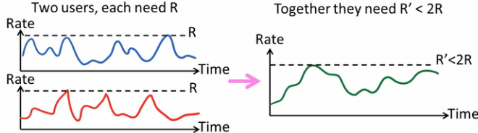
Digital multiplexing
Network traffic uses statistical multiplexing
Network traffic is bursty (on/off source)
one page request gets lots of packets, then no load while you read the page
multiplex traffic based on the demand each user is placing on the link
we use multiple access schemes to let users share access to a link
whenever they need to send a packet, they get to send it
this gives us the benefits of statistical multiplexing
share network bandwidth dynamically based on statistics of demand rather than static allocation (as with TDM or FDM)

Slide 48
Putting it all together – DSL
Digital Subscriber Line (DSL)
widely used for broadband
offer tens of Mbps
Reuses twisted pair telephone line to the home
wire has ~2 MHz of bandwidth but voice uses only lowest ~4 kHz

Slide 49
DSL
DSL uses passband modulation (called OFDM)
Separate bands for upstream and downstream (larger)
Modulation varies both amplitude and phase (called QAM)
High SNR: up to 15 bits/symbol; low SNR: only 1 bit/symbol
Voice
Up to 1 Mbps
Up to 12 Mbps
ADSL2:
0-4
kHz
Freq.
26 – 138
kHz
143 kHz to 1.1 MHz
Telephone
Upstream
Downstream

