Slide 1
ICS 460 – Data Link Layer
Application
Transport
Network
Link
2017
Damodar Chetty
Physical

Slide 2
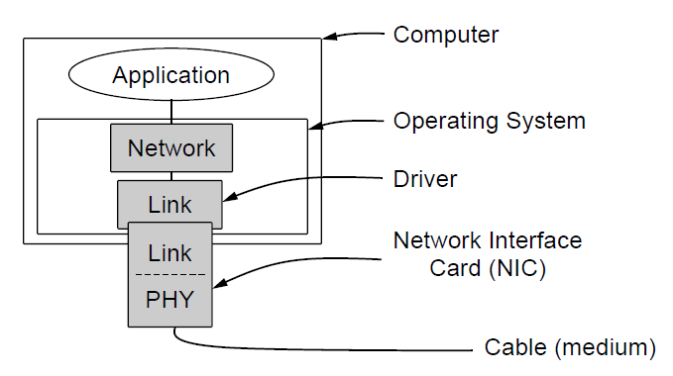
Data Link Layer
Implementation
Physical Layer process and some of the Data Link Layer process runs on hardware - firmware on a Network Interface Card
Rest of the Data Link Layer process (device driver) and the Network layer process run as part of the OS

Slide 3
Scope
Physical layer
delivers a stream of bits over a link
uses modulation to turn signals into a bit stream
for a noisy link (wireless), adds extra bits (e.g., 4B/5B) to reduce errors
but errors can still occur and must be detected/corrected by the next upper layer

Slide 4
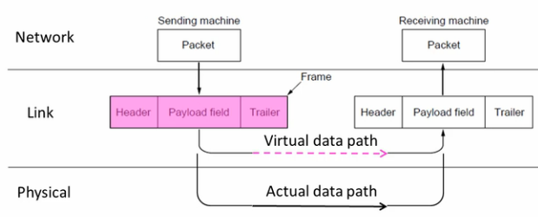
Functions
Provides a well defined service interface to the network layer
delivers a sequence of messages (frames) over the physical layer
encapsulates network layer packets in frames
Deals with transmission errors (esp. on lossy links)
breaks up bit stream into discrete frames – using framing techniques
performs error detection/correction (checksums, etc.)
handles errors (correct error, or discard and notify)
Flow control

Slide 5
Framing
Technique to delimit the start/end of frames
Two techniques
delimit using symbols that cannot occur in the data
Physical layer helps with delimiting frames in Ethernet and 802.11
4B/5B encoding maps 16 symbols into 32 symbols (for sufficient bit transitions)
we use symbols that cannot occur in the data for framing

Slide 6
Framing – Byte Count
delimit using symbols that can occur in the data
Byte count (motivational only)
relies on a header field with a number of bytes
receiver reads that many bytes for that frame
BUT – no way to resynchronize after bit errors in the counter field

Slide 7
Framing – Byte Stuffing
delimit using symbols that can occur in the data (FLAG byte, e.g., 0x7E)
Byte stuffing
uses a special byte value (FLAG byte) to delimit frames
sender prefixes any FLAG byte that appears in the payload field, with ESC byte
sender also prefixes any ESC byte that appears in the payload field, with ESC byte
Receiver strips all ESC bytes to get the data
can resynchronize because 2 FLAG bytes in sequence indicates next frame

Slide 8
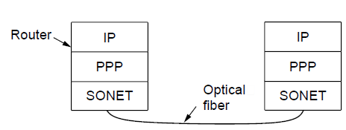
Framing Example: PPP over SONET
Point to Point Protocol
Data link layer protocol used to frame packets for transport over SONET
SONET is the Physical Layer protocol used over ISP backbone fiber links
Protocol stacks

Slide 9
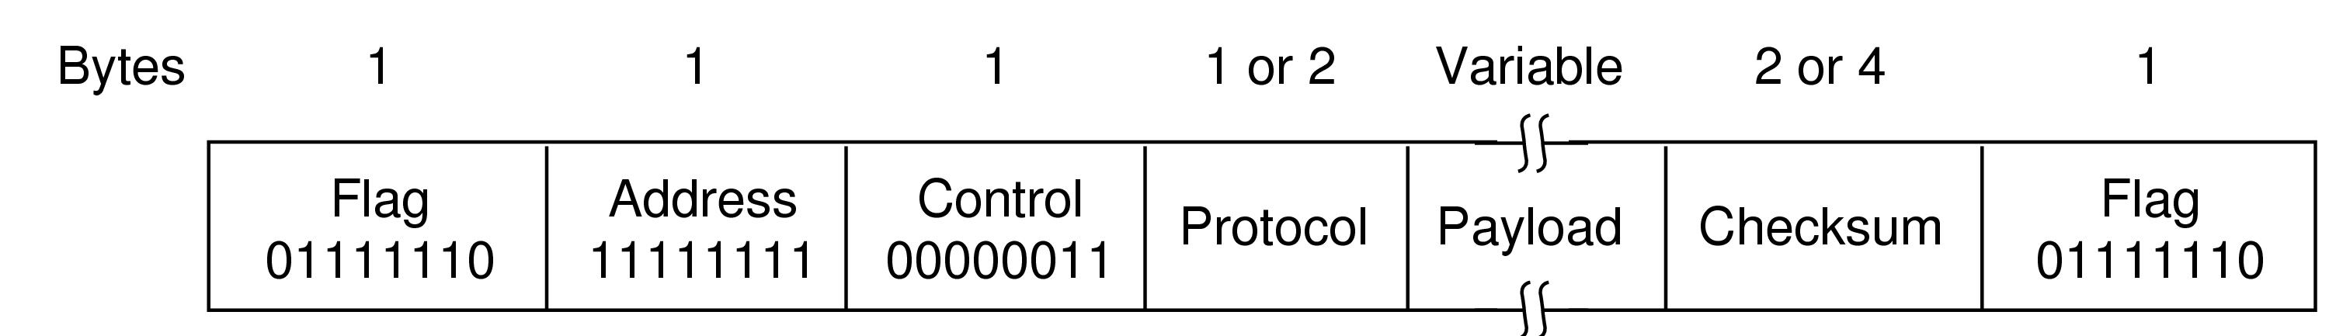
Framing Example: PPP over SONET
Uses byte stuffing with an optimization
Goal: eliminate ALL 0x7E (FLAG) occurrences in the payload data
can then search the bit stream for 0111 1110 to identify frames
Technique:
At Sender:
For a 0x7E (FLAG) in the data: replace it with 0x7D 0x5E instead i.e. 0x7D = ESC, 0x5E = 0x7E XOR 0x20
For a 0x7D (ESC) in the data: replace it with 0x7D 0x5D instead
At receiver:
For a 0x7D in the data: drop it and XOR following byte with 0x20, to get the original (either 0x7D or 0x7E)

Slide 10
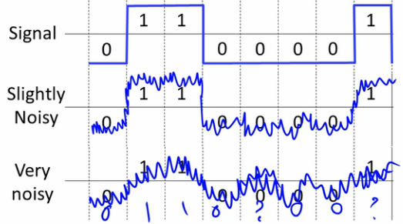
Error Handling
Transmission errors are inevitable
noise in the physical layer flips bits
random thermal noise (isolated bit) or bursts of noise (block of bits)
errors are the norm for wireless
but: optical fiber are highly reliable - have tiny error rates

Slide 11
Error Detection and Correction
Goal
provide extra information so receiver can detect / correct errors
adds redundant check bits to the actual data bits
increases overhead bits on the channel
BUT:
add as few check bits as possible (adds to overhead)
ensure low computation at sender and receiver
not foolproof - check bits could be flipped just as easily as data bits!
Physical layer treats all bits the same
Strategy
For highly reliable channels (fiber optics),
cheaper to use error detection with retransmission
For unreliable channels (wireless),
cheaper to use error correction, since retransmission is just as likely to fail

Slide 12
Error Detection
Motivating example
Simply send two copies of the data: 010 010
Evaluating its performance:
how many errors will it correct? 0.
if we receive 010 011, we don’t know which is correct.
how many errors will it detect? perhaps 3
if we receive 010 101, we can detect 3 errors.
BUT: how many bit flips will cause it to fail? just 2!
if we receive 011 011, just 2 bit flips cause our technique to give a wrong answer.
And for this minimal protection, we used 50% of the link for overhead!
Advanced codes use work done by mathematicians in Applied Mathematics

Slide 13

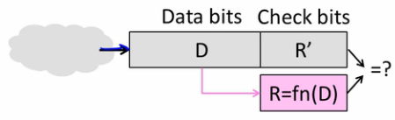
Systematic Block Error Codes
Sender
receives bits from higher layer and generates a codeword (D+R bits)
computes check bits as a function of a block of data bits (block code)
appends these check bits (without modifications) to the data bits (systematic code)
sends codeword (D+R) to the lower layer
Receiver
receives D+R bits with unknown errors
recomputes check bits from the D bits
error if does not match R’
BUT: does not distinguish whether error is in data or checksum bits (R’)

Slide 14
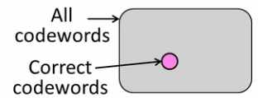
Error Correcting Codes
Goal:
make ratio (correct : all ) codewords small
random noise is unlikely to modify a codeword such that it maps to a different valid codeword – so easy to detect error
For D data bits, R check bits
Ratio of (2^{D} / 2^{D+R} ) must be small (1/2^{R}) ➔ R must be large
Randomly chosen codeword is unlikely to be correct
with 16 check bits, there’s 1 in 65,535 chance of randomly picking a valid codeword

Slide 15
Hamming Codes for error detection and correction
Hamming distance of a code
minimum number of bit flips required to change any valid codeword (D+R)1 into another (D+R)2
Error Detection Rule: a code with distance d+1, can detect d errors.
Error Correction Rule: a code with distance 2d+1, can correct d errors
E.g.: code with 2 valid codewords: 111 for 1, 000 for 0
Hamming distance: 3
Can detect 2 errors
sending 000, 2 bit flips results in: 001, 010, 011, 100, 101, 110
receiver knows these are not valid codewords, so detects an error
Can correct 1 error
sending 000, 1 bit flip results in 001, 010, 100. Receiver corrects this to 000
If more than 1 bit flip occurs, no correction is possible (010 could be 000 or 111)

Slide 16
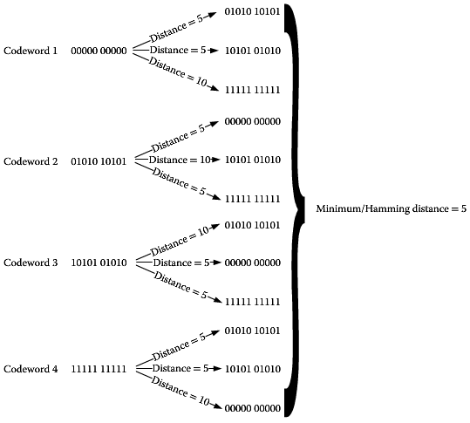
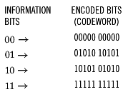
Hamming Distance
4 valid codes
D = 2, R=8, n = 10
00 -> 00 000 00000, 01 -> 01 010 10101, etc.
Hamming Distance: 5
Detects: 4 bit errors
Corrects: 2 bit errors

Slide 17
Visualization of a Hamming code of distance 3
Valid
codeword
A
Error
codeword
B
brown are valid codewords, blue are invalid codewords
For error detection:
can detect 2 bit flip errors
with 3 bit flips (hops) can go from one valid codeword to another

Slide 18
Visualization of a Hamming code of distance 3
Valid
codeword
Single
bit error
from A
A
Three bit
errors to
get to B
Error
codeword
B
For correction:
Box around A indicates codewords within a single bit flip error of A
can correct single bit flips
test received codeword to find its closest valid codeword

Slide 19
Error Detection – Checksum
Sums data and uses n-check bits
used by TCP, IP, and UDP
16-bit one’s complement of the one’s complement sum of all 16-bit words
one’s complement (negative of the number)
invert the bits of a number; 001 → 110
sum the data 16-bits at a time, and negate it
Intuition: for the numbers 1, 5, and 7, the sum is 13, but the negated sum is -13 if we add 1, 5, 7, and -13, at the receiver, we should get 0.
But: computers perform 2s complement arithmetic
to do 1s complement addition on a computer that uses 2s complement arithmetic, track the bit that overflows to the carry field, and add it back to the low order bits

Slide 20


Checksum
For the data: 84328634
Step 1: arrange data in 16 bit words (put 0s in checksum position so we can use the same algorithm at the receiver), and add see: Binary subtraction and Hexadecimal addition 8432 8634 0000 ====== 10A66
Step 2: Add the carry: 0A66 + 0001 = 0A67
Negate to get negative sum: F598
Send data as 84328634F598

Slide 21
Checksum
At the receiver: 84328634F598
Arrange data in 16 bit words 8432 8634 F598 ===== 1FFFE
Add the carry: FFFE + 0001 = FFFF
Negate to get: 0000 – no errors!

Slide 22
Performance of Checksums
Only error detection, not error correction
Efficient and simple
Detects burst errors of up to 16 bits
sequence of errors in a row
will affect only one 16 bit word, or two adjacent words in different places such that they can’t cancel out
Max number of errors that we can detect is 1, two bits can fool it
weak protection – it does not pick up:
adding zeros
swapping parts of the message
complementary changes (add 16 in one place, and subtract 16 elsewhere)

Slide 23

Cyclic Redundancy Checks
Take n bits of data, generate k check bits, such that n+k bits are evenly divisible by a generator C
Intuition
To send the number 302, with a 1 digit CRC, and generator C=3
302x choose x such that the whole number is divisible by 3 3020 % 3 = 2 3021 % 3 = 0 I.e., our check digit should be 1
CRCs do this with the math of Finite Fields
Can’t work out this math from first principles (advanced math)
binary sequences represent polynomials
protection depends on the generator used

Slide 24
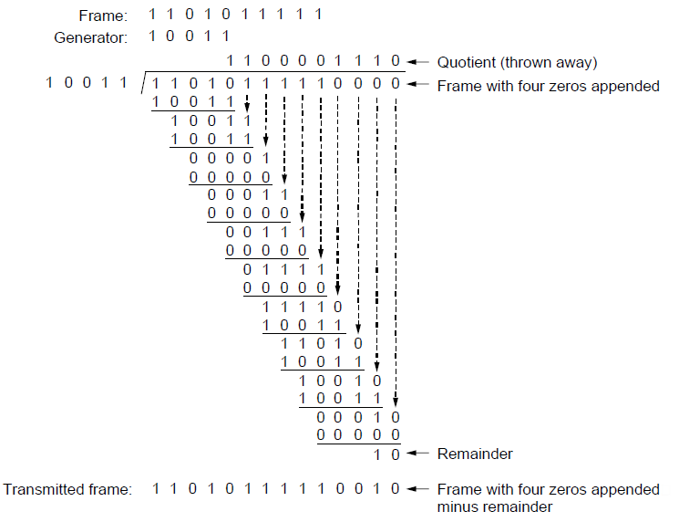
CRC Computation
Sender algorithm
extend n data bits with k zeros (based on degree of polynomial)
divide by the generator polynomial C (based on terms of polynomial) E.g., x⁴ + x¹ + 1
use the remainder as the k check bits
Division notes:
done in modulo 2 arithmetic
without carries in addition or borrows in subtraction
i.e., add/subtract are same as XOR
goes in by 1 if number of bits match
goes in by 0 if number of bits are fewer
see polynomial division

Slide 25
CRC Computation
Receiver algorithm
divide by the generator polynomial C and check for zero remainder
____________________
1 0 0 1 1 | 1 1 0 1 0 1 1 1 1 1 0 0 1 0

Slide 26
Cyclic Redundancy Checks
Industry standard 32-bit CRC (k=32) is 10000010 01100000 10001110 110110111
detects odd number of errors, and bursts up to k bits
used on Ethernet, Wifi, etc.
Hamming distance is 4, can detect 3-bit errors
stronger than checksum
not vulnerable to systematic errors (adding 0s)
detects moving of data
Relies on polynomial division using XOR

Slide 27
Error Detection in practice
CRCs are widely used on links
Ethernet, 802.11, ADSL, cable
Checksum used in the Internet
IP, TCP, UDP, ... but is weak

Slide 28
Other Error Correction Codes
In practice, much more complex codes are used
Convolutional codes
Low density parity check (state of the art today)

Slide 29
Data Link protocols – Reliability Strategies
Error correction: Correct errors with an error correcting code
handled using error correction codes or retransmissions
used by lower layers (Physical and Link layers)
goal is to improve performance (higher layers are oblivious of the errors)
Error detection and recovery: detect errors and retransmit frame
used by upper layers to address issues that cannot be corrected at the bit level
unexpected message received on the other side
cannot connect to the right receiving application on the other host

Slide 30
Automatic Repeat reQuest (ARQ)
Simple auto resend mechanism
used when errors are common (e.g., Wifi and TCP)
Rules:
receiver automatically ACKs correct frames
sender automatically resends after a timeout, unless an ACK is received
Normal case time sequence diagram
Frame is received correctly and is ACKd
ACK arrives before timeout expires
Sender
Receiver
Frame
Timeout
Time
ACK

Slide 31
Automatic Repeat reQuest (ARQ)
Loss and Retransmission case
Data frame (or ACK frame) is lost inside a link
frame arrives, but is corrupted, and receiver simply throws it away
error is so severe that framing is affected – receiver does not detect start of frame, so it looks like the message is lost
Sender does not receive ACK by timeout, so it resends the frame
Considerations
how long to set the timeout?
if too big, link goes idle and wastes bandwidth
if too small, sender resends early, wastes bandwidth
For LAN, we can determine worst case E.g., for Wifi can work out max propagation delay
For Internet as a whole, much harder
a lot of variation in time (depends on host location)
Pick reasonable value
Sender
Receiver
Frame
X
Timeout
Time
Frame
ACK

Slide 32
Automatic Repeat reQuest (ARQ): Design Considerations
Avoiding accepting duplicate frames as new frames (due to retransmissions)?
Two scenarios:
When an ACK is lost OR timeout is early
Solution: All frames (data and ACKs) must carry sequence numbers
Receiver checks sequence number to detect duplicates
Sender
Receiver
Sender
Receiver
Frame
Frame
Timeout
ACK
Timeout
X
ACK
Frame
Frame
New
Frame??
New
Frame??
ACK
ACK

Slide 33
Stop and Wait protocol
Putting it all together
Receiver ACKs every frame received
Every frame carries a sequence number, to detect duplicates
only 1 frame can be outstanding, so bit flag suffices as a sequence number
Sender retransmits after a reasonable timeout, if no ACK received
Sender sends next frame ONLY after previous is ACKed
Normal case:
Sender
Receiver
Frame 0
Timeout
ACK 0
Time
Frame 1
ACK 1

Slide 34
Stop and Wait protocol
With ACK loss
Receiver knows it’s a resend
Sender
Receiver
Frame 0
Timeout
X
ACK 0
Frame 0
It’s a
Resend!
ACK 0

Slide 35
Stop and Wait protocol
With early timeout
Receiver knows it is a resend
Sender gets 2 ACKs for Frame 0
for the first ACK it does not know whether it was for the send or resend – but that does not matter
Sender
Receiver
Frame 0
Timeout
ACK 0
Frame 0
It’s a
Resend
OK …
ACK 0

Slide 36
Stop and Wait protocol
Limitations
allows only 1 frame to be outstanding from a sender at a time
Okay for a LAN (used in Wifi)

Slide 37
Stop and Wait protocol
For Bandwidth B = 1Mbps, Delay D = 50ms
RTT to send a frame and receive an ACK is 2D = 100ms
Takes 100ms/frame: so in 1 second, we can send 10 frames
if each frame is 10,000 bits, this is 100kbps ... on a 1Mbps link!
For Bandwidth B = 10Mbps, Delay = 50ms
we can still only send 10 frames per second!
limited by the protocol and the RTT, not the bandwidth
Max throughput is 100kbps, no matter how fast the link
This is wasteful for networks with high bandwidth-delay product
many packets could fit on the pipe
sending just one is wasteful

Slide 38
Sliding window protocol – window size
Problem: Stop and Wait uses a window of 1
To use the entire network bandwidth, B,
we must send B bps for those RTT seconds (2D)
I.e., send 2D * B = 100ms * 1Mbps = 100 * 10⁻³ sec * 10⁶ bps = 100 * 10³ bits = 100kb
100kb will be stored at the receiver in the time it takes to send a frame and receive an ACK
if frame is 10Kb, then W=10 frames
IF we increase B to 10Mbps, W = 100 frames
sliding window gets larger with higher capacity links
14
13
12
11
10
9
8
7
6
5
4
3
2
1
1
2
3
4
5
6
7

Slide 39
Sliding Window Protocol
Many variations
depending on how buffers, ACKs, and retransmissions are handled
Go Back N
simple, but inefficient
works well when errors are rare, but if line is poor, wastes a lot of bandwidth on retransmitted frames
requires less receiver buffer space (only 1 buffer)
Selective Repeat
more complex, better performance
requires more buffer space (usually, set to W)

Slide 40
Go-back-n Protocol - Errors
Send window size = 7. Receive window size = 1.
Receiver discards all out-of-order frames, sending no ACKs for them
Eventually sender times out, and retransmits all unACKed frames, in order starting with the lost/damaged one
Can waste a lot of bandwidth if the error rate is high

Slide 41
Selective Repeat Protocol - Errors
Send window size = 4, Receive window size = 4.
Bad frame received is discarded
But any good frames received after it, are accepted and buffered
When sender times out, only the oldest unACKed frame is retransmitted
if that frame arrives correctly, receiver can deliver all the buffered frames to the network layer, in sequence order
can be combined with a NAK for frame errors, to cause retransmits before the timer expires. If NAK is lost, timeout causes retransmit.

Slide 42
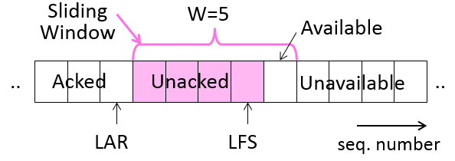
Sliding Window - Sender
Sender
buffers up to W frames (the sliding window size) until they are ACKed
buffering allows it to resend them if needed
Markers delineate three categories of frames
LFS = Last Frame Sent (highest number frame sent, but not yet ACKd)
LAR = Last ACK Received (highest in-sequence ACK that has been received)
Sliding window allows us to have a difference between LFS and LAR – up to W frames can be sent into the network, without being ACKed.

Slide 43
Sliding Window - Sender
Sender
Categories
ACKed
All frames up to LAR have been sent, ACKd, and we’ve received the ACK
UnACKed
All frames between LFS and LAR have been sent, but ACKs not yet received
Unavailable frames:
frames that we can’t send yet, because our window is not big enough

Slide 44
Sliding Window - Sender
Sender
can keep sending while LFS – LAR <= W (here, we can send 1 more frame)
Sliding window moves as we send packets and receive ACKs

Slide 45
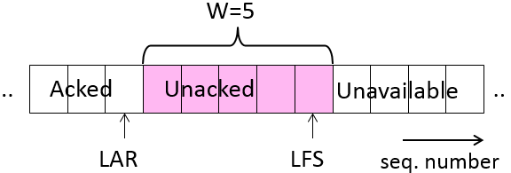
Sliding Window - Sender
Case 1: new frame is accepted for sending
Frame can be sent right away, since since LFS – LAR < W
we only had 4 frames outstanding, and our W was 5
LFS is updated
LAR is not updated since we have not received any ACKs
At this point, LFS-LAR=W,
no more frames can be sent until some of the Unacked frames are ACKed

Slide 46
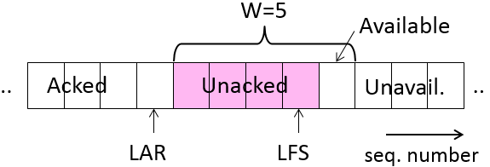
Sliding Window - Sender
Case 2: next higher ACK arrives from the receiver
increment LAR
we now have only 4 frames outstanding in the network
window is still 5, but it has now slid over to the right
opens up space for 1 new segment to be sent into the network
LFS – LAR → 4 (can send one more, since W=5)

Slide 47
Sliding Window – Go-back-N
Receiver has only 1 buffer - for the next frame
State variable, LAS = LAST ACK SENT
On receive
if sequence number is LAS+1, accept and pass to network layer; update LAS; and send ACK
Otherwise discard (it was received out of order)
sender will notice this (at timeout) and retransmit

Slide 48
Sliding Window – Go-Back-N sender
Retransmissions
uses a single timer to detect losses
if frame is not ACKed within a timeout,
assumes it is lost, and that receiver has thrown away all frames after it
resends all buffered packets in the current window, starting at LAR+1
Sequence Numbers
need W+1 (only one ACK outstanding at a time)
Implement with an N-bit counter that wraps around at 2N – 1.
e.g., N=8: ..., 253, 254, 255, 0, 1, 2, 3, ...

Slide 49
Bidirectional Go-Back-N
Additional Concepts
Cumulative ACK
When an ACK comes in for frame n, all prior frames (n-1, n-2, etc.) are considered automatically ACKed
Piggybacking ACKs
receiver does not ACK a frame on arrival
receiver waits until it has a packet to send and attaches ACK to the outgoing frame
ACK gets a free ride on the header of the next outgoing data frame
much cheaper than sending a separate frame (complete with header and checksum)
receiver must have enough traffic to send
Else, traffic will grind to a halt once the sender’s send window is hit
Option is to set a timeout – if no outgoing packet is ready by timeout, ACK is sent by itself

Slide 50
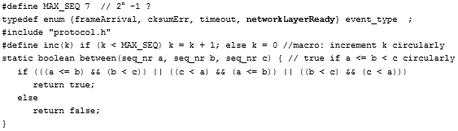
Protocol 5

Slide 51
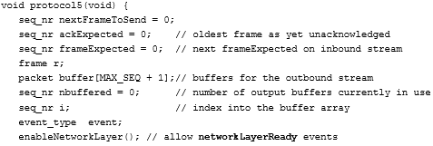
Protocol 5

Slide 52
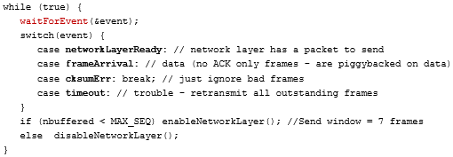
Protocol 5

Slide 53

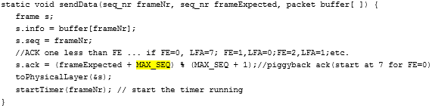
Protocol 5

Slide 54
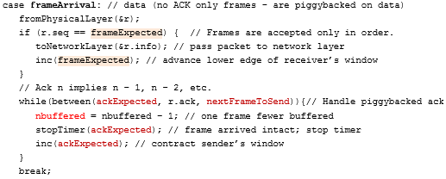
Protocol 5

Slide 55

Protocol 5

Slide 56
Optional Section
The remaining slides are retained for optional additional reading
You will not be tested on these
Optional

Slide 57
Constructing Hamming codewords (to correct single bit errors)
Determining the number of check bits R for data bits D to correct single bit errors:
D <= 2^{R} – R – 1 (OR) R <= 2^{R} – 1 – D
for D=4, we get R=3, for a 7 bit codeword
Calculate R <= 2^{R} – 5 R=1, gives us 1 <= -3 (no!) R=2, gives us 2 <= -1 (no!) R = 3, gives us 3 <= 3 (yes!)
Optional

Slide 58
Constructing Hamming codewords for error correction
Example: data = 0101, 3 check bits
write out the 7 bits, numbered from left to right
bits at positions of powers of 2 are check bits, rest are data bits
check bit for position p is a parity sum over all positions that have the p term in their binary values
check bit at position 1, covers bit positions 1, 3, 5, 7: p1 = 0 + 1 + 1 = 0
check bit at position 2, covers bit positions 2, 3, 6, 7: p2 = 0 + 0 + 1 = 1
check bit at position 4, covers bit positions 4, 5, 6, 7: p4 = 1 + 0 + 1 = 0
_ _ _ _ _ _ _
1 2 3 4 5 6 7
Optional
_ _ 0 _ 1 0 1
1 2 3 4 5 6 7
0 1 0 0 1 0 1
1 2 3 4 5 6 7

Slide 59
Error correction at the Receiver
Recompute all check bits using the check bit parity itself
p1 covers positions 1, 3, 5, 7: p1 = 0 + 0 + 1 + 1 = 0
p2 covers positions 2, 3, 6, 7: p2 = 1 + 0 + 0 + 1 = 0
p4 covers positions 4, 5, 6, 7: p3 = 0 + 1 + 0 + 1 = 0
If all parity bits are 0, then extract data as 0101
If there is an error,
parity bits compute as: p1 = 0 + 0 + 1 + 1 = 0, p2 = 1 + 0 + 1 + 1 = 1, p4 = 0 + 1 + 1 + 1 = 1.
Arrange parity bits as: 011 and flip the bit at that position (6) to get the data
0 1 0 0 1 0 1
1 2 3 4 5 6 7
Optional
0 1 0 0 1 1 1
1 2 3 4 5 6 7

Slide 60
Sliding Window – Selective Repeat
Receiver does more work, but can use network more efficiently
Receiver passes data to upper layer in sequence order
BUT: instead of 1 buffer, has W buffers (size of sender’s sliding window)
Goal is to reduce retransmissions
it will accept frames out of order, and will hold on to them
when it later gets the frame that was missing, it sends all queued frames in sequence order up to the network layer.
Process
when a frame is received
if it falls within the window (from LAS+1 to LAS+W), store it in corresponding buffer
check buffer if any frames starting from LAS+1 have arrived in order
if they have, pass those in-order frames up to the Network layer
update LAS to the highest frame which has been delivered to the network layer
send an ACK
with the current LAS if it has moved OR
with resend ACK with old LAS (tells sender that frames up to and including this one have been received. Gives sender an idea of which packets may have been lost.)
Optional

Slide 61
Sliding Window – Selective Repeat
Retransmissions
uses a timer per unaACKed packet
if it times out, just that frame is retransmitted
hope is to avoid having to resend a whole window’s worth of frames
can do this because receiver is also buffering packets that arrive out of order
Sequence numbers
need W numbers for packets, and W for ACKs of earlier packets
2W sequence numbers
Optional

