Slide 1
ICS 460 – Medium Access Control Sublayer
Application
Transport
Network
Link
Damodar Chetty
Physical

Slide 2
Introduction
Types of networks – by technology type
Point to Point channels
mainly used in WANs
Broadcast channels (or multi-access channels)
mainly used in LANs
key issue is to allocate a single channel among competing users
channel connects each user to other users
any user who uses the channel interferes with others who also wish to use it
portion of the wireless spectrum in a region, or single wire to which nodes are connected

Slide 3
Goals
Simple model to explore how nodes share a single link
e.g., multiple laptops want to send to a single WiFi access point
simplified mode: multiple hosts attached to a single wire
Assume no-one is in charge; this is a distributed system
all nodes have a local view, i.e., can communicate with other nodes
but have no global view of the topology
no one is in charge of what is going on in the network
MAC sublayer focus
determine who gets access to a channel

Slide 4
Statistical multiplexing
Multiplexing technique
dynamic channel allocation
host claims access to the shared channel
avoids/detects collisions and resends if required
uses randomization to handle multiple access
preferred for computer data traffic

Slide 5
Carrier Sense Multiple Access with Collision Detection (CSMA/CD)
Classic Ethernet
nodes share 10Mbps coax cable with baseband signals
Listening for activity before sending
easy to do with wires (not wireless)
but does not eliminate collisions
possible to hear nothing even when another is sending, because of delay
Reduces cost of collisions by detecting them and aborting transmission
hardware listens to channel while transmitting. If signal read back is different from what it is sending, it indicates a collision
X
Jam!
X X X X X X X X
Jam!

Slide 6
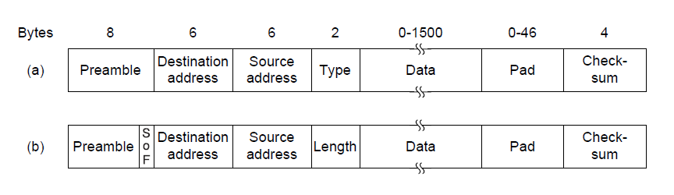
Ethernet Frame Format
Addresses identify sender and receiver
CRC-32 for error detection
no ACKs or retransmission
Start of frame identified with physical layer preamble
Packet from Network layer (IP)

Slide 7
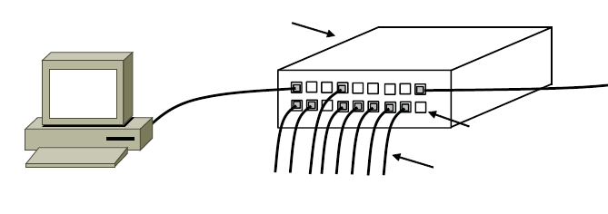
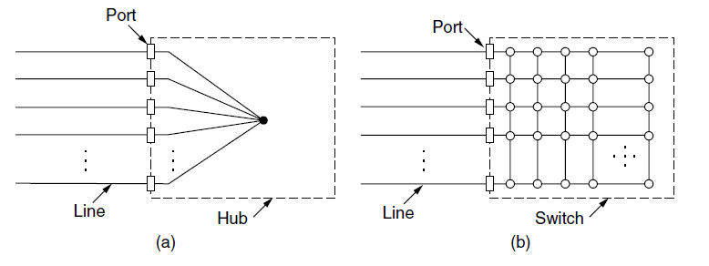
Modern (Switched) Ethernet
Based on switch to connect nodes - NOT multiple access
Hosts are wired to a switch with twisted pair wires
Switch connects pairs of hosts
All ports are wired together;
more convenient to run wires to one location
more reliable than shared wire
easy to diagnose broken wires
Better scalability than using a hub
E.g., 100 Mbps per port, instead of 100Mbps shared across all nodes on a cable or hub
Switch
Switch ports
Switch
Twisted pair

Slide 8
How do switches work?
Forwarding
use frame address to connect input port to right output port – do NOT look at IP address
let hosts be moved around readily
multiple frames may be switched in parallel
port may be used for both input and output (full duplex)
Acts as point-to-point link, so no multiple access protocol needed
Uses the Backward Learning algorithm
to fill the forwarding table: looks at the source address of input frames
to forward: sends to a known port; or broadcasts to all ports
1
2
1 → 4
and
2 → 3
3
. . .
4

Slide 9
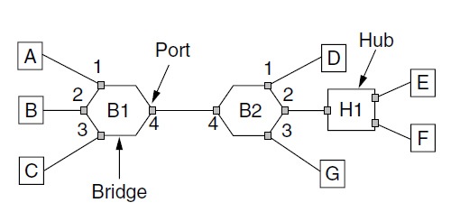
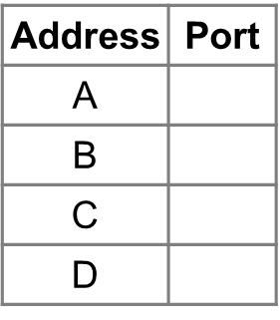
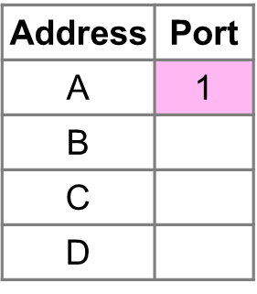
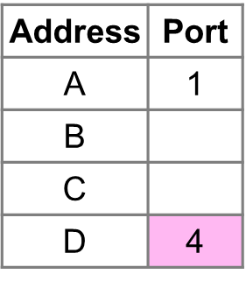
Backward Learning algorithm
0. Start off with no knowledge of topology; and empty table
1. A sends to D We know A’s port. But we don’t know D’s: broadcast over all other ports (2, 3, 4)
2. D sends to A we know both A’s and D’s connected ports - forward to port 1.
3. A sends to D we know D’s port, so forward to port 4.
Switch continues learning the address of other hosts.
D
Switch

Slide 10
Problem: Forwarding Loops
Loops may occur!
intentionally: redundancy for failures
unintentionally: simple mistake
A → F in a topology with loops
A→ C, C broadcasts on B, D-Left, D-Right
D-Left → D, D broadcasts on C-Right, E, F
D-Right → D, D broadcasts on C-Left, E, F
C-Right → C, C broadcasts on D-Left, A, B
C-Left → C, C broadcasts on D-Right, A, B
D-Left → ...
D-Right → ...
and so on
A
B
C
Left / Right
D
E
F

Slide 11
Solution: Spanning Tree Algorithm
Switches find a spanning tree for the topology - collectively
Spanning tree: subset of links that is a tree (no loops) and reaches all switches
switches forward as normal on the spanning tree
broadcasts will go up to the root of the tree, and down all the branches
Topology
One ST
Another ST
Root

Slide 12
Spanning Tree algorithm
Characteristics
Distributed, non centralized:
all switches run the same algorithm
they start with no information
operate in parallel and send messages
always search for the best solution
Ensures a highly robust solution
works for any topology, with no configuration
adapts to link/switch failures

Slide 13
Spanning Tree Algorithm
Outline
elect a root node of the tree (switch with the lowest address)
each switch initially believes it is the root of the tree
grow tree as shortest distances from the root (lowest address breaks ties)
each switch sends periodic updates to neighbors with:
its address, address of the root, and distance (in hops) to root
switches favor ports with shorter distances to lowest root
uses lowest address as a tie break for distances
turn off ports for forwarding if they aren’t on the spanning tree
Hi, I’m C, the root is A, it’s 2 hops away
or (C, A, 2)
C

Slide 14
Spanning Tree Example
1st round, sending:
A sends (A, A, 0) to say it is root
B, C, D, E, and F do likewise
1st round, receiving:
A still thinks it is (A, A, 0)
its switch address is lower than C’s or E’s.
B still thinks it is (B, B, 0) ... likewise for C and F
C updates to (C, A, 1)
C receives (A,A,0) and (B,B,0)
uses lowest switch address to break tie
D updates to (D, C, 1)
D receives (C,C,0), (E,E,0), and (F,F,0)
E updates to (E, A, 1) ... lower of A and D
F updates to (F, B, 1) ... lower of B and D
A,A,0
B,B,0
C,C,0
D,D,0
E,E,0
F,F,0
A,A,0
B,B,0
C,A,1
D,C,1
E,A,1
F,B,1

Slide 15
Spanning Tree Example
2nd round, sending:
Nodes send their updated state
2nd round, receiving:
A remains (A, A, 0)
B updates to (B, A, 2) via C
receives (C,A,1) and defers to lower root address
C remains (C, A, 1)
D updates to (D, A, 2) via C-Left (picking one port)
E remains (E, A, 1)
F remains (F, B, 1)
A,A,0
B,B,0
C,A,1
D,C,1
E,A,1
F,B,1
A,A,0
B,A,2
C,A,1
D,A,2
E,A,1
F,B,1

Slide 16
Spanning Tree Example
3rd round, sending:
Nodes send their updated state
3rd round, receiving:
A remains (A, A, 0)
B remains (B, A, 2) via C
C remains (C, A, 1)
D remains (D, A, 2) via C-Left
E remains (E, A, 1)
F updates to (F, A, 3) via B
A,A,0
B,A,2
C,A,1
D,A,2
E,A,1
F,B,1
A,A,0
B,A,2
C,A,1
D,A,2
E,A,1
F,A,3

Slide 17
Spanning Tree Example
4th round, sending:
steady state has been reached
Nodes turn off forwarding on some ports
eliminate duplicate paths
pick lowest switch address as tie breaker
Algorithm continues to run
adapts by timing out information
e.g., if A fails, other nodes forget it, and B will become the new root
A,A,0
B,A,2
C,A,1
D,A,2
E,A,1
F,A,3

Slide 18
Spanning Tree Example
Forwarding proceeds as usual on the ST
Black arrows - spanning tree
Pink arrows – broadcast from D looking for F
Green arrows – route from F to D
D → F (broadcast since we don’t know its port)
D→ C-Left
C → A, B
A → E
B → F
F → D (we know where D lives)
F → B
B → C
C → D
(not the best route, F is directly connected to D!)
A,A,0
B,A,2
C,A,1
D,A,2
E,A,1
F,A,3

Slide 19
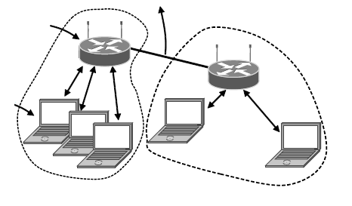
WiFi or 802.11
started in the 90s
clients get connectivity from a wired Access Point (AP)
multi access problem for shared channel
Uses 20/40MHz channels on ISM bands
802.11b/g/n on 2.4GHz
802.11a/n on 5GHz
To Network
Access Point
Client

Slide 20
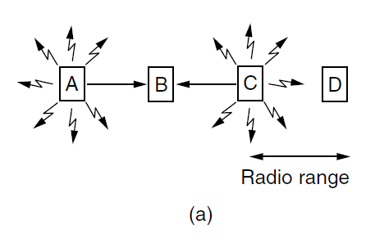
Wireless Channel
Wireless
Does not fit into CSMA/CD model
Nodes may have different areas of coverage – does not fit Carrier Sense
Nodes can’t hear while sending – can’t Collision Detect
Inability to do CD results in wastage for wireless (cannot abort in middle of send)
signal is broadcast, and received where there is sufficient SNR

Slide 21
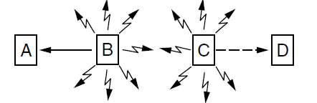
Hidden and Exposed Terminals
Hidden terminals
Nodes A and C are hidden when sending to B
Can’t hear each other (to coordinate), yet collide at B
would prefer to avoid collisions (inefficient)
Exposed terminals
B and C are exposed terminals when sending to A and D
can hear each other, yet don’t collide at receivers A and D
would prefer to concurrently send to increase performance

Slide 22
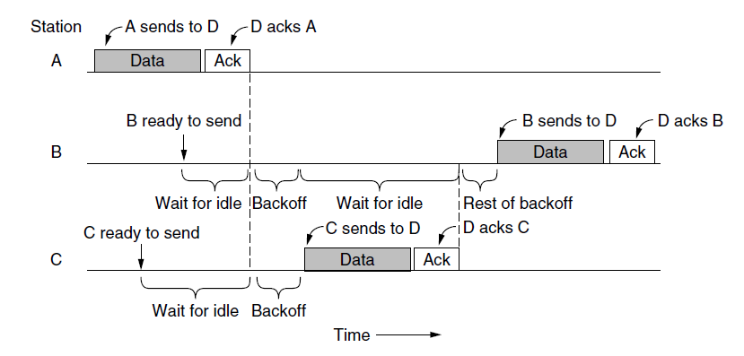
802.11 uses CSMA/CA for Multiple Access
both B and C need to send
Carrier Sense: they sense medium is busy, so they wait until it is free
Collision Avoidance: B and C pick a random backoff time to wait
C picks a smaller gap and goes first.
B suspends its backoff until after C is done, and then transmits its frame
Send?
Send?
Time

Slide 23
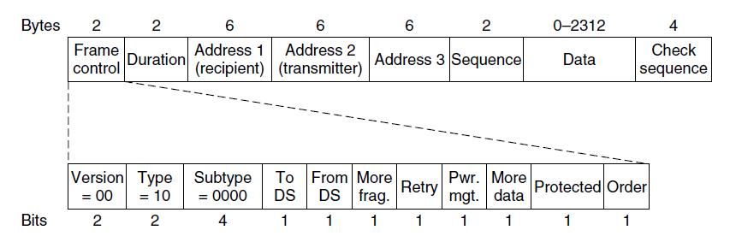
802.11 Link Layer
Multiple access uses CSMA/CA; RTS/CTS optional
Frames are ACKed and retransmitted with ARQ
Needs 3 addresses (due to AP)
Error detection uses 32-bit CRC
Packet from Network layer (IP)

Slide 24
ALOHA Network
Seminal computer network
connected the Hawaiian islands in the late 60s
Simple idea
node just sends when it has traffic
if there is a collision (no ACK received) then wait a random time, and resend
some frames will be lost, but many will get through
Additional

Slide 25
ALOHA Protocol
Result
simple decentralized (no SPoF) protocol that works well under low load
Not efficient under high load
at most 18% efficiency
improvement: divide time into slots, and efficiency goes up to 36%
Additional

Slide 26
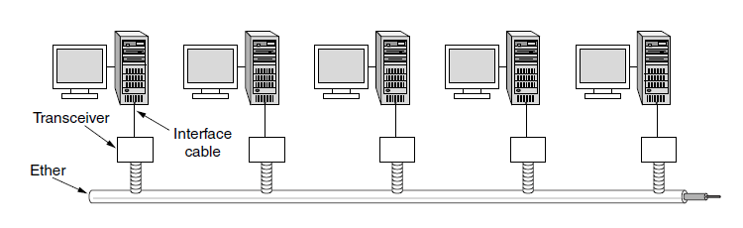
Classic Ethernet (IEEE 802.3)
Inspired by ALOHA, invented in 1973 for LANs
nodes share 10Mbps coax cable with baseband signals
Multiple access with “1-persistent CSMA/CD with BEB”
hugely popular in 80s and 90s
Additional

Slide 27
CSMA/CD Complications
Want everyone who collides to know that it happened
time window in which a node may hear of a collision is 2D seconds
Impose a minimum frame length - that lasts for 2D seconds
so node can’t finish before collision
Ethernet uses a minimum frame length of 64 bytes
X
X
Additional

Slide 28
CSMA Persistence
What should a node do if another node is sending
Idea: wait until it is done, and send
Problem
multiple waiting nodes will queue up then collide (likelihood increases with increased load)
What now?
Additional
Now!
Uh oh
Now!

Slide 29
CSMA Persistence
Better solution
if there are N queued senders, we want each to send with probability 1/N
Binary exponential Backoff (BEB)
estimates probability
1st collision, wait 0 or 1 frame times
2nd collision, wait 0 to 3 frame times
3rd collision, wait 0 to 7 frame times
BEB doubles interval for each successive collision
quickly gets large enough to work
very efficient in practice
Send p=½
Whew
Send p=½
Additional

Slide 30
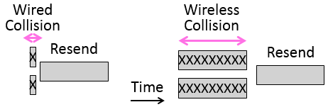
Nodes can’t hear while sending
CD lowers costs with wires
detecting collisions while sending, and aborting
Inability to do CD results in wastage for wireless
Additional

Slide 31
Possible solution – Multiple Access Collision Avoidance
MACA uses a short handshake instead of CSMA
refinement of MACA is used by 802.11
Protocol rules
sender node transmits a Request to Send (RTS) with a frame length
receiver replies with a Clear to Send (CTS) with a frame length
sender transmits the frame while nodes hearing the CTS stay silent
collisions on the RTS/CTS are still possible, but less likely (short bursts)
Additional

Slide 32
Solving the Hidden terminal problem with MACA
A→B with hidden terminal C
A sends RTS to B
B sends CTS to A, and C gets it too
A sends frame while C defers
RTS
A
B
C
D
Alert!
RTS
A
B
C
D
CTS
CTS
Quiet...
Additional
Frame

Slide 33
Solving the Exposed terminal problem with MACA
B→A, and C→D simultaneously
B and C send RTS to A and D
A and D send CTS to B and C
B and C send frames to A and D
RTS
RTS
A
B
C
D
All OK
All OK
RTS
RTS
A
B
C
D
CTS
CTS
Frame
Frame
A
B
C
D
Additional

Slide 34
Switch internals - buffers
Buffers for multiple inputs to send to one output
sustained overload will overflow buffer, and lead to frame loss
Loss!
XXX
Input
. . .
Output
. . .
. . .
. . .
Fabric
Output Buffer
Input Buffer
Additional

Slide 35
Learning with Multiple Switches
Assuming no loops, Backward learning also works with multiple switches
E.g., A sends to D
B1 marks A’s port (1); and broadcasts out to ports 2, 3, and 4
B2 marks A’s port (4) and broadcasts out to ports 1, 2, 3
H1 is a simple hub, so frames are available to all its hosts
frame arrives at port 1 for D
D sends to A
B2 marks D’s port (1) and sends out on A’s port (4)
B1 marks D’s port (4) and sends out on A’s port (1)
Additional
Switch

