Slide 1
ICS 460 – Network Layer
Application
Transport
Network
Link
Damodar Chetty
Physical

Slide 2
Introduction
Where we are
We can build networks with links and switches, and send frames between hosts
But:
switches don’t scale to large networks
tables must have entries for all destinations in the world
broadcasting to new destinations would send packets to the whole internetwork!
switches don’t work across more than one link layer technology
Hosts on Ethernet, 802.11, 4G, ...
spanning trees are not efficient for routing - does not pick shortest paths
wastes bandwidth - the most scarce network resource.

Slide 3
Network Layer
Fixes shortcomings in Switches
Scaling
Provides an addressing hierarchy, in the form of prefixes (focus of this lecture)
Heterogeneity (Supports different link layer technologies)
IP for internetworking (the narrow waist of the Internet)
Uses link bandwidth well
lowest-cost routing
Quality of Service

Slide 4
Key Terms
Routing
process of computing all of the paths through the network, so that you will be prepared to forward packets when they arrive
it is a network-wide process, and is expensive
Forwarding
process of handling a packet when it arrives, and sending it on its way
uses the routing table generated by the routing algorithm
it is a local node process, and is fast

Slide 5
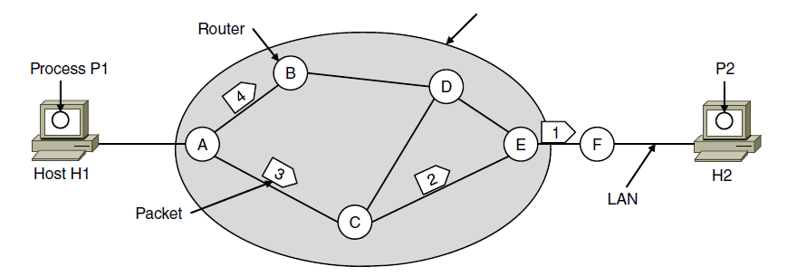
Store and forward Packet Switching
ISP’s equipment
Host H1 transmits a packet to its nearest router
on own LAN or over a point-to-point link to the ISP
Router will
Buffer packet until fully received (stores it temporarily)
Verify its checksum
Forward it to the next router along the path to its destination host.
not stored for very long – except if there is contention for the destination port.

Slide 6
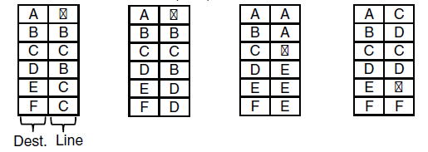
Network Service Models - Datagrams
ISP’s equipment
Post Office model: Each packet contains a destination address
each router uses it to forward each packet; possibly on different paths
Each router has a forwarding table keyed by destination IP network prefix
gives next hop for each destination
can change due to congestion, failure, …
A learns of congestion along A-C-E
updates its routing table to send #4 to B instead
A’s table (initial) A’s table (later) C’s Table E’s Table

Slide 7
Network Service Models - Datagrams
ISP’s equipment
Post Office model: Each packet contains a destination address
each router uses it to forward each packet; possibly on different paths
Each router has a forwarding table keyed by destination IP network prefix
gives next hop for each destination
can change due to congestion, failure, …
A learns of congestion along A-C-E
updates its routing table to send #4 to B instead
Dominant model on the Internet

Slide 8
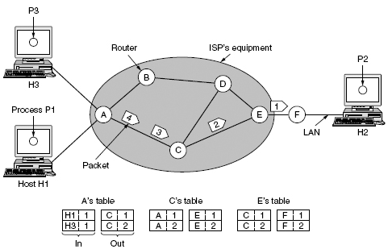
Network Service Models - Virtual Circuits
path from source to destination router is first established - a virtual circuit (VC)
stored in all routers along that path, and used to forward all packets for a given VC
routing decisions made only on new VC setup and remains in force for entire session
Packet identifies a VC using a locally unique (to the router) label
VC #1 is the connection between H1 and H2 via A->C->E
VC #2 is the connection between H3 and H2
Locally to H3, the label is 1, but A uses label switching to change it to 2 to keep it unique at C
ISPs use MultiProtocol Label Switching (MPLS) to setup long paths through their network

Slide 9
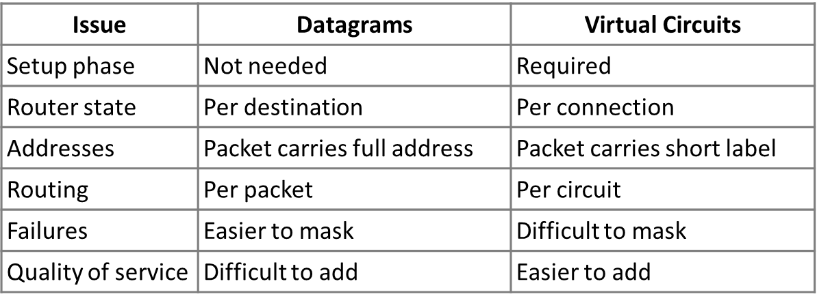
Datagrams vs Virtual Circuits
Complementary strengths

Slide 10
Internetworking
Combining different networks into a larger network
Different networking technologies exist (Ethernet, 802.11, etc.)
Lots of differences between these technologies: e.g.,
Service models (datagrams, Virtual Circuits)
Packet sizes (how to pass an 8000-byte packet through a network whose max size is 1500 bytes?)
Addressing (flat or hierarchical?)
QoS (how to guarantee QoS when one network provides QoS, and the other only best effort service?)
Internetworking hides the differences with a common protocol
IP is the narrow waist of the Internet that defines a universal packet format
that all routers recognize (network interconnection device, works at network layer)
that can pass through any network
many different link technologies below, many applications above
BUT:
lowest common denominator service
e.g., does not preserve QoS
Applications implement any higher level services needed
7. Application
SMTP
HTTP
RTP
DNS
4. Transport
TCP
UDP
3. Internet
IP
2/1. Link
Ethernet
3G
Cable
DSL
802.11

Slide 11
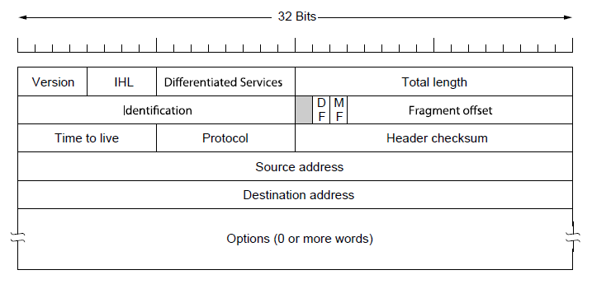
Internet Protocol (IP)
Network layer of the Internet
Common format to represent packets
bits are transmitted from left to right and top to bottom
Two main sections: Header and Payload
Provides a layer of addressing above link addresses
IPv4 carries 32 bit source and destination interface addresses on each packet
Globally unique
Options are rarely used
Payload (e.g., TCP segment)

Slide 12
IPv4
Version of the protocol (e.g., 4)
Internet Header Length: length of the header up to the start of the payload
Total length: header + payload (max of 64KB)
TTL: limits packet lifetimes, decremented on each hop, and discarded when 0
Protocol: which transport layer (TCP or UDP) to give the assembled packet to
Header checksum
recomputed at each hop because at least one field always changes (TTL)
Payload (e.g., TCP segment)

Slide 13
IPv4
Handle fragmentation and packet size differences
Id: all fragments of a packet contain the same id
DF: don’t fragment – used to discover the path’s Max Transmission Unit
MF: More fragments – set to 1 for all fragments except the last.
Fragment Offset: ordering of fragment within a packet
Payload (e.g., TCP segment)

Slide 14
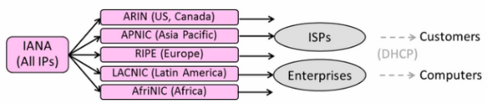
IPv4 Addresses
Internet Assigned Numbers Authority (IANA) owns all public IP addresses
Internet Corporation for Assigned Names and Numbers (ICANN)
Created to manage network numbers since the late 1990s
Delegates address space to Regional Internet Registries (RIRs)
RIRs dole out blocks of addresses
Companies (e.g., ISPs) apply to these bodies for IP addresses.
ISPs redistribute to end-user organizations or to smaller ISPs
Companies assign these addresses to computers on their network (using DHCP)
IP address assignment is an ongoing process as companies grow.
https://www.icann.org/en/system/files/files/functions-basics-07apr14-en.pdf

Slide 15
IPv4 Addresses
IPv4 uses 32-bit addresses
Written in dotted-quad notation: four 8-bit numbers separated by dots
Address is hierarchical: comprised of a network prefix (address) and a host address
IP addresses are allocated in blocks called IP prefixes, e.g., 18.13.0.0/16
hosts on one network are all in the same prefix
high order bits (the network id) are common across all hosts in a network
Written in “IP address/length” notation
The 128.13.0.0/16 prefix has host addresses from 128.13.0.0 to 128.13.255.255
An L-bit prefix, has the first L bits fixed, and contains 2^{32-L} host addresses
8 bits
8 bits
8 bits
8 bits
aaaaaaaabbbbbbbbccccccccdddddddd ↔ A.B.C.D
00010010000111110000000000000001 ↔
18.31.0.1

Slide 16
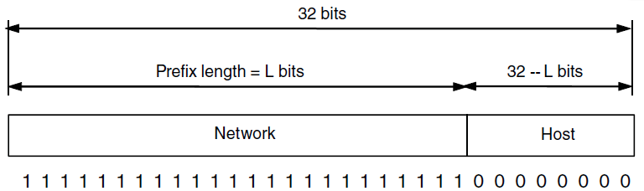
IPv4 Addresses – IP Prefixes
Characteristics
More specific prefix: longer prefix, fewer IP addresses
Less specific prefix: shorter prefix, more IP addresses
Prefix
length
/0
/8
/16
/24
/32
2¹⁶
2⁰
Addresses
in prefix
2³²
2²⁴
2⁸
Less specific
More specific
000100100001111100000000xxxxxxxx ↔
18.31.0.0/24
1000000000001101xxxxxxxxxxxxxxxx ↔
128.13.0.0/16

Slide 17
IP Prefixes
Benefit: Prefixes let Internet routing scale
routers forward packets based on ONLY the network portion of a host’s address
Routers do not consider the host portion while forwarding - all packets for all hosts on the same network are sent in the same direction
host portion is only relevant once the packet arrives at its destination network
Despite over a billion hosts, routing tables need to track much fewer prefixes (0.3 to 1 M)

Slide 18
Subnets and Aggregation
We can go even farther for scaling to reduce the entries needed in a routing table
split a prefix (subnets) and join prefixes (aggregation)
Subnets: internally split one less specific prefix into multiple more specific prefixes
to the outside world, the less specific prefix acts as a single network
but internally we split it into more specific prefixes – called subnets
Aggregation: externally join multiple more-specific prefixes into one larger less-specific prefix
represents multiple networks as a single larger network
can be done if all of the addresses are in the same portion of the address space
used by routers in the middle of the Internet
I’m the whole region
IP1 /18
1
IP2 /20
2
Region
IP /16
IP3 /22
3
I’m the whole region
IP1 /18
1
IP2 /18
2
Region
IP /16
IP3 /18
3

Slide 19
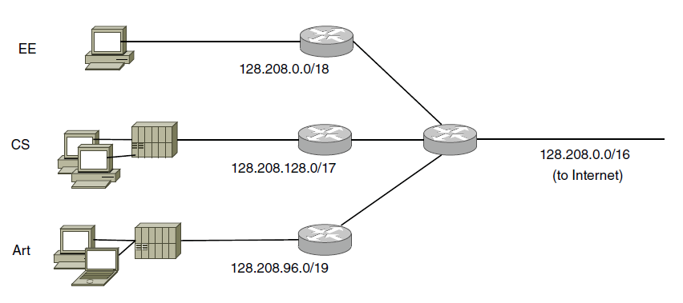
Subnets
Company leases one IP prefix, and splits it up into multiple internal sub networks
routers on the Rest of the Internet do not know about internal subnets
they send all traffic for this prefix to the company’s edge router
Company’s edge routers know the subnet masks for all internal networks
incoming packets are forwarded to the matching subnet
outgoing packets are simply sent on the line to the ISP
One prefix sent to rest of Internet
16K
32K
64K addresses
8K
University
Rest of Internet

Slide 20
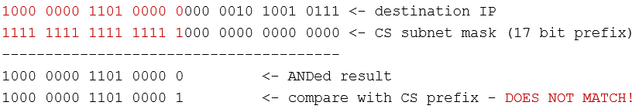
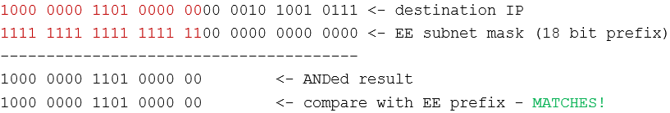
Subnets
When a packet arrives at the edge router, it forwards it on to the right subnet
Its routing table only needs the prefix for each subnet
ANDs destination IP address with each subnet mask to determine destination subnet
Incoming packet has destination address: 128.208.2.151
Compare against CS subnet:
Compare against EE subnet:

Slide 21
Aggregation
Company’s edge routers send
outbound traffic out the line that connects to the rest of the Internet
Inbound traffic to the appropriate subnet (needs an entry per subnet)
Routers in the middle of the Internet
have no easy default – need entry for each prefix on the Internet (1m+ networks)
to reduce the prefixes they must know about, they build supernets
join prefixes for several networks into a single larger, less-specific, prefix
works only if the prefixes fall within the same portion of the address space
networks do not belong to the same entity
reduces router tables to around 200,000 prefixes

Slide 22
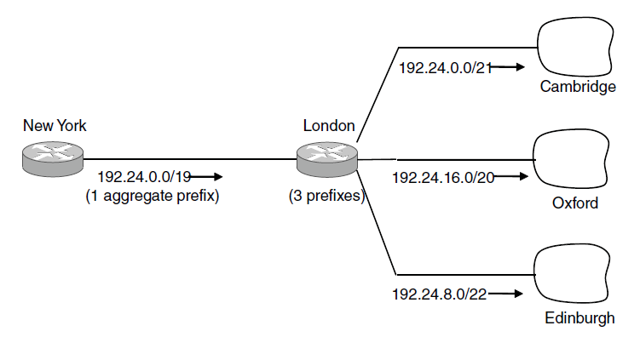
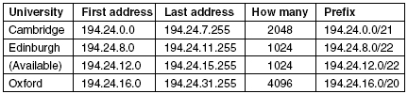
Aggregation
An ISP has the following block of addresses
[194.24.0.0 to 194.24.11.25] and [194.24.16.0 to 194.24.31.255]
it does not own [194.24.12.0 to 194.24.15.255] within this range
it claims to own the complete range [194.24.0.0 to 194.24.31.255] to NY router
NY router sends traffic in this full range to this ISP router
PROBLEM: Packets addressed to host 194.24.12.1 should be sent elsewhere!
Longest Matching Prefix rule addresses this issue
One prefix sent to rest of Internet
\
Rest of Internet
ISP

Slide 23
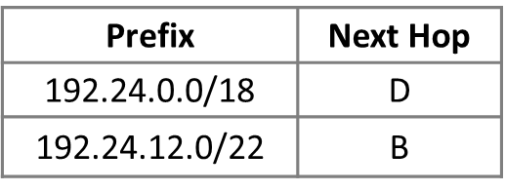
Forwarding Packets
IP Forwarding uses a table that lists the next hop, by IP prefix
Longest Matching Prefix forwarding rule
Prefixes in the table can overlap due to aggregation (supernets)
for each packet, find the longest prefix that contains the destination address (most specific entry)
Forward the packet to the next hop router for that prefix
192.24.63.255
More
specific
D
/18
192.24.15.255
B
/22
192.24.6.0 → D
192.24.14.32 → B
192.24.54.0 → D
192.24.12.0
D
192.24.0.0
IP address

Slide 24
Getting IP addresses
Problem
Node waking up for the first time needs its IP address, IP address of its router, network prefix, DNS server, time server, etc.
Its Ethernet address is hardwired into its NIC
Options
Manual configuration – but is tedious and error-prone esp. for large networks
Dynamic Host Configuration Protocol (since 1993)
automatically configures addresses and other parameters
What’s my IP?
Use A.B.C.D

Slide 25
Address Resolution Protocol – sending an IP packet
Problem
node needs link layer addresses to send a frame over the local link
How to transform a destination IP address into a link address?
ARP
node broadcasts the IP to all nodes, asking node with that IP to identify itself
node maps local IP addresses to the corresponding Link layer addresses
Link layer
Source
Ethernet
Dest.
Ethernet
Source IP
Dest.
IP
Payload …
From
NIC
From
DHCP
From ARP

Slide 26
IP errors – Internet Control Message Protocol
ICMP
sits on top of IP (sets Protocol = 1 in IP packet header)
Provides error reporting and testing (e.g., Ping)
when router encounters an error while forwarding
it sends an ICMP error report back to the IP source address
it discards the problem packet; host needs to rectify
Ping relies on a Echo Request, which requires an immediate Reply
Oh, now I see …
Report then toss it!
XXXXXXX
ICMP report

Slide 27
traceroute
repurposes TTL and ICMP functionality
TTL field is decremented every router hop, with ICMP error if it hits 0
protects against forwarding loops
sends probe packets, increasing TTL starting from 1
ICMP errors identify the routers on the path
Local
Host
. . .
Remote
Host
1 hop
2 hops
3 hops
N-1 hops
N hops

Slide 28
Public/Private IP addresses
Public IP address. e.g., 18.31.0.1
Valid destination on the global Internet
Must be allocated before use (by IANA and regional bodies)
Mostly exhausted
Private IP addresses
can be used freely within private networks
10.0.0.0/8, 172.16.0.0/12, 192.168.0.0/16
Need public IP address(es) and NAT to connect to the global Internet

Slide 29
Network Address Translation
connects an internal network to an external network
motivated by IP address scarcity
commonly used in home networks, built into wireless router
converts private IP addresses (many) to one public IP address
Unmodified computers at home
Looks like one
computer outside
ISP
NAT box

Slide 30
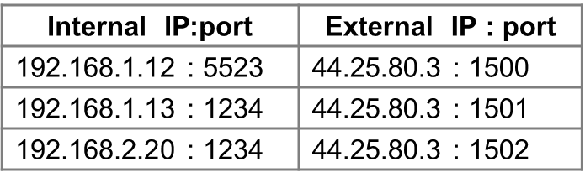
How NAT works
Keeps an internal/external address table
uses IP address + TCP port
so really is address and port translation
Need ports to make mapping 1:1 since there are fewer external IPs
What host thinks
What ISP thinks

Slide 31
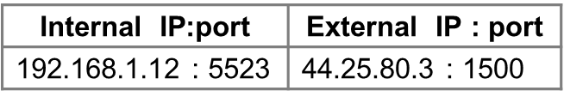
How NAT works
Internal → External
Look up and rewrite source IP/port
External → Internal
Look up and rewrite Destination IP / port
Internal
source
External
destination
NAT box

Slide 32
IPv6
Internet is growing
over 1 billion hosts, and we’re still using 32-bit addresses
now assigning addresses from leftover blocks held by the regional registries
IPv6
effort started by the IETF in 1994; standard in 1998
much larger addresses, 128 bits
new notation: 8 groups of 4 hex digits (16 bits)
omit leading zeros, groups of zeros e.g., 2001:0db8:0000:0000:0000:ff00:0042:8329
Other improvements
streamlined header processing
flow label to group packets
better fit with advanced features (mobility, multicast, security)

Slide 33
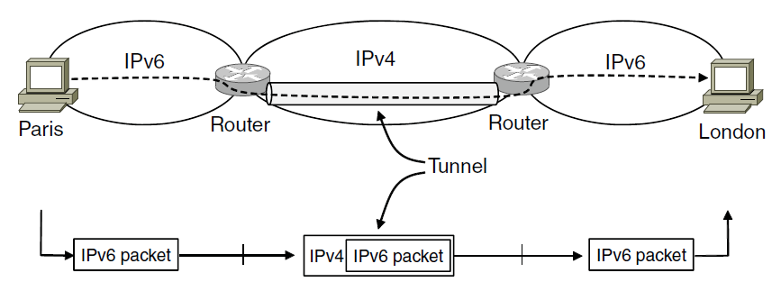
IPv6 Transition
Optional
Problem: How to deploy IPv6
IPv4 is incompatible with IPv4
Tunneling (carry IPv6 over IPv4)
Native IPv6 islands connected via IPv4
Tunnel acts as a single link across IPv4 network
carries IPv6 packets across IPv4 network

Slide 34
Tunneling
Optional
Difficulty:
must set up tunnel endpoints and routing
User
Tunnel
User
IPv6
IPv6
IPv6
IPv6
IPv6
IPv6
IPv4
IPv4
Link
Link
Link
Link
Link
Link
Native IPv6
Native IPv4
Native IPv6

Slide 35
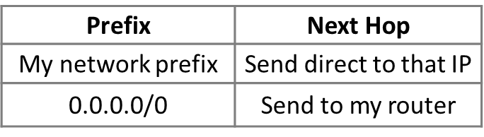
Host/Router distinction
Optional
Hosts can reach other hosts on their own prefix (own network)
But they send remote traffic (outside the prefix) to their nearest router
Routers do the routing – know the way to all destinations
Forwarding table for a host on the network
relies on the longest matching prefix algorithm
0.0.0.0/0 is a default route that catches all IP addresses
Not for my network? Send it to the router
It’s my job to know which way to go …

