Slide 1

Chapter 8 outline
What is network security?
Principles of cryptography
Message integrity, authentication
Securing TCP connections: TLS
Network layer security: IPsec

Slide 2
What is network security?
confidentiality: only sender, intended receiver should “understand” message contents
sender encrypts message
receiver decrypts message
authentication: sender, receiver want to confirm identity of each other
message integrity: sender, receiver want to ensure message not altered (in transit, or afterwards) without detection
access and availability: services must be accessible and available to users

Slide 3



Friends and enemies: Alice, Bob, Trudy
well-known in network security world
Bob, Alice (lovers!) want to communicate “securely”
Trudy (intruder) may intercept, delete, add messages
Alice
channel
data, control messages
Bob
secure
sender
secure
receiver
data
data
Trudy

Slide 4
Friends and enemies: Alice, Bob, Trudy
Who might Bob and Alice be?
… well, real-life Bobs and Alices!
Web browser/server for electronic transactions (e.g., on-line purchases)
on-line banking client/server
DNS servers
BGP routers exchanging routing table updates
other examples?

Slide 5
There are bad guys (and girls) out there!
Q: What can a “bad guy” do?
A: A lot! (recall section 1.6)
eavesdrop: intercept messages
actively insert messages into connection
impersonation: can fake (spoof) source address in packet (or any field in packet)
hijacking: “take over” ongoing connection by removing sender or receiver, inserting himself in place
denial of service: prevent service from being used by others (e.g., by overloading resources)

Slide 6
Chapter 8 outline
What is network security?
Principles of cryptography
Message integrity, authentication
Securing TCP connections: TLS
Network layer security: IPsec

Slide 7
The language of cryptography
Alice’s
encryption
key
Bob’s
decryption
key
K
A
K
B
plaintext
encryption
algorithm
ciphertext
decryption
algorithm
plaintext
m: plaintext message
K_{A}(m): ciphertext, encrypted with key K_{A}
m = K_{B}(K_{A}(m))

Slide 8
Symmetric key cryptography
K
K
S
S
plaintext
encryption
algorithm
ciphertext
decryption
algorithm
plaintext
K (m)
S
symmetric key crypto: Bob and Alice share same (symmetric) key: K
e.g., key is knowing substitution pattern in mono alphabetic substitution cipher
Q: how do Bob and Alice agree on key value?

Slide 9
Simple encryption scheme
substitution cipher: substituting one thing for another
monoalphabetic cipher: substitute one letter for another
plaintext: abcdefghijklmnopqrstuvwxyz
ciphertext: mnbvcxzasdfghjklpoiuytrewq
e.g.:
Plaintext: bob. i love you. alice
ciphertext: nkn. s gktc wky. mgsbc
Encryption key: mapping from set of 26 letters
to set of 26 letters

Slide 10
A more sophisticated encryption approach
n substitution ciphers, M₁,M₂,…,M_{n}
cycling pattern:
e.g., n=4: M₁,M₃,M₄,M₃,M₂; M₁,M₃,M₄,M₃,M₂; ..
for each new plaintext symbol, use subsequent substitution pattern in cyclic pattern
dog: d from M₁, o from M₃, g from M₄
Encryption key: n substitution ciphers, and cyclic pattern
key need not be just n-bit pattern

Slide 11
Breaking an encryption scheme
cipher-text only attack: Trudy has ciphertext she can analyze
two approaches:
brute force: search through all keys
statistical analysis
known-plaintext attack: Trudy has plaintext corresponding to ciphertext
e.g., in monoalphabetic cipher, Trudy determines pairings for a,l,i,c,e,b,o,
chosen-plaintext attack: Trudy can get ciphertext for chosen plaintext

Slide 12
Symmetric key crypto: DES
DES: Data Encryption Standard
US encryption standard [NIST 1993]
56-bit symmetric key, 64-bit plaintext input
block cipher with cipher block chaining
how secure is DES?
DES Challenge: 56-bit-key-encrypted phrase decrypted (brute force) in less than a day
no known good analytic attack
making DES more secure:
3DES: encrypt 3 times with 3 different keys

Slide 13
AES: Advanced Encryption Standard
symmetric-key NIST standard, replaced DES (Nov 2001)
processes data in 128 bit blocks
128, 192, or 256 bit keys
brute force decryption (try each key) taking 1 sec on DES, takes 149 trillion years for AES

Slide 14

Public Key Cryptography
symmetric key crypto:
requires sender, receiver know shared secret key
Q: how to agree on key in first place (particularly if never “met”)?
public key crypto
radically different approach [Diffie-Hellman76, RSA78]
sender, receiver do not share secret key
public encryption key known to all
private decryption key known only to receiver

Slide 15
Public Key Cryptography
+
Bob’s public key
K
B
-
Bob’s private key
K
B
plaintext
message, m
encryption
algorithm
ciphertext
decryption
algorithm
plaintext
+
-
+
K (m)
m = K (K (m))
B
B
B
Wow - public key cryptography revolutionized 2000-year-old (previously only symmetric key) cryptography!
similar ideas emerged at roughly same time, independently in US and UK (classified)

Slide 16
Public key encryption algorithms
requirements:
+
.
-
.
1
need K ( ) and K ( ) such that
B
B
-
+
K (K (m)) = m
B
B
+
2
given public key K , it should be impossible to compute private key K
B
-
B
RSA: Rivest, Shamir, Adelson algorithm

Slide 17
RSA in practice: session keys
exponentiation in RSA is computationally intensive
DES is at least 100 times faster than RSA
use public key crypto to establish secure connection, then establish second key – symmetric session key – for encrypting data
session key, K_{S}
Bob and Alice use RSA to exchange a symmetric session key K_{S}
once both have K_{S}, they use symmetric key cryptography

Slide 18
Chapter 8 outline
What is network security?
Principles of cryptography
Message integrity, Authentication
Securing TCP connections: TLS
Network layer security: IPsec

Slide 19

Digital signatures
cryptographic technique analogous to hand-written signatures:
sender (Bob) digitally signs document: he is document owner/creator.
verifiable, nonforgeable: recipient (Alice) can prove to someone that Bob, and no one else (including Alice), must have signed document
simple digital signature for message m:
Bob signs m by encrypting with his private key K_{B}, creating “signed” message, K_{B}⁻(m)
-
Bob’s private
key
-
Bob’s message, m
K
m,K
(m)
B
B
Dear Alice
Oh, how I have missed you. I think of you all the time! …(blah blah blah)
Bob
Dear Alice
Oh, how I have missed you. I think of you all the time! …(blah blah blah)
Bob
Public key
encryption
algorithm
-
K
(m)
B

Slide 20
Digital signatures
-
suppose Alice receives msg m, with signature: m, K_{B}(m)
Alice verifies m signed by Bob by applying Bob’s public key K_{B} to K_{B}(m) then checks K_{B}(K_{B}(m) ) = m.
If K_{B}(K_{B}(m) ) = m, whoever signed m must have used Bob’s private key
+
-
+
-
+
-
Alice thus verifies that:
Bob signed m
no one else signed m
Bob signed m and not m’
non-repudiation:
Alice can take m, and signature K_{B}(m) to court and prove that Bob signed m
-

Slide 21
Message digests
computationally expensive to public-key-encrypt long messages
goal: fixed-length, easy- to-compute digital “fingerprint”
apply hash function H to m, get fixed size message digest, H(m)
large
message
m
H: Hash
Function
H(m)
Hash function properties:
many-to-1
produces fixed-size msg digest (fingerprint)
given message digest x, computationally infeasible to find m such that x = H(m)

Slide 22
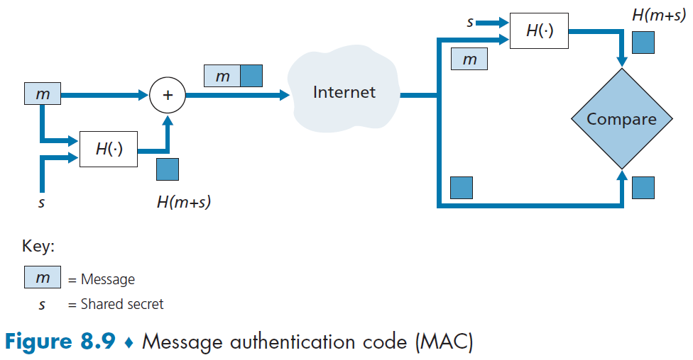
Message Authentication Code

Slide 23
Digital signature = signed message digest
Bob sends digitally signed message:
Alice verifies signature, integrity of digitally signed message:
large
message
m
H: Hash
Function
H(m)
encrypted
message digest
-
K_{B}(H(m))
digital
signature
(encrypt)
Bob’s
private
key
large
message
m
-
K
B
digital
signature
(decrypt)
Bob’s
public
key
+
encrypted
message digest
H: Hash
function
K
B
+
-
K_{B}(H(m))
H(m)
H(m)
?
equal

Slide 24
Hash function algorithms
MD5 hash function widely used (RFC 1321)
computes 128-bit message digest in 4-step process.
arbitrary 128-bit string x, appears difficult to construct msg m whose MD5 hash is equal to x
SHA-1 is also used
US standard [NIST, FIPS PUB 180-1]
160-bit message digest

Slide 25
Chapter 8 outline
What is network security?
Principles of cryptography
Message integrity, Authentication,
Securing TCP connections: TLS
Network layer security: IPsec

Slide 26
Authentication: ap4.0
Goal: Bob wants Alice to “prove” her identity to him
nonce: number (R) used only once-in-a-lifetime
protocol ap4.0: to prove Alice “live”, Bob sends Alice nonce, R
Alice must return R, encrypted with shared secret key
“I am Alice”
R
K (R)
Bob know Alice is live, and only Alice knows key to encrypt nonce, so it must be Alice!
A-B

Slide 27
Authentication: ap5.0
ap4.0 requires shared symmetric key - can we authenticate using public key techniques?
ap5.0: use nonce, public key cryptography
“I am Alice”
R
Bob computes
+
-
-
K
(K (R)) = R
K (R)
A
A
A
and knows only Alice could have the private key, that encrypted R such that
Send me your public key
+
K
+
-
A
K
A
(K (R)) = R
A

Slide 28
Authentication: ap5.0 – there’s still a flaw!
man (or woman) in the middle attack: Trudy poses as Alice (to Bob) and as Bob (to Alice)
I am Alice
I am Alice
?
R
-
K (R)
T
R
Where are mistakes made here?
Send me your public key
-
+
K (R)
K
Bob computes
A
T
+
-
Send me your public key
K
(K (R)) = R,
+
T
T
K
authenticating
Trudy as Alice
A
Trudy recovers m:
+
+
-
+
K (m)
Trudy recovers Bob’s m:
m = K (K (m))
Bob sends a personal message, m to Alice
-
+
K (m)
T
T
m = K (K (m))
A
T
A
A
sends m to Alice encrypted with Alice’s public key
and she and Bob meet a week later in person and discuss m, not knowing Trudy knows m

Slide 29
Authentication: ap5.0 – let’s fix it!!
Recall the problem: Trudy poses as Alice (to Bob) and as Bob (to Alice)
I am Alice
I am Alice
?
R
-
K (R)
T
R
Where are mistakes made here?
Send me your public key
-
+
K (R)
K
Bob computes
A
T
+
-
Send me your public key
K
(K (R)) = R,
+
T
T
K
authenticating
Trudy as Alice
A
Trudy recovers m:
+
+
-
+
K (m)
Trudy recovers Bob’s m:
m = K (K (m))
Bob sends a personal message, m to Alice
-
+
K (m)
T
T
m = K (K (m))
A
T
A
A
sends m to Alice encrypted with Alice’s public key
and she and Bob meet a week later in person and discuss m, not knowing Trudy knows m

Slide 30
Public key Certification Authorities (CA)
certification authority (CA): binds public key to particular entity, E
entity (person, website, router) registers its public key with CE provides “proof of identity” to CA
CA creates certificate binding identity E to E’s public key
certificate containing E’s public key digitally signed by CA: CA says “this is E’s public key”
Alice’s
public
key
digital
signature
(encrypt)
+
+
K
K
B
B
CA’s
private
key
-
certificate for Alice’s public key, signed by CA
Alice’s
identifying information
K
CA

Slide 31
Public key Certification Authorities (CA)
when Bob wants Alice’s public key:
gets Alice’s certificate (Alice or elsewhere)
apply CA’s public key to Alice’s certificate, get Alice’s public key
+
digital
signature
(decrypt)
Alice’s
public
key
K
+
B
K
B
CA’s
public
key
+
K
CA

Slide 32
Chapter 8 outline
What is network security?
Principles of cryptography
Authentication, message integrity
Securing TCP connections: TLS
Network layer security: IPsec

Slide 33
Transport-layer security (TLS)
widely deployed security protocol above the transport layer
supported by almost all browsers, web servers: https (port 443)
provides:
confidentiality: via symmetric encryption
integrity: via cryptographic hashing
authentication: via public key cryptography
all techniques we have studied!
history:
early research, implementation: secure network programming, secure sockets
secure socket layer (SSL) deprecated [2015]
TLS 1.3: RFC 8846 [2018]

Slide 34
Transport-layer security: what’s needed?
let’s build a toy TLS protocol, t-tls, to see what’s needed!
we’ve seen the “pieces” already:
handshake: Alice, Bob use their certificates, private keys to authenticate each other, exchange or create shared secret
key derivation: Alice, Bob use shared secret to derive set of keys
data transfer: stream data transfer: data as a series of records
not just one-time transactions
connection closure: special messages to securely close connection

Slide 35
t-tls: initial handshake
t-tls handshake phase:
Bob establishes TCP connection with Alice
Bob verifies that Alice is really Alice
Bob sends Alice a master secret key (MS), used to generate all other keys for TLS session
potential issues:
3 RTT before client can start receiving data (including TCP handshake)
TCP SYN
SYNACK
ACK
t-tls hello
public key certificate
K_{B}⁺(MS) = EMS
client request
server reply

Slide 36
t-tls: cryptographic keys
considered bad to use same key for more than one cryptographic function
different keys for message authentication code (MAC) and encryption
four keys:
K_{c} : encryption key for data sent from client to server
M_{c} : MAC key for data sent from client to server
K_{s} : encryption key for data sent from server to client
M_{s} : MAC key for data sent from server to client
keys derived from key derivation function (KDF)
takes master secret and (possibly) some additional random data to create new keys

Slide 37
t-tls: encrypting data
recall: TCP provides data byte stream abstraction
Q: can we encrypt data in-stream as written into TCP socket?
A: where would MAC go? If at end, no message integrity until all data received and connection closed!
solution: break stream in series of “records”
each client-to-server record carries a MAC, created using M_{c}
receiver can act on each record as it arrives
t-tls record encrypted using symmetric key, K_{c,} passed to TCP:
K_{c}(
)
data
MAC

Slide 38
Chapter 8 outline
What is network security?
Principles of cryptography
Authentication, message integrity
Securing TCP connections: TLS
Network layer security: IPsec

Slide 39
IP Security Protocol (IPSec)
Provides security at the network layer
between pairs of network-layer entities (host-host, host-router, router-router)
Provides
confidentiality: sender encrypts datagram payload (e.g., TCP segment, UDP datagram)
provides “blanket coverage” from network sniffing
data integrity: receiver can check for tampering while datagram was in transit
source authentication: receiver can verify source of the secured datagram
replay-attack prevention: receiver can detect duplicate datagrams inserted
Used to create Virtual Private Networks (VPNs) that run over the public Internet

Slide 40
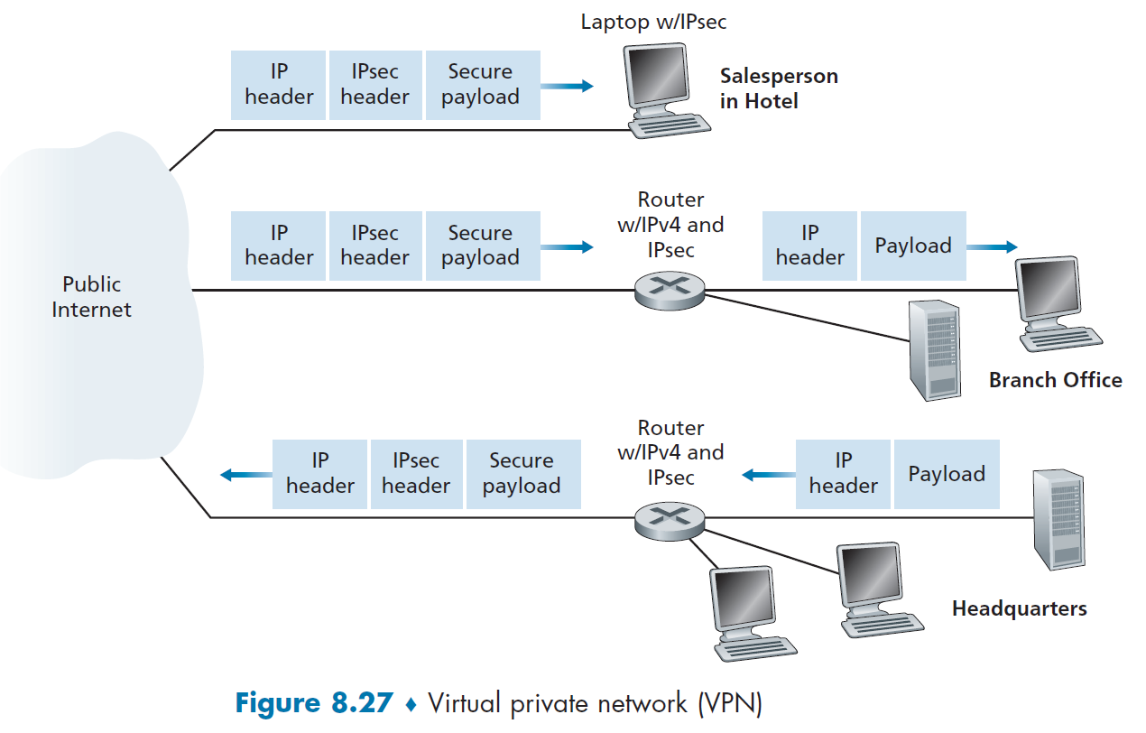
IPSec and VPNs
Distributed institution can either:
create a private network
deploys private routers, links and DNS infra
very costly to purchase, install, maintain
create a VPN over the public Internet
inter-office traffic must first be encrypted (intra-office can use vanilla IP)
IP header is not encrypted so can traverse the Internet, but payload is encrypted
gateway routers (HQ or Branch Office) or host OS converts between IP to IPsec datagrams

