Slide 1

Assignment 2
Tic Tac Toe
(Java, Processing GUI)
Siva R Jasthi
ICS499 Software Engineering and Capstone Project
Spring 2022
Computer Science and Cyber Security
Metropolitan State University

Slide 2
Assignment 2 Goals
[1] Exploring “Processing” GUI library
https://processing.org/
[2] Learning new IDE / technology to solve a problem
[3] Refactoring
Given some code, how can we refactor it so as to support building a GUI in “Processing”?

Slide 3
Background
Processing IDE is a lightweight GUI tool typically introduced in high school (for AP CS A students).
This library doesn’t have the overhead of heavy weight Swing or JavaFX components.
Download this book and quickly skim through the chapter headings (table of contents)
https://www.pdfdrive.com/make-getting-started-with-processing-a-hands-on-introduction-to-making-interactive-graphics-e158742550.html
Processing Reference: https://processing.org/reference/

Slide 4
Assignment 2 Details
[1] Review “TicTacToe.java” and “ConsoleMain.java”.
These two classes reflect the how TicTacToe game can be played.
[2] However, the current implementation doesn’t have “Graphical User Interface”.
So, the goal of this assignment is to build a light-weight GUI using “Processing” library.
This GUI will let two users play Tic Tac Toe game (Note: this is not a web based app; So, just assume that two users are sitting in front of a desktop and are taking turns to play the game).

Slide 5
Assignment 2: Setup
Import the “A2_TicTacToe.zip” project into your Eclipse environment.
Reference Video: https://www.youtube.com/watch?v=NMfIHuEwE7A
You should get the “core.java” as the Referenced Library in your Eclipse project
Another reference o how core.java comes into play in Eclipse projects
https://happycoding.io/tutorials/java/processing-in-java

Slide 6
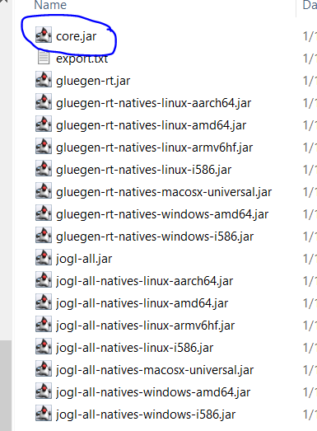
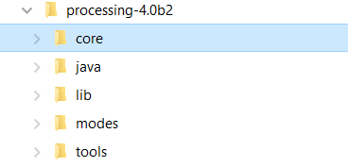
Assignment 2: Setup (If the previous step is not working)
If you are still having compile issues, you need to manually include “core.jar” (the Processing jar file) into your project
Download Processing library
https://processing.org/download
And add “core.jar” manually
to your Eclipse project

Slide 7
Assignment 2: Final Output
Once “GraphicsMain.java” is run, it presents the UI for the players to play Tic Tac Toe
You are welcome to refactor “TicTacToe.java” to add additional methods and fix the existing methods. However, you may also need to refactor “ConsoleMain.java” accordingly.

Slide 8
Assignment 2: Implementation Guidance
https://processing.org/reference
You will use “rect()” construct to draw the TicTacToe board.
Based on the mouse clicks and the ‘turn’ (whose turn is it now), you play X or ) in the rectangles.
See https://processing.org/examples/button.html
One the board is full or if there is a winner, you show a message indicating the winner.
The user starts the application again if he/she wants to play the game.

Slide 9
What to submit?
Submit all *.java files to D2L
Capture the screen shot of “GraphicsMain.java” and submit the screen shot to D2L
Capture the screen shot of “ConsoleMain.java” and submit the screen shot to D2L. (this should NOT regress).

