Slide 1

Application layer: overview
content distribution networks
Principles of network applications and socket programming
Web and HTTP
The Domain Name System DNS

Slide 2
















Creating a network app
application
transport
network
data link
physical
write programs that:
run on (different) end systems
communicate over network
e.g., web server software communicates with browser software, HTTP, IMAP, FTP
network-core devices do not run user applications
mobile network
national or global ISP
local or regional ISP
home network
content
provider
network
application
transport
network
data link
physical
application
transport
network
data link
physical
datacenter
network
enterprise
network

Slide 3
Client-server paradigm
server:
always-on host
permanent IP address and known port
often in data centers, for scaling
clients:
communicates with server
intermittently connected
dynamic IP addresses
do not communicate directly with each other
mobile network
national or global ISP
local or regional ISP
home network
content
provider
network
datacenter
network
enterprise
network

Slide 4
Addressing a process
process: program running on a host
  processes in different hosts communicate by exchanging messages using sockets
to receive messages, process must have identifier
  globally unique 32-bit IP address
  unique port number on a host that identifies a process running on it
    well-known port numbers: HTTP server: 80, mail server: 25
Server usually has a fixed, well-known, IP address, and the application protocol defines a standard port number to use

Slide 5
An application-layer protocol :
Protocols define the format, order of messages sent and received among network entities, and actions taken on msg transmission, receipt
defines
  types of messages exchanged: request, response
  message syntax: fields in messages
  message semantics: meaning of information in fields
  rules for when and how processes send & respond to messages
implemented by client and server programs
Open protocol - published in an RFC (HTTP, SMTP, FTP)
  different developers write client and server programs and have them interoperate
  must use well-known port numbers
proprietary protocol (Skype)
  single developer creates both client and server
  must avoid using well-known port numbers

Slide 6
Transport services provided to application
throughput
guarantee
elastic
elastic
elastic
audio: 5Kbps-1Mbps
video:10Kbps-5Mbps
same as above
Kbps+
elastic
time sensitive?
(low delay)
no
no
no
yes, 10’s msec
yes, few secs
yes, 10’s msec
yes and no
application
file transfer/download
e-mail
Web documents
real-time audio/video
streaming audio/video
interactive games
text messaging
data integrity
no loss
no loss
no loss
loss-tolerant
loss-tolerant
loss-tolerant
no loss

Slide 7
Internet transport protocols services
TCP service:
reliable transport between sending and receiving process
flow control: sender won’t overwhelm receiver
congestion control: throttle sender when network overloaded
connection: setup between client and server processes
does not provide timing, throughput guarantee, security
UDP service:
does not provide reliability, flow control, congestion control, or connection setup, timing, throughput guarantee, security.
Internet applications have been designed to cope without guarantees on timing and throughput

Slide 8
Internet transport protocols services
application
layer protocol
FTP
SMTP
HTTP 1.1
SIP, RTP, or proprietary HTTP, DASH
WOW, FPS (proprietary)
application
file transfer/download
e-mail
Web documents
Internet telephony
streaming audio/video
interactive games
transport protocol
TCP
TCP
TCP
TCP or UDP
TCP
UDP or TCP

Slide 9
Types of application layer protocols
client and server program can implement an application-layer protocol that
  is proprietary
    single developer creates both client and server programs
    must avoid using well-known port numbers
  is openly published and specified as a standard
    different developers can write client and server programs and have them interoperate
    uses well known port numbers

Slide 10

Socket programming
goal: build client/server application that uses sockets to communicate
Application:
client connects to server
server sends current time to client
client receives time and displays it
Socket types: UDP (unreliable datagram) OR TCP (reliable, byte stream)
application
socket
application
controlled by
app developer
process
process
transport
transport
network
network
controlled
by OS
link
Internet
link
physical
physical

Slide 11
Transport Layer –TCP and UDP
  TCP: reliably send a stream of bytes
  Like phone system
    first set up a connection to ensure that someone is there to receive data
    send data
  guarantees receiver gets all data in right order
  server process must be running and ready to accept incoming connections
  Use when
    reliability is critical
  UDP: unreliably sends datagrams to another
    Like postal system
      send packets of mail to an address
      some may be lost, or arrive out of order
      reliability needs a protocol to be established with recipient
        number the envelopes
        recipient sends you acknowledgments
        you resend
    Use when
      raw speed is critical (no need to setup a connection, no retries)
      application is responsible for reliability

Slide 12
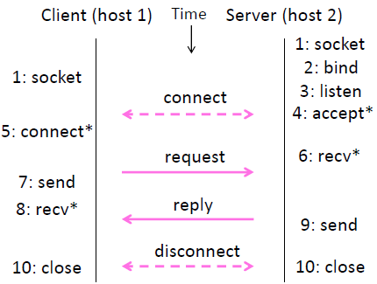

Socket API
Socket data structure
permits an app attach to the network
represents a connection endpoint
  address (host) and port number (application)
  of sender or receiver
API primitives turn control over to the OS
SOCKET: create new communication endpoint
BIND: associate local address with a socket
LISTEN: announce willingness to accept connections
ACCEPT: establish an incoming connection
CONNECT: request a connection
SEND: send data
RECEIVE: receive data
CLOSE: release connection

Slide 13
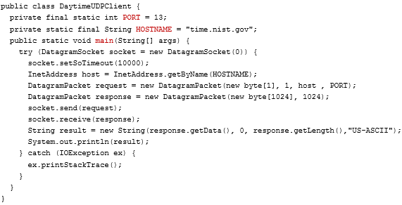
UDP Example - Client
Sender attaches IP address and port # of destination to each datagram

Slide 14
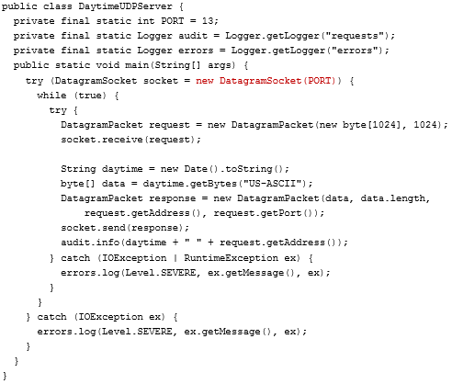
UDP Example - Server
Sender attaches IP address and port # of destination to each datagram
receiver extracts sender IP address and port # from received datagram

Slide 15
Socket programming with TCP
when contacted by client, server TCP creates new socket for server process to communicate with that particular client
  allows server to talk with multiple clients
  source port numbers used to distinguish clients (more in Chap 3)

Slide 16
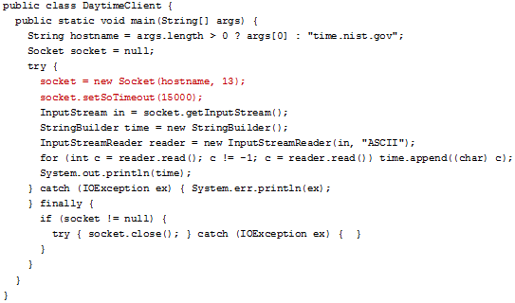
TCP Example – Client
Application viewpoint
TCP provides reliable, in-order
byte-stream transfer (“pipe”)
between client and server

Slide 17
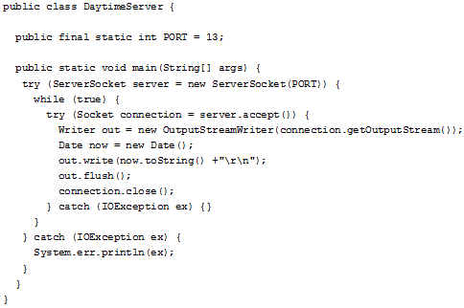
TCP Example – Server
Application viewpoint
when contacted by client, server TCP creates a new socket to communicate with that client.
This allows server to talk with multiple clients (distinguished by port numbers)

Slide 18
Securing TCP
Sockets API:
no encryption
passwords sent into socket traverse Internet in cleartext
Transport Layer Security (TLS)
provides encrypted TCP connections, data integrity, end-point authentication
Implemented in application layer
  apps use TLS libraries, that use TCP in turn
  TLS Sockets API encrypts cleartext sent over Internet

Slide 19
Application layer: overview
content distribution networks
Principles of network applications and socket programming
Web and HTTP
The Domain Name System DNS

Slide 20
Web and HTTP
web page consists of base HTML file which includes several referenced objects,
  each can be stored on different Web servers
  can be HTML file, JPEG image, Java applet, audio file,…
each resource is addressable by a URL
www.someschool.edu/someDept/pic.gif
host name
path name

Slide 21

HTTP overview
HTTP: hypertext transfer protocol
Web’s application layer protocol
client/server model:
  client: browser that requests, receives, and “displays” Web objects
  server: Web server sends objects in response to requests
HTTP request
PC running
Firefox browser
HTTP response
HTTP request
server running
Apache Web
server
HTTP response
iPhone running
Safari browser

Slide 22
HTTP overview (continued)
HTTP uses TCP:
client initiates TCP connection (creates socket) to server, port 80
server accepts TCP connection from client
HTTP messages (application-layer protocol messages) exchanged between browser (HTTP client) and Web server (HTTP server)
TCP connection closed
HTTP is “stateless”
server maintains no information about past client requests
aside
Great advantage of layering
HTTP need not worry about lost data or details of how TCP recovers from loss/reordering within the network.

Slide 23
Non-persistent HTTP
User enters URL:
www.someSchool.edu/someDepartment/home.index
(references 10 jpegs)
1a. HTTP client initiates TCP connection to HTTP server at www.someSchool.edu on port 80
1b. HTTP server waiting for TCP connection “accepts” connection, notifying client
2. HTTP client sends HTTP request message for a URL into socket.
3. HTTP server sends a response with requested object, into its socket
4. HTTP server closes TCP connection
5. client renders html. Parsing it,
finds 10 referenced jpeg objects
time
6. Steps 1-5 repeated for each of 10 jpeg objects

Slide 24
Non-persistent HTTP: response time
RTT: time for a small packet to travel from client to server and back
HTTP response time (per object):
one RTT to initiate TCP connection
one RTT for HTTP request and first few bytes of HTTP response to return
object transmission time
Issues:
requires 2 RTTs overhead per object
OS adds overhead for each connection
browsers open multiple TCP connections to fetch referenced objects in parallel
initiate TCP
connection
RTT
request file
RTT
time to
transmit
file
file received
time
time

Slide 25
Persistent HTTP (HTTP 1.1)
server leaves connection open after sending response
  used for subsequent HTTP messages
  client sends requests as soon as it encounters a referenced object
  1 RTT for all referenced objects (cuts response time in half)
  Pipelining: all requests are sent without waiting for replies

Slide 26
HTTP request message
two types of HTTP messages: request, response
HTTP request message:
  ASCII (human-readable format)
carriage return character
line-feed character
request line (GET, POST,
HEAD commands)
GET /index.html HTTP/1.1\r\n
Host: www-net.cs.umass.edu\r\n
User-Agent: Firefox/3.6.10\r\n
Accept: text/html,application/xhtml+xml\r\n
Accept-Language: en-us,en;q=0.5\r\n
Accept-Encoding: gzip,deflate\r\n
Accept-Charset: ISO-8859-1,utf-8;q=0.7\r\n
Keep-Alive: 115\r\n
Connection: keep-alive\r\n
\r\n
header
lines
carriage return, line feed at start of line indicates end of header lines
* Check out the online interactive exercises for more examples: http://gaia.cs.umass.edu/kurose_ross/interactive/

Slide 27
HTTP request messages
POST method:
web page includes form input
user input sent to server in entity body of POST request message
HEAD method:
requests headers (only) that would be returned if URL were requested with a GET.
PUT method:
uploads new file (object) to server
replaces file at specified URL with content in entity body of POST HTTP request message
GET method:
include user data in URL field of HTTP GET request message (following a ‘?’):
www.somesite.com/animalsearch?monkeys&banana

Slide 28
HTTP response message
status line (protocol
status code status phrase)
HTTP/1.1 200 OK\r\n
Date: Sun, 26 Sep 2010 20:09:20 GMT\r\n
Server: Apache/2.0.52 (CentOS)\r\n
Last-Modified: Tue, 30 Oct 2007 17:00:02 GMT\r\n
ETag: "17dc6-a5c-bf716880"\r\n
Accept-Ranges: bytes\r\n
Content-Length: 2652\r\n
Keep-Alive: timeout=10, max=100\r\n
Connection: Keep-Alive\r\n
Content-Type: text/html; charset=ISO-8859-1\r\n
\r\n
data data data data data ...
header
lines
data, e.g., requested
HTML file
* Check out the online interactive exercises for more examples: http://gaia.cs.umass.edu/kurose_ross/interactive/

Slide 29
HTTP response status codes
status code appears in 1st line in server-to-client response message.
some sample codes:
200 OK
  request succeeded, requested object later in this message
301 Moved Permanently
  requested object moved, new location specified later in this message (in Location: field)
400 Bad Request
  request msg not understood by server
404 Not Found
  requested document not found on this server
505 HTTP Version Not Supported

Slide 30
Maintaining user/server state: cookies
HTTP GET/response interaction is stateless
  no notion of multi-step exchanges of messages to complete a “transaction”
BUT often desirable for a site to identify users to
  restrict user access or to serve content based on user identity
  track users
  maintain state between transactions
Notes:
t’

Slide 31
Maintaining user/server state: cookies
client
server
ebay 8734
usual HTTP request msg
Amazon server
creates ID
1678 for user
cookie file
Response with header
set-cookie: 1678
backend
database
create
entry
ebay 8734
amazon 1678
HTTP request msg
cookie: 1678
cookie-
specific
action
access
usual HTTP response msg
one week later:
access
ebay 8734
amazon 1678
usual HTTP request msg
cookie: 1678
cookie-
specific
action
usual HTTP response msg
time
time
Notes:
t’

Slide 32

Web caches (proxy servers)
Goal: satisfy client request without involving origin server
user configures browser to point to a Web cache
  installed by ISP (university, company, residential ISP)
browser sends all HTTP requests to cache
  if object in cache: cache returns object to client
  else cache requests object from origin server, caches received object, then returns object to client
reduces response time for client requests
  cache is closer to client
proxy
server
HTTP request
HTTP request
client
HTTP response
HTTP response
origin
server
HTTP request
HTTP response
client
origin
server
Notes:
t’

Slide 33
Conditional GET
client
server
Goal: don’t send object if cache has up-to-date version
server: specify modified date in response
Last-Modified: <date>
cache: specify date of cached copy in HTTP request
  If-modified-since: <date>
server: response contains no object if cached copy is up-to-date:
  HTTP/1.0 304 Not Modified
HTTP request msg
If-modified-since: <date>
object
not
modified
before
<date>
HTTP response
HTTP/1.0
304 Not Modified
HTTP request msg
If-modified-since: <date>
object
modified
after
<date>
HTTP response
HTTP/1.0 200 OK
<data>
Notes:
t’

Slide 34
Application Layer: Overview
content distribution networks
Principles of network applications and socket programming
Web and HTTP
The Domain Name System DNS

Slide 35
DNS: Domain Name System
IP address
  fixed-length, hierarchically structured
  used for addressing datagrams
  preferred by routers
Host “name”
  preferred by humans
Domain Name System:
maps IP addresses to/from names
distributed database implemented in hierarchy of many name servers
application-layer protocol: hosts, name servers communicate to resolve names (address/name translation)
runs over UDP on port 53

Slide 36
DNS: services, structure
DNS services
hostname to IP address translation
host aliasing or mail server aliasing
  maps canonical to alias names
load distribution
  replicated Web servers: 1+ IP addresses correspond to one alias
Q: Why not centralize DNS?
single point of failure
doesn’t scale - Comcast DNS servers alone: 600B DNS queries per day
centralized database cannot be close to all clients
maintenance – centralized database would be huge and would have to be updated frequently

Slide 37
DNS: a distributed, hierarchical database
Root DNS Servers
Root
…
…
.com DNS servers
.org DNS servers
.edu DNS servers
Top Level Domain
…
…
…
…
yahoo.com
DNS servers
amazon.com
DNS servers
pbs.org
DNS servers
nyu.edu
DNS servers
umass.edu
DNS servers
Authoritative
Client wants IP address for www.amazon.com:
client queries root server to find .com DNS server
client queries .com DNS server to get amazon.com DNS server
client queries amazon.com DNS server to get IP address for www.amazon.com

Slide 38
DNS servers
Root name servers:
Provides IP addresses of TLD servers
1000 replicas of 13 root servers
  managed by 12 different organizations and coordinated through the IANA
Top-Level Domain (TLD) servers:
  responsible for .com, .edu, ..., and country domains: .uk, .fr, …
  Verizon Global Registry Services maintains TLD servers for .com, Educause for .edu
Authoritative DNS servers:
  DNS server(s) for organization’s named hosts
  can be maintained by organization or service provider

Slide 39
Local DNS servers (Default name servers)
does not belong to the DNS server hierarchy
maintained by each ISP
  ISP provides host with IP addresses of its local DNS Servers (via DHCP)
Host’s DNS query is sent to its local DNS server
  acts as proxy, forwards query into DNS server hierarchy
  has cache of recent translations

Slide 40
DNS name resolution: iterated query
root DNS server
Example: host at engineering.nyu.edu wants IP address for gaia.cs.umass.edu
2
3
TLD DNS server
Iterated query:
contacted server replies with name of server to contact
“I don’t know this name, but ask this server”
1
4
8
5
requesting host at
engineering.nyu.edu
local DNS server
dns.nyu.edu
gaia.cs.umass.edu
7
6
authoritative DNS server
dns.cs.umass.edu

Slide 41
DNS name resolution: recursive query
root DNS server
Example: host at engineering.nyu.edu wants IP address for gaia.cs.umass.edu
2
3
7
6
Recursive query:
puts burden of name resolution on contacted name server
1
TLD DNS server
8
requesting host at
engineering.nyu.edu
local DNS server
dns.nyu.edu
5
4
gaia.cs.umass.edu
authoritative DNS server
dns.cs.umass.edu

Slide 42
Caching, Updating DNS Records
once a name server learns mapping, it caches mapping
  cache entries timeout after some time
  TLD servers cached in local name servers (root name servers bypassed)
cached entries may be out-of-date
  if host changes IP address, may not be known Internet-wide until all TTLs expire!

Slide 43
DNS records
DNS: distributed database storing resource records (RR)
RR format: (name, value, type, ttl)
type=A
  name is hostname
  value is IP address
type=CNAME
  name is alias for a “canonical” (real) name
  value is canonical name
  www.ibm.com is really servereast.backup2.ibm.com
type=NS
  name is domain (e.g., foo.com)
  value is hostname of authoritative name server for this domain
type=MX
  value is canonical name of mailserver with alias name

Slide 44
Inserting records into DNS
Example: new startup “Network Utopia”
register name networkuptopia.com at DNS registrar
  provide names, IP addresses of authoritative name server (primary and secondary)
  registrar inserts NS, A RRs into .com TLD server:
  (networkutopia.com, dns1.networkutopia.com, NS)
  (dns1.networkutopia.com, 212.212.212.1, A)
create authoritative server locally with IP address 212.212.212.1
  type A record for www.networkuptopia.com
  type MX record for networkutopia.com

Slide 45
DNS security
DDoS attacks
bombard root servers with traffic
  not successful to date
  traffic filtering
  local DNS servers cache TLD server IPs, allowing root server bypass
bombard TLD servers
  potentially more dangerous
Redirect attacks
man-in-middle
  intercept DNS queries
DNS poisoning
  send bogus relies to DNS server, which caches
DNSSEC
secured version of DNS
addresses these vulnerabilities
DNSSEC
[RFC 4033]

Slide 46
Application layer: overview
content distribution networks
Principles of network applications and socket programming
Web and HTTP
The Domain Name System DNS

Slide 47
Content distribution networks (CDNs)
challenge: how to stream content (selected from millions of videos) to hundreds of thousands of simultaneous users?
option 1: single, large “mega-server”
  single point of failure
  point of network congestion
  long path to distant clients
  multiple copies of video sent over outgoing link
….quite simply: this solution doesn’t scale

Slide 48


Content distribution networks (CDNs)
challenge: how to stream content (selected from millions of videos) to hundreds of thousands of simultaneous users?
option 2: store/serve multiple copies of videos at multiple geographically distributed sites (CDN)
  enter deep: push CDN servers deep into many access networks
    close to users
    Akamai: 240,000 servers deployed in more than 120 countries (2015)
  bring home: smaller number (10’s) of larger clusters in POPs near (but not within) access networks
    used by Limelight

Slide 49




Content distribution networks (CDNs)
CDN: stores copies of content at CDN nodes
  e.g. Netflix stores copies of MadMen
subscriber requests content from CDN
  directed to nearby copy, retrieves content
  may choose different copy if network path congested
…
…
…
manifest file
…
where’s Madmen?
…
…
Notes:
49
Akamai: 100,000+ servers in 1000+ clusters in 1000+ networks in 70+ countries serving trillions of requests a day.
How many people use Netflix?

Slide 50

CDN content access: a closer look
Bob (client) requests video http://netcinema.com/6Y7B23V
video stored in CDN at http://KingCDN.com/NetC6y&B23V
1. Bob gets URL for video http://netcinema.com/6Y7B23V
from netcinema.com web page
2. resolve http://netcinema.com/6Y7B23V
via Bob’s local DNS
1
2
6. request video from
KINGCDN server,
streamed via HTTP
5
Bob’s
local DNS
server
netcinema.com
3. netcinema’s DNS returns CNAME for
http://KingCDN.com/NetC6y&B23V
4
3
netcinema’s
authoratative DNS
KingCDN.com
KingCDN
authoritative DNS

