Slide 1

Programming in Python
Siva Jasthi
Power Point Integration

Slide 2
python-pptx package
python-pptx is a Python library for creating and updating PowerPoint (.pptx) files.
See examples here:
https://python-pptx.readthedocs.io/en/latest/user/quickstart.html
Documentation:
https://python-pptx.readthedocs.io/en/latest/index.html
Installation:
pip install python-pptx

Slide 3
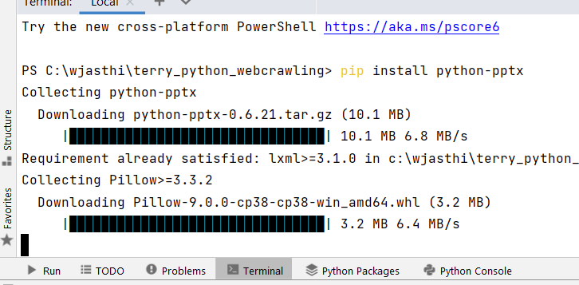
python-pptx package

Slide 4
Outline
Read the CSV file
For each string(quote) in the file:
Call indic-wp API to get the logical characters of the ‘quote’
Group these characters into 15 chunks
Shuffle (randomize) these 15 chunks
Create a PPT slide
Add these 15 chunks to the slide

Slide 5

Thank You. धन्यवाद
PYTHON PROGRAMMING

