Slide 1
ICS 432 – 01 Distributed and Cloud Computing Fall 2021
Instructor: Thanaa Ghanem
thanaa.ghanem@metrostate.edu
Lectures 13
November 20, 2021

Slide 2
IMPORTANT DATES
Day | Date | Due time | Assignment | Points | Optional
Saturday | November, 20 | 12:20 PM | Quiz 4 | 10 | Optional
Monday | November, 29 | 11:59 PM | Lab 12 – Make up a missed lab | 25 | Optional
Saturday | December, 4 | 9:00 AM | Final Exam | 165 | REQUIRED
Wednesday | December, 8 | 11:59 PM | Homework 4 | 40 | REQUIRED
Saturday | December, 11 | 12:20 PM | Week 15 module | 35 | REQUIRED

Slide 3
Week 15 module: Cloud Billing
To be completed asynchronously.
Details will be posted on D2L after the final exam.
From AWS Academy Cloud Foundations course
Watch module 2 (Cloud Billing and Economics) videos.(~1 hour of videos)
Read module 2 slides. (~65 slides).
(10 Points) Complete Knowledge check – will be posted on D2L starting on December 4.
(25 Points) Complete a cost-analysis activity. Due on December 11, 12:20 PM.

Slide 4
Web Services and RESTful APIs

Slide 5
Introduction
You usually use Graphical User Interface (GUI) to interact with computer software.
For example, the AWS Management Console is a GUI for interacting with Amazon cloud services.
Web services and their corresponding Application programming interfaces (APIs) make computer software accessible to developers via code in the same way as they are accessible via GUI
so that they can build software programs that interact with other software programs.

Slide 6
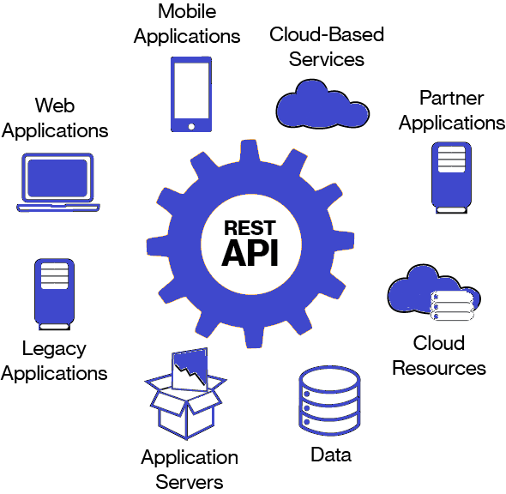
Web Services
The goal of web services is to provide technologies to allow software in different places, written in different languages and resident on different platforms to connect and interoperate.
Web services is one of the dominant paradigms for programming distributed systems.
Web services enables business to business integration.
Suppose one organization uses CORBA and another uses .NET → No problem!
Web services may exist internally to an organization or externally (in the cloud).
Notes:
Source: https://dzone.com/articles/an-introduction-to-restful-apis

Slide 7
Web Services (continued)
Clients of web services do NOT need to know how the service is implemented.
Network
Web
Service
Application
client
Application
code

Slide 8
Application Programming Interfaces (APIs)
An API is a set of instructions that defines how programmers interact with an application.
An API is often designed to be used with a software development kit (SDK), which is a collection of tools that enables developers to create downstream applications based on the API.
Examples:
AWS S3 APIs: s3.upload_file and s3.put_bucket_policy
AWS DynamoDB APIs: table.put_item and table.query

Slide 9


How APIs work?
APIs work as an intermediary so that applications are able to communicate with each other.
This communication is initiated with an API call, which is a message that is delivered to the other server as a request, and then returned as a response to the requestor.
An API is a software structure written so that it presents a clean, well-defined, interface that abstracts away needless detail.
Request
Client
Response
Application
API
interface

Slide 10
APIs hide the details and enforce contracts
Users
Complex, changeable implementation
API
Simple, versioned interface
Notes:
APIs are used to simplify the way different, disparate, software resources communicate. By using a universal structure of communications, we open up a wide range of opportunities.

Slide 11
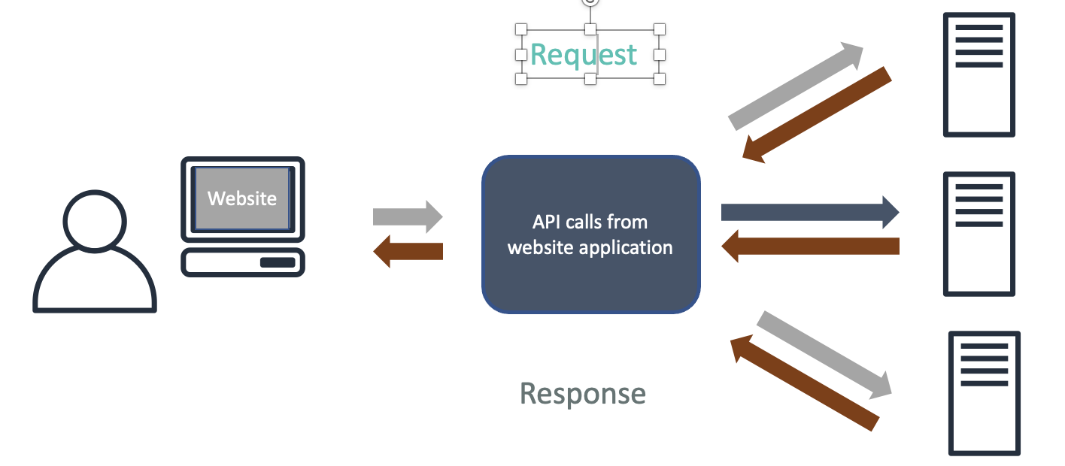
Example API 1
Consider a real estate application:
A user goes to the website.
They enter search criteria such as city, neighborhood, property type, and price range.
The web application then makes a series of API calls to services that process the information and send back the requested information.
The website application collects this information and presents it to the user.

Slide 12



A more complicated example
API calls from website application
Users
Web client
API calls from mobile application
Users
Mobile client
Notes:
As your application evolves, your APIs will proliferate. For example, you discover that your customers want your webpages to load faster. You move some of your business logic into your web frontend, so that it fetches data automatically in the background without having to reload the webpage. This makes your website feel more responsive. Next, you might want to introduce native mobile apps for iOS and Android. To support these different clients, you must refactor your backend to expose an API so that your team can reuse the business logic across different applications.

Slide 13
An even more complicated example
API calls from website application
Users
Web client
API calls from mobile application
Users
Mobile client
API calls from third-party application
Users
Third-party
Notes:
Along the way, your feature set grows, and so does your team. You want to add new features, such as recommendations and inventory-tracking systems. You refactor your application into multiple microservices to enable each team to manage and update their service more rapidly. This causes you to expose more APIs. You then want to expand further and build a marketplace to allow third-party sellers to list items. Some of your partners are now asking for APIs to help them automate repetitive tasks. In all of these cases, you are building and deploying APIs as part of your software development cycle.

Slide 14
Types of APIs
RESTful APIs (request-response)
WebSocket APIs (bidirectional)
GET
POST
PUT
DELETE
Client
HTTP methods
Server
Client
Server
Online transactions
Blogs, social media
Media streaming
Weather application
Chat applications
Real-time dashboards
Real-time alerts and notifications

Slide 15
Overview of Web Socket API
WebSocket APIs support two-way communication between clients and servers.
This means that a client application and backend servers can both send messages to each other at any time.
Backend servers do not have to wait for a request from a client.
WebSocket APIs are used to build real-time communication applications, such as chat applications, real-time dashboards (for example, stock tickers), and to get real-time alerts and notifications.

Slide 16
Overview of RESTful APIs
RESTful APIs adhere to the REST (REpresentational State Transfer) architectural style.
REST APIs communicate over HTTP.
A REST API is a group of resources and methods, or endpoints.
It uses a request-response model where a client application sends an HTTP request to a backend server, and the server responds synchronously back to the client.
This response could be in Hypertext Markup Language (HTML), Extensible Markup Language (XML), or JavaScript Object Notation (JSON).

Slide 17
RESTful APIs

Slide 18
REpresentational State Transfer (REST)
REST is a style of software architecture for distributed hypermedia systems such as the World Wide Web.
A collection of network architecture principles which outline how resources are defined and addressed
REST uses the common HTTP methods to insert/delete/update/retrieve information.
Notes:
https://www.geeksforgeeks.org/difference-between-rest-api-and-soap-api/

Slide 19
REST - not a Standard
REST is not a standard
But it uses several standards:
HTTP
URL
XML/HTML/GIF/JPEG/etc (Resource Representations)
text/xml, text/html, image/gif, image/jpeg, etc (Resource Types, MIME Types)

Slide 20
REST Core Ideologies
Simple is better
The web works and works well
Some web services should follow the “way of the web”.

Slide 21
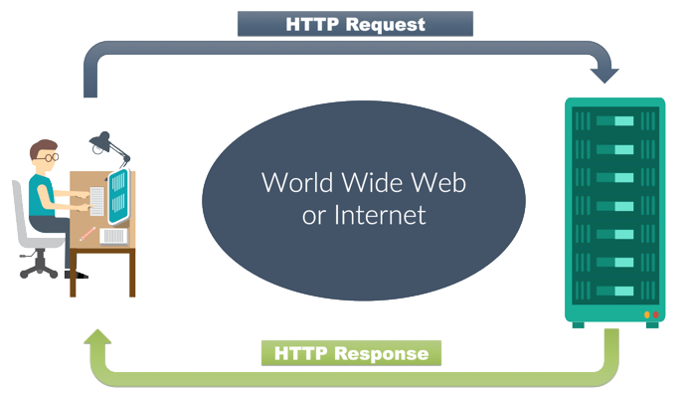
Hypertext Transfer Protocol (HTTP)
HTTP Request
GET /index.html HTTP/1.1
Host: www.pitt.edu
HTTP is the foundational protocol that is used for any data exchange on the Web.
HTTP allows the fetching of resources, such as HTML documents.
A client-server protocol in which clients and servers communicate by exchanging individual messages:
Requests are initiated by clients, usually the web browsers.
Server constructs a complete document from the different sub-documents fetched, for instance text, layout description, images, videos, scripts, and more.
The server sends a response messages as an answer to the client request.
HTTP Response
HTTP/1.1 200 OK
Content-Type: text/html
<html><head>…

Slide 22
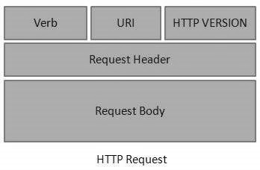
HTTP Requests
An HTTP Request has five major parts −
Verb: indicates the HTTP methods such as GET, POST, DELETE, PUT, etc.
URI: Uniform Resource Identifier (URI) to identify the resource on the server.
HTTP Version: indicates the HTTP version. For example, HTTP v1.1.
Request Header: contains metadata for the HTTP Request message as key-value pairs. For example, client (or browser) type, format supported by the client, format of the message body, cache settings, etc.
Request Body: message content or Resource representation.
Notes:
Source: https://www.tutorialspoint.com/restful/restful_messages.htm

Slide 23
HTTP Verbs
HEAD
GET: requests a specific representation of a resource
POST: submits data to be processed by the identified resource
PUT: creates or updates a resource with the supplied representation
DELETE: deletes the specified resource
TRACE
OPTIONS
CONNECT

Slide 24
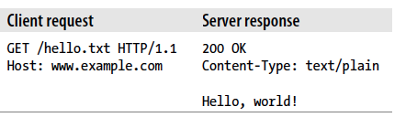
Uniform Resource Identifier (URI)
URI is the name and address of a resource.
http://www.example.com/hello.txt
An HTTP client manipulates a resource by:
connecting to the server that hosts it (www.example.com)
sending the server a method (GET) and a path to the resource (/hello.txt)

Slide 25
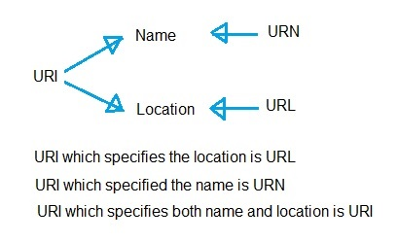
URI vs. URL vs. URN
URI is a label which can be used to name or locate any resource on internet.
In other words, URI is a string of characters used to identify a resource on the internet either by location or by name or both.
URL: Uniform Resource Locator
URN: Uniform Resource Name

Slide 26
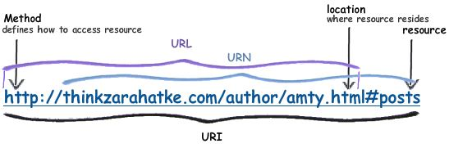
Example on URI vs. URL vs. URN

Slide 27
URIs should be descriptive
A resource and its URI ought to have an intuitive correspondence.
URI should have a structure and they should vary in predictable ways.
You should not go to /search/jellyfish for jelly fish and /i-want-to-know-about/Mice for mice.
If a client knows the structure of the service’s URIs, it can create its own entry points into the service.
This makes it easy for clients to use your service in ways you did not think of.

Slide 28
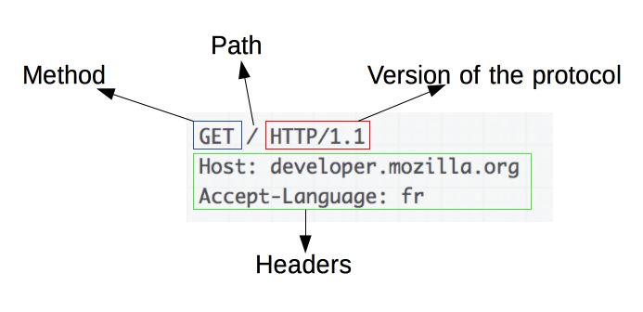
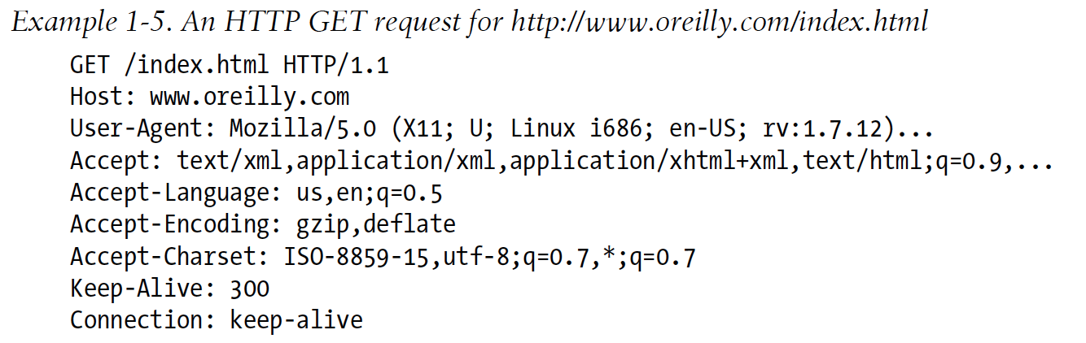
Examples on HTTP GET Request

Slide 29
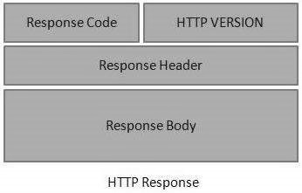
HTTP Response
An HTTP Response has four major parts −
Status/Response Code: indicates the Server status for the requested resource.
For example, 404 means resource not found and 200 means response is ok.
HTTP Version: indicates the HTTP version. For example HTTP v1.1.
Response Header: contains metadata for the HTTP Response message as key-value pairs.
For example, content length, content type, response date, server type, etc.
Response Body: response message content or Resource representation.

Slide 30
HTTP status codes
An HTTP status code will be included in REST API responses
HTTP status codes:
100s – Informational response
200s – Success
300s – Redirection
400s – Client errors
500s – Server errors
Notes:
. It is helpful to know what the codes mean, because the code will indicate if the request was received successfully, or if there were errors. Understanding what status codes indicate — especially the error codes —can be helpful when you troubleshoot REST API requests.
The groups of status codes are provided for your reference.
There are hundreds of status codes, but they are grouped so that the first of the three digits will indicate the general nature of the status.
Here are some commonly seen HTTP status codes:
200 – Indicates success. The request was received and accepted by the server.
401 – Indicates a client error, Unauthorized. Authentication is required, but the provided credentials were not accepted, or perhaps no credentials were provided in the request.
403 – Indicates a client error, Forbidden. The request was properly made, but the server is not allowing the request.
404 – Indicates a client error, Not Found. The resource is unavailable or could not be accessed.
500 – Indicates an unspecific internal server error.
503 – Indicates the service is temporarily unavailable.

Slide 31
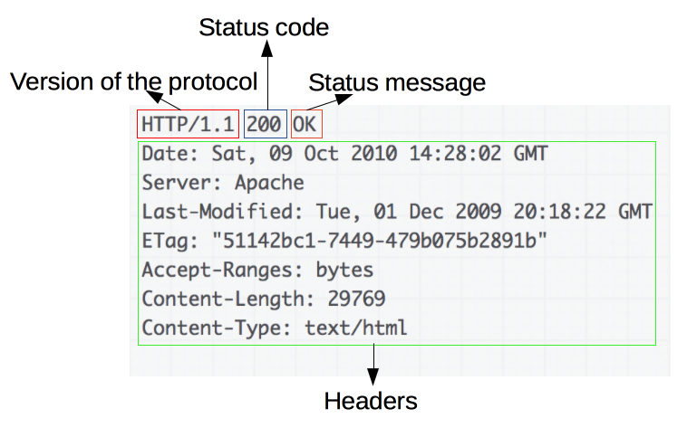
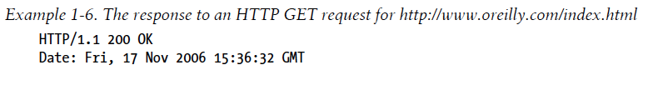
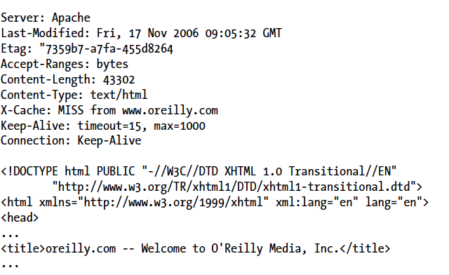
Examples on HTTP Response
Body

Slide 32
REST and HTTP
The motivation for REST was to capture the following characteristics of the Web which made the Web successful.
URI Addressable resources
HTTP Protocol
Make a Request – Receive Response – Display Response
REST Exploits the use of the HTTP protocol beyond POST and GET

Slide 33
How REST Works?
In a RESTful application, a client sends a request over HTTP using the standard HTTP methods (PUT, GET, POST, and DELETE).
The server issues a response that includes the representation of the resource.
The GET, PUT, POST, and DELETE methods constitute a minimal set of operations for retrieving, adding, modifying, and deleting data.
Together with an appropriate URI organization to identify resources, all the atomic operations required by a web service are implemented.
RESTful Web services operate in an environment where no additional security beyond the one supported by HTTP is required.
Twitter, Yahoo! (searchAPIs, maps, photos), Flickr, and Amazon.com all leverage REST.

Slide 34
REST Vocabulary
Nouns (Resources) unconstrained i.e., http://example.com/employees/12345
REST
Verbs constrained i.e., GET
Representations constrained i.e., XML

Slide 35
RESTful Architecture: Resource-Oriented Architecture (ROA)
ROA is a way of turning a problem into a RESTful web service
What is a resource?
A document, a row in a database
Physical (apple) or logical (courage)
Anything that’s important enough to be referenced as a thing in itself.
If your users might want to create a hyperlink link to it, retrieve a representation of it, or perform other operations on it.

Slide 36
Representations
Representations refers to how data is represented or returned to the client for presentation.
Two main formats:
JavaScript Object Notation (JSON)
XML
It is common to have multiple representations of the same data

Slide 37
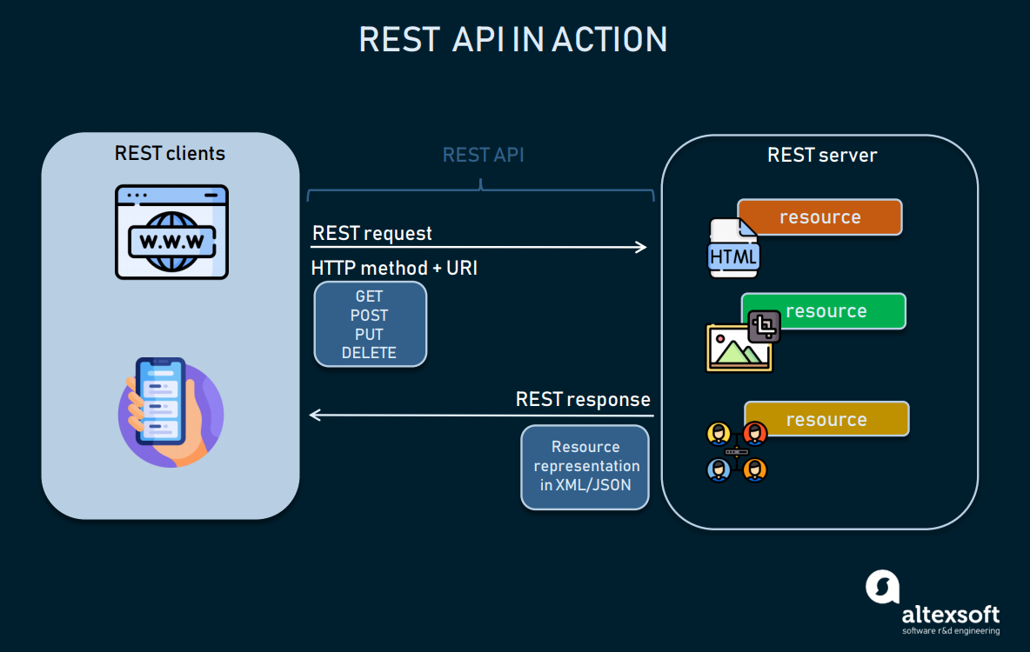

Slide 38
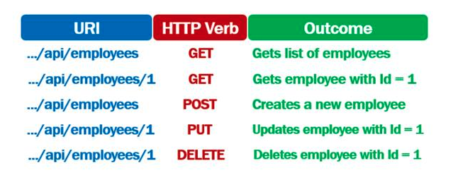
REST APIs and HTTP verbs

Slide 39
REST Architecture Style
Request
(XML doc)
HTTP GET
URL 1
doGet()
Response
(XML doc)
HTTP Response
doPost(id)
Request
(XML doc)
HTTP POST
URL 1
REST Engine
(locate resource and generate response)
Web/Proxy Server
Response
(JSON doc)
HTTP Response
doDelete()
PO
(XML doc)
HTTP DELETE
URL 1
Response
(TEXT doc)
HTTP Response

Slide 40
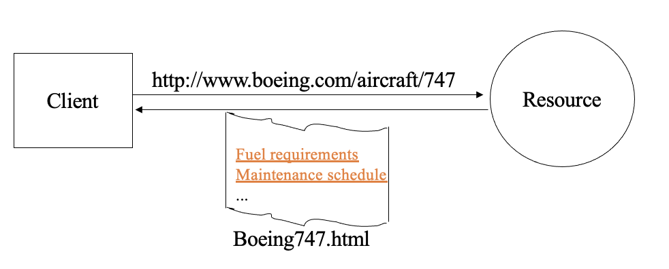
Why is it called "Representational State Transfer"?
The Client references a Web resource using a URL.
A representation of the resource is returned (in this case as an HTML document).
The representation (e.g., Boeing747.html) places the client application in a state.
The result of the client traversing a hyperlink in Boeing747.html is another resource accessed.
The new representation places the client application into yet another state.
Thus, the client application changes (transfers) state with each resource representation --> Representation State Transfer!

Slide 41
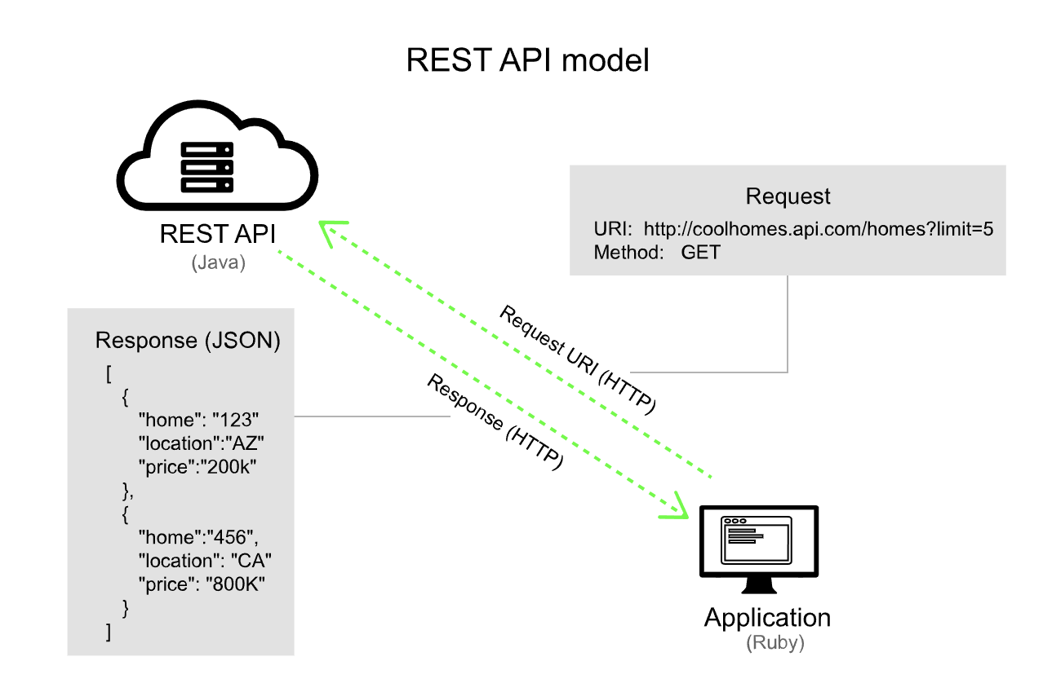
Example RESTfule request/response

Slide 42
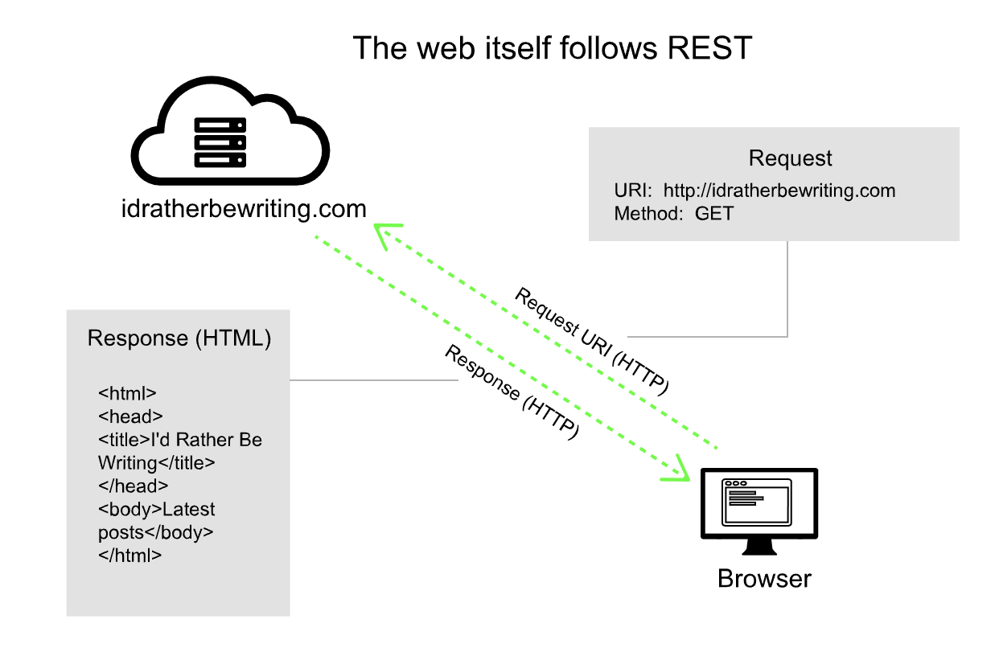

Slide 43
Example RESTful APIs using GET
Issuing a GET request transfers the data from the server to the client in some representation
GET http://localhost/books
Retrieve all books
GET http://localhost/books/ISBN-0011021
Retrieve book identified with ISBN-0011021
GET http://localhost/books/ISBN-0011021/authors
Retrieve authors for book identified with ISBN-0011021

Slide 44
Examples APIs using PUT and POST
POST http://localhost/books/
Content: {title, authors[], …}
Creates a new book with given properties
PUT http://localhost/books/isbn-111
Content: {isbn, title, authors[], …}
Updates book identified by isbn-111 with submitted properties

Slide 45
HTTP DELETE
Removes the resource identified by the URI
DELETE http://localhost/books/ISBN-0011
Delete book identified by ISBN-0011

Slide 46
RESTful APIs
Representational state transfer (REST):
A design for loosely coupled network-based applications
Communication is over HTTP
Exposes resources at specific URLs
Many web APIs are RESTful
6 RESTful design principles:
A uniform interface
Stateless
Client-server architecture
Cacheable
Layered system
Code on demand (optional)
Notes:
REST follows six design principles:
There should be a simple and uniform interface for the client to access the server. A request should be made to a single endpoint or URI when interacting with each distinct resource that is part of the service. The interface does not define the structure of what is returned when the client makes a request.
RESTful services are also stateless. Stateless means that the server does keep track of what requests the connecting client has made over time, or what step the client might have completed in terms of a series of actions. Instead, any session information about the client is only known to the client itself.
The server doesn’t know about the state of the client, and the client doesn’t know about the state of the server.
REST clients should be able to cache the responses they receive from the REST server.
RESTful services support layered systems, where the client might connect to an intermediate server. This design enables the REST server to be distributed, which supports load balancing.
RESTful services can optionally support code on demand, which means that the server could pass a piece of code that can be run to the client (such as some JavaScript). This feature extends the functionality of the REST client. Uses for code-on-demand in RESTful APIs can achieve some of the following:
Client-side validation
Asynchronous, lightweight sub-requests
Dynamic processing of additional message semantics, above the semantics contained in the core media type definition
NOTE: The use of code-on-demand is still not widely adopted across developers and is still an optional component of API development.

Slide 47
REST Architectural Principles
The web has been successful because of the following:
Addressable resources: the web consists of addressable resources where each resource has a URI.
Uniform and constrained interface: HTTP, for example, has a small number of methods that are used to manipulate resources.
Representation oriented: different applications/platforms need different formats (XML OR JSON)
Communicate statelessly: hence providing scalability
Hypermedia is used as the Engine Of Application State (HATEOAS).

Slide 48
Principle 1: Addressability
The key abstraction of information and data in REST is a resource.
Each resource must be addressable via a URI (Uniform Resource Identifier).
An application is addressable if it exposes its data set as resources.
A URI for every piece of information it might conceivably serve.

Slide 49
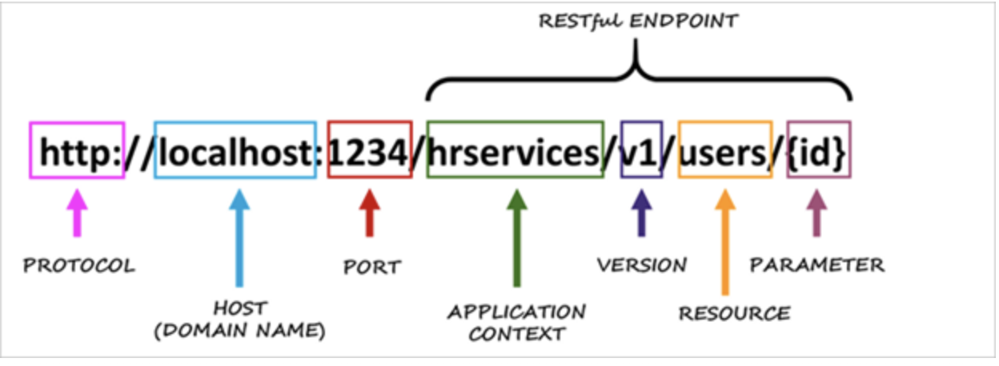
Principle 1: Addressability -- URI
The format of a URI is well defined as follows:
scheme://host:port/path?queryString#fragment
The scheme protocol need not be HTTP. May be FTP or HTTPS (how do we communicate)
The host field may be a DNS name or a IP address (where is it on the network)
The port may be derived from the scheme. Using HTTP implies port 80.
The path is a set of text segments delimited by the “/”. (what resource are we communicating with)
The queryString is a list of parameters represented as name=value pairs. Each pair is delimited by an “&”.
The fragment is used to point to a particular place in a document.

Slide 50
Principle 1: Addressability (Examples)
A search engine is a web service with an infinite number of possible states:
at least one for every string you might search for.
Each state has its own URI
https://www.google.com/search?q=metropolitanstate
https://www.google.com/search?q=jellyfish
https://www.google.com/search?q=metropolitanstate&start=10

Slide 51
Principle 2: Statelessness
Statelessness means that every HTTP request happens in complete isolation.
When a client makes an HTTP request, it includes all information necessary for the server to fulfill this request.
The server never relies on information from previous requests.
If that information was important, the client would have sent it again in this request.
To eliminate state from a protocol is to eliminate a lot if failure conditions.
The sever never has to worry about the client timing out because no interactions lasts longer than a single request.

Slide 52
Principle 2: Communicate Statelessly
The application may have state but there is no client session data stored on the server.
If there is any session-specific data, it should be held and maintained by the client and transferred to the server with each request as needed.
The server is easier to scale. No replication of session data concerns.

Slide 53
Principle 3: Uniform Interface
All across the web, there are only a few basic things you can do to a resource.
HTTP provides four basic methods for the four most common operations:
Retrieve a representation of the resource: HTTP GET
Create a new resource: HTTP PUT to a new URI or HTTP POST to an existing URI
Modify an existing resource: HTTP PUT
Delete an existing resource: HTTP DELETE

Slide 54
Principle 3: Uniform Interface Advantages of uniform interface
Familiarity
Without the uniform interface, you have to learn how each service expected to receive and send information.
We already know the methods (i.e., GET to read)
Interoperability
You can program a computer to understand what GET means and that understanding will apply to every RESTful web service.
HTTP is widely supported.
Scalability
Since GET is idempotent and safe, results may be cached by clients or proxy servers.
Since PUT and DELETE are both idempotent neither the client or the server need worry about handling duplicate message delivery.

Slide 55
Principle 4: Representation Oriented
Representations of resources are exchanged.
GET returns a representation.
PUT and POST passes representations to the server so that underlying resources may change.
Representations may be in many formats: XML, JSON, YAML, etc.,

Slide 56
Principle 4: Representation Oriented
HTTP uses the CONTENT-TYPE header to specify the message format the server is sending.
The value of the CONTENT-TYPE is a MIME typed string.
MIME: Multipurpose Internal Mail Extensions is an internet standard that extends the format of email messages to various data formats.
Versioning information may be included.
Examples formats:
text/plain
text/html

Slide 57
Principle 5: HATEOAS (1)
Hypermedia As The Engine Of Application State
Hypermedia is document centric but with the additional feature of links.
Connectedness and Discoverability
Like the Web, HTTP Responses contains links to other resources
With each request returned from a server it tells you what interactions you can do next as well as where you can go to transition the state of your application.
Example:
<order id = “111”>
<customer>http://…/customers/3214
<order-entries>
<order-entry>
<qty>5
<product>http://…/products/111

Slide 58
Principle 5: HATEOS
From Wikipedia:
A REST client enters a REST application through a simple fixed URL. All future actions the client may take are discovered within resource representations returned from the server. The media types used for these representations, and the link relations they may contain, are standardized. The client transitions through application states by selecting from the links within a representation or by manipulating the representation in other ways afforded by its media type. In this way, RESTful interaction is driven by hypermedia, rather than out-of-band information.

Slide 59
Tutorial

Slide 60
Steps to Design a REST API
Decide what resource(s) need to be available.
Assign URLs to those resources.
Decide what actions the client should be allowed to perform on those resources.
Figure out what pieces of data are required for each action and what format they should be in.

Slide 61
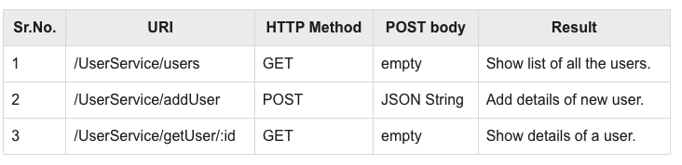
Implementing a User Management RESTful Web Service
We will implement a web service for user management with following functionalities

Slide 62
Flask Application Implementation
Flask is a web framework in Python that lets you develop web applications easily
Application folder (users-flask-app) should at least include the following two files:
requirements.txt
app.py
Optional: input file with user information: users.json

Slide 63
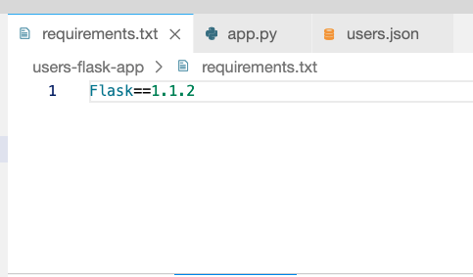
Setting up the environment

Slide 64
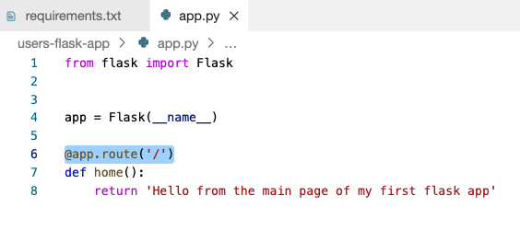

Entry point to the application: @app.route('/')
Compile and run.
You will be given a URL
Access your application from the browser.

Slide 65


Accessing still pages: @app.route('/about')
Application URL
route

Slide 66
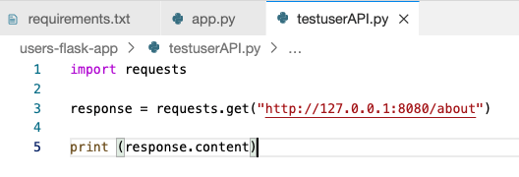

Testing your API programmatically

Slide 67
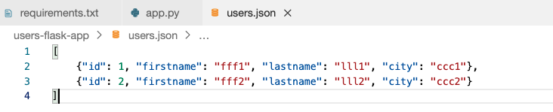
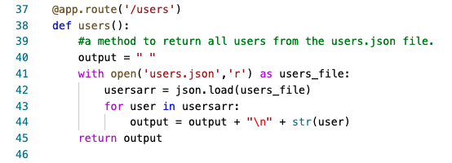
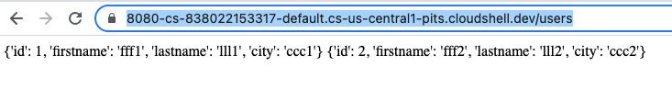
Reading data fom a file: @app.route('/users')
Input file:

Slide 68
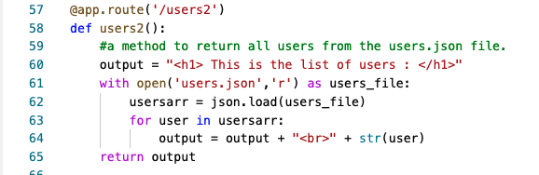
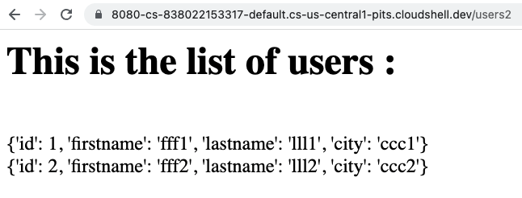
Formatting the output to be browser friendly

Slide 69
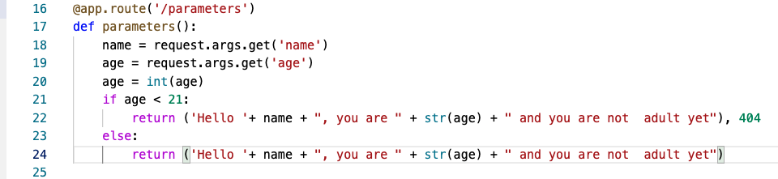
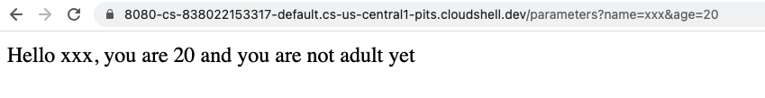
Sending arbitrary parameters: @app.route('/parameters')
/route?parameters /parameters?name=xxx&age=20
parameters

Slide 70
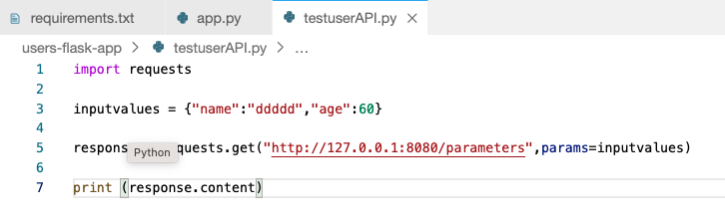

Testing programmatically

Slide 71
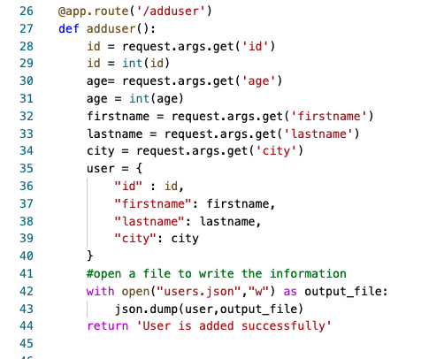
Adding data to a file: @app.route('/adduser')

Slide 72
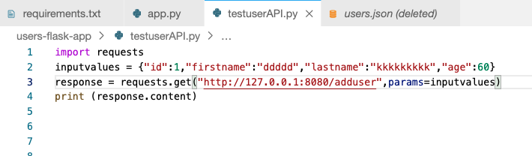
Testing

Slide 73
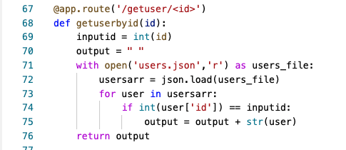
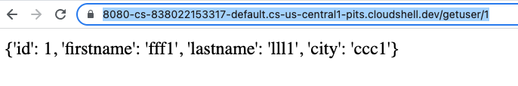
Using fixed attributes: @app.route('/getuser/<id>')
/getuser/1

Slide 74
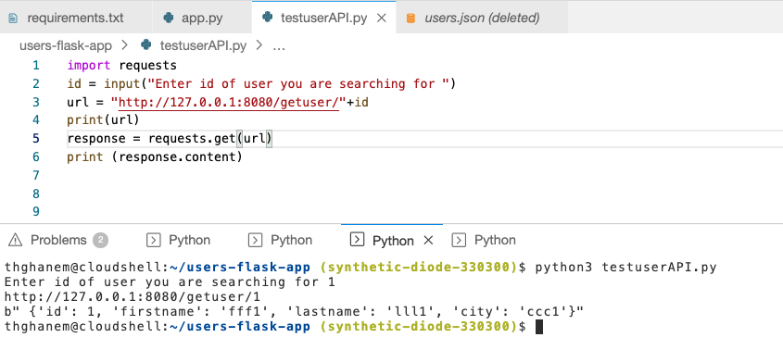
Testing

