Slide 1

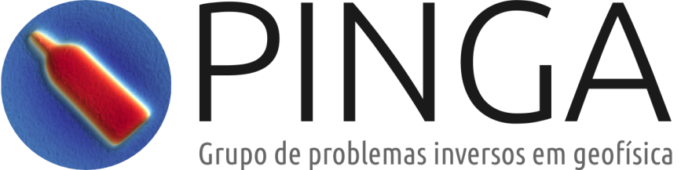


Camada equivalente aplicada ao processamento e interpretação de dados de campos potenciais
Vanderlei C. Oliveira Jr.
2016

Slide 2
Generalização da integral de continuação para cima
Vanderlei C. Oliveira Jr.
2016

Slide 3
Tal como mencionado anteriormente, a técnica da camada equivalente é baseada em uma equação integral chamada integral de continuação para cima (Skeels, 1947; Henderson and Zietz, 1949; Henderson, 1960; Roy, 1962; Bhattacharyya,
1967; Henderson, 1970; Twomey, 1977; Blakely, 1996)

Slide 4

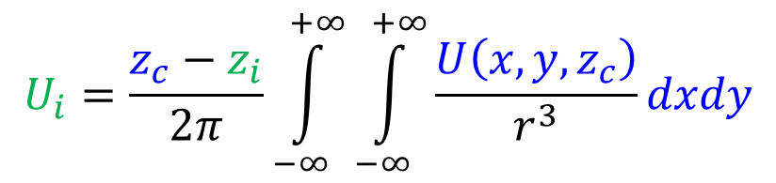







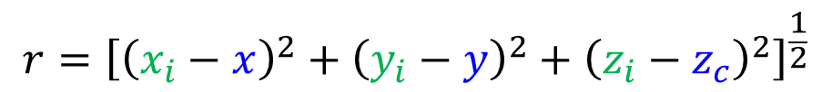
$$\left(x_{i},y_{i},z_{i}\right)$$
Topografia
$$r$$
$$−∞$$
$$+∞$$
$$y$$
$$z_{c}$$
$$\left(x,y,z_{c}\right)$$
$$z$$
$$U_{i}=\frac{z_{c}−z_{i}}{2π}\int_{−∞}^{+∞}{\int_{−∞}^{+∞}{\frac{U\left(x,y,z_{c}\right)}{r^{3}}}}dxdy$$
$${r=\left[{\left(x_{i}−x\right)}^{2}+{\left(y_{i}−y\right)}^{2}+{\left(z_{i}−z_{c}\right)}^{2}\right]}^{\frac{1}{2}}$$

Slide 5
A integral de continuação para cima, em sua forma clássica, restringe a aplicação da técnica da camada equivalente para o caso em que: 1) as fontes equivalentes estão localizadas sobre um plano horizontal e 2) as funções harmônicas representam o efeito gravitacional das fontes equivalentes

Slide 6
A integral de continuação para cima, em sua forma clássica, restringe a aplicação da técnica da camada equivalente para o caso em que: 1) as fontes equivalentes estão localizadas sobre um plano horizontal e 2) as funções harmônicas representam o efeito gravitacional das fontes equivalentes
Nesta parte do curso, vamos generalizar a integral de continuação para cima com o intuito de remover estas duas restrições

Slide 7



$$\left(x_{i},y_{i},z_{i}\right)$$
Topografia
$$r$$
$$\left(x^{′},y^{′}, z^{′}\right)$$
$$−∞$$
$$+∞$$
$$y$$
$$z_{c}$$
$$\left(x,y,z_{c}\right)$$
$$z^{′}=f\left(x^{′},y^{′} \right)$$
$$z_{i}<z^{′}≤z_{c}$$
$$z$$
$$U_{i}=\frac{z_{c}−z_{i}}{2π}\int_{−∞}^{+∞}{\int_{−∞}^{+∞}{\frac{U\left(x,y,z_{c}\right)}{r^{3}}}}dxdy$$
$${r=\left[{\left(x_{i}−x\right)}^{2}+{\left(y_{i}−y\right)}^{2}+{\left(z_{i}−z_{c}\right)}^{2}\right]}^{\frac{1}{2}}$$

Slide 8
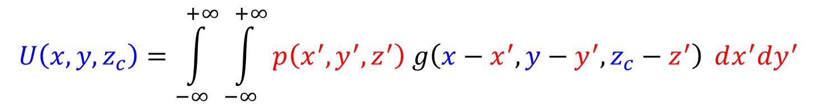
$$\left(x_{i},y_{i},z_{i}\right)$$
Topografia
$$r$$
$$\left(x^{′},y^{′}, z^{′}\right)$$
$$−∞$$
$$+∞$$
$$y$$
$$z_{c}$$
$$\left(x,y,z_{c}\right)$$
$$z^{′}=f\left(x^{′},y^{′} \right)$$
$$z_{i}<z^{′}≤z_{c}$$
$$z$$
$$U\left(x, y, z_{c}\right)=\int_{−∞}^{+∞}{\int_{−∞}^{+∞}{p\left(x^{′},y^{′},z^{′}\right) g\left(x−x^{′},y−y^{′},z_{c}−z^{′}\right)}} dx^{′}dy^{′}$$
$$U_{i}=\frac{z_{c}−z_{i}}{2π}\int_{−∞}^{+∞}{\int_{−∞}^{+∞}{\frac{U\left(x,y,z_{c}\right)}{r^{3}}}}dxdy$$
$${r=\left[{\left(x_{i}−x\right)}^{2}+{\left(y_{i}−y\right)}^{2}+{\left(z_{i}−z_{c}\right)}^{2}\right]}^{\frac{1}{2}}$$

Slide 9
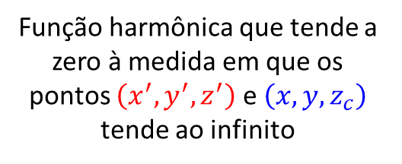
$$\left(x_{i},y_{i},z_{i}\right)$$
Topografia
$$r$$
$$\left(x^{′},y^{′}, z^{′}\right)$$
$$−∞$$
$$+∞$$
$$y$$
$$z_{c}$$
$$\left(x,y,z_{c}\right)$$
$$z^{′}=f\left(x^{′},y^{′} \right)$$
$$z_{i}<z^{′}≤z_{c}$$
$$z$$
$$U\left(x, y, z_{c}\right)=\int_{−∞}^{+∞}{\int_{−∞}^{+∞}{p\left(x^{′},y^{′},z^{′}\right) g\left(x−x^{′},y−y^{′},z_{c}−z^{′}\right)}} dx^{′}dy^{′}$$
Função harmônica que tende a zero à medida em que os pontos $\left(x^{′},y^{′}, z^{′}\right)$ e $\left(x, y, z_{c}\right)$ tende ao infinito
$$U_{i}=\frac{z_{c}−z_{i}}{2π}\int_{−∞}^{+∞}{\int_{−∞}^{+∞}{\frac{U\left(x,y,z_{c}\right)}{r^{3}}}}dxdy$$
$${r=\left[{\left(x_{i}−x\right)}^{2}+{\left(y_{i}−y\right)}^{2}+{\left(z_{i}−z_{c}\right)}^{2}\right]}^{\frac{1}{2}}$$

Slide 10
$$\left(x_{i},y_{i},z_{i}\right)$$
Topografia
$$r$$
$$\left(x^{′},y^{′}, z^{′}\right)$$
$$−∞$$
$$+∞$$
$$y$$
$$z_{c}$$
$$\left(x,y,z_{c}\right)$$
$$z^{′}=f\left(x^{′},y^{′} \right)$$
$$z_{i}<z^{′}≤z_{c}$$
$$z$$
$$U\left(x, y, z_{c}\right)=\int_{−∞}^{+∞}{\int_{−∞}^{+∞}{p\left(x^{′},y^{′},z^{′}\right) g\left(x−x^{′},y−y^{′},z_{c}−z^{′}\right)}} dx^{′}dy^{′}$$
$$U_{i}=\frac{z_{c}−z_{i}}{2π}\int_{−∞}^{+∞}{\int_{−∞}^{+∞}{\frac{U\left(x,y,z_{c}\right)}{r^{3}}}}dxdy$$
Função que satisfaz as condições necessárias para que esta integral seja convergente
$${r=\left[{\left(x_{i}−x\right)}^{2}+{\left(y_{i}−y\right)}^{2}+{\left(z_{i}−z_{c}\right)}^{2}\right]}^{\frac{1}{2}}$$

Slide 11
$$\left(x_{i},y_{i},z_{i}\right)$$
Topografia
$$r$$
$$\left(x^{′},y^{′}, z^{′}\right)$$
$$−∞$$
$$+∞$$
$$y$$
$$z_{c}$$
$$\left(x,y,z_{c}\right)$$
$$z^{′}=f\left(x^{′},y^{′} \right)$$
$$z_{i}<z^{′}≤z_{c}$$
$$z$$
$$U\left(x, y, z_{c}\right)=\int_{−∞}^{+∞}{\int_{−∞}^{+∞}{p\left(x^{′},y^{′},z^{′}\right) g\left(x−x^{′},y−y^{′},z_{c}−z^{′}\right)}} dx^{′}dy^{′}$$
$$U_{i}=\frac{z_{c}−z_{i}}{2π}\int_{−∞}^{+∞}{\int_{−∞}^{+∞}{\frac{U\left(x,y,z_{c}\right)}{r^{3}}}}dxdy$$
Substituindo esta nova integral na integral de continuação para cima e mudando a ordem da integração...
$${r=\left[{\left(x_{i}−x\right)}^{2}+{\left(y_{i}−y\right)}^{2}+{\left(z_{i}−z_{c}\right)}^{2}\right]}^{\frac{1}{2}}$$

Slide 12

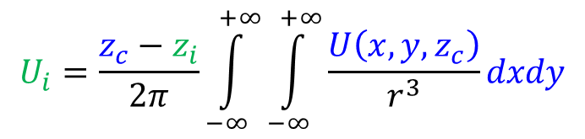
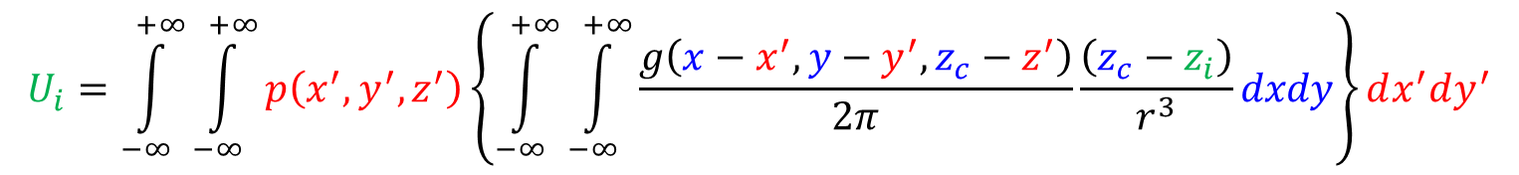

$$\left(x_{i},y_{i},z_{i}\right)$$
Topografia
$$r$$
$$\left(x^{′},y^{′}, z^{′}\right)$$
$$−∞$$
$$+∞$$
$$y$$
$$z_{c}$$
$$\left(x,y,z_{c}\right)$$
$$z^{′}=f\left(x^{′},y^{′} \right)$$
$$z_{i}<z^{′}≤z_{c}$$
$$z$$
$$U\left(x, y, z_{c}\right)=\int_{−∞}^{+∞}{\int_{−∞}^{+∞}{p\left(x^{′},y^{′},z^{′}\right) g\left(x−x^{′},y−y^{′},z_{c}−z^{′}\right)}} dx^{′}dy^{′}$$
$$U_{i}=\frac{z_{c}−z_{i}}{2π}\int_{−∞}^{+∞}{\int_{−∞}^{+∞}{\frac{U\left(x,y,z_{c}\right)}{r^{3}}}}dxdy$$
$${r=\left[{\left(x_{i}−x\right)}^{2}+{\left(y_{i}−y\right)}^{2}+{\left(z_{i}−z_{c}\right)}^{2}\right]}^{\frac{1}{2}}$$
$$U_{i}=\int_{−∞}^{+∞}{\int_{−∞}^{+∞}{p\left(x^{′},y^{′},z^{′}\right)\left\{\int_{−∞}^{+∞}{\int_{−∞}^{+∞}{\frac{g\left(x−x^{′},y−y^{′},z_{c}−z^{′}\right)}{2π}\frac{\left(z_{c}−z_{i}\right)}{r^{3}}}}dxdy\right\}}}dx^{′}dy^{′}$$

Slide 13
$$\left(x_{i},y_{i},z_{i}\right)$$
Topografia
$$r$$
$$\left(x^{′},y^{′}, z^{′}\right)$$
$$−∞$$
$$+∞$$
$$y$$
$$z_{c}$$
$$\left(x,y,z_{c}\right)$$
$$z^{′}=f\left(x^{′},y^{′} \right)$$
$$z_{i}<z^{′}≤z_{c}$$
$$z$$
$$U\left(x, y, z_{c}\right)=\int_{−∞}^{+∞}{\int_{−∞}^{+∞}{p\left(x^{′},y^{′},z^{′}\right) g\left(x−x^{′},y−y^{′},z_{c}−z^{′}\right)}} dx^{′}dy^{′}$$
$$U_{i}=\frac{z_{c}−z_{i}}{2π}\int_{−∞}^{+∞}{\int_{−∞}^{+∞}{\frac{U\left(x,y,z_{c}\right)}{r^{3}}}}dxdy$$
$${r=\left[{\left(x_{i}−x\right)}^{2}+{\left(y_{i}−y\right)}^{2}+{\left(z_{i}−z_{c}\right)}^{2}\right]}^{\frac{1}{2}}$$
$$U_{i}=\int_{−∞}^{+∞}{\int_{−∞}^{+∞}{p\left(x^{′},y^{′},z^{′}\right)\left\{\int_{−∞}^{+∞}{\int_{−∞}^{+∞}{\frac{g\left(x−x^{′},y−y^{′},z_{c}−z^{′}\right)}{2π}\frac{\left(z_{c}−z_{i}\right)}{r^{3}}}}dxdy\right\}}}dx^{′}dy^{′}$$

Slide 14
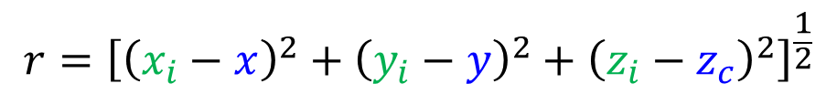
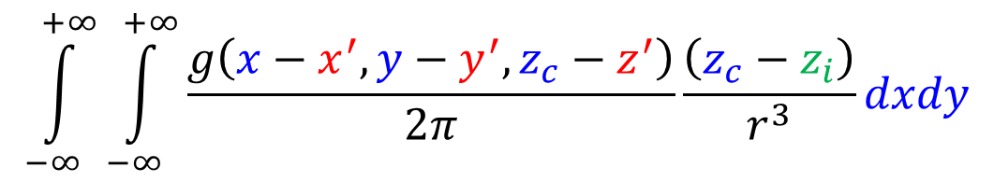
$$\int_{−∞}^{+∞}{\int_{−∞}^{+∞}{\frac{g\left(x−x^{′},y−y^{′},z_{c}−z^{′}\right)}{2π}\frac{\left(z_{c}−z_{i}\right)}{r^{3}}}}dxdy$$
$${r=\left[{\left(x_{i}−x\right)}^{2}+{\left(y_{i}−y\right)}^{2}+{\left(z_{i}−z_{c}\right)}^{2}\right]}^{\frac{1}{2}}$$

Slide 15



$$\int_{−∞}^{+∞}{\int_{−∞}^{+∞}{\frac{g\left(x−x^{′},y−y^{′},z_{c}−z^{′}\right)}{2π}\frac{\left(z_{c}−z_{i}\right)}{r^{3}}}}dxdy$$
$$r={\left[{\left(x_{i}−x\right)}^{2}+{\left(y_{i}−y\right)}^{2}+{\left(z_{i}−z_{c}\right)}^{2}\right]}^{\frac{1}{2}}$$
$$ε=x−x^{′}$$
$$η=y−y^{′}$$
$$ς=z_{c}−z^{′}$$
Mudança de variáveis

Slide 16




$$\int_{−∞}^{+∞}{\int_{−∞}^{+∞}{\frac{g\left(x−x^{′},y−y^{′},z_{c}−z^{′}\right)}{2π}\frac{\left(z_{c}−z_{i}\right)}{r^{3}}}}dxdy$$
$$z_{i}<z^{′}≤z_{c}$$
$$r={\left[{\left(x_{i}−x\right)}^{2}+{\left(y_{i}−y\right)}^{2}+{\left(z_{i}−z_{c}\right)}^{2}\right]}^{\frac{1}{2}}$$
$$z_{i}−z^{′}<0≤z_{c}−z^{′}$$
$$ς$$
$$z_{i}−z^{′}<ς$$
$$ε=x−x^{′}$$
$$η=y−y^{′}$$
$$ς=z_{c}−z^{′}$$

Slide 17

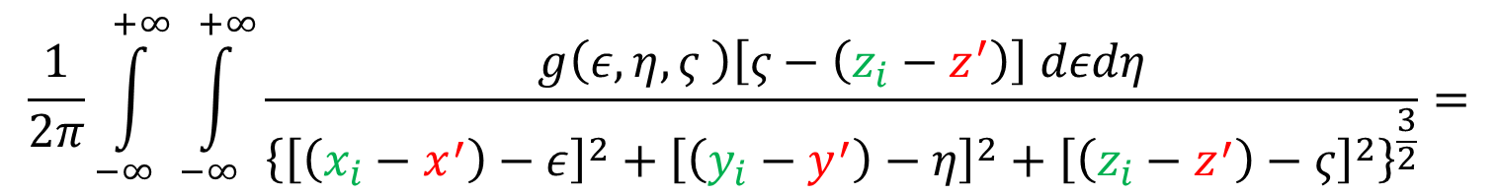
$$\int_{−∞}^{+∞}{\int_{−∞}^{+∞}{\frac{g\left(x−x^{′},y−y^{′},z_{c}−z^{′}\right)}{2π}\frac{\left(z_{c}−z_{i}\right)}{r^{3}}}}dxdy$$
$$z_{i}<z^{′}≤z_{c}$$
$$r={\left[{\left(x_{i}−x\right)}^{2}+{\left(y_{i}−y\right)}^{2}+{\left(z_{i}−z_{c}\right)}^{2}\right]}^{\frac{1}{2}}$$
$$z_{i}−z^{′}<0≤z_{c}−z^{′}$$
$$ς$$
$$z_{i}−z^{′}<ς$$
$$ε=x−x^{′}$$
$$η=y−y^{′}$$
$$ς=z_{c}−z^{′}$$
$$\frac{1}{2π}\int_{−∞}^{+∞}{\int_{−∞}^{+∞}{\frac{g\left(ε,η,ς \right)\left[ς−\left(z_{i}−z^{′}\right)\right] dεdη}{{\left\{{\left[\left(x_{i}−x^{′}\right)−ε\right]}^{2}+{\left[\left(y_{i}−y^{′}\right)−η\right]}^{2}+{\left[\left(z_{i}−z^{′}\right)−ς\right]}^{2}\right\}}^{\frac{3}{2}}}}}=$$
$$=g\left(x_{i}−x^{′},y_{i}−y^{′},z_{i}−z^{′}\right)$$

Slide 18
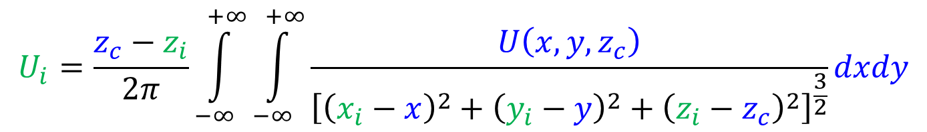
$$\int_{−∞}^{+∞}{\int_{−∞}^{+∞}{\frac{g\left(x−x^{′},y−y^{′},z_{c}−z^{′}\right)}{2π}\frac{\left(z_{c}−z_{i}\right)}{r^{3}}}}dxdy$$
$$z_{i}<z^{′}≤z_{c}$$
$$r={\left[{\left(x_{i}−x\right)}^{2}+{\left(y_{i}−y\right)}^{2}+{\left(z_{i}−z_{c}\right)}^{2}\right]}^{\frac{1}{2}}$$
$$z_{i}−z^{′}<0≤z_{c}−z^{′}$$
$$ς$$
$$z_{i}−z^{′}<ς$$
$$ε=x−x^{′}$$
$$η=y−y^{′}$$
$$ς=z_{c}−z^{′}$$
$$\frac{1}{2π}\int_{−∞}^{+∞}{\int_{−∞}^{+∞}{\frac{g\left(ε,η,ς \right)\left[ς−\left(z_{i}−z^{′}\right)\right] dεdη}{{\left\{{\left[\left(x_{i}−x^{′}\right)−ε\right]}^{2}+{\left[\left(y_{i}−y^{′}\right)−η\right]}^{2}+{\left[\left(z_{i}−z^{′}\right)−ς\right]}^{2}\right\}}^{\frac{3}{2}}}}}=$$
$$=g\left(x_{i}−x^{′},y_{i}−y^{′},z_{i}−z^{′}\right)$$
$$U_{i}=\frac{z_{c}−z_{i}}{2π}\int_{−∞}^{+∞}{\int_{−∞}^{+∞}{\frac{U\left(x,y,z_{c}\right)}{{\left[{\left(x_{i}−x\right)}^{2}+{\left(y_{i}−y\right)}^{2}+{\left(z_{i}−z_{c}\right)}^{2}\right]}^{\frac{3}{2}}}}}dxdy$$

Slide 19

$$\left(x_{i},y_{i},z_{i}\right)$$
Topografia
$$r$$
$$\left(x^{′},y^{′}, z^{′}\right)$$
$$−∞$$
$$+∞$$
$$y$$
$$z_{c}$$
$$\left(x,y,z_{c}\right)$$
$$z^{′}=f\left(x^{′},y^{′} \right)$$
$$z_{i}<z^{′}≤z_{c}$$
$$z$$
$$U\left(x, y, z_{c}\right)=\int_{−∞}^{+∞}{\int_{−∞}^{+∞}{p\left(x^{′},y^{′},z^{′}\right) g\left(x−x^{′},y−y^{′},z_{c}−z^{′}\right)}} dx^{′}dy^{′}$$
$$U_{i}=\frac{z_{c}−z_{i}}{2π}\int_{−∞}^{+∞}{\int_{−∞}^{+∞}{\frac{U\left(x,y,z_{c}\right)}{r^{3}}}}dxdy$$
$${r=\left[{\left(x_{i}−x\right)}^{2}+{\left(y_{i}−y\right)}^{2}+{\left(z_{i}−z_{c}\right)}^{2}\right]}^{\frac{1}{2}}$$
$$U_{i}=\int_{−∞}^{+∞}{\int_{−∞}^{+∞}{p\left(x^{′},y^{′},z^{′}\right)\left\{\int_{−∞}^{+∞}{\int_{−∞}^{+∞}{\frac{g\left(x−x^{′},y−y^{′},z_{c}−z^{′}\right)}{2π}\frac{\left(z_{c}−z_{i}\right)}{r^{3}}}}dxdy\right\}}}dx^{′}dy^{′}$$

Slide 20
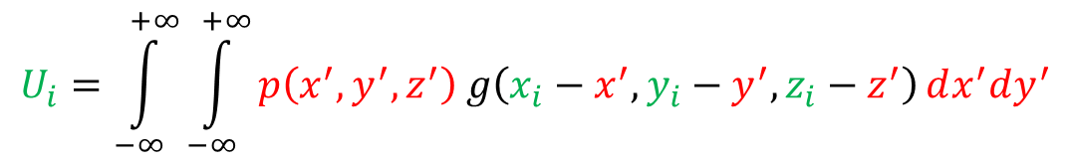
$$\left(x_{i},y_{i},z_{i}\right)$$
Topografia
$$r$$
$$\left(x^{′},y^{′}, z^{′}\right)$$
$$−∞$$
$$+∞$$
$$y$$
$$z_{c}$$
$$\left(x,y,z_{c}\right)$$
$$z^{′}=f\left(x^{′},y^{′} \right)$$
$$z_{i}<z^{′}≤z_{c}$$
$$z$$
$$U\left(x, y, z_{c}\right)=\int_{−∞}^{+∞}{\int_{−∞}^{+∞}{p\left(x^{′},y^{′},z^{′}\right) g\left(x−x^{′},y−y^{′},z_{c}−z^{′}\right)}} dx^{′}dy^{′}$$
$$U_{i}=\frac{z_{c}−z_{i}}{2π}\int_{−∞}^{+∞}{\int_{−∞}^{+∞}{\frac{U\left(x,y,z_{c}\right)}{r^{3}}}}dxdy$$
$${r=\left[{\left(x_{i}−x\right)}^{2}+{\left(y_{i}−y\right)}^{2}+{\left(z_{i}−z_{c}\right)}^{2}\right]}^{\frac{1}{2}}$$
$$U_{i}=\int_{−∞}^{+∞}{\int_{−∞}^{+∞}{p\left(x^{′},y^{′},z^{′}\right) g\left(x_{i}−x^{′},y_{i}−y^{′},z_{i}−z^{′}\right)}}dx^{′}dy^{′}$$

Slide 21
$$\left(x_{i},y_{i},z_{i}\right)$$
Topografia
$$\left(x^{′},y^{′}, z^{′}\right)$$
$$−∞$$
$$+∞$$
$$y$$
$$z_{c}$$
$$z^{′}=f\left(x^{′},y^{′} \right)$$
$$z_{i}<z^{′}≤z_{c}$$
$$z$$
$$U_{i}=\int_{−∞}^{+∞}{\int_{−∞}^{+∞}{p\left(x^{′},y^{′},z^{′}\right) g\left(x_{i}−x^{′},y_{i}−y^{′},z_{i}−z^{′}\right)}}dx^{′}dy^{′}$$

Slide 22
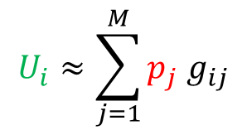



$$\left(x_{i},y_{i},z_{i}\right)$$
Topografia
$$\left(x_{j},y_{j}, z_{j}\right)$$
$$y$$
$$z_{c}$$
$$g_{ij}≡g\left(x_{i}−x_{j},y_{i}−y_{j},z_{i}−z_{j}\right)$$
$$z^{′}=f\left(x^{′},y^{′} \right)$$
$$z_{i}<z^{′}≤z_{c}$$
$$z$$
$$p_{j}≡p\left(x_{j},y_{j},z_{j}\right)$$
$$U_{i}≈\sum_{j=1}^{M}{p_{j} g_{ij}}$$
$$U_{i}=\int_{−∞}^{+∞}{\int_{−∞}^{+∞}{p\left(x^{′},y^{′},z^{′}\right) g\left(x_{i}−x^{′},y_{i}−y^{′},z_{i}−z^{′}\right)}}dx^{′}dy^{′}$$

Slide 23




$$\left(x_{i},y_{i},z_{i}\right)$$
Topografia
$$\left(x_{j},y_{j}, z_{j}\right)$$
$$y$$
$$z_{c}$$
$$g_{ij}≡g\left(x_{i}−x_{j},y_{i}−y_{j},z_{i}−z_{j}\right)$$
$$z^{′}=f\left(x^{′},y^{′} \right)$$
$$z_{i}<z^{′}≤z_{c}$$
$$z$$
$$p_{j}≡p\left(x_{j},y_{j},z_{j}\right)$$
$${\left[U\right]}_{i}=U_{i}$$
$${\left[A\right]}_{ij}=g_{ij}$$
$$U_{i}≈\sum_{j=1}^{M}{p_{j} g_{ij}}$$
$${\left[p\right]}_{j}=p_{j}$$
$$U_{N×1}=A_{N×M}p_{M×1}$$
$$U_{i}=\int_{−∞}^{+∞}{\int_{−∞}^{+∞}{p\left(x^{′},y^{′},z^{′}\right) g\left(x_{i}−x^{′},y_{i}−y^{′},z_{i}−z^{′}\right)}}dx^{′}dy^{′}$$

Slide 24
$$\left(x_{i},y_{i},z_{i}\right)$$
Topografia
$$\left(x_{j},y_{j}, z_{j}\right)$$
$$y$$
$$z_{c}$$
$$g_{ij}≡g\left(x_{i}−x_{j},y_{i}−y_{j},z_{i}−z_{j}\right)$$
$$z^{′}=f\left(x^{′},y^{′} \right)$$
$$z_{i}<z^{′}≤z_{c}$$
$$z$$
$$p_{j}≡p\left(x_{j},y_{j},z_{j}\right)$$
$${\left[U\right]}_{i}=U_{i}$$
Note que esta abordagem não impõe que as fontes equivalentes estejam sobre um plano, nem restringe o tipo de função harmônica a ser utilizada
$${\left[A\right]}_{ij}=g_{ij}$$
$$U_{i}≈\sum_{j=1}^{M}{p_{j} g_{ij}}$$
$${\left[p\right]}_{j}=p_{j}$$
$$U_{N×1}=A_{N×M}p_{M×1}$$
$$U_{i}=\int_{−∞}^{+∞}{\int_{−∞}^{+∞}{p\left(x^{′},y^{′},z^{′}\right) g\left(x_{i}−x^{′},y_{i}−y^{′},z_{i}−z^{′}\right)}}dx^{′}dy^{′}$$

Slide 25
$$\left(x_{i},y_{i},z_{i}\right)$$
Topografia
$$\left(x_{j},y_{j}, z_{j}\right)$$
$$y$$
$$z_{c}$$
$$g_{ij}≡g\left(x_{i}−x_{j},y_{i}−y_{j},z_{i}−z_{j}\right)$$
$$z^{′}=f\left(x^{′},y^{′} \right)$$
$$z_{i}<z^{′}≤z_{c}$$
$$z$$
$$p_{j}≡p\left(x_{j},y_{j},z_{j}\right)$$
$${\left[U\right]}_{i}=U_{i}$$
$${\left[A\right]}_{ij}=g_{ij}$$
$$U_{i}≈\sum_{j=1}^{M}{p_{j} g_{ij}}$$
Como escolher estas funções harmônicas?
$${\left[p\right]}_{j}=p_{j}$$
$$U_{N×1}=A_{N×M}p_{M×1}$$
$$U_{i}=\int_{−∞}^{+∞}{\int_{−∞}^{+∞}{p\left(x^{′},y^{′},z^{′}\right) g\left(x_{i}−x^{′},y_{i}−y^{′},z_{i}−z^{′}\right)}}dx^{′}dy^{′}$$

Slide 26
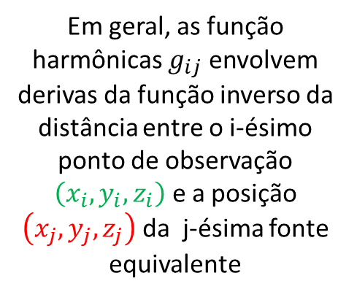
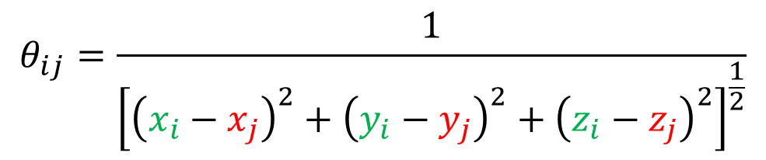
$$θ_{ij}=\frac{1}{{\left[{\left(x_{i}−x_{j}\right)}^{2}+{\left(y_{i}−y_{j}\right)}^{2}+{\left(z_{i}−z_{j}\right)}^{2}\right]}^{\frac{1}{2}}}$$
Em geral, as função harmônicas $g_{ij}$ envolvem derivas da função inverso da distância entre o i-ésimo ponto de observação $\left(x_{i},y_{i},z_{i}\right)$ e a posição $\left(x_{j},y_{j}, z_{j}\right)$ da j-ésima fonte equivalente

Slide 27


$$θ_{ij}=\frac{1}{{\left[{\left(x_{i}−x_{j}\right)}^{2}+{\left(y_{i}−y_{j}\right)}^{2}+{\left(z_{i}−z_{j}\right)}^{2}\right]}^{\frac{1}{2}}}$$
Em geral, as função harmônicas $g_{ij}$ envolvem derivas da função inverso da distância entre o i-ésimo ponto de observação $\left(x_{i},y_{i},z_{i}\right)$ e a posição $\left(x_{j},y_{j}, z_{j}\right)$ da j-ésima fonte equivalente
Geralmente utilizada com dados gravimétricos
$$g_{ij}=κ_{g}∂_{z}θ_{ij}$$
$$κ_{g}={10}^{5}G$$

Slide 28
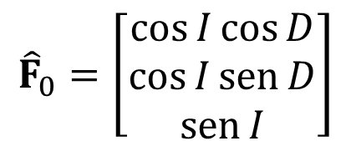
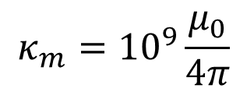

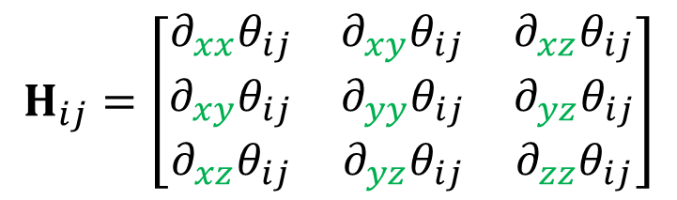
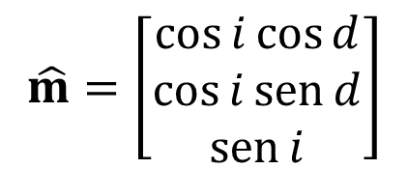
$$θ_{ij}=\frac{1}{{\left[{\left(x_{i}−x_{j}\right)}^{2}+{\left(y_{i}−y_{j}\right)}^{2}+{\left(z_{i}−z_{j}\right)}^{2}\right]}^{\frac{1}{2}}}$$
Em geral, as função harmônicas $g_{ij}$ envolvem derivas da função inverso da distância entre o i-ésimo ponto de observação $\left(x_{i},y_{i},z_{i}\right)$ e a posição $\left(x_{j},y_{j}, z_{j}\right)$ da j-ésima fonte equivalente
Geralmente utilizada com dados gravimétricos
$$g_{ij}=κ_{g}∂_{z}θ_{ij}$$
$$κ_{g}={10}^{5}G$$
Campo geomagnético local
$${\hat{F}}_{0}=\left[\begin{matrix}\cos{I}\cos{D} \\ \cos{I}\operatorname{sen}{D} \\ \operatorname{sen}{I}\end{matrix}\right]$$
Geralmente utilizada com dados magnetométricos
$$κ_{m}={10}^{9}\frac{μ_{0}}{4π}$$
$$g_{ij}=κ_{m}m_{j}{\hat{F}}_{0}^{T}H_{ij}\hat{m}$$
Magnetização da fonte equivalente
$$H_{ij}=\left[\begin{matrix}∂_{xx}θ_{ij} & ∂_{xy}θ_{ij} & ∂_{xz}θ_{ij} \\ ∂_{xy}θ_{ij} & ∂_{yy}θ_{ij} & ∂_{yz}θ_{ij} \\ ∂_{xz}θ_{ij} & ∂_{yz}θ_{ij} & ∂_{zz}θ_{ij}\end{matrix}\right]$$
$$\hat{m}=\left[\begin{matrix}\cos{i}\cos{d} \\ \cos{i}\operatorname{sen}{d} \\ \operatorname{sen}{i}\end{matrix}\right]$$

Slide 29
Referências
Bhattacharyya, B. K., 1967, Some general properties of potential fields in space and frequency domain: a review: Geoexploration, 5, 127-143.
Blakely, R. J., 1996, Potential theory in gravity and magnetic applications: Cambridge University Press.
Green, G., 1871, Mathematical papers of the late George Green, ed. Ferrers, N. M., London: MacMillan and Co., Cambridge University Press.
Henderson, R. G., e Zietz, I., 1949, The upward continuation of anomalies in total magnetic intensity fields: GEOPHYSICS, 14, 517-534.
Henderson, R. G., 1960, A comprehensive system of automatic computation in magnetic and gravity interpretation: GEOPHYSICS, 25, 569-585.
Henderson, R. G., 1970, On the validity of the use of the upward continuation integral for total magnetic intensity data: GEOPHYSICS, 35, 916-919.
Kellogg, O. D., 1929, Foundations of potential theory: Frederick Ungar Publishing Company.
Roy, A., 1962, Ambiguity in geophysical interpretation: GEOPHYSICS, 27, 90-99.
Skeels, D. C., 1947, Ambiguity in gravity interpretation: GEOPHYSICS, 12, 43-56.
Twomey, S., 1977, Introduction to the mathematics of inversion in remote sensing and indirect measurements: Dover Publications, Inc.

