Slide 1
Complexity Analysis

Slide 2
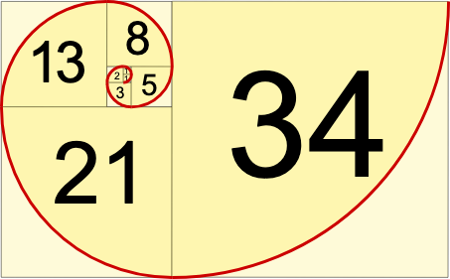
Fibonacci’s Number
fibonacci(n)= fibonacci(n−1)+fibonacci(n−2)
1, 1, 2, 3, 5, 8, 13, 21, 34, 55, 89, 144, 233…

Slide 3
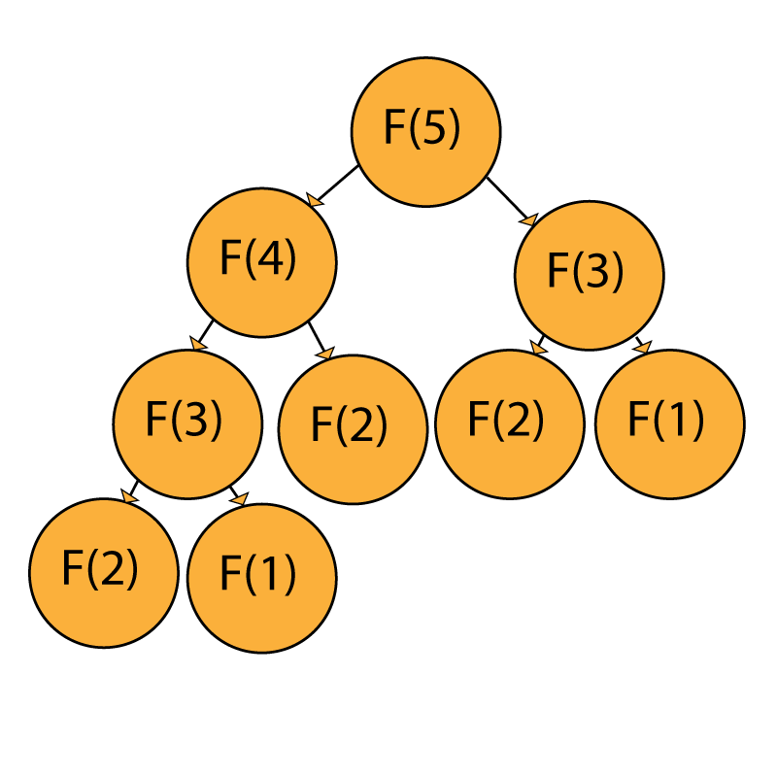

Slide 4
TASKS FOR TODAY
Add a logger method to the complexity project
Add a parameter using parseargs that sets nmax
For the GC calc project
Add a logger method
Generate logo plots and calculate GC frequency for all miRNAs for mouse, human and rat
Generate a Markdown report to summarise your findings

