Slide 1



Department of Computer Engineering
Academic Year 2025-2026 (Even Sem)
SY Mini Project
Mini Project Presentation
Vedanshi Parmar (B-48)
Urvi Parekh (B-47)
Heli Shah (B-24)
Rashmi Pinge (B-16)
Guided By : Ms.Vaishali Patil
Computer Engineering Department
1

Slide 2

Problem Statement 1
Effective communication relies on natural pacing, emphasis, and momentum, allowing speakers to guide attention and reinforce key ideas in real time.
Manual slide navigation repeatedly disrupts this flow, forcing presenters to break eye contact and thought continuity.
Speakers must shift focus to clickers, annotation tools, or verbal cues, dividing attention between delivery and control.
These constant micro-interruptions reduce confidence, audience engagement, and message clarity, weakening overall impact.
Existing voice assistants operate on rigid, predefined commands, requiring users to adapt their speech unnaturally.
They lack awareness of context, intent, and presentation flow, making them ineffective in live, dynamic settings.

Slide 3
Solution 1
An intelligent presentation system that understands what the speaker means, not just what they say — eliminating manual interruptions and restoring natural presentation flow.
Key Capabilities
Hands-Free Slide Navigation Controls slides using natural speech and pacing, removing the need for clickers or manual input. Examples: “Let’s move on” → Next slide “Going back…” → Previous slide “Skip this” → Jump forward
Speech-Synced Content Emphasis & Reveal Automatically highlights, reveals, or emphasizes slide content as it is spoken, keeping the audience aligned with the narrative. Examples: Reading a bullet → That bullet is highlighted “This is the critical takeaway…” → critical is visually emphasized
Intelligent Annotation & Visual Guidance Draws attention to relevant areas in charts, images, and diagrams based on verbal cues. Examples: “As you can see in the top-left corner…” → Area is subtly circled “Watch this line trend upwards…” → The line is dynamically emphasized
Context & Intent Awareness Goes beyond predefined voice commands by understanding presentation context and speaker intent, enabling smooth, adaptive interactions in real time

Slide 4
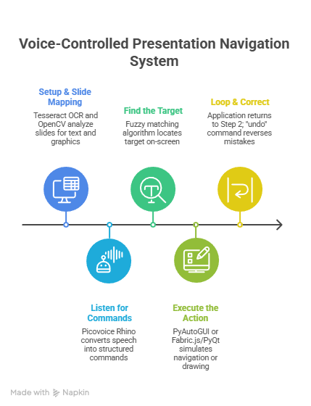
Methodology/ Algorithms
Initialize: Load slides and start microphone input. Python with pvporcupine/pvrhino to initialize the Speech-to-Intent engine.
Map Slides: Use OCR to catalog all text and objects on each slide into a searchable map. Tesseract OCR to extract text and OpenCV with a pre-trained model to detect graphical elements
Listen & Process: Continuously capture audio, detect speech, and feed it to a Speech-to-Intent engine. Picovoice Rhino (for intent) and a simple FFT library like numpy.fft (for analysis of pitch/pause).
Parse Command: Engine outputs a structured command (e.g., {intent: 'highlight', target: 'key metric'}).
Find Target: Use the slide map to locate the coordinates of the mentioned "key metric" on the current slide. Fuzzy matching algorithm to match the spoken word from Rhino's slot to the text in the slide map from Step 2.
Execute Action: Trigger the correct function—press a key to advance or draw a graphic at the target coordinates. Google Slides API / Microsoft Graph API to navigate and Fabric.js (web) to draw annotations.
Loop & Handle Errors: Return to Step 3. If a mistake happens, a vocal "undo" command reverses the last action.

Slide 5
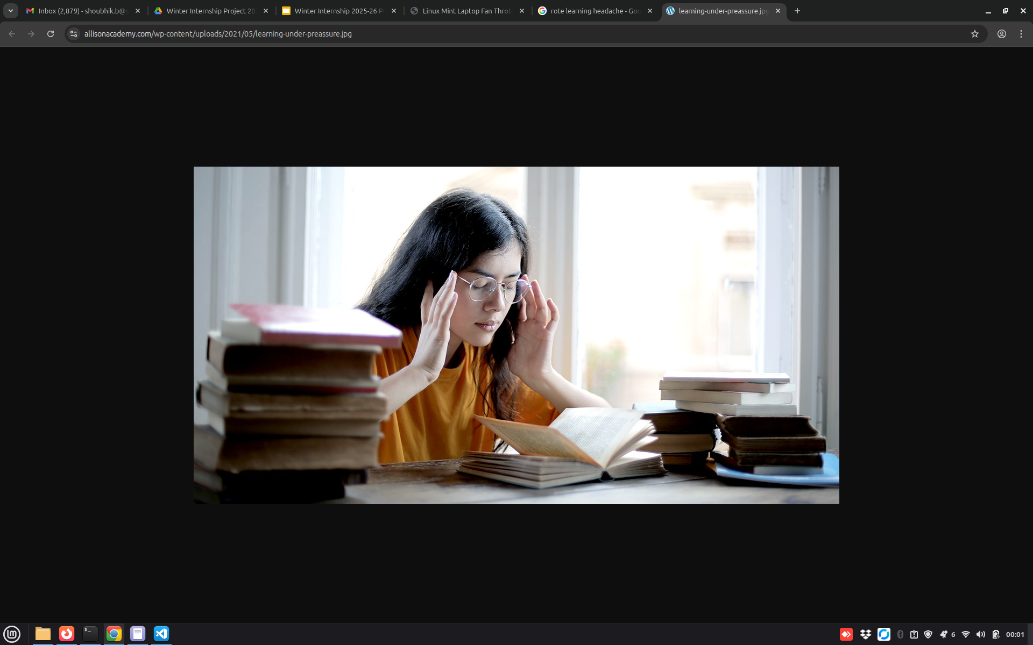
Problem Statement 2
Learners often understand concepts during study but struggle to recall structured points, definitions, and characteristics during revision or exams.
Learning resources such as PPTs, PDFs, and documents are available on platforms like Google Classroom and college repositories, but accessing specific conceptual information is difficult.
Students must manually browse multiple files or depend on keyword-based searches, which are inefficient and time-consuming.
Learning materials contain lengthy explanations, examples, and illustrations, making quick information retrieval challenging.
As a result, students spend more time searching for content rather than revising or applying concepts.
There is a need for an intelligent, browser-based solution that enables intuitive and efficient interaction with academic resources.

Slide 6
Solution 2
Develop a browser-based intelligent academic assistant (AI Bot).
Upload all course-related materials (PPTs, PDFs, documents) into the system.
Students interact with the bot using natural language questions.
The bot extracts answers only from the uploaded documents.
Ensures:
1.Syllabus-bound answers
2.High accuracy
3.No out-of-context or irrelevant content
Eliminates manual searching and scrolling through multiple files.
Enables quick revision, structured answers, and better exam preparation.

Slide 7
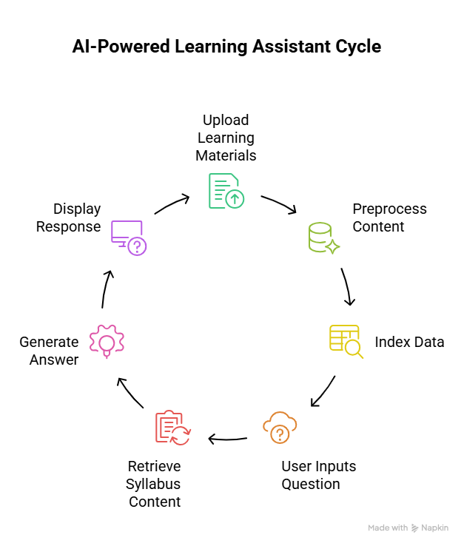
Methodology/ Algorithms
Document Upload: All academic resources such as PPTs, PDFs, and lecture notes are uploaded into the system to form the knowledge base.
Data Preprocessing: The uploaded documents are processed to extract text and organize the content into meaningful sections.
Knowledge Indexing: The processed content is converted into semantic representations and stored in a searchable database for efficient retrieval.
User Query Input: Students interact with the system by entering natural language questions through a browser-based interface.
Relevant Content Retrieval: The system analyzes the user query and retrieves the most relevant content strictly from the uploaded documents.
Answer Generation: The bot generates concise and structured answers using the retrieved document content, ensuring syllabus-bound and accurate responses.
User Interaction: The final answers are displayed in a chat-based interface, allowing students to quickly revise concepts and ask follow-up questions.

Slide 8
Thank You!!

