Slide 1
Unit 2: Using Objects
Math And Wrapper Classes

Slide 2
Static Methods
The Math class has many useful static methods. The class is part of the java.lang package(group of classes) that is available by default(no need to import to use). To call these, use the syntax:
  Math.methodName(parameters);
double answer = Math.sqrt(9.2);
int b = Math.round(5.6755);

Slide 3
Java's Math class
Method name | Description
int abs(int x) double abs(double x) | returns the absolute value of a int or double value (overloaded method)
double pow(double base, double exponent) | Returns the value of the first parameter raised to the power of the second parameter
double sqrt(double x) | Returns the positive square root of a double value
double random() | Returns a random double value greater than or equal to 0.0 and less than 1.0
Constant | Description
Math.E | 2.7182818...
Math.PI | 3.1415926...

Slide 4
Calling Math methods
Examples:
  double squareRoot = Math.sqrt(121.0);
  System.out.println(squareRoot); // 11.0
  int absoluteValue = Math.abs(-50);
  System.out.println(absoluteValue); // 50
  System.out.println(Math.min(3, 7) + 2); // 5
The Math methods do not print to the console.
  Each method produces ("returns") a numeric result.
  Remember to store, print or use the result in some expression

Slide 5
Math questions
Evaluate the following expressions:
  Math.abs(-1.23)
  Math.pow(3, 2)
  Math.pow(10, -2)
  Math.sqrt(121.0) - Math.sqrt(256.0)

Slide 6
Math questions
  Write a method withinHalf which takes two double parameters and return true if they are within .5 of each other and false otherwise.
  withinHalf(4,5.1) // returns false
  withinHalf(3.4,3.9) // returns true
  withinHalf(3.9,3.4) // returns true
  withinHalf(-1.2,-1.1) // returns true
  public static boolean withinHalf(double x, double y)
  {
  return Math.abs(x - y) <= .5;
  }

Slide 7
Quirks of real numbers
Some Math methods return double or other non-int types.
  int x = Math.pow(10, 3); // ERROR: incompat. types
Some double values print poorly (too many digits).
  double result = 1.0 / 3.0;
  System.out.println(result); // 0.3333333333333
The computer represents doubles in an imprecise way.
  System.out.println(0.1 + 0.2);
  Instead of 0.3, the output is 0.30000000000000004

Slide 8
Random Numbers

Slide 9
Random numbers
Math.random() produces a number from 0(inclusive) to 1 exclusive.
  double x = Math.random(); // 0.0 <= x < 1.0
  double x = 3 * Math.random(); // 0.0 <= x < 3.0
  double x = Math.random() + 2; // 2.0 <= x < 3.0
  double x = 5 * Math.random() + 4; // 4.0 <= x <9.0
  In general, to produce a random real number in the range [low,high),
  double x = (high - low) * Math.random() + low;
  Generate a random real value in [7.0,15.0).
  double x = 8 * Math.random() + 7;

Slide 10
Random Integers
  How do we generate random integers? Use casting!
  int x = (int)(100 * Math.random());
  // random integer 0 to 99 inclusive.
  int y = (int)(100 * Math.random()) + 4;
  // random integer 4 to 103 inclusive.
  int z = (int)(2 * Math.random());
  // random integer 0 or 1, useful for heads/tails

Slide 11
More Examples
  int x = (int) Math.random() * 5;
  // x = 0
  int y = (int)(6 * Math.random()) - 10;
  // integer from -10 to -5 inclusive.
  double z = 3 * Math.random() + 5;
  //random double in [5,8)

Slide 12
Wrapper Classes
A wrapper class takes an existing value of primitive type and “wraps” or “boxes” it in an object, and provides a new set of methods for that type.
It can be used in Java container classes that requires the item to be objects. (Arraylist)

Slide 13
Wrapper Classes
The wrapper class allows
The construction of an object from a single value(wrapping or boxing the primitive in a wrapper object. )
The retrieval of a primitive value(unwrapping or unboxing from a wrapper object.)

Slide 14
Wrapper Classes
You will need to know two wrapper classes:
Integer class
Double class

Slide 15
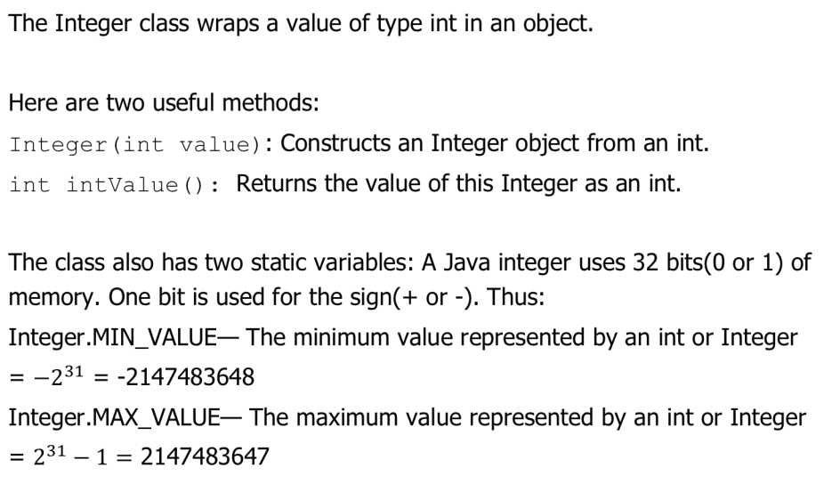
Integer Class

Slide 16
Double Class
The Double class wraps a value of type double in an object.
Here are two useful methods:
Double(double value): Constructs an Double object from an double.
double doubleValue(): Returns the value of this Double as a double

Slide 17
Examples
Integer intObj = new Integer(6);//boxes 6 in Integer object
int j = intObj.intValue(); //unboxes 6 from Integer object
Double dObj = new Double(2.5);//boxes 2.5 in Double object
double d = dObj.doubleValue(); //unboxes 2.5 from Double object

Slide 18
Auto-Boxing and Unboxing
Auto-boxing is the automatic boxing of primitive types in their wrapper classes.
To retrieve the value of an Integer(or Double), the intValue() or
doubleValue() method can be called(unboxing).
Auto-unboxing is the automatic conversion of a wrapper class to its corresponding primitive type. This means you don’t need to explicitly call the intValue() or doubleValue().

Slide 19
Autoboxing and Auto-unboxing
Integer a = new Integer(5);
int x = a.intValue(); // unboxing x = 5
int y = a; // auto-unboxing, easier.
Integer b = new Integer(7); // boxing
Integer c = 7; // auto-boxing
int z = a + x; // auto-unboxing
Double d = new Double(7.5); // boxing
double e = d.doubleValue(); // unboxing
double f = d + 2.0; // auto-unboxing

Slide 20
Lab
class Main {
public static void main(String[] args) {
// fill in the code
// create a random double in the range [0, 10), store in variable b, print out b
// print out a random double in the range [-2,8),
// print out a random integer from the set {5, 6, ..., 16}
// create a variable called min which is the smallest possible integer, print it
// subtract 1 from min, print it, what happened?
// create a variable called max which is the largest possible integer, print it
// add 1 to max, print it, what happened?
}
}

