Slide 1
Unit 2: Using Objects
Methods

Slide 2
Modularity
modularity: Writing code in smaller, more manageable components or modules. Then combining the modules into a cohesive system.
  Modularity with methods. Break complex code into smaller tasks and organize it using methods.
Methods define the behaviors or functions for objects.
An object’s behavior refers to what the object can do (or what can be done to it). A method is simply a named group of statements.

Slide 3
static vs non-static
Variables and methods can be classified as static or nonstatic(instance).
Non-static or instance: Part of an object, rather than shared by the class. Non-static methods are called using the dot operator along with the object variable name.
static: Part of a class, rather than part of an object. Not copied into each object; shared by all objects of that class. Static methods are called using the dot operator along with the class name.
We will further clarify this distinction in Unit 5 when we learn to write our own classes.

Slide 4
Static Method Inside Driver Class
The driver class is the class with the main method. Note that the main method is the begin point of a run of any program. The driver class can contain other static methods. You can call a static method from another method in the same enclosing class directly without referencing the name or object of the class.
public class MyClass{
public static void main(String[] args){
method2();
method1();
}
public static void method1(){
System.out.println(“running method1”);
}
public static void method2(){
System.out.println(“running method2”);
}
}
MyClass.java
Output:
running method2
running method1

Slide 5
Static Method Inside Driver Class
The order of the methods in the driver class does not matter and does not affect the run or output of the program. The program below has the exact same output as the program from the previous slide. The main method is always the starting point of the run of any program.
public class MyClass{
public static void method1(){
System.out.println(“running method1”);
}
public static void main(String[] args){
method2();
method1();
}
public static void method2(){
System.out.println(“running method2”);
}
}
MyClass.java
Output:
running method2
running method1

Slide 6
Control flow
When a method is called, the program's execution...
  "jumps" into that method, executing its statements, then
  "jumps" back to the point where the method was called.
What is the output?
public class MethodsExample {
public static void main(String[] args) {
message1();
message2();
}
...
}
public static void message1() {
System.out.println("This is message1.");
}
public static void message2() {
System.out.println("This is message2.");
message1();
System.out.println("Done with message2.");
}
Output:
This is message1.
This is message2.
This is message1.
Done with message2.
public static void message1() {
System.out.println("This is message1.");
}

Slide 7
Methods
Non-static or instance methods belong to individual objects. They are usually implemented inside of an object class rather than the driver class.
Methods in an object class are non-static by default unless explicitly labeled "static".
Non-static methods are called through objects of the class.

Slide 8
Non-static Method Call
Output:
Begins here.
method1
method2
Ends here.
A program’s run begins and ends at the main method.
MyClass.java
non-static(instance) methods
MyProgram.java
public class MyProgram{
public static void main(String[] args){
System.out.println(“Begins here.”);
MyClass c = new MyClass();
c.method1();
c.method2();
System.out.println(“Ends here.”);
}
}
public class MyClass{
…
public void method1(){
System.out.println(“method1”);
}
public void method2(){
System.out.println(“method2”);
}
}
non-static method is called through the name of an object using the dot notation

Slide 9
Method Signature
A method signature for a method consists of the method name and the ordered, possibly empty, list of parameter types.
public void name(parameters){
  statements;
  }
Examples:
public void method1(){
…
}
public void method2(int x, double y){
…
}
The parameters in the method header are formal parameters.
void: no value is returned when method ends.
no parameters

Slide 10
Static Example
When calling a method with parameters, values provided in the parameter list
need to correspond to the order and type in the method signature.
public class MyProgram{
public static void main(String[] args){
mystery1(3, 4); // error, incompatible types!
mystery1(); // missing actual parameters
mystery1(3); // missing actual parameters
mystery1(3, true); // correct
mystery2(3.2, 3.0); // error, incompatible types!
double a = 2.5;
int b = 5;
mystery2(double a, int b); // error, no type in actual parameters
mystery2(a, b); // correct
}
public static void mystery1(int x, boolean y){
…
}
public static void mystery2(double x, int z){
…
}
}

Slide 11
Non-static Example
When calling a method with parameters, values provided in the parameter list
need to correspond to the order and type in the method signature.
MyProgram.java
public class MyProgram{
public static void main(String[] args){
MyClass c = new MyClass();
c.method1(); // correct!
c.method2(); // error! Missing actual parameters
c.method2(3.5, 4.1); // error! Wrong types
c.method2(2, 3.1); // correct!
c.method2(3, 4); // correct, 4 is casted to a double 4.0
}
}
MyClass.java
public class MyClass{
…
public void method1(){
…
}
public void method2(int x, double y){
…
}
}

Slide 12
Static Vs Non-static Method Calling
MyClass.java
public class MyClass{
public static void main(String[] args){
System.out.println(SomeClass.method1());
SomeClass a = new SomeClass();
System.out.println(a.method2());
System.out.println(a.method1());
System.out.println(SomeClass.method2());
}
}
public class SomeClass{
public SomeClass(){…}
public static int method1(){…} // static method
public int method2(){…} // non-static or instance method
}
call static method through
name of class
call non-static method
through name of an object
This works also but not considered "best practice"
This is an error!
Note that method1 and method2 both belong to a different class than the driver class where they are being called.
SomeClass.java

Slide 13
Method Returns
Methods in Java can have return types. Such non-void methods return values back that can be used by the program. A method can use the keyword “return” to return a value.
public type methodName(type var1,…, type var2){
…
}
Examples:
public int method1(){
…
}
public double method2(int x){
…
}
Note: Method parameters are its inputs and method returns are its outputs.
return types

Slide 14
Return
return: To send out a value as the result of a method.
  The opposite of a parameter:
    Parameters send information in from the caller to the method.
    Return values send information out from a method to its caller.
      A call to the method can be used as part of an expression.
-42
Math.abs(-42)
42
main
2.71
3
Math.round(2.71)

Slide 15
Return
Non-void methods return a value that is the same type as the return type in the signature.
To use the return value when calling a non-void method, it must be stored in a variable or used as part of an expression.
Procedural abstraction allows a programmer to use a method by knowing what the method does even if they do not know how the method was written.
For example, the Math library, part of the java.lang package contains many useful mathematical methods. We may not know how these methods were implemented but we can still use them.

Slide 16
Common error: Not storing
Many students forget to store the result of a method call.
public static void main(String[] args) {
Math.abs(-4); // value not stored nor used
int result = Math.abs(-4);// corrected
System.out.println(result); // 4
System.out.println(“the square root of 4 is “ + Math.sqrt(4));
// the square root of 4 is 2.0
}
returned value is concatenated with a string

Slide 17
NullPointerException
Using a null reference to call a method or access an instance variable causes a NullPointerException to be thrown.
public static void main(String[] args) {
Sprite a = null; //currently the variable a references no object
a.display(); // NullPointerException, can’t call method on
// a reference to nothing!
System.out.println(a.center_x); // NullPointerException
}

Slide 18
Void Methods
Void methods do not have return values. Once the execution of the method completes, the flow of control returns to the point immediately following where the method was called.
public void methodName(type var1,…, type var2){
…
}
Examples:
public void method1(){
…
}
public void method2(int x){
…
}
void

Slide 19
Void Methods
Void methods do not have return values and are therefore not called as part of an expression.
public class MyClass{
public static void main(String[] args){
int a = 3 + printX(5); //error! Does not return!
int b = 5 * twiceX(3); // correct, b = 30
printX(5); // correct
// Output: The input x is 5
}
public static void printX(int x){
System.out.println(“The input x is” + x);
}
public static int twiceX(int x){
return 2 * x;
}
}

Slide 20
Overloaded Methods
Methods are said to be overloaded when there are multiple methods with the same name but a different signature.
public class MyClass{
public static void main(String[] args){
double a = add(1, 2) + add(1.8, 5.2) + add(1, 2, 3);
System.out.println(a); // 16.0
}
public static int add(int x, int y){
return x + y;
}
public static double add(double x, double y){
return x + y;
}
public static int add(int x, int y, int z){
return x + y + z;
}
}
Three methods named “add”.

Slide 21
Value Semantics
Parameters are passed using call by value or value semantics. Call by value initializes the formal parameters with copies of the actual parameters.
When primitive variables (int, double,boolean) and String(the only object class that does this) are passed as parameters, their values are copied.
  Modifying the parameter will not affect the variable passed in.
public class MyClass{
public static void main(String[] args){
  int x = 23;
  strange(x);
  System.out.println("2. x = " + x);
}
public static void strange(int x){
  x = x + 1;
  System.out.println("1. x = " + x);
}
Note: The value of x in main did not change.
The x variable in main is different than the x variable in strange.
Output:
1. x = 24
2. x = 23

Slide 22
Value semantics
Value semantics: methods cannot change the values of primitive types(int, boolean, float) and String.
public class MyClass{
public static void main(String[] args){
int x = 5;
doubleMyNumber(x);
System.out.println(“My number is” + x); //My number is 5
}
public static void doubleMyNumber(int x){
  x *= 2;
}
}
Note: The value of x in main did not change.

Slide 23
Find all errors.
public class MyClass{
public static void main(String[] args){
printX();
add();
add(3, 5);
System.out.println(printX()); System.out.println(“3 + 5 = “ + add(3, 5));
int y = 3 + add(4, 6.0);
}
public static void printX(int x){
System.out.println(“The input x is” + x);
}
public static int add(int x, int y){
return x + y;
}
}

Slide 24
Answers
public class MyClass{
public static void main(String[] args){
printX(); // missing actual parameter.
add(); // missing actual parameters.
add(3, 5); // not a syntax error.returned value not stored
System.out.println(printX(5)); // error!
//no returned value!
System.out.println(“3 + 5 = “ + add(3, 5));//correct!
int y = 3 + add(4, 6.0); // incompatible types!
}
public static void printX(int x){
System.out.println(“The input x is” + x);
}
public static int add(int x, int y){
return x + y;
}
}

Slide 25
Nonstatic vs Static
Let’s do one example of a object class to understand when to make a method static vs. non-static.
class Student{
int id;
public Student(int new_id){
id = new_id;
}
public void printMyID(){
System.out.println(“My ID is “ + id);
}
public static void printWelcomeMessage(){
System.out.println(“Welcome all students!”);
}
}
}
printMyID is a non-static method and belong to individual student objects. E.g. if there are 5 student objects, there are 5 different copies of printMyID, one for each student.

Slide 26
Nonstatic vs Static
Let’s do one example of a object class to understand when to make a method static vs. non-static.
class Student{
int id;
public Student(int new_id){
id = new_id;
}
public void printMyID(){
System.out.println(“My ID is “ + id);
}
public static void printWelcomeMessage(){
System.out.println(“Welcome all students!”);
}
}
}
printWelcomeMessage is a static(class) method. It belongs to the class rather than individual objects. If there are 5 student objects, there is only ONE shared printWelcomeMessage.

Slide 27
Nonstatic vs Static
Here's how we can use the Student class.
class DriverClass{
public static void main(String[] args){
// create a Student object
Student s1 = new Student(12343);
// call instance or non-static printMyID()
s1.printMyID();
// call static printWelcomeMessage()
Student.printWelcomeMessage();
// this also works but not considered
// "best practice"
s1.printWelcomeMessage();
}
}

Slide 28
Lab
Write a driver class with the following five static methods.
// given two integers x and y, returns their average.
public static double average(int x, int y)
{…}
// given two points (x1, y1) and (x2,y2), returns
// the slope of the line through them. You may assume
// x1 is not equal to x2.
public static double slope(int x1,int y1,int x2,int y2)
{…}

Slide 29
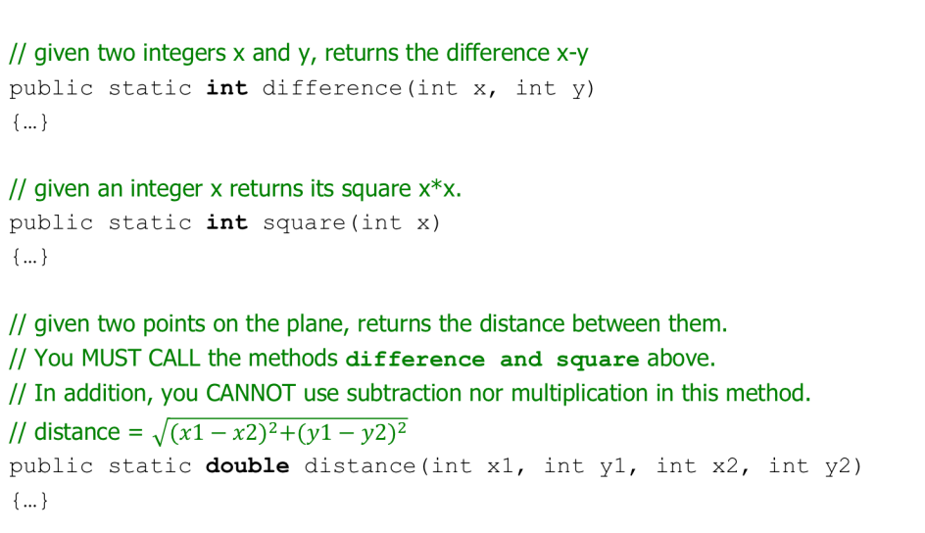
Lab

Slide 30

Lab
Write your main() method so that your program has an output similar to:
Notice the format of the points on the coordinate plane.

Slide 31
Lab 2
Implement the driver class to ask the user to enter two different points(using a Scanner object)on the plane and print out their midpoint and the distance between them.
For (x1, y1) and (x2, y2):
Midpoint: ((x1+x2)/2, (y1+y2)/2)

Slide 32
Lab 2
Write your program so that it has EXACTLY THE FOLLOWING OUTPUT.
Program Output: (underlined values are user-entered inputs)
Enter x1: 2
Enter y1: -1
Enter x2: 3
Enter y2: 5
The midpoint between (2,-1) and (3,5) is (2.5, 3.0)
The distance between (2,-1) and (3,5) is 6.082762530298219

