Slide 1
Unit 4: Iteration
Nested Loops

Slide 2
Nested loops
nested loop: A loop placed inside another loop.
  for (int i = 1; i <= 5; i++) {
  for (int j = 1; j <= 10; j++) {
  System.out.print("*");
  }
  System.out.println(); // to end the line
  }
Output:
  **********
  **********
  **********
  **********
  **********
The outer loop repeats 5 times; the inner one 10 times.
  "sets and reps" exercise analogy

Slide 3
Nested for loop exercise
What is the output of the following nested for loops?
  for (int i = 1; i <= 5; i++) {
  for (int j = 1; j <= i; j++) {
  System.out.print("*");
  }
  System.out.println();
  }
Output:
  *
  **
  ***
  ****
  *****

Slide 4
Nested for loop exercise
What is the output of the following nested for loops?
  for (int i = 1; i <= 5; i++) {
  for (int j = 1; j <= i; j++) {
  System.out.print(i);
  }
  System.out.println();
  }
Output:
  1
  22
  333
  4444
  55555

Slide 5
Nested for loop exercise
What is the output of the following nested for loops?
  for (int i = 1; i <= 5; i++) {
  for (int j = i; j <= 5; j++) {
  System.out.print(i);
  }
  System.out.println();
  }
Output:
  11111
  2222
  333
  44
  5

Slide 6
Common errors
  for (int i = 1; i <= 5; i++) {
  for (int j = 1; i <= 10; j++) {
  System.out.print("*");
  }
  System.out.println();
  }
  Infinite loops!
  for (int i = 1; i <= 5; i++) {
  for (int j = 1; j <= 10; i++) {
  System.out.print("*");
  }
  System.out.println();
  }
  Infinite loops!

Slide 7
Computational Complexity
Computational complexity of an algorithm is the amount of computational resources(e.g. math operations) needed to perform the algorithm.
For example, how many iterations does a for loop execute?

Slide 8
Some Examples
What’s the total number of x++ operations?
int x = 0;
for(int i = 0; i < 10; i++){
x++;
}
for(int j = 1; j <= 15; j++){
x++;
}
Answer: 10 + 15 = 25

Slide 9
Some Examples
What’s the total number of x++ operations?
int x = 0;
for(int i = 0; i < 10; i++){
for(int j = 0; j < 15; j++)
x++;
}
Answer: 10 * 15 = 150

Slide 10
Some Examples
What’s the total number of x++ operations in terms of n?
int x = 0;
for(int i = 0; i < n; i++){
x++;
}
for(int j = 0; j < n; j++){
x++;
}
Answer: n + n = 2n (linear)

Slide 11
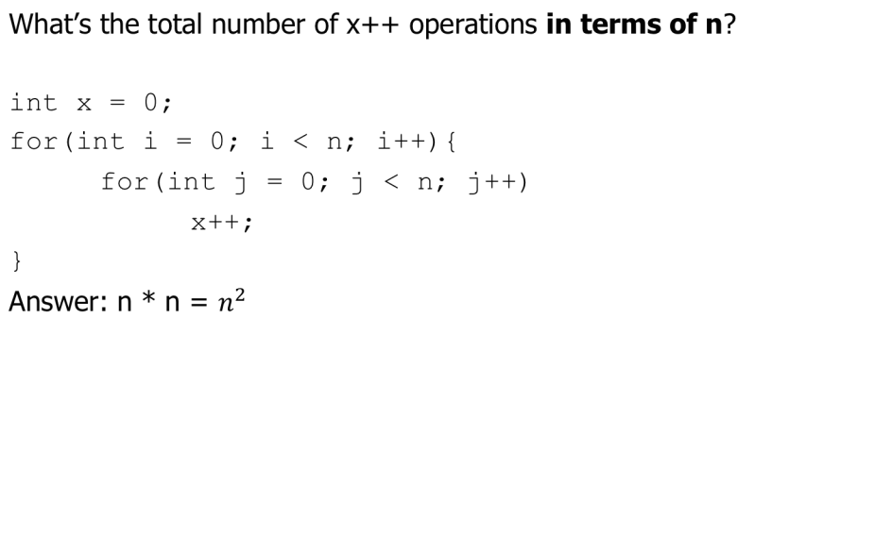
Some Examples

Slide 12
Some Examples
What’s the total number of operations in terms of n?
for(int i = 0; i < n; i++){
for(int j = i; j < n; j++)
x++;
}
Answer:
n + (n-1) + (n-2) + .. + 2 + 1 = n(n+1)/2 (quadratic)
where the equality is obtained from using the summation equation for an arithmetic series.
(For example, 1+2+3+4+…+100=100*101/2)

Slide 13
Lab 1
Implement a static void method called printLadder which accepts a nonnegative integer n and print a ladder shape of 1's consisting of n steps. For example:
printLadder(1);
1
printLadder(4);
1
11
111
1111

Slide 14
Lab 1
Implement a static void method called multiplicationTable which accepts a positive integer n and print the multiplication table starting at 1 up to and including n.(use tab to separate values "\t")
multiplicationTable(2);
1 2 3 4 5 6 7 8 9 10
2 4 6 8 10 12 14 16 18 20
multiplicationTable(3);
1 2 3 4 5 6 7 8 9 10
2 4 6 8 10 12 14 16 18 20
3 6 9 12 15 18 21 24 27 30

