Slide 1

Heart Failure Prediction
By- NANPING LI

Slide 2
Abstract
Heart Disease can affect a greater number of people in the world. Machine Learning can play an essential role in predicting presence/absence of Locomotor disorders, Heart diseases and more. Such information, if predicted well in advance, can provide important insights to doctors who can then adapt their diagnosis and treatment per patient basis.

Slide 3
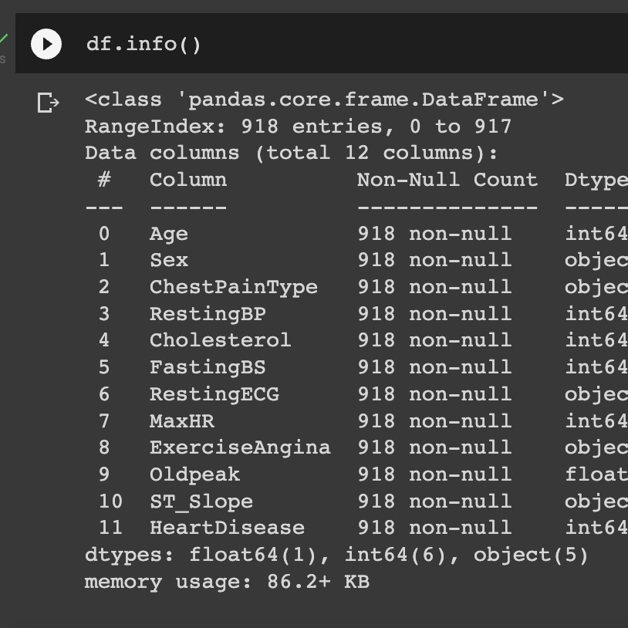
Data info
12 features
1 target

Slide 4
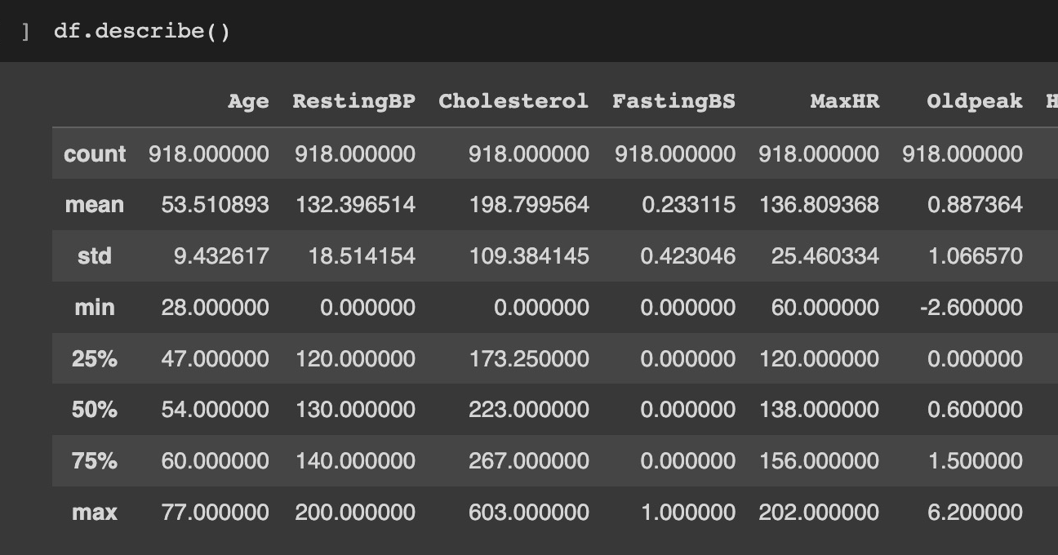

Slide 5
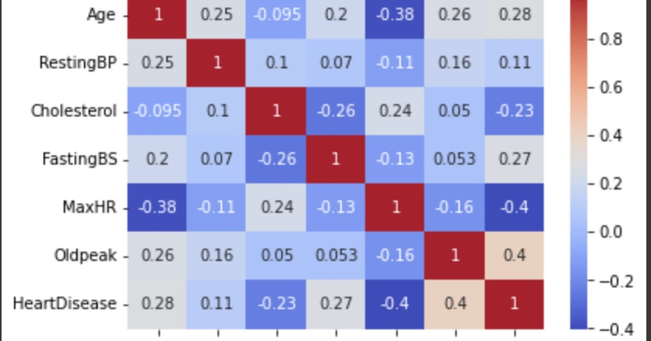
except for old peak, no single feature has a very high correlation with our target value

Slide 6
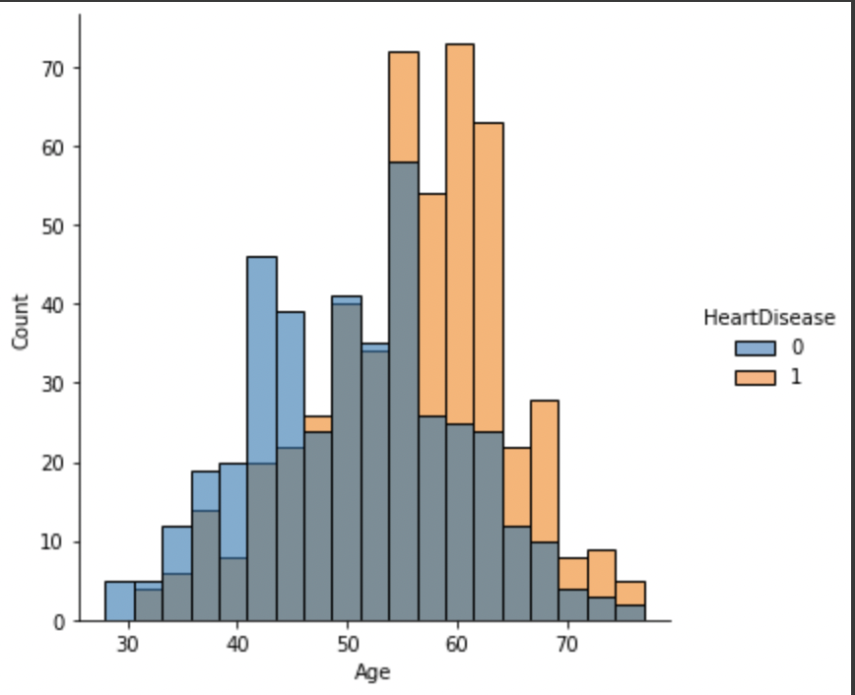
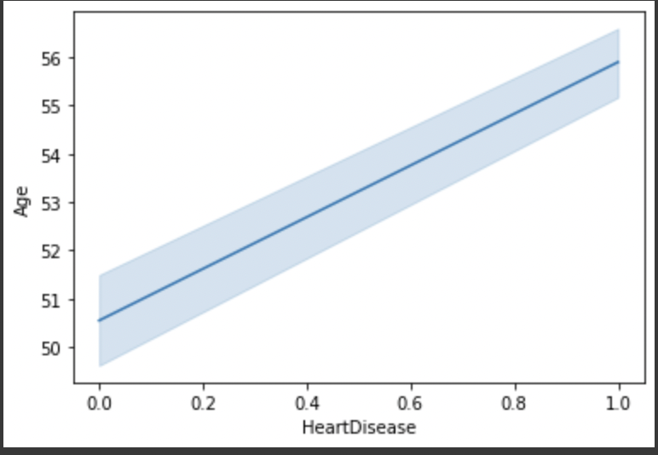
Heart disease incidence of Age
As age increases the risk of heart disease also increases for the age range of 55-65.

Slide 7
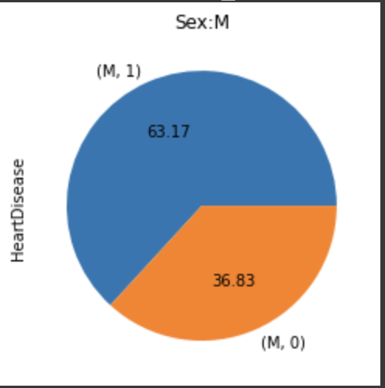
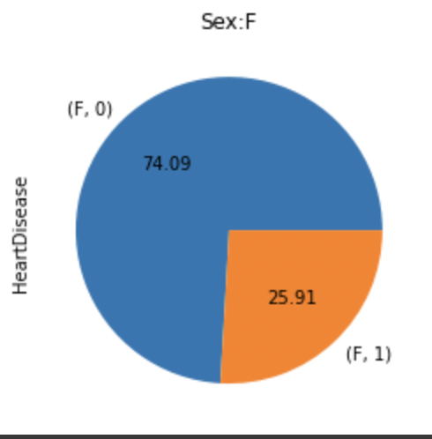
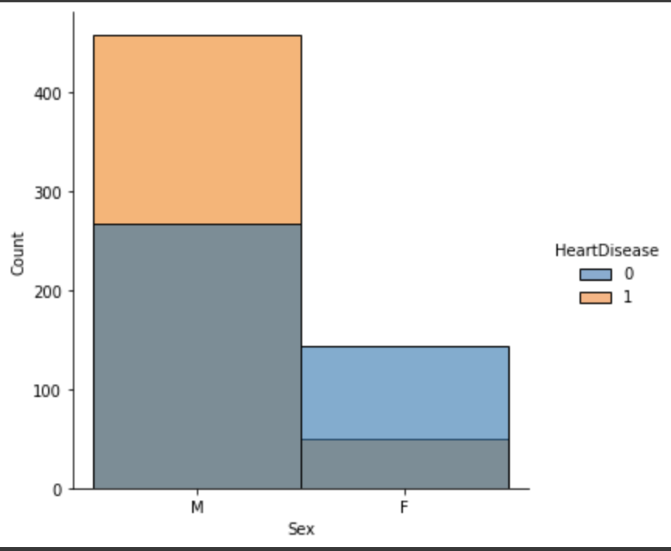
Heart disease incidence of Sex Male: 63 % Famale: 25.91%

Slide 8
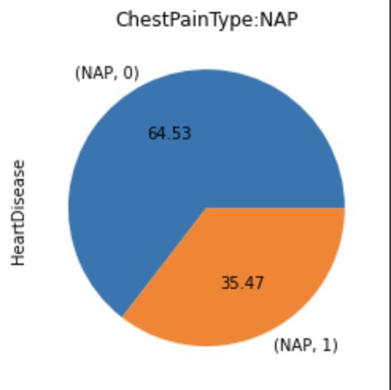
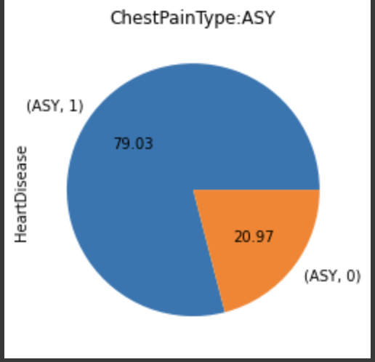
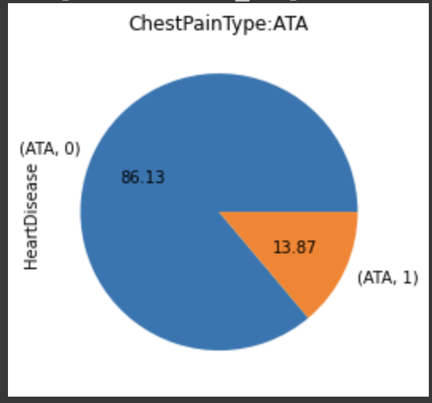
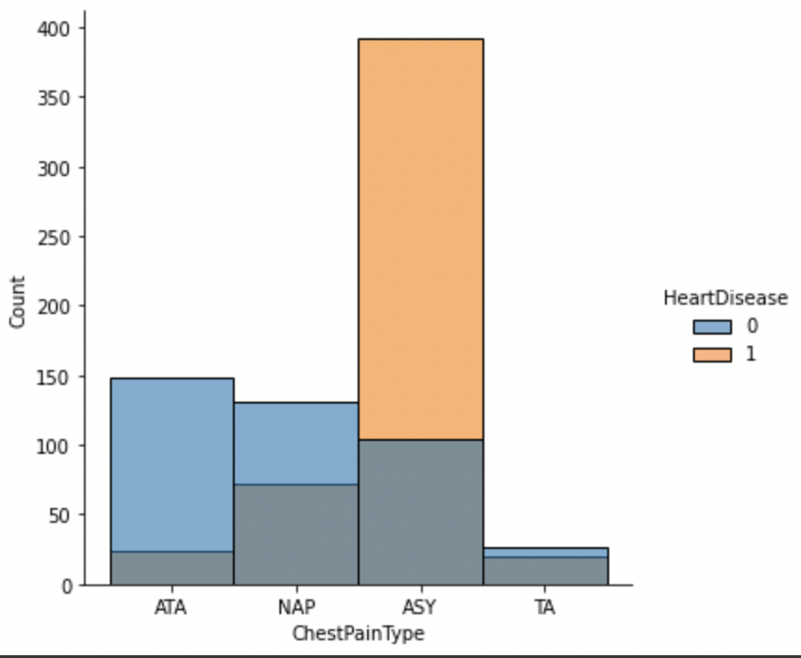
ASY: 80 % NAP: 35 % ATA : 13.87%
Heart Disease incidence of Chest pain type

Slide 9
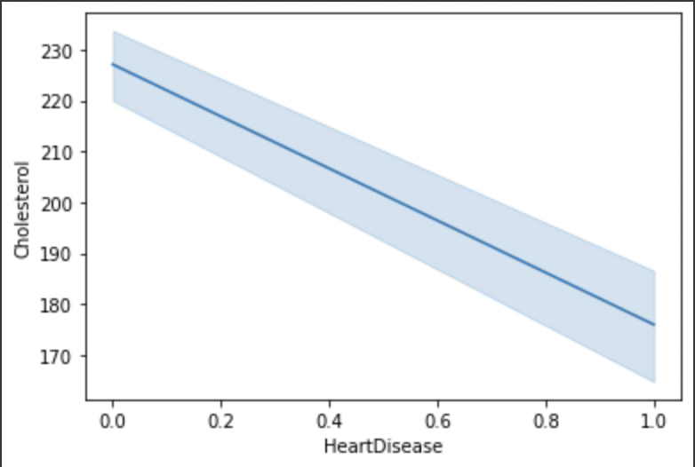
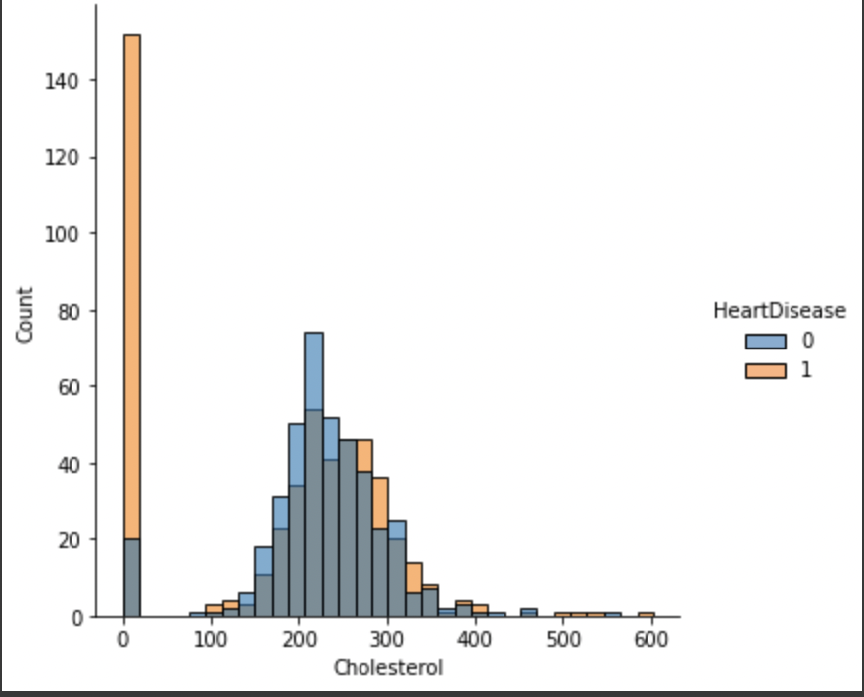
Cholesterol having a value near 200 is good for the heart otherwise low and high cholesterol can cause heart disease. Cholesterol: 0 and above 200
Heart disease incidence of Cholesterol

Slide 10
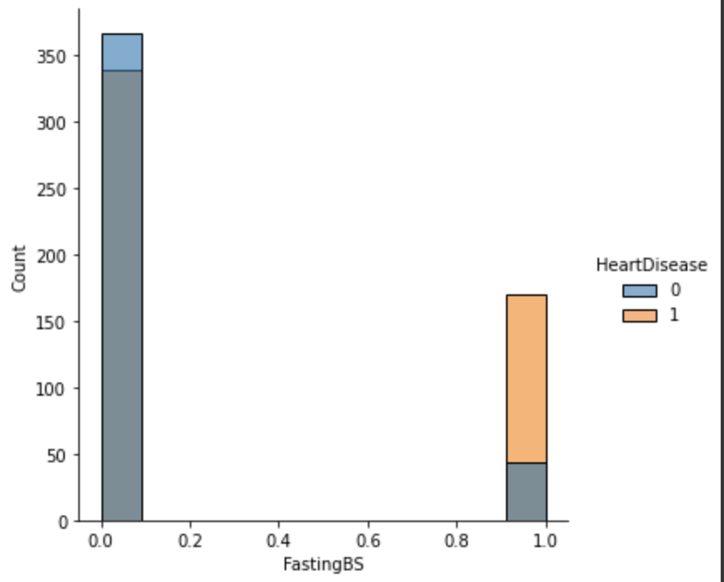
FastingBS: 1
Heart disease of FastingBS

Slide 11
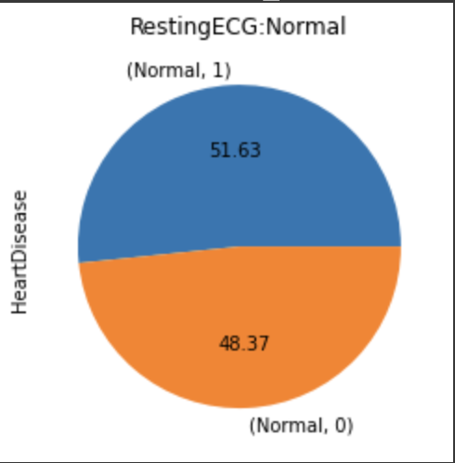
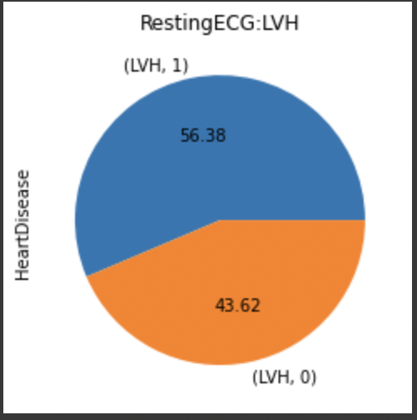
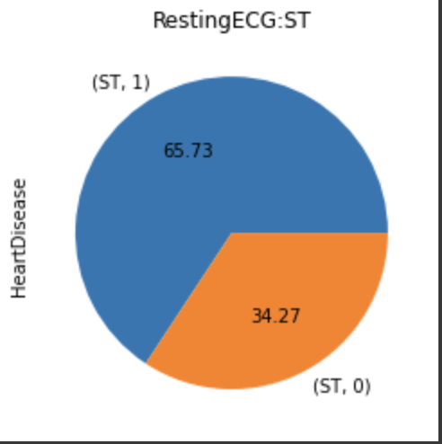
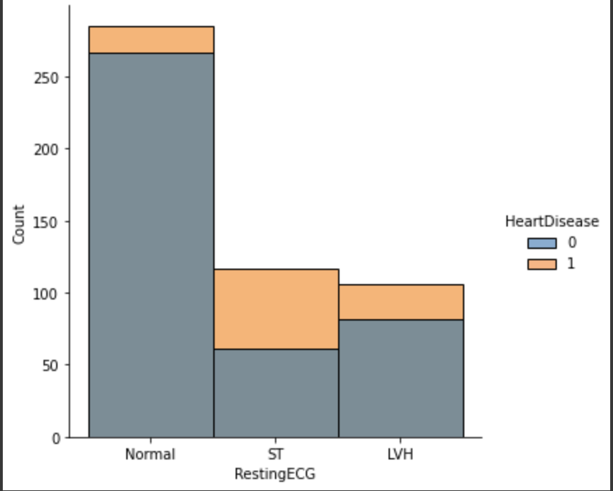
ST: 66% LVH: 56.38% NORMAL:51.63%
Heart disease incidence of Resting ECG

Slide 12
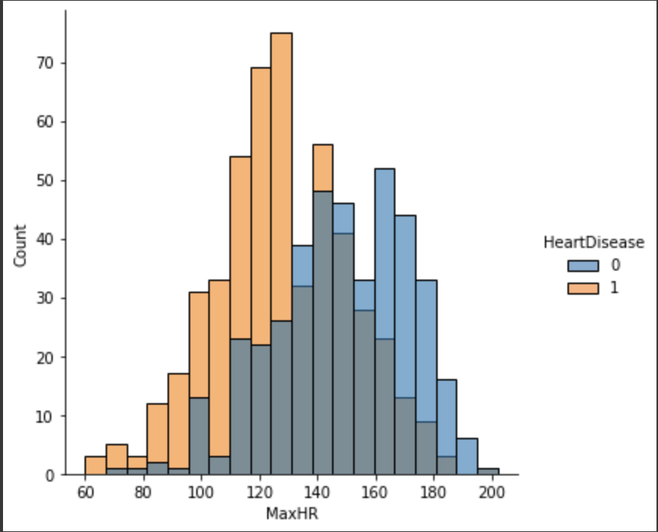
MaxHR ：60 to 130
Heart disease incidence of MaxHR

Slide 13
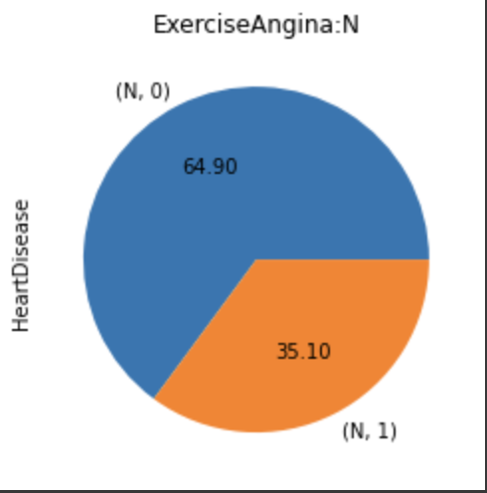
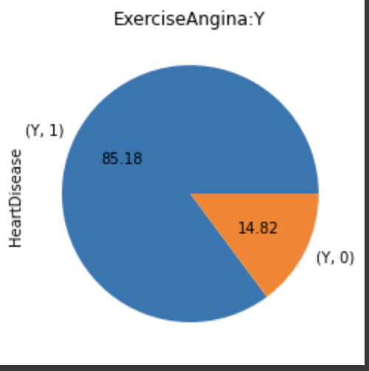
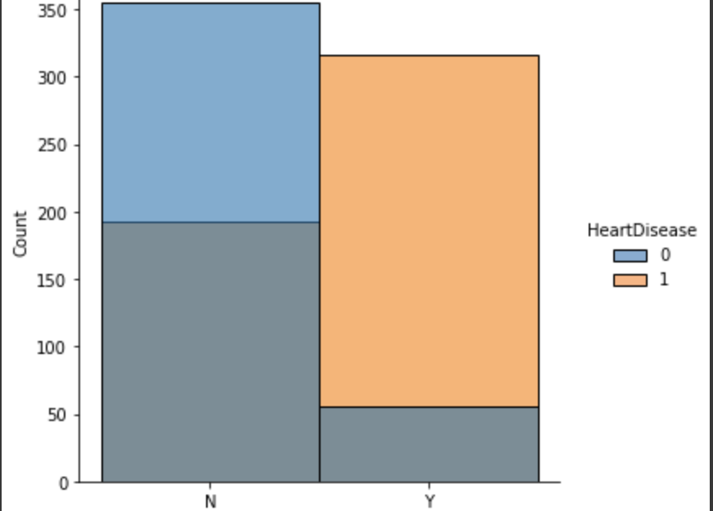
Heart disease incidence of Exercise Angina Y:85.15% N:35.10%

Slide 14
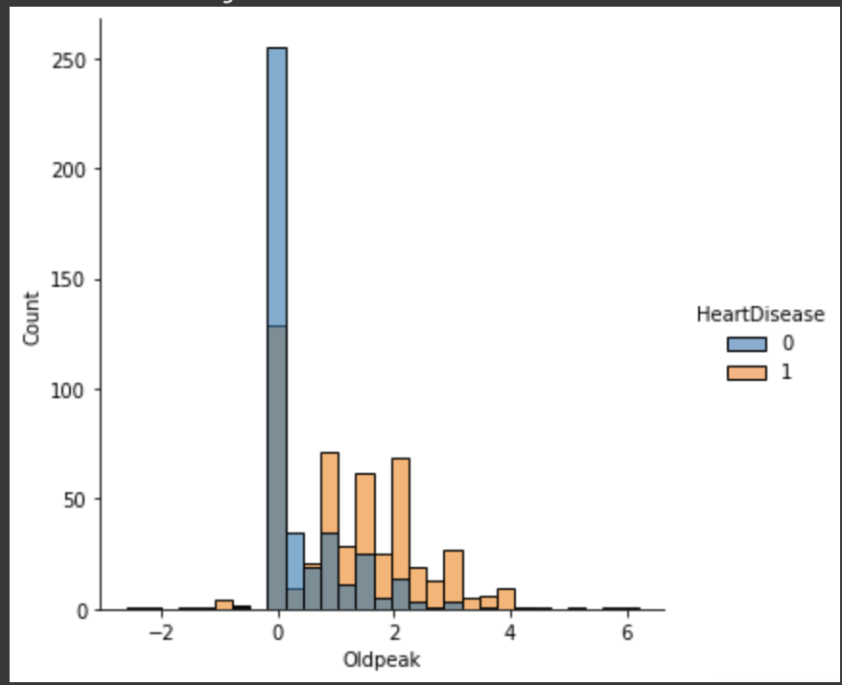
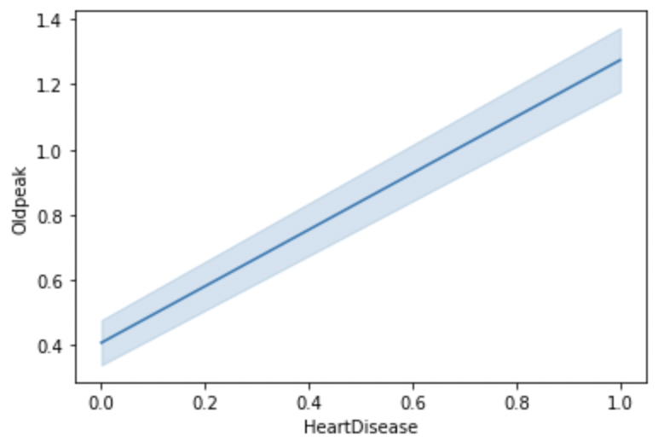
With an increase in Old peak risk of heart disease incidence also increases.
Heart disease of incidence of old peak

Slide 15
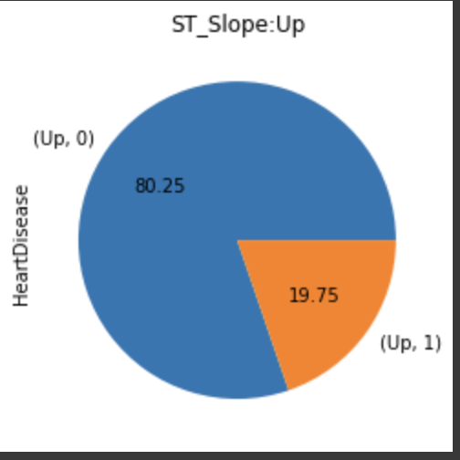
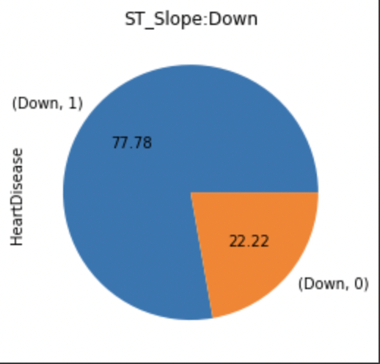
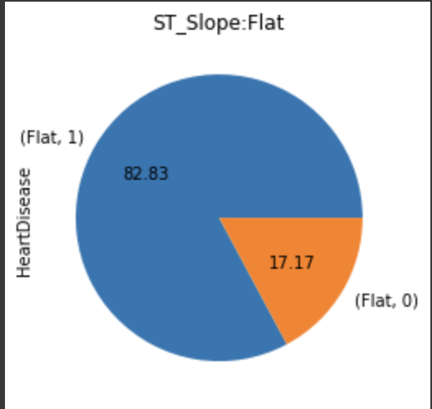
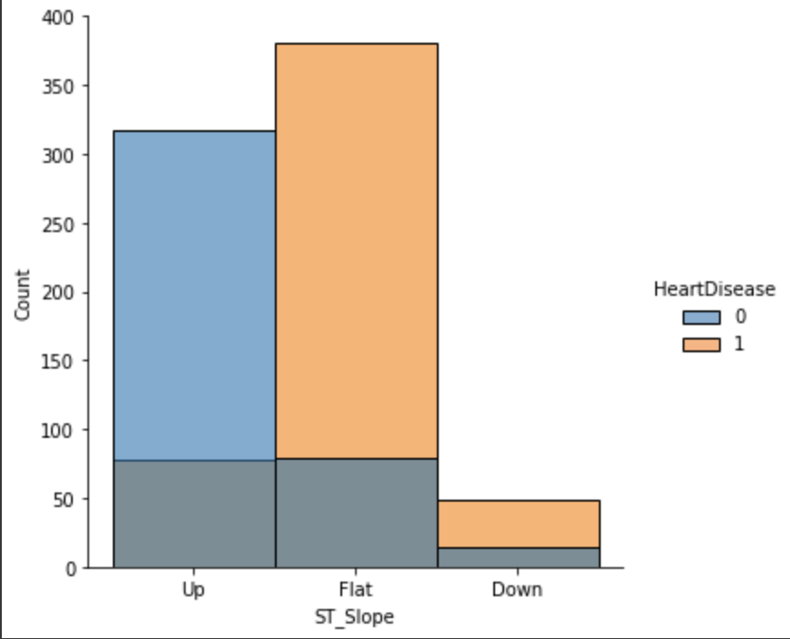
Flat: 82.23% Down : 77.78% up : 19.75% For ST_Slpoe of Flat and Down have high risk (i.e. 83% and 77% respectively) of heart disease whereas for ST_Slope of Up affection risk is low (20%)
Heart disease incidence of ST_Slope

Slide 16
In my Heart Disease project
Algorithm included:
Decision Tree Classifier: 74%
K Neighbors Classifier:88%
Logistic Regression Classifier:88%
Random Forest Classifier: 87%

Slide 17
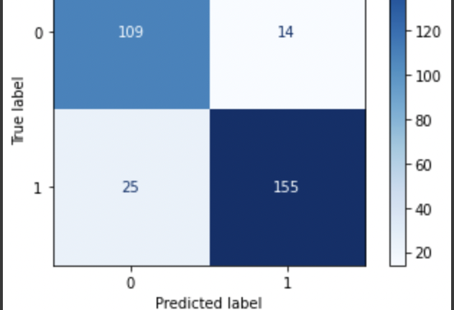
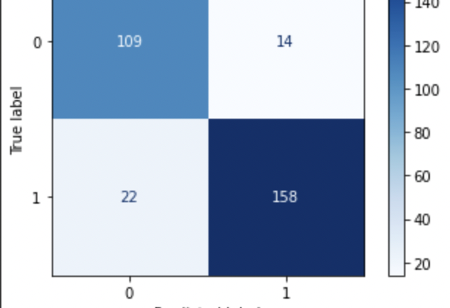
The top is random forest model The Bottom is knn model
The false negative value is more problematic in this data set. Knn would be the best model.

Slide 18
Conlusion
The false negative value is more problematic in this data set. knn and Random Forest both models give the result with an accuracy of 88 percent, and both models have no big differences. In our data set, negative values are non-heart disease, false negative labels are problematic because the labeled patients have heart disease but our model considered them as non-heart disease patients, so false negative labeled patients won't get any treatment. To be less harmful, our goal is to reduce false negative values in our ideal model. KNN played well with the false negative labels.

