Slide 1

Heart Failure Analysis
By- NANPING LI

Slide 2
Abstract
. The primary purpose of this study is to give clinicians a tool to detect cardiac problems at an early stage. As a result, it will be easier to deliver appropriate treatment to patients while avoiding serious effects.

Slide 3
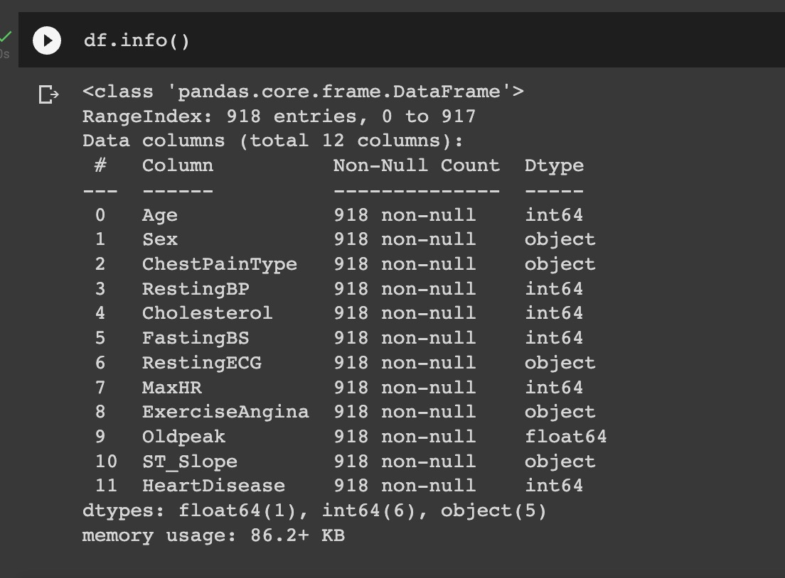
Data info
12 features

Slide 4
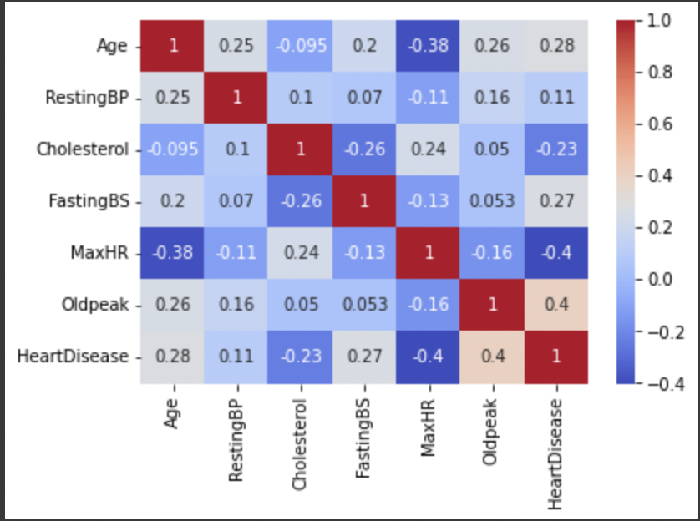
except for old peak and MaxHr, no single feature has a very high correlation with our target value

Slide 5
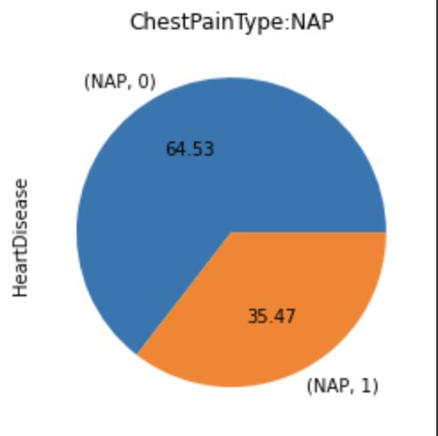
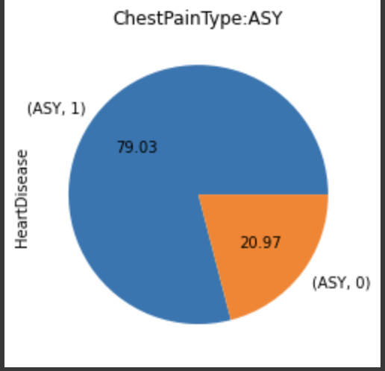
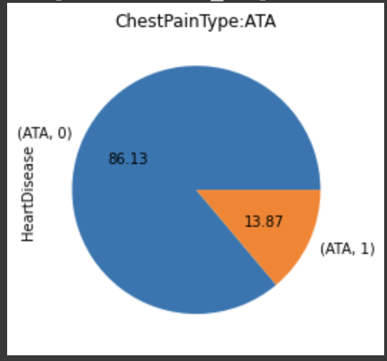
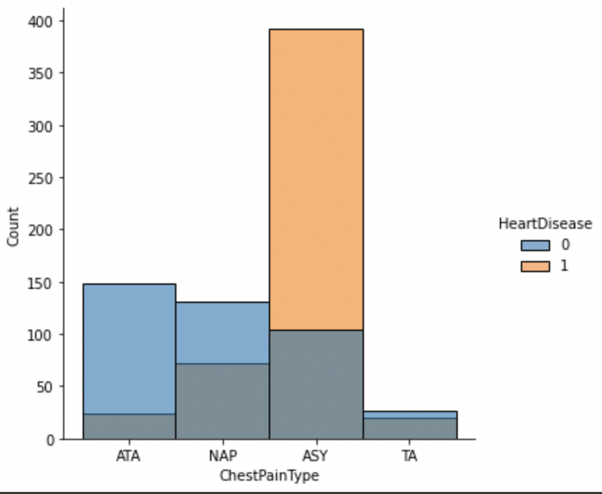
ASY: 80 % NAP: 35 % ATA : 13.87% TA: 6% ASY chest pain patients have more potential getting heart disease.
Heart Disease incidence of Chest pain type

Slide 6
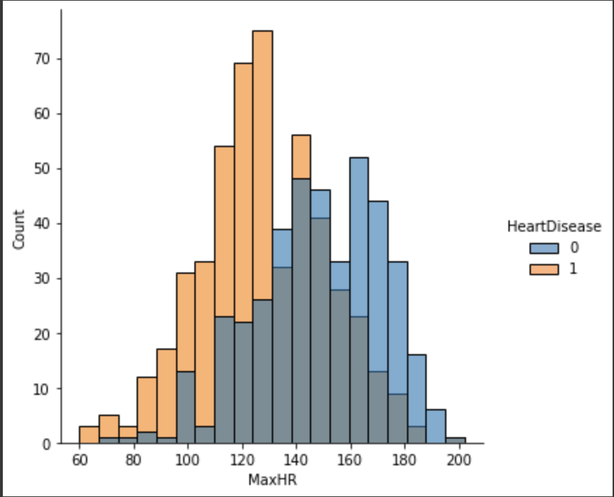
MaxHR ：60 to 130 Higher MaxHR has a sign of healthy heart.
Heart disease incidence of MaxHR

Slide 7
In my Heart Disease project
Algorithm included:
Decision Tree Classifier: 74%
K Neighbors Classifier:88%
Logistic Regression Classifier:87%
Random Forest Classifier: 88%

Slide 8
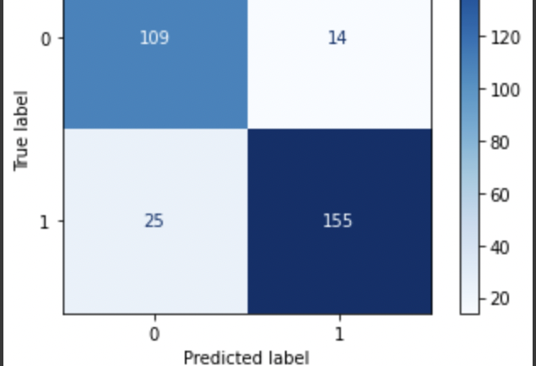
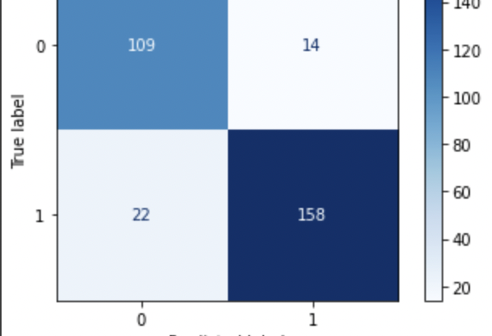
The top is random forest model The Bottom is knn model
The false negative value is more problematic in this data set. Knn would be the best model.

Slide 9
Conlusion
The false negative value is more problematic in this data set. knn and Random Forest both models give the result with an accuracy of 88 percent, and both models have no big differences. In our data set, negative values are non-heart disease, false negative labels are problematic because the labeled patients have heart disease but our model considered them as non-heart disease patients, so false negative labeled patients won't get any treatment.To be less harmful, our goal is to reduce false negative values in our ideal model. KNN played well with the false negative labels.

