Slide 1
ViTOR: Learning to Rank Webpages Based on Visual Features
Paper Written by Bram van den Akker et al, WWW 2019
CSCE 670 Paper Breakdown by Ping Lu, Texas A&M

Slide 2
Motivation
Opportunities: Use the design and visual appearance of a webpage to improve the performance of learning to rank (LTR).
Challenge 1: Relatively little is known about the the relation between visual appearance and user perception of a webpage.
Challenge 2 : Methods to extract visual features is limited
Challenge 3: No appropriate dataset available to support research on LTR with visual features.

Slide 3
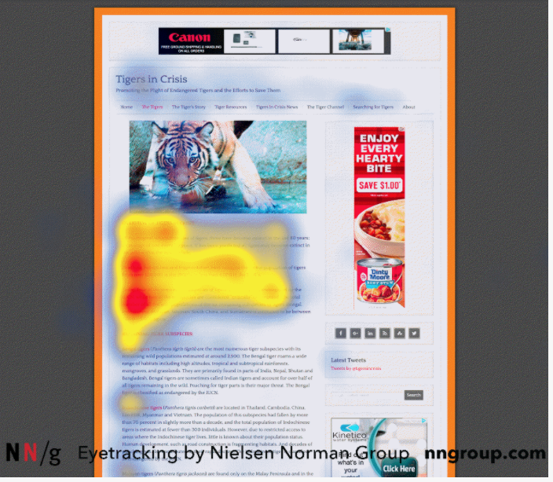
Motivation
The perceived relevance of a page is dictated by the layout of the page and formatting: people tend to read in an “F-shape” (on the right graph)
Users like to scan first lines in a page
Then first few words on the left of each line (shorter bar in F)
Finally, users scan the content’s very left side in a vertical movement (stem of F)
Users like to scan bold words, headings and subheadings, and different formatting words.
Advice: Prioritize and format words carrying the most relevant information in the “F-shape” and in different formats
Figure 1: Heat map in an F-shaped pattern from an eye tracking research 2016, www.nngroup.com/articles/f-shaped-pattern-reading-web-content

Slide 4
Main Technical Contribution
There was a study by Fan et al. that used visual information to rank pages by building a model called ViP.
In our paper here, the authors proposed the Visual learning TO Rank (ViTOR) model that integrates the state-of-the-art visual features extraction methods, and it has shown to significantly improved LTR performance and outperformed ViP.
First, the authors extract visual features from webpage snapshots using transfer learning and, in particular, by adopting the VGG-16 and ResNet-152 models pre-trained on ImageNet.
Second, they introduce a novel set of visual features extracted from synthetic saliency heatmaps, which explicitly model how users view webpages.

Slide 5
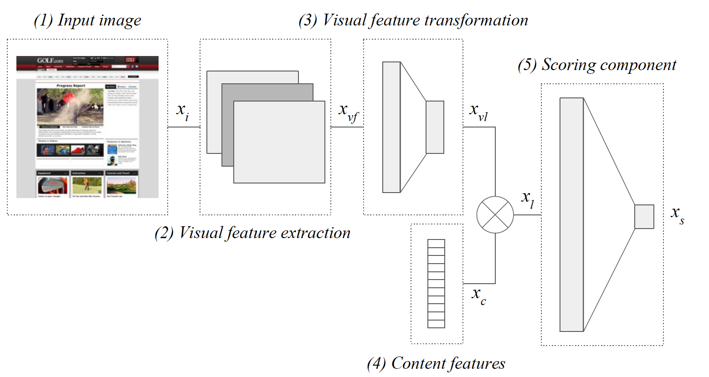
Main Technical Contribution-Model Architecture
The visual feature vector Xvl are combined with other content features Xc and form the final feature vector Xl.
Visual feature extraction layer (2) creates a generic visual feature vector Xvf .
a single score Xs for each query-document pair.
Figure 1. Model Architecture
The resulting model is trained end-to-end using a pair-wise hinge loss with L2 regularization

Slide 6
Main Technical Contribution-Visual Feature Extractors
The authors use the VGG-16 [Karen Simonyan 2014] and ResNet-152 [Kaiming He 2016] Models as the visual feature extraction models which both have pre-trained parameters.
VGG-16 and ResNet-152 have convolutional layers that extract features from an input image, which are in turn used by a fully connected layer to classify each image.
We use these convolutional layers as the visual feature extraction layer, which transforms Xi to Xvf . All parameters of these convolutional layers are frozen during training.
The fully connected layers can be altered and retrained in order to be used with new inputs and tasks. We utilize them as a visual feature transformation layer within the ViTOR architecture to produce LTR specific features Xvl.

Slide 7
Main Technical Contribution- Saliency Heatmaps Advantage
The authors propose to explicitly model the user viewing pattern through synthetic saliency heatmaps.
First, the synthetic saliency heatmaps explicitly learn to predict how users perceive webpages by training end-to-end model on actual eye-tracking data. We expect this information to better correlate with webpage relevance compared to raw snapshots.
Second, saliency heatmaps reduce the average storage requirements by up to 90%, because they are gray-scale images.
The authors use a two-stage transfer learning model that convert a raw snapshot into a synthetic saliency heatmap. This heatmap is then used as an input image Xi for the ViTOR model.

Slide 8
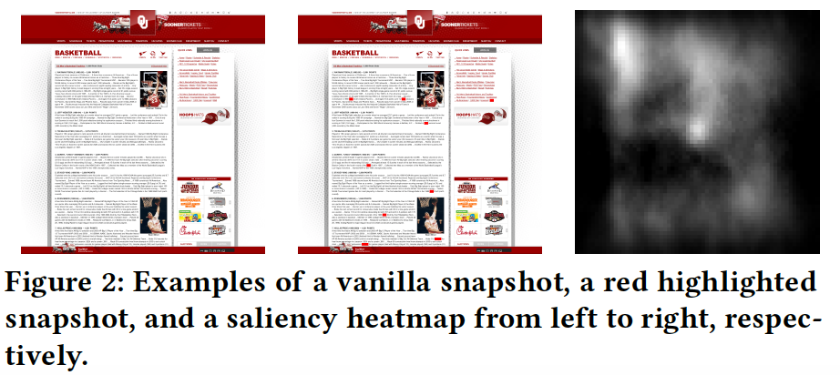
Interesting Experimental Results- Three Types of Input and Output Baseline
ViTOR highlights use visual features extracted from snapshots of webpages with highlighted query terms (2nd column on the right).
ViTOR saliency uses visual features extracted from synthetic saliency heatmaps.
The vanilla snapshots, highlights and saliency heatmaps for each model respectively are used as the input image.
The authors compare the proposed ViTOR model to the ViP model by Fan et al., and a number of content-based ranking methods.

Slide 9
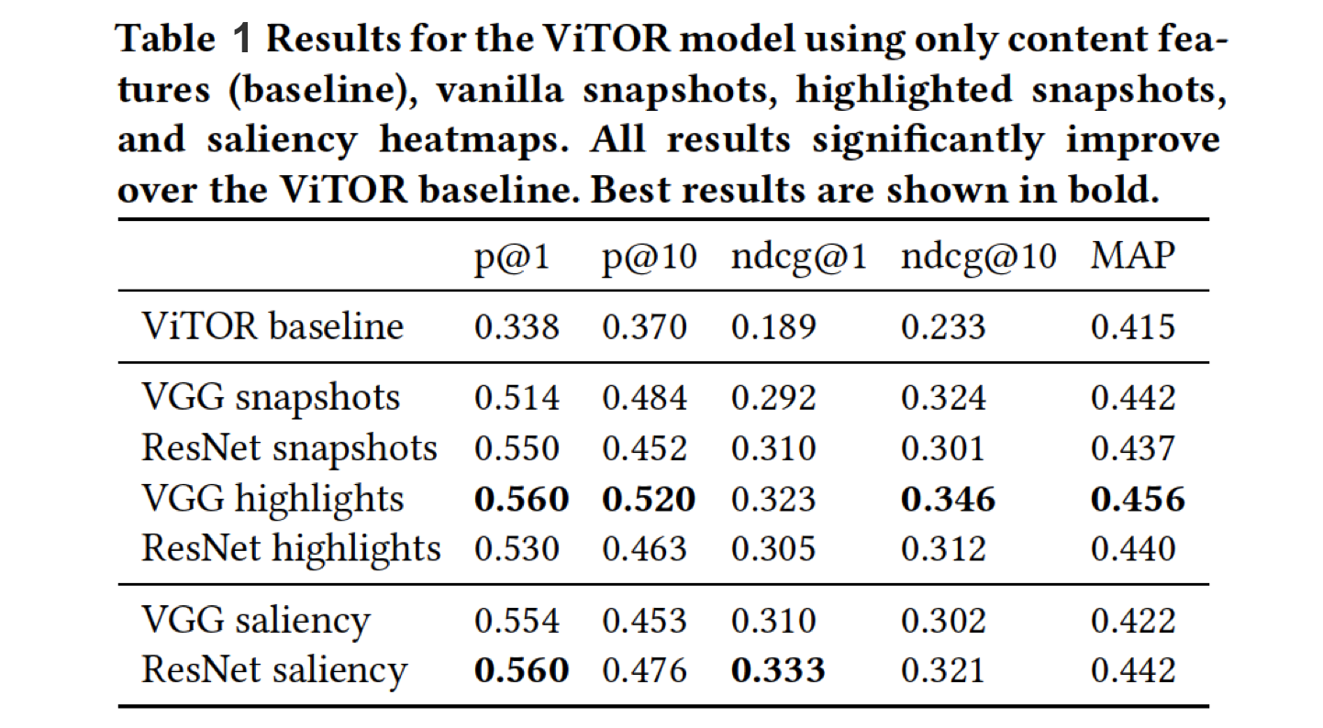
Interesting Experimental Results
The highlighted
snapshots carry more information compared to vanilla snapshots.
The saliency
heat maps with ResNet-152 match and outperform VGG-16 with highlighted snapshots when looking at ndcg@1.

Slide 10
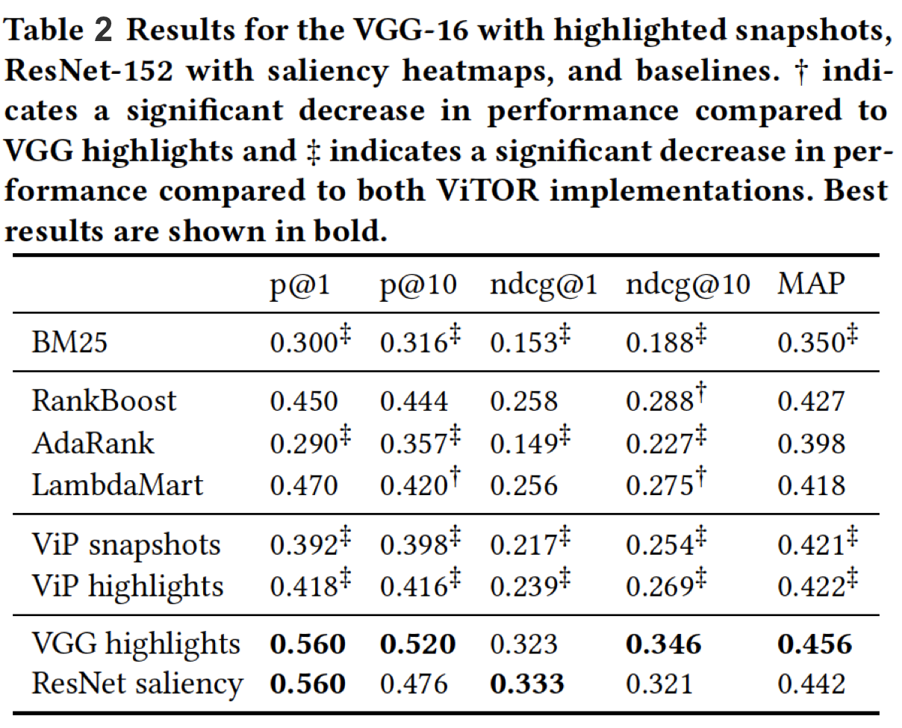
Interesting Experimental Results
The proposed ViTOR model outperforms baselines, whether they are supervised or unsupervised, use visual features or not.

Slide 11
My Thoughts-The Good
The genius 1: The architecture of this model separate the visual feature extraction layer and visual feature transformation layer, this step made the computation way faster and cost-efficient in memory. Since the model is pretrained and the parameters are all frozen during the extraction step, the extraction step results are query independent for the snapshots input and saliency heatmaps input and can be stored on disk. The real time query dependent LTR happens in the feature transformation layer and is fast to compute.

Slide 12
My Thoughts-The Good
The genius 2: Utilized a model trained on actual eye-tracking data to synthesize saliency heatmaps, which explicitly model how users view webpages. The authors then use the resulting heatmaps as an input Xi. The input is query independent and relate to what information the users actually get from the webpage better than vanilla snapshots.

Slide 13
My Thoughts-Suggestions
However, to achieve consistent significant improvements compared to the state-of-the-art LTR methods, different loss functions within the ViTOR model have to be investigated.
Other state-of-the-art feature extraction methods can be implemented for further exploration, such as the CapsuleNet [Sara Sabour 2017] model.
Another promising direction is to combine multiple visual features, i.e., visual features extracted from vanilla snapshots, snapshots with highlights and saliency heatmaps.
Other methods of combining visual and textual features might also be worth exploring.

