Slide 1
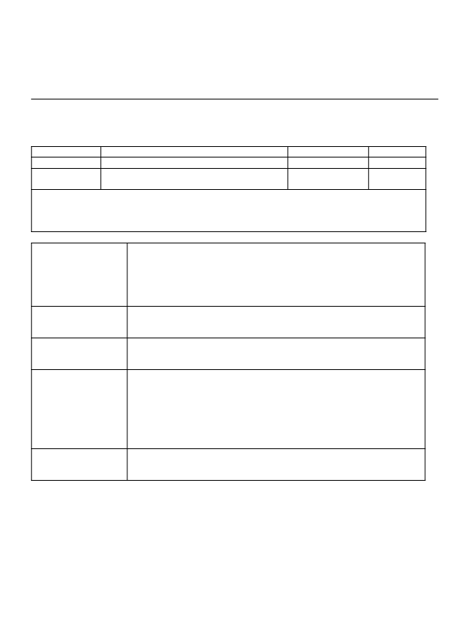

Academic year 2025-2026 (Odd Sem)
DEPARTMENTOFCOMPUTERSCIENCE&ENGINEERING
Date:
Course – Code:
Faculty:
28/Oct/2025 DESIGN THINKING LAB Dr. Chethana R Murthy (CRM) Dr. Manas M N (MMN)
Maximum Marks:
Sem:
Batch:
10
III-A
EMPATHY PHASE Synopsis
Team Details:
AADHYA R 1RV24CS002
﻿A S S S KOUNDINYA 1RV24CS001
﻿AMRUTHA 1RV24CS033
﻿AARNAAMITH 1RV24CS004
Domain/Theme of the work: Title of the proposed
work:
Target users /
stakeholders:
﻿AI IN HEALTHCARE
﻿Exploring the documentation of Nurse
Write details on
● User Profiles: Briefly describe the intended users or stakeholders your
DT lab work will focus on.
● Context: Explain their context, environment, and any background
details that might affect their experiences or behavior.
Planned activities for gathering insights:
Write details on User Interviews, Surveys or any other method/s planned by
you.

