Slide 1
電腦視覺與深度學習 (Computer Vision and Deep Learning) Final Project
TA:
Kevin: i1007673219@gmail.com
Office Hour: 19:00~21:00, Mon.
09:00~11:00, Wed.
At CSIE 9F Robotics Lab.

Slide 2
Notice (1/1)
Copy is strictly prohibited!! Penalty: Grade will be zero for both persons!!
Due date => 2020/01/09 (Thu.) 23:59:59
No delay. If you submit project after deadline, you will get 0.
Demo date => 2020/01/10 (Fri.) 09:10 – 12:00
Please check the time table on the moodle.
Upload to => 140.116.154.1 -> /Upload/FinalProject
User ID: opencvdl2019 Password: opencvdl2019
Format
Filename: FinalProject_GroupNumber_Version.rar
FinalProject_01_v1.rar
If you want to update your file, you should update your version to be v2, ex: FinalProject_01_v2.rar
Only group leader needs to hand in the final project file.
Content: project folder*( including ppt file)
Topic of final project is unlimited.
All group members must attend the demo.

Slide 3
Grading
(50%) Source code & PPT file
(50%) Project Demo

Slide 4
1. (50%) Source code & PPT file
Source code
The source code of your final project: You can use any programming languages.
PPT file
PPT file: Please check following example slices.
(x pages)

Slide 5
2. (50%) Project Demo
Project Demo
The project demonstration time is 9:10 ~ 12:00 on 2020/01/10. You can check your demo time on Moodle. Remember to bring your notebook to demo your project.

Slide 6
Faster R-CNN: Towards Real-Time Object Detection with Region Proposal Networks
Neural Information Processing Systems (NIPS 2015)
Shaoqing Ren, Kaiming He, Ross Girshick, and Jian Sun
Keywords: Object Detection, Region Proposal, Convolutional Neural Network.
Group Number: 01
Group Members: 連震杰 P00001111 電機所
黃鼎元 P46061411 資訊所
Notes:
Hello everyone, today, I am going to present Faster R-CNN, a fast and high-accuracy of region based detection algorithm.

Slide 7
1. Introduction
Motivation:
- Usually it is at the first paragraph of Introduction Session.
- Why does this paper want to do this research? Application?
- Like why is face detection research important? Its application is…..
Objective:
What is the goal/objective of this paper?
Like what kind of face detection this research can complete? Frontal view? 45⁰ view? …. Detection in the cloud?
Contribution:
- What is its the contribution?
- Because this paper develops xxx methods to solve yyy existing problem.

Slide 8
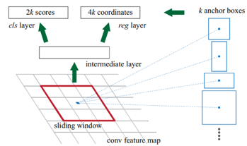
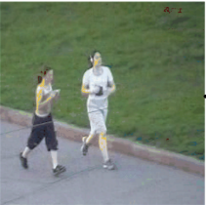
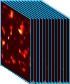
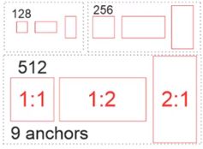
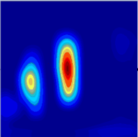
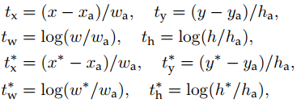
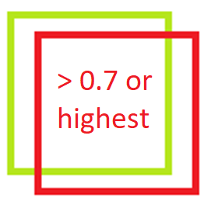
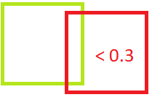
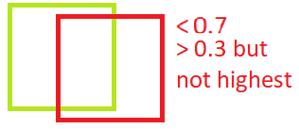





2. System Framework: Training Process
Images
N_{t}, N_{v}
Feature maps
512 x N_{t}
Feature maps
512 x N_{v}
Anchors
(Object/no object)
1x1x18
(Left, top, width, height)
1x1x36
(3.2)
(3.1)
(3)
Region Proposal Networks (1/4):
Anchor generation:
Anchors: (possible proposals)
Pre-defined reference boxes.
Multi scales and ratios.
Translation invariant. (Same set of anchors at every location)
At each sliding-window position on image, k anchor boxes is generated.
k: number of maximum possible proposals for each location.
In our case:
k = 9 anchors.
3 scales: 128x128, 256x256, 512x512.
3 ratios: 1:1, 1:2, 2:1 (each scale)
Ignore unnecessary Anchors:
Total: w*h*k anchor (60x40x9 = 21600)
(Actually) Ignore all cross-boundary anchors.
The final number of anchors: ~6000
1x1 conv
1x1 conv
Sliding window and low feature vector extraction:
Slide a window (size nxn, ex: n=3) over the convolutional feature map
Map window to a lower-dimensional feature vector (512-d VGG).
The vectors contain the location information on original image. (an receptive field of 228 pixels for VGG)
This process works as a 3x3-kernel convolution with 512 output feature maps
Vectors contain the location information on original image.
512-d VGG
1x1x512
Feature vector
3x3 conv
Sliding window:
size 3x3
(1)
(2)
Moving sliding window.
Stride: 1
Padding: 1
512-d vector
(1x1x512)
Feature maps: 60x40x512
Ex: k = 9 per window
Fig. How RPN works at each sliding window
2400
vectors
(60*40)
9 Anchors
3x3 Conv
…
Original image
60x40x512
512 feature maps
lower-dimensional features
Fig. Anchors are generated at the position re-projected from a sliding window center on feature map.
Fig. Sample Anchors
This process works as a convolution with 3x3 kernel
Fig. lower-dimensional features extraction
2400 low-dimensional vectors
~6000 anchors: x_{a}, y_{a}, w_{a}, h_{a}
Feeding data into Sibling networks:
Simultaneously classifying (Cls) and regressing (Reg) anchors based on their corresponding feature vectors.
3.1. Regression:
Object: Compute offsets from anchor boxes.
Method: linear regression
Process:
Bbox regression:
Loss function:
3.2. Binary Classification:
Output: Probability that each anchor shows an object.
Method: Binary classification.
Process:
Assign a binary class label for p_{i}*: (Using IoU)
Minimize loss function: log-loss (can use sigmoid, instead)
x, y: center of box
w, h: width, height
x, y, w, h: Predicted box
x_{a}, y_{a}, w_{a}, h_{a}: Anchor box
x*, y*, w*, h*: Ground-truth Box
2400 vectors
Ground-truth
box
k anchors
k anchors
Predicted
box
…
p_{i}* = 1 (positive)
p_{i}* = 0 (negative)
No concern
(1x1x512)
(1x1x512)
k anchors
i: index of an anchor in a mini-batch.
t_{i}: vector represents 4 parameterized coordinates of the predicted box.
t_{i}*: the ground-truth box associated with a positive anchor.
i: index of an anchor in a mini-batch.
p_{i}: the predicted probability of i^{th} anchor being an object.
p_{i}*: the ground-truth label. (from IOU)
(1x1x512)
1x1 conv
1x1 conv
1x1 conv
1x1 conv
1x1 conv
1x1 conv
Cls
Reg
Cls
Reg
R: robust loss function (smooth L₁)
Fig. 1x1-kernel convolutional layer for classification. Output: 1x1x2k.
(1x1x2k)
(1x1x4k)
(1x1x2k)
(1x1x4k)
Cls
Reg
4) Loss function of RPN:
(1x1x2k)
(1x1x4k)
Output: (Soft-max Probability)
Output:
Region proposals
Lambda: balancing parameter (10)
N_{cls}: Normalized term by mini-batch (512)
N_{reg}: Normalized term by number of anchors (2400)
Fig. Feed lower dimensional vectors and anchors into sibling networks
Fig. 1x1-kernel convolutional layer for regression. Output: 1x1x4k.
Reg only for positive anchors
Objectness score (P_{c})
Region proposals (t_{x}, t_{y}, t_{w}, t_{h})
Notes:
The RPN:
The input of RPN is: the images and their feature maps.
The output would be region proposals and their objectness scores. At the last shared layer of initial CNN, a 3x3 sliding window moves across the feature map and maps it to a lower dimension vector (256-d ZF; 512-d VGG, with RELU). (The position of the sliding window provides localization information with reference to the image.)
Let’s take a look at how RPN work:
1) This is sliding window, a sliding window run across the feature maps and will be map with a feature vector.
2) A pre-defined number of anchors are generated at the position of sliding window on the image, which is re-projected from feature map. So we have anchors.
3) At the position of a sliding window, each anchor will be classified and regressed into proposal regions if it possibly contains object based on the feature vectors.
Let’s go to detail.
) Sliding window and low feature vector extraction:
Slide a window (size nxn, ex: n=3) over the convolutional feature map
Map window to a lower-dimensional feature vector (512-d VGG).
The vectors contain the location information on original image. (an receptive field of 228 pixels for VGG)
This process works as a 3x3-kernel convolution with 512 output feature maps
For example: we have 512 60x40 feature maps. Each sliding window run on a feature map (we can assume its size is 3x3x512 when running all feature maps at a time)
We move this sliding window (the yellow area) across the feature maps with stride 1 and using padding 1.
Each position of feature map, we can get a feature vector sized 1 x1x512.
Because using stride 1, we can have 2400 vectors in total.
Each vector contains the location information on original iamge.
Anchor generation:
Anchors:
What are anchors? they are Pre-defined reference boxes that may contain objects in the image. Each set of anchors has multi scales and ratios and has the characteristic of translation invariant. (it means we use the same set of anchors at every location)
How it work? Firstly, we re-project the center of sliding window back to the image. At that position. K anchor boxes are generated. K mean number of maximum possible proposals for each location.
In our case: k = 9 anchors are formed from 3 scales: 128, 256, 512 and 3 ratios: 1:1, 1:2, 2:1
1 sliding window we have 9 anchors. There are totally 60x40x9 = 21600 anchors.
It is recommended that we ignore all cross-boundary anchors. It mean anchors have a part outside the range of image.
We now have 6000 anchors to the next step.
3) Feeding data into Sibling networks:
The data including 2400 vectos and 6000 anchors are fed into the sibling networks:
1) A 1x1-filter regression network (reg). outputs 4 coordinates representing the bounding box of the region.
2) A 1x1-filter classification network (cls). outputs the “objectness” score for that region. (object or no object)
To have more understand let see my picture.
K anchor at a position of sliding window and their corresponding feature vector are fed into 2 sibling networks.
Each anchor will have 2 outputs in classification and 4 outputs in regression. Therefore, k anchors create 2k outputs in classification and 4k outputs in regression.
So how regression and classification work: 1. regression: the object is to compute offsets from anchor boxes using the linear regression method.
X,y now represent center of box; w,h are width and height.
We now have 3 kinds of box: regressed box : notation; anchor box: notation a; and GT box: notation star.
the parameters of box can be regressed using these functions.
In these function i: index of an anchor in a mini-batch.
t_{i}: vector represents 4 parameter of the predicted box.
t_{i}*: the ground-truth box associated with a positive anchor.
After that, we can compute the loss value. In this function: R is robust function (smooth L1)

Slide 9
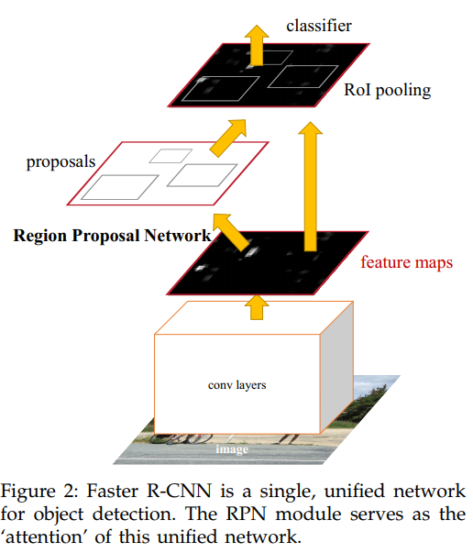
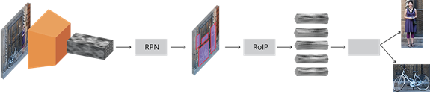

3. Deep Learning Architecture
1.1 Feature Extraction Layers
1.2 Region Proposal Network
2.0 FCN: Detect / ROI Classify object scores
Image
(D-CNN)
Region Proposal
ROIs
FCN:
Fast R-CNN
Fig. Faster R-CNN scheme. A single, unified network for object detection.
2.0) FCN: ROI Classification Layers
1.1 Feature Extraction Layers
1.2 Region proposal Network
2.0 FCN: Fast R-CNN
1.2) RPN
1.1 Feature Extraction Layers
Input image:
Feature extraction:
Region Proposal Network:
FCN - ROI Pooling layer:
=> Upsampling, fixed-size feature maps
Classifier: Using SVD
Pre-trained DCNN
(VGG16, ResNet50)
4k coordinates 2k scores
“Person”
(x,y)
High-res feature maps
Region proposer
(2 convolutional layers)
ROIs
1) Regressor
2) Classifier
Input: any size feature map
h
w
“Bike”
VGG-16: Feature map
(After last (13th) convolutional layer, without 5th max pooling layer)
Feature map
(x,y)
Rescale image. Shorter side = 600 pixels.
h
D-CNN: extracts high-resolution feature maps. These features are fed into RPN.
Using Transfer Learning.
RPN: a small network.
Integrated with anchors, it is used to propose regions, which may contain objects in the feature maps (image).
FCN-ROI: a pooling layer with fixed size output. It crops and resizes the feature maps according to these region proposals.
w
A fully connected neural network: classifies ROIs and regresses coordinate output.
Fig. Overview of Faster R-CNN
Output:
x,y (top left point),
w (width), h (height)
-> Object class
對每個ROI output一個object class
Image source: https://tryolabs.com/blog/2018/01/18/faster-r-cnn-down-the-rabbit-hole-of-modern-object-detection/
Notes:
This is overview of Faster r-CNN
[H1] This is the picture that demonstrates the unified network after merging RPN and Fast R-CNN. You can see, 2 modules use the same feature map extracted from 1 convolutional network.
[H2]
Intuitively, Faster RCNN composed of main 2 modules after feature extraction process. The first module is Region proposal network that proposes regions, and the second module is the Fast R-CNN that uses the proposed regions to detect the objects.
The entire system is a single and unified network for object detection.
[H3]
The faster r-cnn can be demonstrated like this:
Data preparation. We rescale image so that the shorter side equals 600 pixels.
Feature extraction. Employ a pre-trained deep CNN, such as VGG, to extract feature map from image.
Region proposal network. It is composed of 2 small conv network that detect the regions which might contain objects in the feature maps.
Region of Interest pooling layer. We use this layer to crops and resizes the proposed regions into fixed size.
And classifier layer. The new feature maps of each region are then used for classification and finer bounding box regression through three fully connected layers.

Slide 10
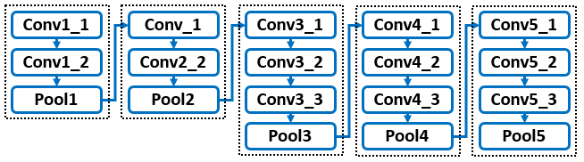
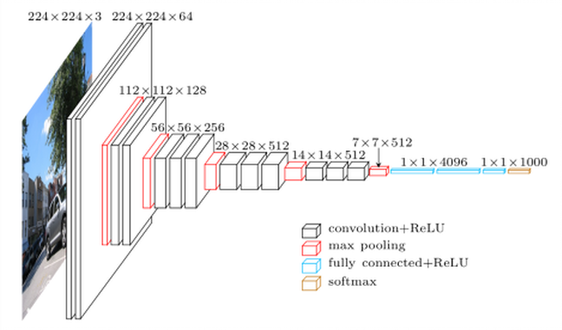
Or 3. Deep Learning Architecture
Images
N_{t}, N_{v}
1.1-2) Feature Extraction Using Deep Convolutional Neural Network: (ex: VGG16, ZF, ResNet)
Object: Extract feature maps from input images.
512 feature maps
Layer 13
Size: 1000 x 600 x 3
Size: (60x40 grids) x 512c
J: same as (14x14 grids) x 512c in VGG16
Deep Convolutional network: (ex VGG16)
VGG-16: Feature map
(After last (13th) convolutional layer, without 5th max pooling layer)
Fig. Feature extraction process
用ImageNet train過的weight當初始值
(Total 16 layers, 13 shareable convolutional layers)
13 Convolutions layers (used kernel: 3*3 size )
5 Max pooling layers (used kernel: 2*2 size)
2 Fully connected layers (4096 nodes)
1 Output layer (soft-max,1000nodes)
Layer 13
Fig. VGG16 for feature extraction. (until the last convolutional layer)
Very Deep Convolutional Networks for Large-Scale Image Recognition
https://www.quora.com/What-is-the-VGG-neural-network
N_{t} x (60x40 grids)x512c feature maps
N_{v} x (60x40 grids)x512c
feature maps
Notes:
2) The next part is feature extraction.
The object is to extract feature maps from the input, which is the image dataset from prior step. The output is feature maps for each image.
The feature maps are extracted by using Deep convolutional network such as VGG16 or ResNet.
For instance, by using VGG16, We only use the feature extraction part of the model until the last convolutional layer. You can see the network in programming on the right side.
we can get 512 smaller feature maps sized 60x40 from each input image sized 1000x600.

Slide 11
4.1 Experimental Result – Correct Examples
Why is it correct?

Slide 12
4.2 Experimental Result – Incorrect Examples
Why is it incorrect?

Slide 13
5. Conclusion

