Slide 1
Innovation or growth?
Is sustainability a technical issue?

Slide 2
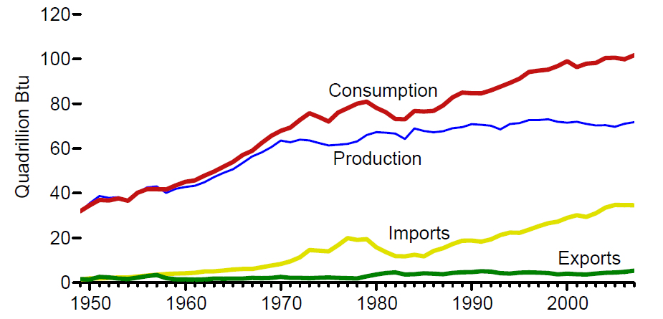
US Energy Consumption
Source:US Energy Information Administration report, Energy Perspectives: 1949-2007 at eia.doe.gov

Slide 3
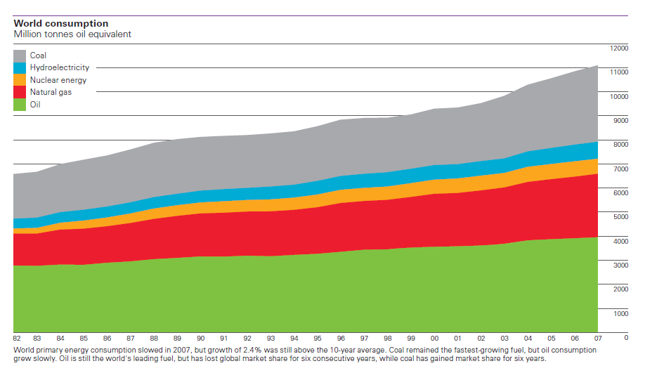
World energy consumption
Source: BP Statistical Review of World Energy, June 2008 at bp.com

Slide 4
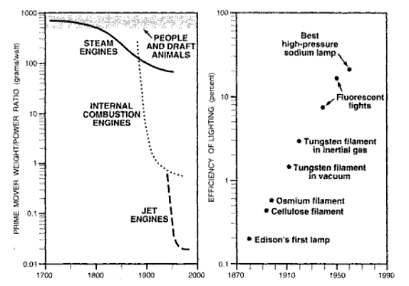
Innovation: we’re so damn smart
Source: Vaclav Smil, Energy in World History, 1994

Slide 5
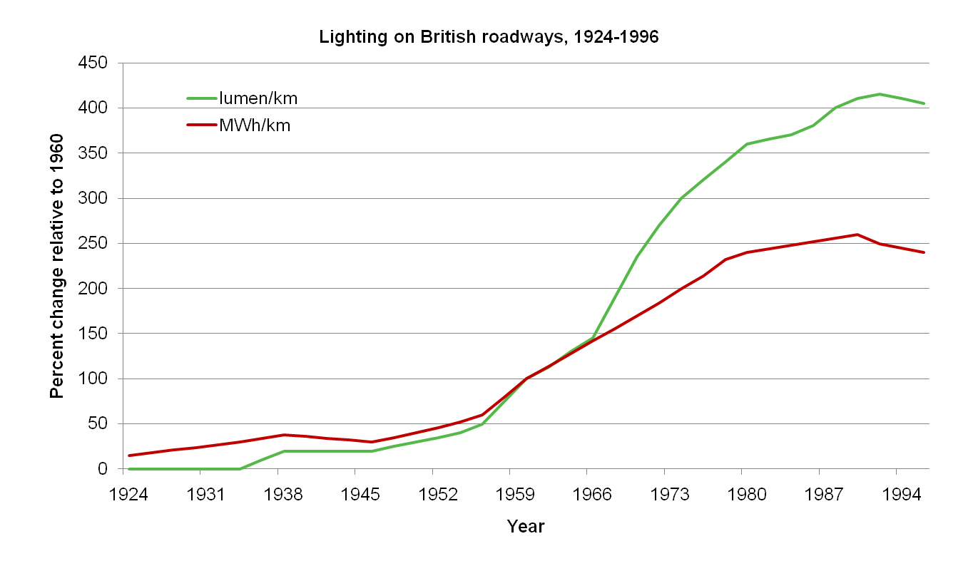
Or is efficiency enabling more consumption?
Source: Vaclav Smil, Energy at the Crossroads, 2003

Slide 6
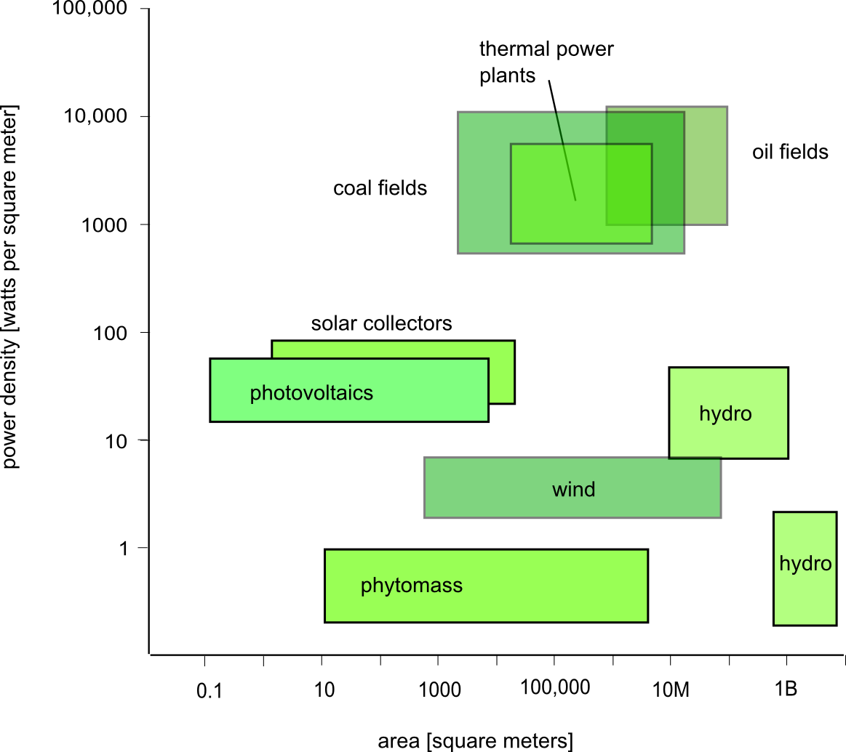
Power density of supplies
Source: Vaclav Smil, Energy at the Crossroads, 2003

Slide 7
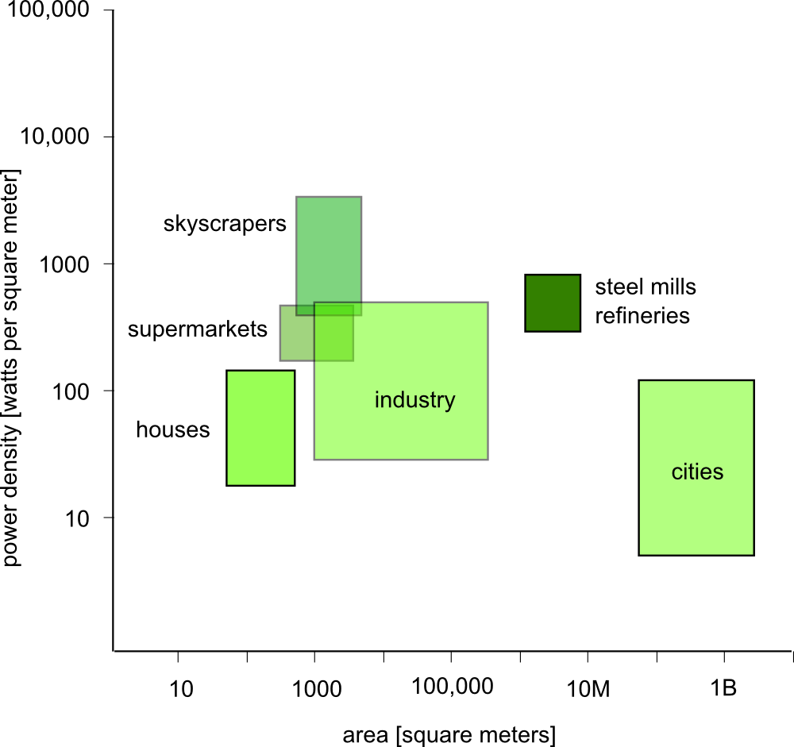
Power density of demands
Source: Vaclav Smil, Energy at the Crossroads, 2003

