Slide 1

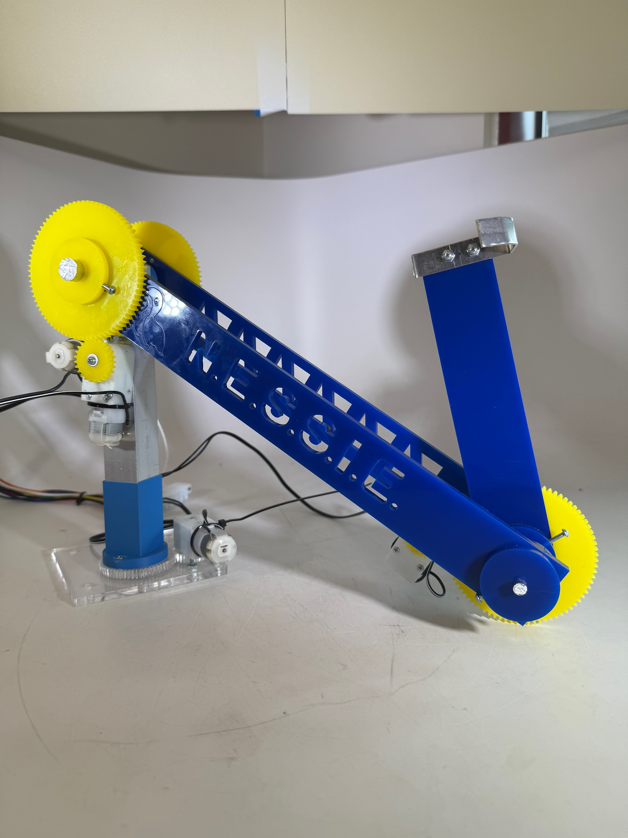
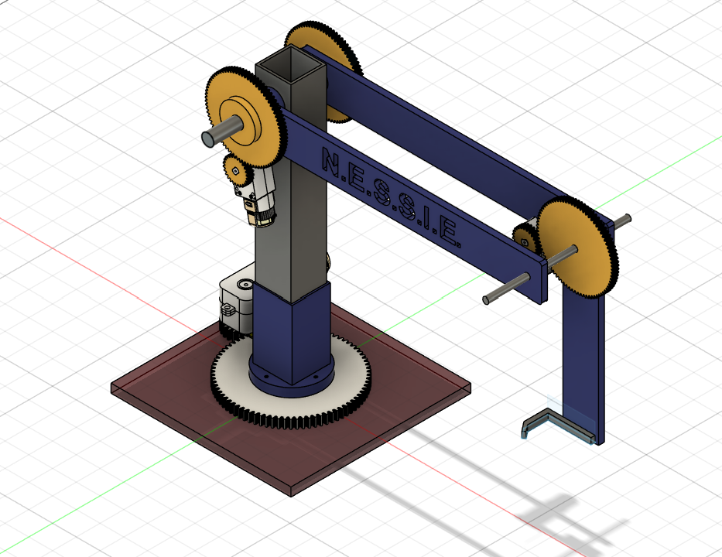
Team 27: “N.E.S.S.I.E.”
Joshua Conge, Isaac Kim, Connor Lin, Pranav Ramesh

Slide 2

N.E.S.S.I.E.
3 Key Powered Components
  Rotating Base (1 geared)
  Longer rotating Arm (2 geared)
  Shorter rotating Arm (1 geared)
Goals
  Maximize scoring potential
  Extend 18 inches from start to Sun God
Final Design

Slide 3
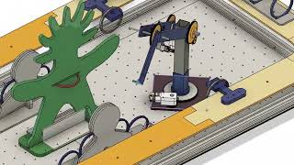
N.E.S.S.I.E. In Practice

Slide 4
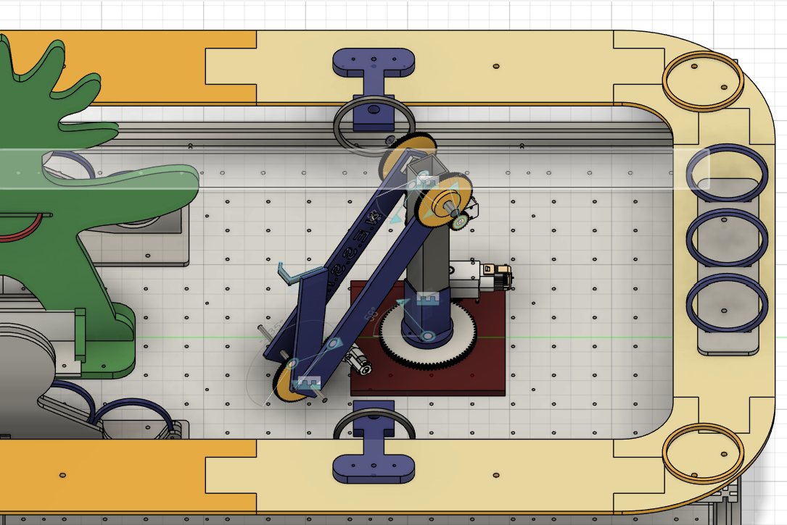
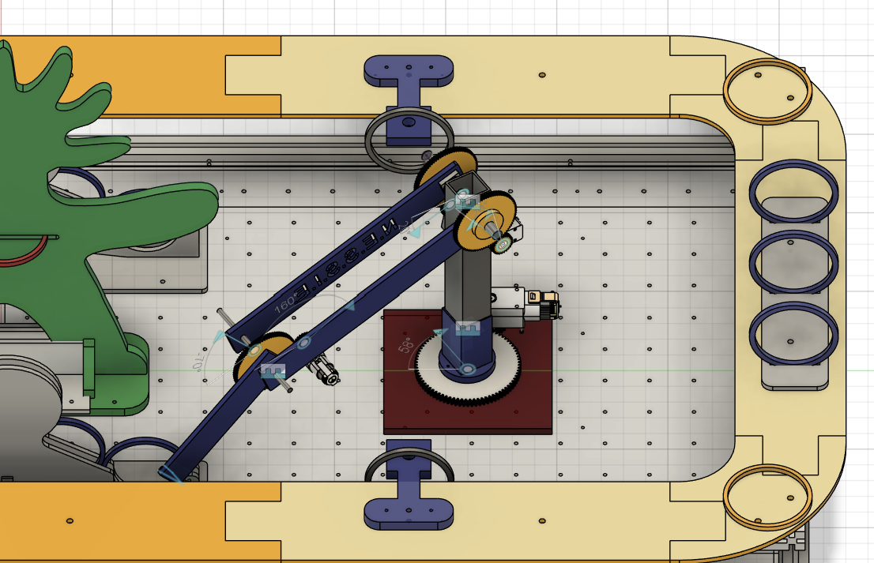
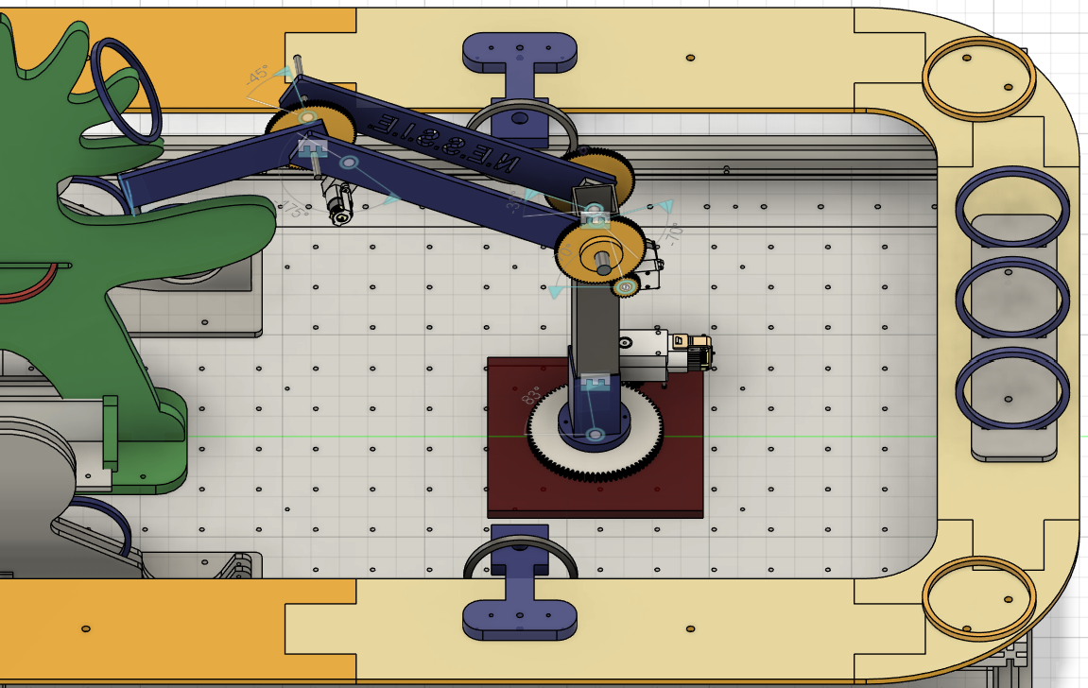
How Does N.E.S.S.I.E Work?
Lower and Upper arm compressed
Lower and Upper arm extend
Raise arm up
Rotate base
Step 1: Initial Position
Step 2: Reach for Rings
Step 3: Place Ring on Sungod
Notes:
Connor

Slide 5
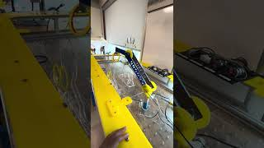
N.E.S.S.I.E. in Action
Performance:
Max Scoring Potential: 3400 points
  10 rings on 3rd highest
  2 rings on 4th highest
Actually Scored: 2400 points
  8 rings on 3rd highest

Slide 6
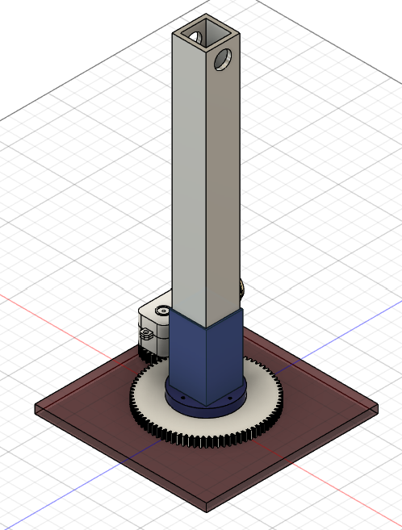
Base Arm
7” Aluminum tubing
Geared Straight Motor
3D - printed holder
Acrylic Base Plate
60:20 mm Gear Ratio
Functional Requirements: Rotate 650g 360°within 5s, fully extended in the horizontal position(max moment of inertia)

Slide 7
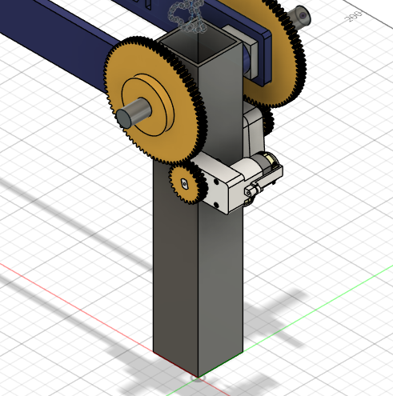
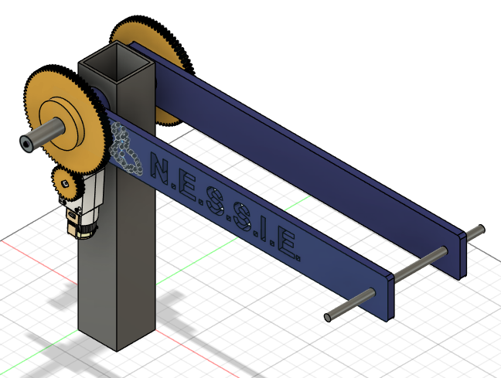
Lower Arm
One geared motor on each side for added to rotate arm up & down(mounted on base arm)
Cutouts to decrease torque on the motor
13” Acrylic Arms
80:25 mm gear ratio
Geared Straight Motor
Geared Angled Motor
Functional Requirements: Lift 200g from -45° to +90° in 7s while the upper arm is fully extended in horizontal direction

Slide 8
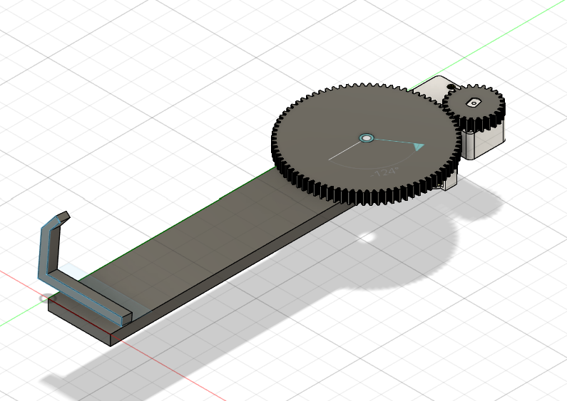
Upper Arm
90 degree geared Motor
7.5” Acrylic Arm
Attaches to the end of the lower arm
Gears 80:25 mm ratio
Aluminum hook
Functional Requirements: Lift from -90° to +90° in 4 seconds while carrying four rings
Notes:
Steel hook
Fits box

Slide 9
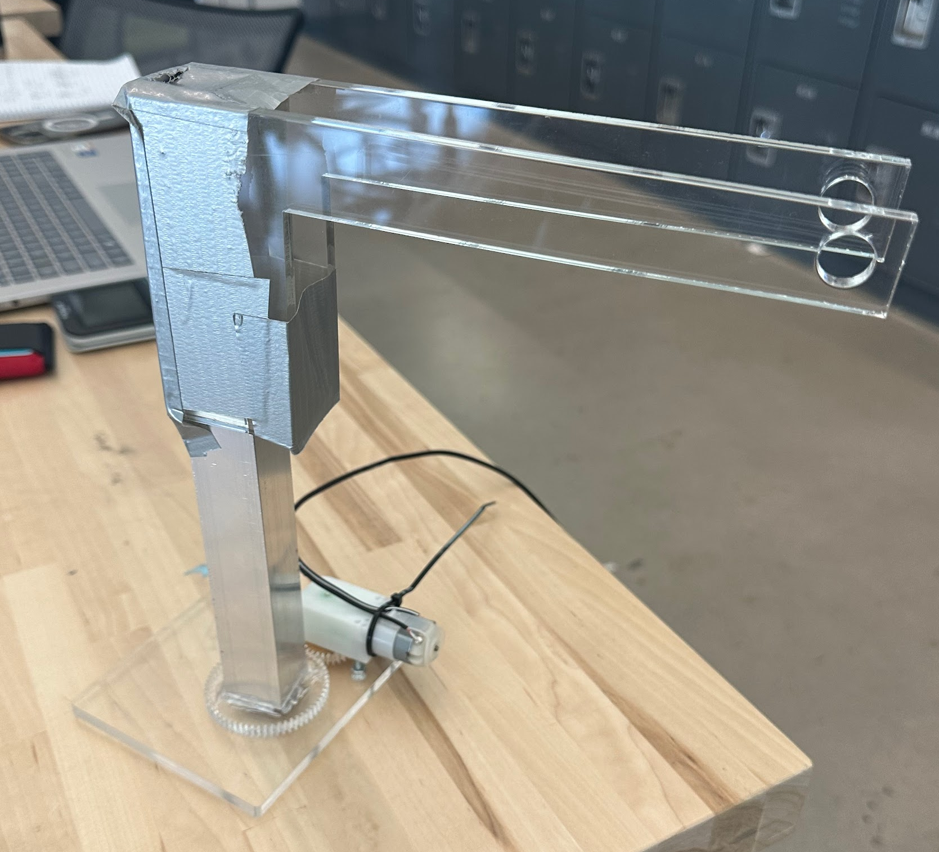
Risk Reduction of Base Arm
Thought rotating base component would be riskiest
New problem arose while manufacturing
  Moment of weight on end of lower arm lifted the gear off the base plate

Slide 10
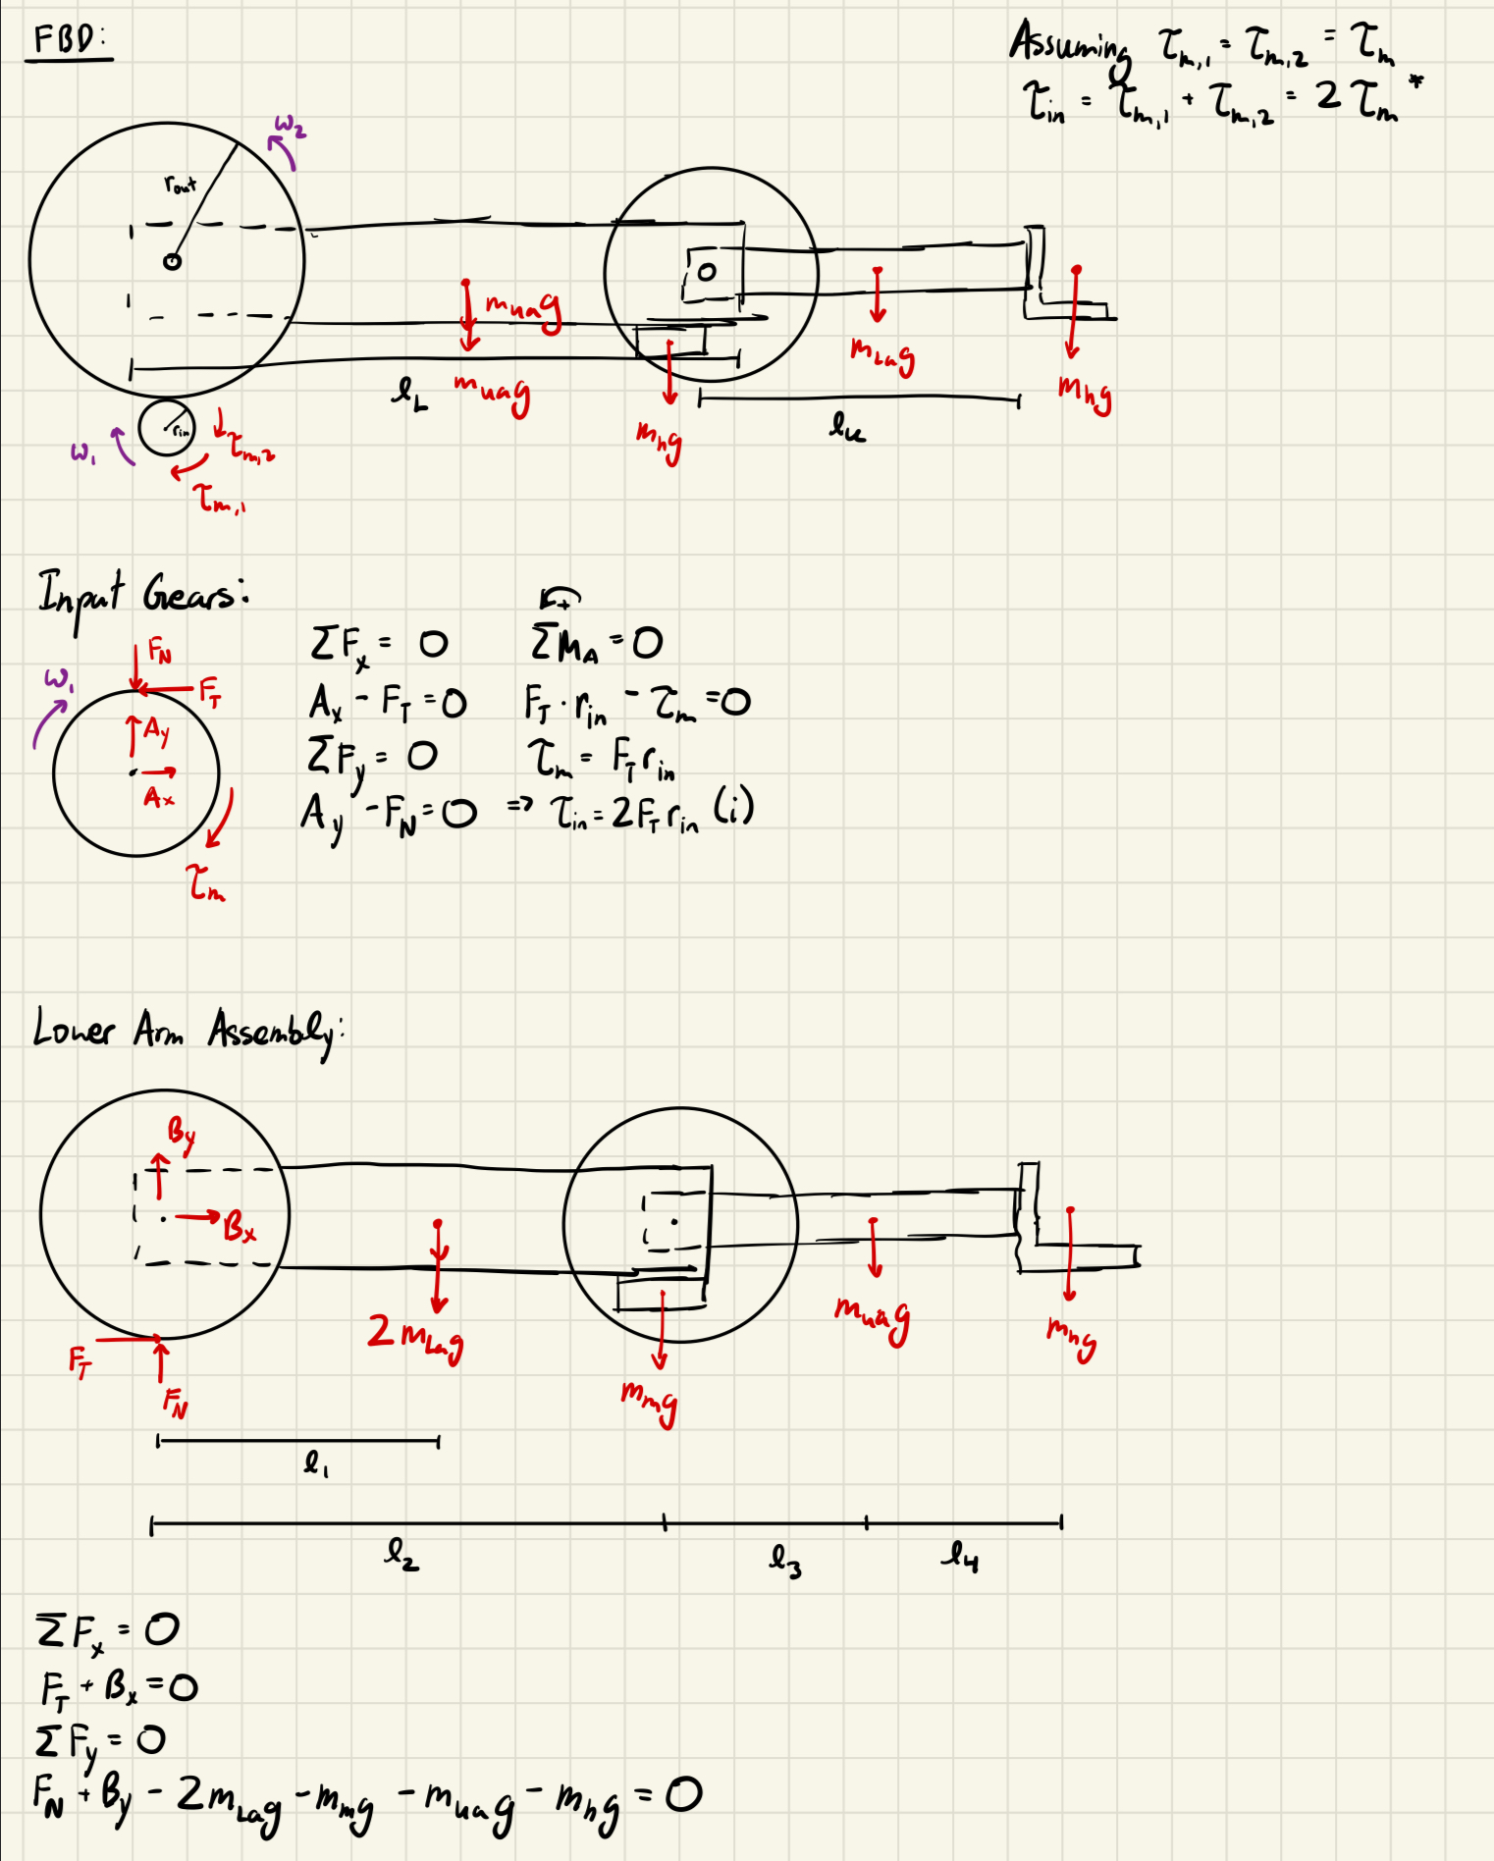
Free Body Diagrams of Lower Arm
FBD of Input Gears
FBD of Arm Mechanism

Slide 11
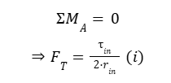
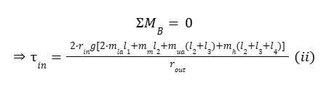

Calculations
r_{in}= 12.5 mm
r_{out}= 40 mm
m_{la}= 102.551 g
m_{ua}= 95.603 g
m_{m}= 26 g
m_{h}= 8 g
l₁= 14.732 cm
l₂= 29.718 cm
l₃= 7.874 cm
l₄= 17.399 cm
⇒ τ_{needed}= .480 Nm
⇒ F_{T}= 19.20 N
⇒ F.S._{torque}= 1.13

Slide 12

Design: Why did we choose this?
Simplicity
Do not have to worry about moving around the field
High reach; maximum height of ~20 in.
Efficient and gets points quickly

