Slide 1

MOBILE PHONE JAMMER Estimated deadline – 06/02/2022

Slide 2
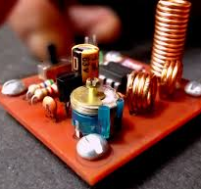
The device made will block the signal from the tower that the mobile generally receives. This will be done by using the frequency of the signal generated by 555 timer.

Slide 3
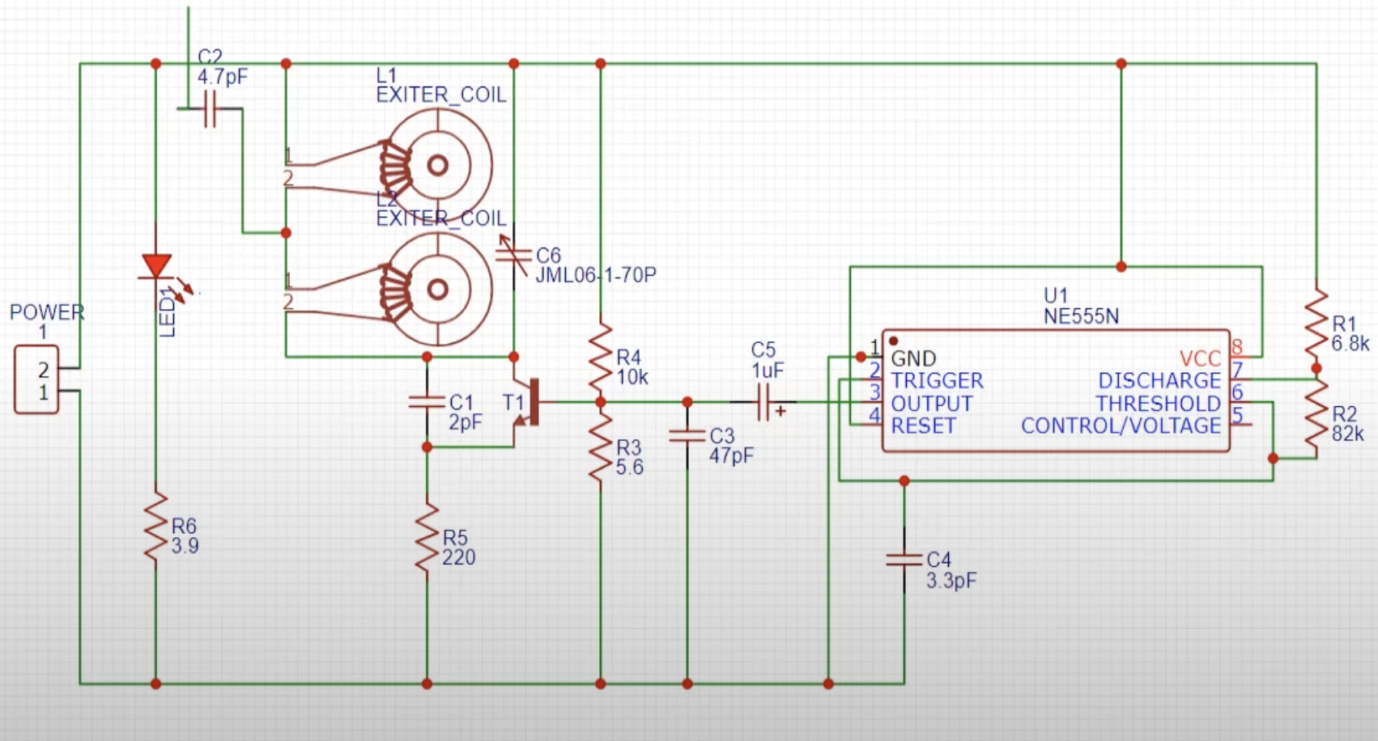
Circuit Diagram

Slide 4
Components Required
NE-555 timer IC –1
PCB Board
NE-555Timer IC Holder – 1
BF495 IC – 1
1-30PF Timmer(variable capacitance) - 1
Slide Switch – 1
Power Connector
LED – 1
Copper Wire
Battery

Slide 5

Team Name – Aryaman&Dikshant
Made By - Dikshant

