Slide 1
ADO.NET

Slide 2
Enabling Objectives
After completing this chapter, you will be able to explain about the basics of ADO.Net

Slide 3
Key Topics
Connected & Disconnected architecture
Querying database
Data binding
Managing Local Transactions
Usage of LINQ
Integration with ASP.Net

Slide 4
What is ADO.Net and benefits of ADO.Net

Slide 5

ADO .Net : Overview
ADO.Net is a set of classes that comes with the Microsoft .NET framework to facilitate data access from managed languages.
ADO.Net has been in existence for a long time and it provides a comprehensive and complete set of libraries for data access.

Slide 6
Evolution of ADO.NET
The first data access model, DAO (Data Access Model) was created for local databases with the built in Jet engine which had performance and functionality issues
Next came RDO( Remote Data Object) and ADO (Active Data Object) which were designed for Client server Architectures but, soon ADO took over RDO.
With ADO, all the data is contained in a recordset object which had problems when implemented on the network and penetrating firewalls.

Slide 7
Evolution of ADO.NET (Contd.)
ADO was a connected data access, when a connection to the database is established the connection remains open until the application is closed.
Leaving the connection open for the lifetime of the application raises concerns about database security and network traffic .
Also, as database are becoming increasingly important and as they are serving more people, a connected data access model makes us think about its productivity.

Slide 8
Why ADO.Net?
ADO.NET is ADO extended to work in cooperation with any software component , on any platform, that understands XML.
The ADO.Net interface is readily accessible using any of the .NET complaint languages.
Following are some of the Design Goal of ADO.NET
Scalability
Reliability
Performance
Statelessness
Robustness
Disconnected view of data (Dataset)
XML

Slide 9
Connected & Disconnected architecture

Slide 10
Connected Architecture in ADO.NET
In the Connection Oriented Data Access Architecture the application makes a connection to the Data Source and then interact with it through SQL requests using the same connection.
In these cases the application stays connected to the database system even when it is not using any Database Operation.

Slide 11
Connected Environment in ADO.NET
Working with data directly via Open connection.
Advantages:
Simple security realization
Work with real data
Simple Organization of distributed work
Drawbacks:
Continual Connection
Not available Via Internet

Slide 12
Components of SQL connection

Slide 13
Creating a SqlConnection Object
The SqlConnection object uses a constructor with a single argument of type string.
This argument is called a connection string.
SqlConnection conn = new SqlConnection( "Data Source=(local);Initial Catalog=Northwind; Integrated Security=SSPI");

Slide 14
The SqlCommand Object
A SqlCommand object allows you to specify what type of interaction you want to perform with a database.
For example, you can do select, insert, modify, and delete commands on rows of data in a database table.
The SqlCommand object can be used to support disconnected data management scenarios

Slide 15
Creating a SqlCommand Object
The SqlCommand class is at the heart of the System.SqlClient namespace.
It is used to execute operations on a database and retrieve data.
SqlCommand object takes a string parameter that holds the command you want to execute and a reference to a SqlConnection object
Eg : SqlCommand cmd = new SqlCommand("select CategoryName from Categories", conn);

Slide 16
SqlCommand Properties
Item | Description
CommandText | Contains the text of a SQL query
CommandTimeout | Contains the length of the timeout of a query, in seconds
CommandType | Specifies the type of command to be executed
Connection | Specifies the connection to the database
Parameters | Specifies a collection of parameters for the SQL query
Transaction | Specifies a transaction object, which enables developers to run queries in a transaction

Slide 17
Preparing a SqlCommand Object for Parameters
The first step in using parameters in SQL queries is to build a command string containing parameter placeholders.
These placeholders are filled in with actual parameter values when the SqlCommand executes. Proper syntax of a parameter is to use an '@' symbol prefix on the parameter name as shown below:
SqlCommand cmd = new SqlCommand();
cmd.CommandText = "DELETE FROM Empls WHERE EmployeeID = @ID";

Slide 18
Preparing a SqlCommand Object for Parameters
// 1. declare command object with parameter
SqlCommand cmd = new SqlCommand( "select * from Customers where city = @City", conn);
In the SqlCommand constructor above, the first argument contains a parameter declaration, @City.
This example used one parameter, but you can have as many parameters as needed to customize the query.
Each parameter will match a SqlParameter object that must be assigned to this SqlCommand object.

Slide 19
Declaring a SqlParameter Object
Each parameter in a SQL statement must be defined.
// 2. define parameters used in command object
SqlParameter param = new SqlParameter(); param.ParameterName = "@City";
param.Value = inputCity;
Notice that the ParameterName property of the SqlParameter instance must be spelled exactly as the parameter that is used in the SqlCommand SQL command string.
You must also specify a value for the command. When the SqlCommand object executes, the parameter will be replaced with this value.

Slide 20
Associate a SqlParameter Object with a SqlCommand Object
For each parameter defined in the SQL command string argument to a SqlCommand object, you must define a SqlParameter.
// 3. add new parameter to command object cmd.Parameters.Add(“@City”,SQLDBType.String);
cmd.Parameters[“@City”].Value=“Boston”;
The SqlParameter instance is the argument to the Add method of the Parameters property for the SqlCommand object above.
You must add a unique SqlParameter for each parameter defined in the SqlCommand object's SQL command string.

Slide 21
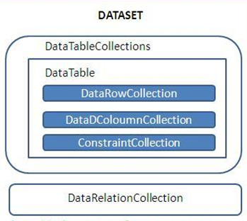
ADO.NET DataSets
The DataSet is a memory-resident representation of data that provides a consistent relational programming model regardless of the data source.
The DataSet object supports disconnected, distributed data scenarios with ADO.NET.
The DataSet represents a complete set of data, including related tables, constraints, and relationships among the tables.
The DataSet can also persist and reload its contents as XML, and its schema as XML schema definition language (XSD) schema.

Slide 22
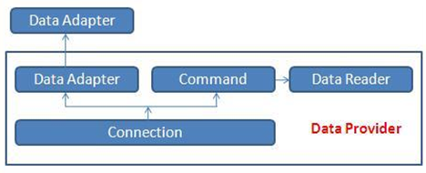
ADO.NET Data Providers
The two key components of ADO.NET are Data Providers and DataSet
The .Net Framework includes mainly three Data Providers for ADO.NET. They are the following:
Microsoft SQL Server Data Provider
OLEDB Data Provider
ODBC Data Provider
Components of data provider include:
Connection
Command
DataReader
DataAdapter

Slide 23
ADO.NET- .NET Data Providers
The following table lists the data providers that are included in the .NET Framework.
.NET Framework data provider | Description
.NET Framework Data Provider for SQL Server | Provides data access for Microsoft SQL Server.
.NET Framework Data Provider for OLE DB | For data sources exposed by using OLE DB.
.NET Framework Data Provider for ODBC | For data sources exposed by using ODBC.
.NET Framework Data Provider for Oracle | For Oracle data sources.
EntityClient Provider | Provides data access for Entity Data Model (EDM) applications.
.NET Framework Data Provider for SQL Server Compact 4.0. | Provides data access for Microsoft SQL Server Compact 4.0.

Slide 24
Components for querying

Slide 25
SqlCommand. ExecuteNonQuery()
Syntax
sqlCommand.ExecuteNonQuery()
Description
The ExecuteNonQuery() method executes the command text against the database specified in the Connection object.
This method is optimized for queries that do not return any information
(for example, DELETE and UPDATE queries).
Example
SqlCommand cmd = new SqlCommand("DELETE FROM Customers WHERE LastName='Jones'", conn);
cmd.ExecuteNonQuery();

Slide 26
SqlCommand.ExecuteReader()
Syntax
SqlDataReader ExecuteReader()
Description
The ExecuteReader() method executes the command text against the database specified in the Connection object and returns a SqlDataReader object with the results of the query.
Example
SqlCommand cmd = new SqlCommand("SELECT Name, City FROM Customers", conn);
SqlDataReader reader = cmd.ExecuteReader();

Slide 27
SqlCommand.ExecuteScalar()
Synatx
Object ExecuteScalar()
Description
The ExecuteScalar() method executes the command text against the database specified in the Connection object and returns a single object.
The ExecuteScalar() method exists because it is wasteful to return a dataset for a single value.
The overhead for the dataset would be much larger than the actual value being returned.
Example
SqlCommand cmd = new SqlCommand("SELECT count(*) FROM Customers", conn);
Int customerCount = (Int)cmd.ExecuteScalar();
msg.Text = "There are "+customerCount.ToString()+" customers in the database.";

Slide 28
Querying database

Slide 29
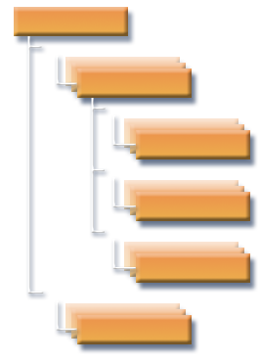
Data Set
A Dataset is an in-memory data store that can hold numerous tables.
Datasets only hold data and do not interact with a data source.
Eg : DataSet dsCustomers = new DataSet();
DataSet
Tables
Table
Columns
Column
Constraints
Constraint
Rows
Row
Relations
Relation

Slide 30
The DataSet Object Model
Common collections
Tables (collection of DataTable objects)
Relations (collection of DataRelation objects)
DataColumn
DataRow
DataTable
DataRelation
Constraints

Slide 31
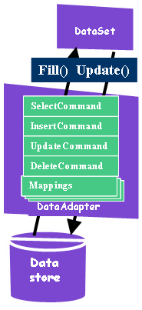
Data Adapter
It is the SqlDataAdapter that manages connections with the data source and gives us disconnected behavior.
The SqlDataAdapter opens a connection only when required and closes it as soon as it has performed its task.
Eg : SqlDataAdapter daCustomers = new SqlDataAdapter("select CustomerID, Company Name from Customers", conn);

Slide 32

Data Adapter
For example, the SqlDataAdapter performs the following tasks when filling a Dataset with data
Open connection
Retrieve data into Dataset (Fill)
Close connection
Filling the DataSet
Syntax:
Dataadapter.fill(dataset,”datatablename”);
Eg :
daCustomers.Fill(dsCustomers,"Customers");
32
Notes:
32

Slide 33
Recall
Recall the importance of 'Using' statement in opening and closing SQL connection

Slide 34
Data binding

Slide 35
SqlCommand. ExecuteNonQuery()
Syntax
sqlCommand.ExecuteNonQuery()
Description
The ExecuteNonQuery() method executes the command text against the database specified in the Connection object.
This method is optimized for queries that do not return any information
(for example, DELETE and UPDATE queries).
Example
SqlCommand cmd = new SqlCommand("DELETE FROM Customers WHERE LastName='Jones'", conn);
cmd.ExecuteNonQuery();

Slide 36
Managing Local Transactions

Slide 37
TransactionScope
Feature of ADO.Net to ensure transactional operations complete successfully
On error occurrence the data operation is rolled back so that the previous stable state of the data and database is restored
TransactionScope of System.Transactions
TransactionScope complete commits a successful transaction
TransactionScope enclosed within Using statement ensures that the rollback happens on occurrence of error
Reference link:
https://docs.microsoft.com/en-us/dotnet/framework/data/transactions/implementing-an-implicit-transaction-using-transaction-scope

Slide 38
Usage of LINQ

Slide 39
LINQ Architecture
Visual C#
Visual Basic
Others
.NET Language Integrated Query (LINQ)
LINQ-enabled data sources
LINQ-enabled ADO .NET
LINQ
to Objects
LINQ
to SQL
LINQ
to Datasets
LINQ
to Entities
LINQ
to XML
<book>
<title/>
<author/>
<price/>
</book>
Objects
Databases
XML
39
Notes:
6/11/2019 11:34 AM
39
©2005 Microsoft Corporation. All rights reserved.
This presentation is for informational purposes only. Microsoft makes no warranties, express or implied, in this summary.

Slide 40
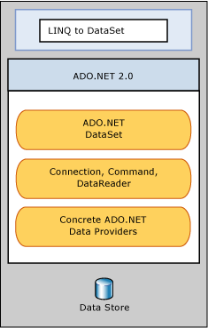
LINQ to DataSet
LINQ to DataSet makes it easier and faster to query over data cached in a DataSet object.
LINQ to DataSet simplifies querying by enabling developers to write queries from the programming language itself, instead of by using a separate query language.
Notes:
http://msdn.microsoft.com/en-us/library/bb397942.aspx

Slide 41
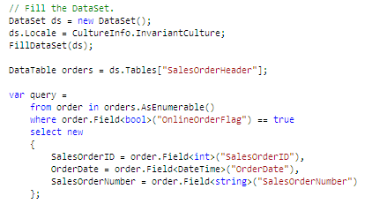
LINQ to DataSet – Querying DataSets
Formulating queries with LINQ to DataSet is similar to using LINQ against other LINQ-enabled data sources.
When using LINQ queries over a DataSet object, the developers are actually querying an enumeration of DataRow objects, instead of an enumeration of a custom type.
DataTable does not implement IEnumerable<T>. You have to call AsEnumerable, which is an extension method for DataTable, to obtain a wrapper that implements that interface.
Use the Field<T> accessor method instead of using a direct cast on the result of the standard DataRow accessor (such as o[“OnlineOrderFlag"]).
Notes:
http://msdn.microsoft.com/en-us/library/bb397942.asp
The list is made of DataRow objects; thus, you must access DataRow member properties to get a field value. This arrangement allows the call of any DataRow member instead of using a query expression over a DataTable. You can use the Field<T> accessor method instead of using a direct cast on the result of the standard DataRow accessor (such as o[“OnlineOrderFlag"]).

Slide 42
Integration with ASP.Net

Slide 43
Integration requirement
Create a Class Library project
Create a Business entity class
Create class with a method to fetch data from database using ExecuteDataSet
Fill the data in the business entity class
Return the data
Reference ADO.Net project in ASP.Net application
Invoke the ADO.Net project class method to fetch the data returned by it
Display the data returned by ADO.Net project on Gridview

Slide 44
Test Your Understanding
Practice Check
Final Check

Slide 45
Recap
In this chapter, we have learnt about:
Connected & Disconnected architecture
Querying database
Data binding
Managing Local Transactions
Usage of LINQ
Integration with ASP.Net

Slide 46
ADO.Net
You have successfully completed –
Learning on basics of ADO.Net

