Slide 1


IN4315 Information Retrieval
Final Project
Made by Group 1
Jelle Licht, Ping Wan, Roeland Oosterloo, Christian den Boer & Margot Jonker

Slide 2

WHAT?
Suppose you search for a job…
Application where people can comply their resume out of multiple jobs
It uses innovative functions…
Makes resume building a new dimension

Slide 3

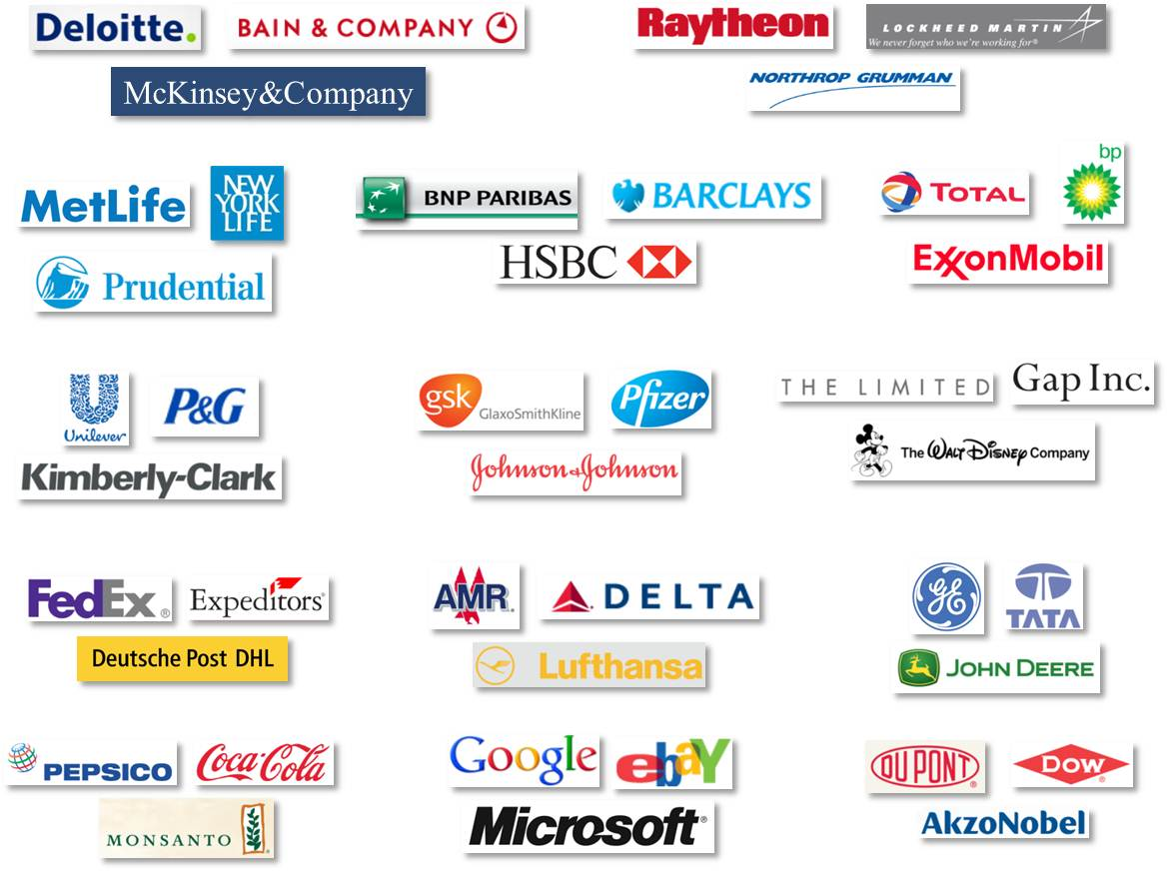
WHO?
Job seekers
Companies

Slide 4
WHY?
It is different than other applications, because…
Innovative techniques:
New way of search…
New way of ranking…
New way of complying…

Slide 5


WHERE & WHEN?
Available on internet via PC
Our process / Recruitment process?

Slide 6
HOW?
Demo on four parts:
Overall application (User interface, login, entries aanmaken etc)
Text analysis
Crowdflower
VSM
???

Slide 7
DEMO 1

Slide 8
DEMO 2

Slide 9
DEMO 3

Slide 10
DEMO 4

Slide 11
CONCLUSION

Slide 12
RESUME BUILDER!
“Your life is your message to the world. Make sure it's inspiring.”
“Your dream job does not exist. You must create it.”
Made by:
Group 1
Jelle Licht
Ping Wan
Roeland Oosterloo
Christian den Boer
Margot Jonker
Special thanks to:
Allessandro Bozzon

