Slide 1


IN4315 Information Retrieval
Final Project
Made by Group 1
Jelle Licht, Ping Wan, Roeland Oosterloo, Christian den Boer & Margot Jonker

Slide 2

FINAL PROJECT
Course
IN4315 Information Retrieval
Final project for the course
Design and develop a personalised, sense making Web application that:
Should solve a real world data or information sense making problem
Should involve Information Retrieval components
Should use crowdsourcing or human computation
Should explain the choice of incentives and discuss alternative ways of incentivizing workers
Students
Jelle Licht – CS/IA -
Ping Wan – CS/IA -
Roeland Oosterloo – CS/IA -
Christian den Boer – CS/IA -
Margot Jonker – SEPAM/IA - 4397975
Supervisor
Allessandro Bozzon

Slide 3

WHAT?
The Resume Builder…
…makes it possible to create resumes from multiple entries according to a specific area of job
…makes use of innovative technologies for several functions
…adds a totally new dimension to building resumes

Slide 4
WHAT?
Problem
Suppose you just have been graduated. Obviously you will have to search for a job. You have already a basic resume, but you used that only to apply for a job as bartender in a local pub. In this case you will have to adjust this resume, but you also do not want to delete the current resume. You could make multiple versions of your resume, but this mean you will get many different versions as you probably also want to change some details of the entries according to the jobs you are applying to. All these different versions have to be saved on your computer and in these versions there is much redundancy. So you search for an easy method to solve this problem you are facing…
Now suppose you are on the other side of the job vacancies and you are a recruiter at a big company. You want to perform your job properly and as fast as possible as time is money. You could ask for student resumes at an university or specialized recruitment company and search through all these resumes one by one, but this costs also time and a lot of money. So you are probably searching for a method that costs less money and which makes it easier to find the applicable candidates for you…
Application
Here is where the application “Resume Builder” comes in. This application solves the problems of these two clients. The companies have a problem with decreasing the amount of money spent on recruitment and finding the right resumes. Job seekers have the problem of building and maintaining an applicable resume.
The “Resume Builder” makes it possible to create resumes from multiple entries according to a specific area of job. Job seekers can upload their entries and compose a resume with the preferred entries shown. Companies can on the other hand search through the uploaded resumes and search for the best applicable candidates. The application makes use of innovative technologies for several functions, as for example the search and ranking for the resumes. This adds a totally new dimension to building resumes for both job seekers and companies. Building a resume will become fun and recruitment will never be the same.

Slide 5


WHO?
Job seekers
Companies

Slide 6
WHO?
Job seeker
On one side we have students who are struggling build and keep track of their resume and sometimes tweak it for a job application. If they do not want to lose the entries they remove for some interview, they quickly move to some basic version control scheme, with outdated copies of the resume in several places. The application helps people to manage their resume by giving them a simple interface to compose a resume out of the entries they already have in store. Our platform provides an easy and intuitive way for users to maintain and curate a resume.
Job seeker’s interest:
Building a resume on a nice way and create multiple versions easily and fast.
Companies
On the other hand companies can use the special portal to search through our resume base in a more structured way to get the best match for their company.
In the Netherlands the average recruitment budget per vacancy has increased with 58% between 2007 and 2013. Although there are less vacancies, the money spent on the existing, difficult to fill positions is increasing as it is hard to find the right people for the job. The research ‘Recruitment Kengetallen 2013’ is also stating that in 2013 recruitment will mainly focus on purchase and implementation of ICT/automation, cost reduction and recruitment process outsourcing. Therefore companies are for example hiring social media experts to search through the dusty corners of LinkedIn in a quest for that as of yet undiscovered new talent, but this is a very inefficient and costly procedure. Thus, in order to reduce the cost and to make the recruitment process more effective, the companies could use some supporting software for these tasks. This platform will provide recruiters advanced searching capabilities through all resumes that are stored in the database.
Company’s interest:
Get access to many resumes and search through these resumes on a easy and effective way.

Slide 7
WHY?
It is ground-breaking against other applications, because…
… it is build from an innovative approach
… it uses state-of-the-art technologies:
Text analysis
Search
Ranking
Retrieving information from the crowd

Slide 8
WHY?
Innovation
Creating this application is challenging and ground-breaking, because it solves a problem on a new manner. The application makes the recruitment process and building a resume a totally new dimension. The solution is searched and found in an innovative way. New and state-of-the-art technologies are used to reach its functionality according to information retrieval. The resume builder involves several information retrieval elements to function as expected. These elements are:
Human computation
Users of the system can review the entries posted by other users. This way the users can get feedback on their entries. To make sure that the feedback makes sense, the feedback can be voted, and finally, the feedback gets accepted by the owner of the content. By providing feedback on entries, a user can acquire credits. With enough credits, the user can become a premium user for a limited of time. In order to stimulate people to become a premium member, multiple premium features will be provided such as extra themes.
Crowdsourcing
The crowd can be leveraged to annotation of entries of resumes. Think hereby of annotating the entities (companies, functions) and duration of employment. For this annotation think of some kind of rdf style of adding semantics to the text. This will significantly improve the search capabilities.
Advanced search
The search from the recruiters will be more than just a database lookup. The search will include a more sophisticated search because e.g. different combinations of education and past working experience heavily influences the relevance of the results. Thus ranking plays a huge role in this kind of search. For search we will use advanced search techniques such query expansion. Therefore, the system will also be able to handle for some fuzziness in the search terms when people formulate things differently.
Ranking
Probabilistic IR will be used to rank resumes by probability of relevance with respect to the search query of the user. This form of ranking requires interaction with the user in the form of explicit (asking users to rank the relevance) and implicit (click through numbers) feedback to improve the probabilistic description of the ideal set of resumes for that certain combination of user profile and search query. Eventually we hope to be able to perfectly serve users’ needs.

Slide 9


WHERE & WHEN?
Available on internet via PC
Our process / Recruitment process?

Slide 10
WHERE & WHEN?
Multiple browsers
Process

Slide 11
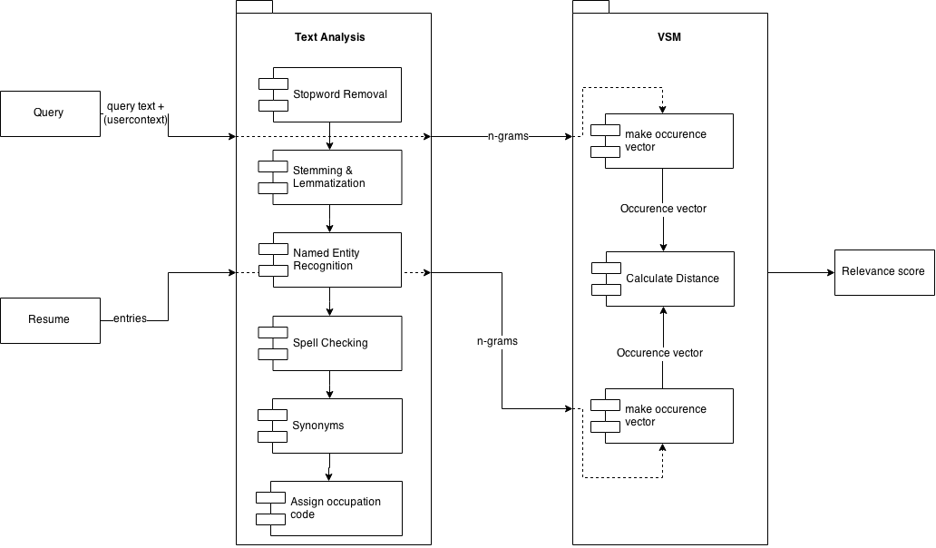
DESIGN CHOICES

Slide 12
DESIGN CHOICES

Slide 13
HOW IMPLEMENTED?
Demo on four parts:
Overall application (User interface, login, entries aanmaken etc)
Text analysis
Crowdflower
VSM
???

Slide 14
DEMO 1

Slide 15
DEMO 1

Slide 16
DEMO 2

Slide 17
DEMO 2

Slide 18
DEMO 3

Slide 19
DEMO 3

Slide 20
DEMO 4

Slide 21
DEMO 4

Slide 22
INCENTIVES

Slide 23
INCENTIVES

Slide 24
CONCLUSION

Slide 25
CONCLUSION

Slide 26
RESUME BUILDER!
“Your life is your message to the world. Make sure it's inspiring.”
“Your dream job does not exist. You must create it.”
Made by:
Group 1
Jelle Licht
Ping Wan
Roeland Oosterloo
Christian den Boer
Margot Jonker
Special thanks to:
Allessandro Bozzon

