Slide 1
Self Introduction
Sutanto Edward Budiman 20185029

Slide 2
Who?
Name : Edward Budiman Sutanto
Age : 29 (30 in Korea)
Birthplace : Surabaya, Indonesia
Hobby : Eat, Play games
Previous education : Undergraduate Program of Informatics Engineering in Petra Christian University

Slide 3
Work Experience
WOWRACK Indonesia (2012-2014) as a Mobile Developer
camLine Pte Ltd (2014-2015) as a Java Programmer
Freelance Mobile Application and Trader (2015-2018)

Slide 4

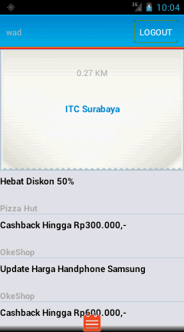
Past Work
My thesis :
Brosurku.com Android Application
Brosurku.com is a web portals shows
promos or discounts

Slide 5
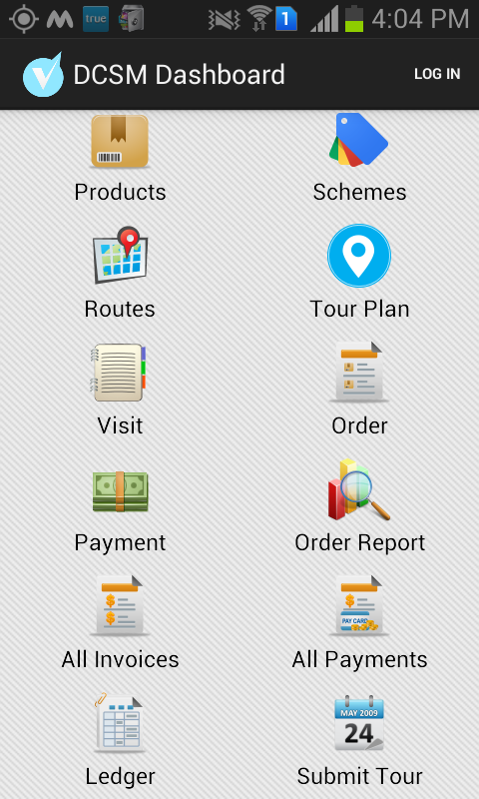
Past works(cont.)
Sales Marketing Tracker App

Slide 6
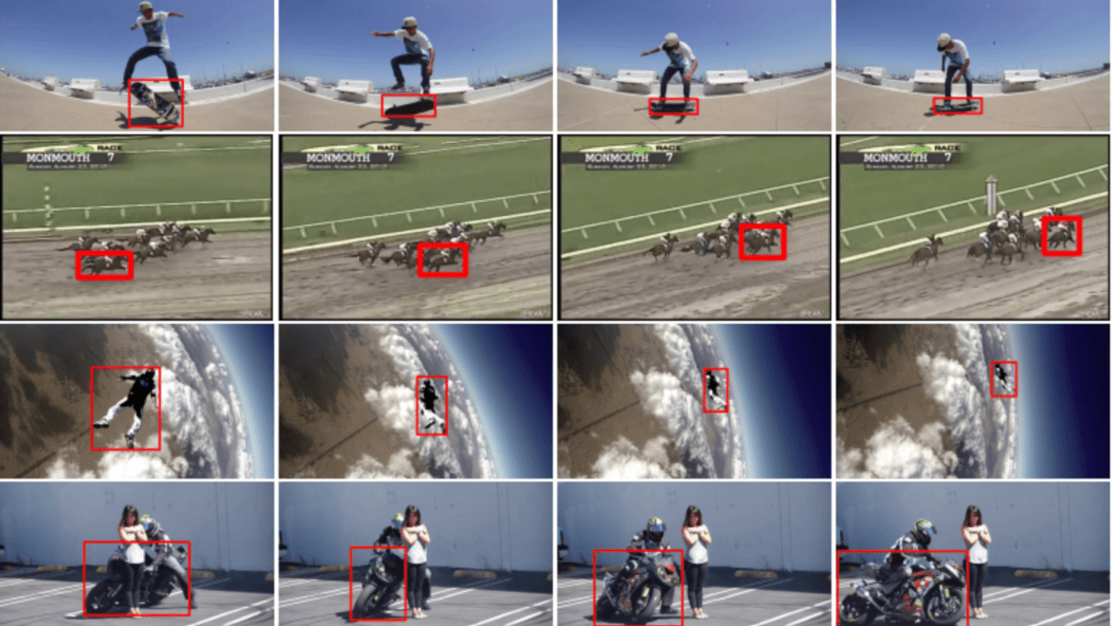
Current Research Topic
Single Object Tracking

Slide 7

ReconstructMe
http://reconstructme.net/

Slide 8
ReconstructMe
https://www.esat.kuleuven.be/psi
ReconstructMe is a powerful 3D real-time scanning system
ReconstructMe usage concept is similar to that of an ordinary video camera, simply move the camera around the object to be modelled in 3D.
ReconstructMe is developed by a group of computer vision experts at PROFACTOR (research company in production located nearby Steyr- Austria, specialized in robotics and computer vision.)

Slide 9
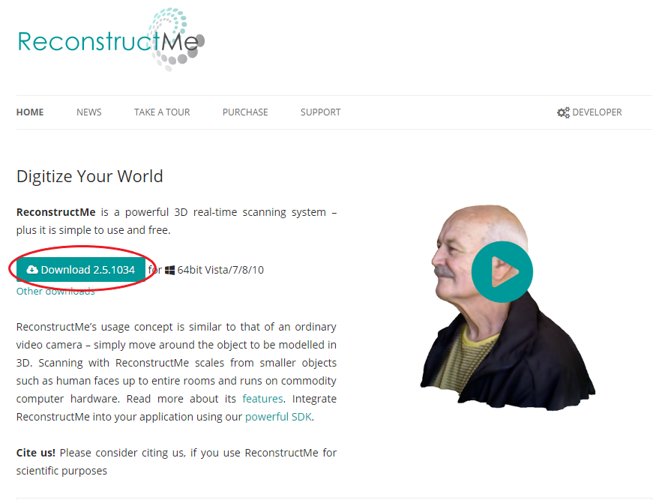
How to install
Visit ReconstructMe

Slide 10
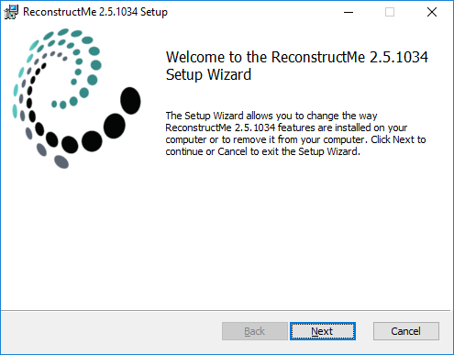
How to install(cont.)

Slide 11
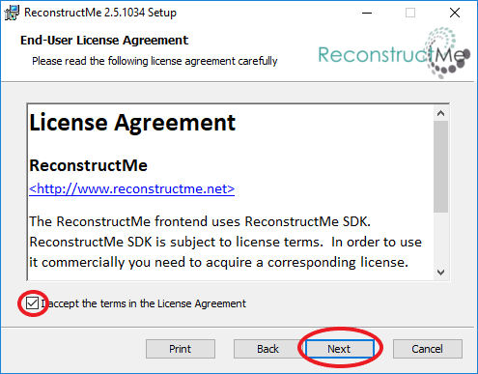
How to install(cont.)

Slide 12
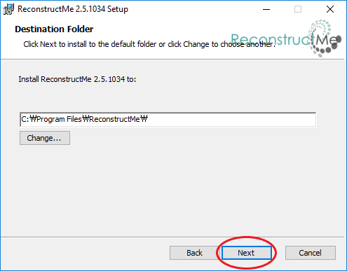
How to install(cont.)

Slide 13
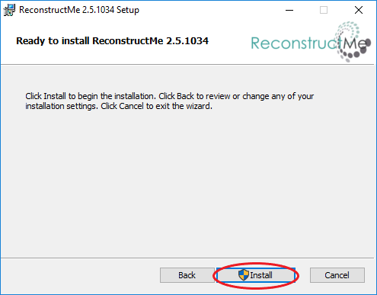
How to install(cont.)

Slide 14
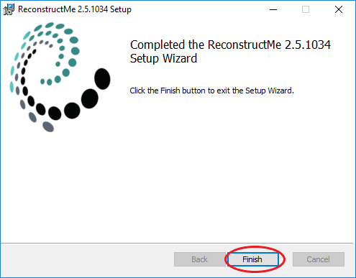
How to install(cont.)

Slide 15
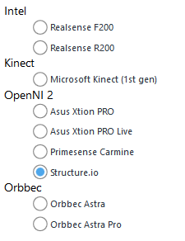
Building 3d Models
ReconstructMe (Non-Commercial) only support 9 camera devices

Slide 16
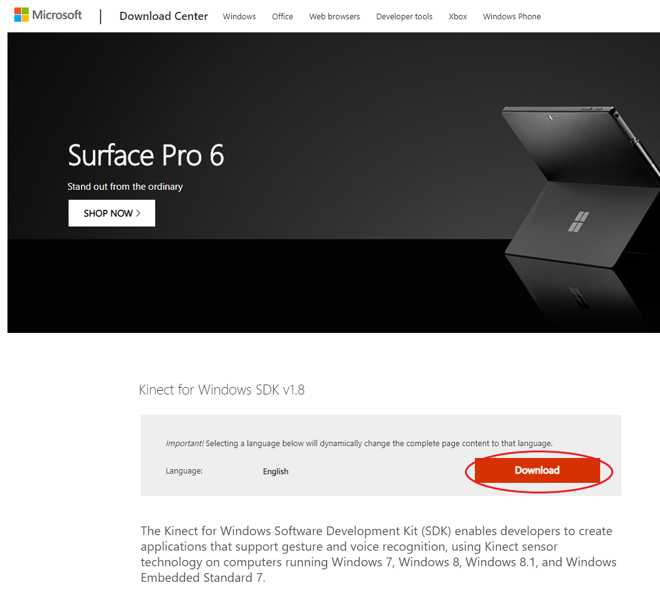
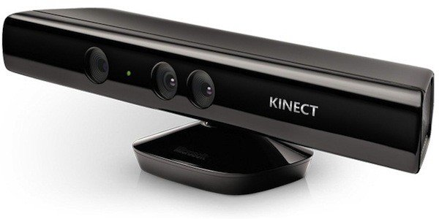
Building 3d Models(cont.)
Download KinectSDKv1

Slide 17
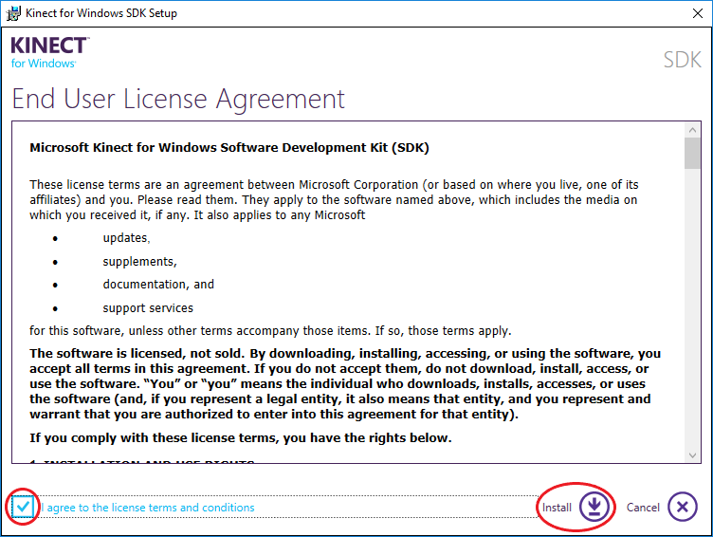
Building 3d Models(cont.)

Slide 18
Building 3d Models(cont.)
Place the kinect with the same eye level with you
Video

Slide 19
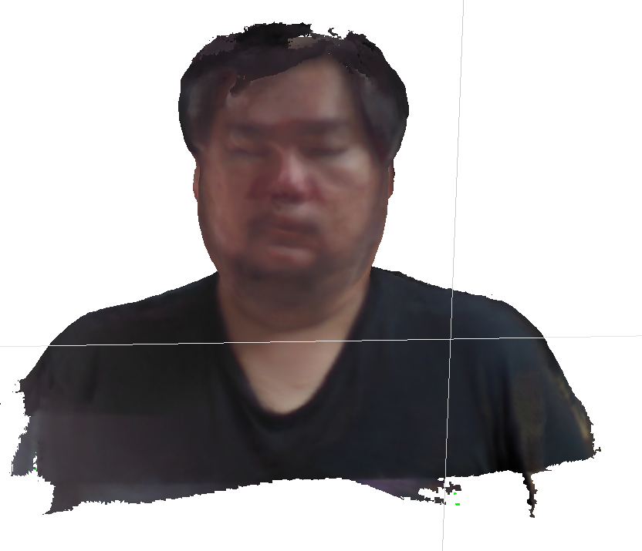
Building 3d Models(cont.)

Slide 20
Reference
ReconstructMe
PROFACTOR
Paper

Slide 21
Thank You

