Slide 1
Thread Programming with Shared Memory using pthreads library
CSCI-442 Spring’21 – Project 3

Slide 2
Thread Programming with Shared Memory
Program is a collection of threads of control.
Can be created dynamically
Each thread has a set of private variables, e.g., local stack variables
Also a set of shared variables, e.g., static variables, shared common blocks, or global heap.
Threads communicate implicitly by writing and reading shared variables.
Threads coordinate by synchronizing on shared variables
Shared memory
s
s = ...
Private memory
i: 2
i: 5
i: 8
P0
P1
Pn
Notes:
Example: think of a thread as a subroutine that gets called on on processor, executed on another
Like concurrent programming on a uniprocessor (as studied in CS162).

Slide 3
Pthread reading material
We taught multi-threading concepts in Ch#4.
However, it is your responsibility to learn how to use pthreads programming library.
Please READ https://computing.llnl.gov/tutorials/pthreads/

Slide 4
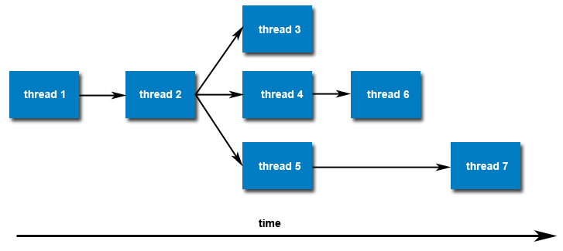
pthread_create
Initially, your main() program comprises a single, default thread. All other threads must be explicitly created by the programmer.
pthread_create creates a new thread and makes it executable. This routine can be called any number of times from anywhere within your code.

Slide 5
pthreads Hello World
1 2 3 4 5 6 7 8 9 10 11 12 13 14 15 16 17 18 19 20 21 22 23 24 25 26 27 28 29 |  | #include <pthread.h> #include <stdio.h> #define NUM_THREADS 5 void *PrintHello(void *threadid) { long tid; tid = (long)threadid; printf("Hello World! It's me, thread #%ld!\n", tid); pthread_exit(NULL); } int main (int argc, char *argv[]) { pthread_t threads[NUM_THREADS]; int rc; long t; for(t=0; t<NUM_THREADS; t++){ printf("In main: creating thread %ld\n", t); rc = pthread_create(&threads[t], NULL, PrintHello, (void *)t); if (rc){ printf("ERROR; return code from pthread_create() is %d\n", rc); exit(-1); } } /* Last thing that main() should do */ pthread_exit(NULL); }

Slide 6
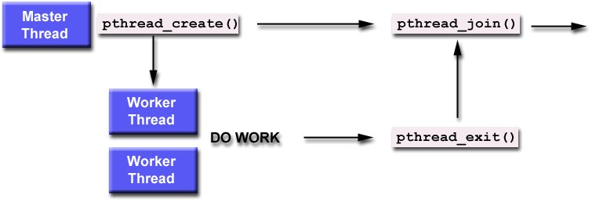
pthread_join
The pthread_join() subroutine blocks the calling thread until the specified thread id thread terminates.
A joining thread can match one pthread_join() call. It is a logical error to attempt multiple joins on the same thread.

Slide 7
1 2 3 4 5 6 7 8 9 10 11 12 13 14 15 16 17 18 19 20 21 22 23 24 25 26 27 28 29 30 31 32 33 34 |  | int main (int argc, char *argv[]) { pthread_t thread[NUM_THREADS]; pthread_attr_t attr; int rc; long t; void *status; /* Initialize and set thread detached attribute */ pthread_attr_init(&attr); pthread_attr_setdetachstate(&attr, PTHREAD_CREATE_JOINABLE); for(t=0; t<NUM_THREADS; t++) { printf("Main: creating thread %ld\n", t); rc = pthread_create(&thread[t], &attr, PrintHello, (void *)t); if (rc) { printf("ERROR; return code from pthread_create() is %d\n", rc); exit(-1); } } /* Free attribute and wait for the other threads */ pthread_attr_destroy(&attr); for(t=0; t<NUM_THREADS; t++) { rc = pthread_join(thread[t], &status); if (rc) { printf("ERROR; return code from pthread_join() is %d\n", rc); exit(-1); } printf("Main: completed join with thread %ld having a statusof %ld\n",t,(long)status); } printf("Main: program completed. Exiting.\n"); pthread_exit(NULL); }
pthreads Hello World ->modification for join

Slide 8
pthread_mutex*
A special type for mutexes: pthread_mutex_t.
To gain access to a critical section, call (i.e., semWait())
To release (i.e., semSignal())
When finishing use of a mutex, call

Slide 9
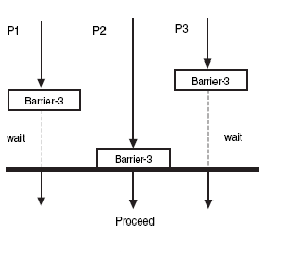
pthread_barrier*
Synchronizing the threads to make sure that they all are at the same point in a program is called a barrier.
No thread can cross the barrier until all the threads have reached it.
// Initialization in main thread
pthread_barrier_t barrier;
pthread_barrier_init (&barrier, NULL, 3);
// Call from a child thread (and main, if needed)
pthread_barrier_wait (&barrier);
// Cleanup in main thread
pthread_barrier_destroy (&barrier);

Slide 10

Project 3: pzip
inputs
int n_threads | 4
int input_chars_size | 28
char* input_chars | ●
d
d
y
y
y
s
s
s
s
s
a
p
p
p
z
z
d
d
d
d
d
q
q
q
q
q
q
q
pzip(inputs,outputs)
pthread_create()
Iterate through this portion of input_chars
Store counts locally localResult
Update char_frequency (via mutexes)
localResult =
{{d,2}, {y,3},{s,2}}
localResult =
{{s,3}, {a,1},{p,3}}
localResult = {{z,2}, {d,5}}
localResult = {{q,7}}
pthread_barrier()
Find where to start writing the output zipped_chars array using previous threads’ results
copy localResult to zipped_chars
localResult
localResult
localResult
localResult
pthread_join()
Copy
Copy
Copy
Copy
Outputs
zipped_char* zipped_chars | ●
d
2
y
3
s
2
s
3
a
1
p
3
z
2
d
5
q
7
int zipped_chars_count | 9
int char_frequency[26] | ●
1 |  |  | 7 |  |  |  |  |  |  |  |  |  |  |  | 3 | 7 |  | 5 |  |  |  |  |  | 3 | 2
a
d
p
q
s
y
z

Slide 11
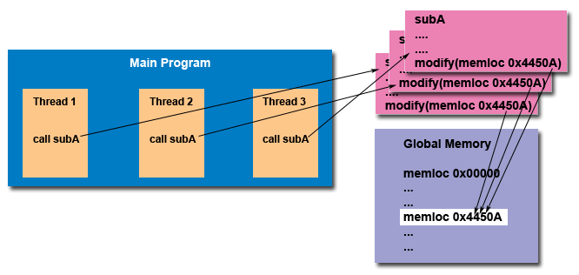
Thread Safety
Thread-safety: It refers to an application's ability to execute multiple threads simultaneously without creating "race" conditions.
For example suppose that your application creates several threads, each of which makes a call to the same library routine:
This library routine accesses/modifies a global structure or location in memory.
As each thread calls this routine it is possible that they may try to modify this global structure/memory location at the same time.
If the routine does not employ some sort of synchronization constructs to prevent data corruption, then it is not thread-safe.

