Slide 1


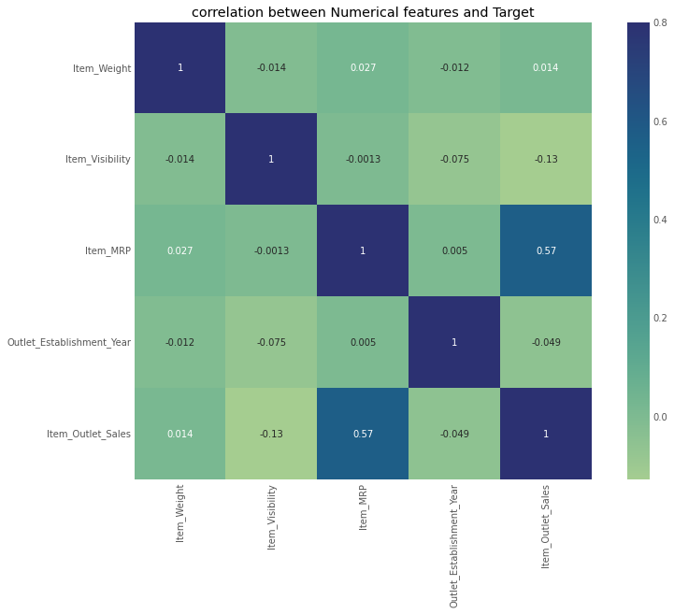
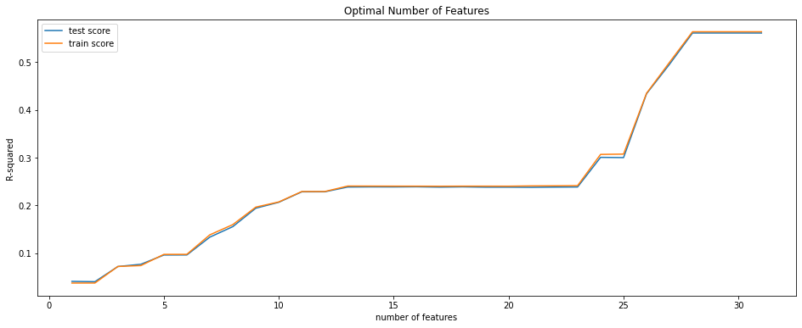
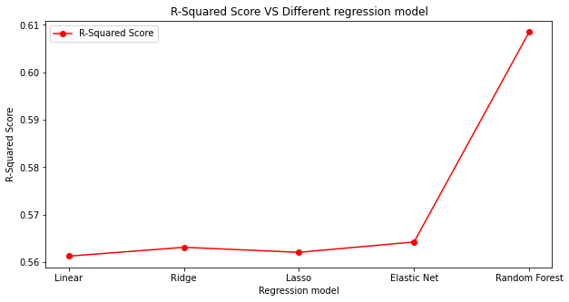
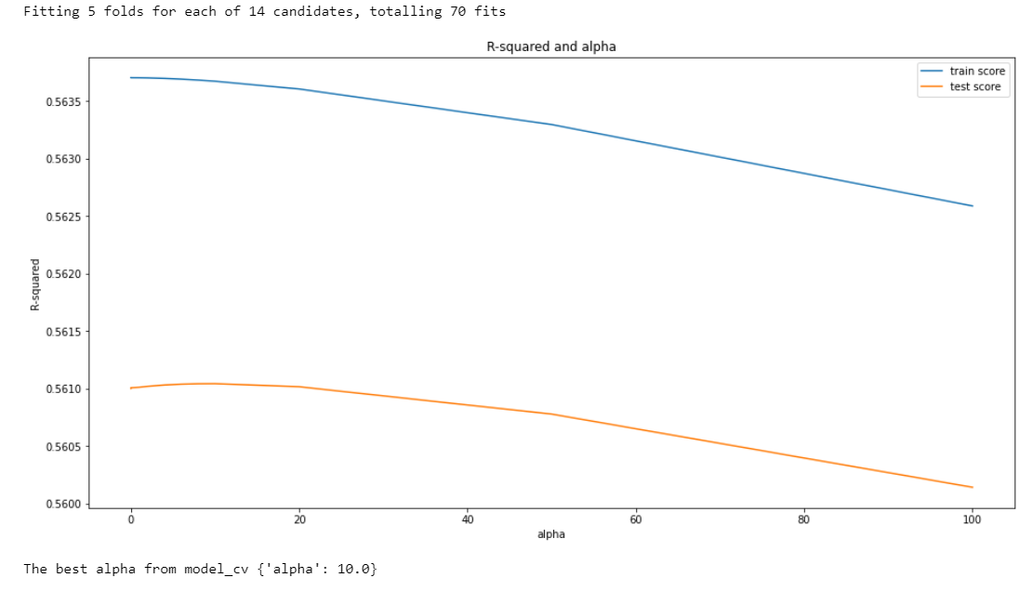
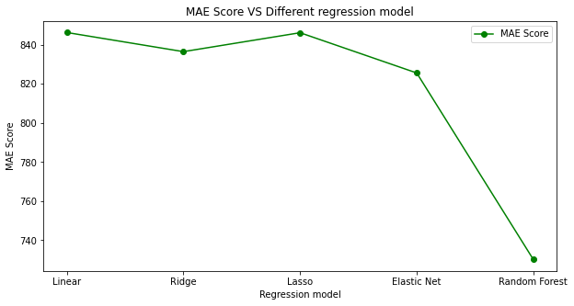
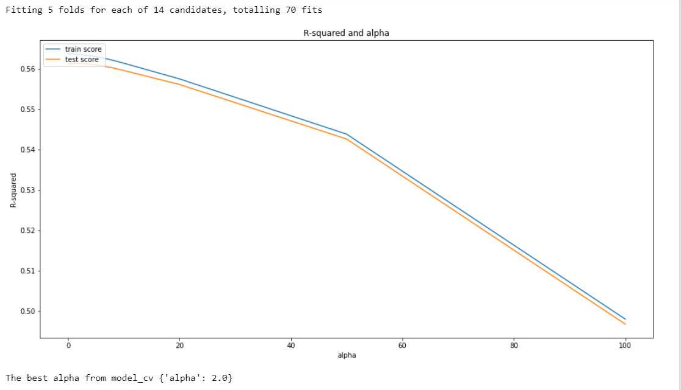
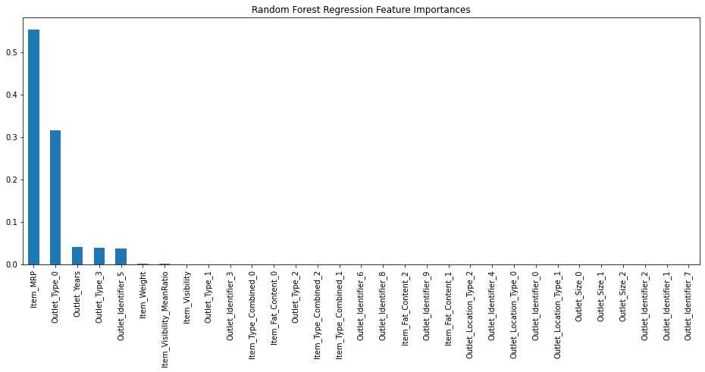
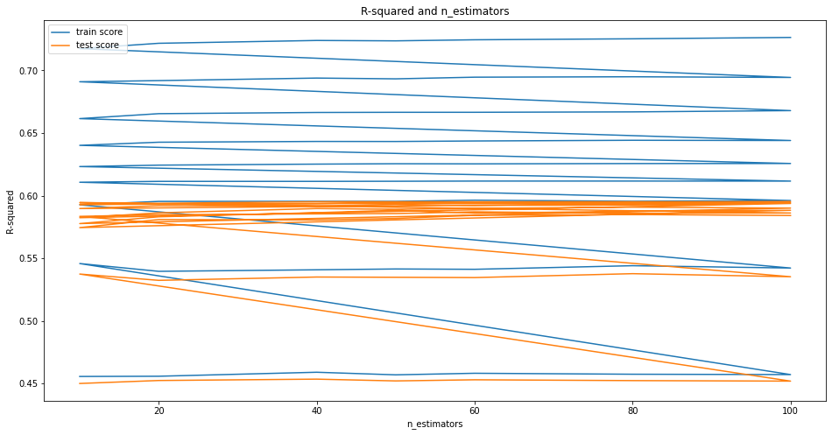
Big Mart Sales Prediction Using Five Regression Models
Ping Zhang pingzhang@mines.edu Colorado School of Mines, Department of Computer Science
Over view
Data Exploration
Model Selection
Conclusions
Using BigMart Sales data set to build a model for predicting the Sales of the products:
Analyzing correlations between different features
Data Preprocessing
Model selection: comparing five regression models.
Model evaluation, visualizations and conclusion
Numerical feature analysis
Using grid search with cross-validation to get best parameters.
Model Evaluation
Random Forest Regression has the best performance on the train set and test set. Its R-squared is 60.84%.
Analysis correlation map as below:
Linear Regression Model
Ridge Regression Model
Related Work
Importance of pre-processing
I fund the precious research that data exploration, data transformation, and feature engineering play a vital role in predicting accurate results[3].
Previous work on optimizing the parameters
The paper[2], proposed a Grid Search Optimization (GSO) technique to optimize and select the best tuning hyperparameters.
Previous work on comparing
Applied four algorithms XGBoost, Random Forest, Linear Regression, and Decision Tree. Concluded that among all the four algorithms XGBoost has the highest accuracy of 61.14% [1] .
Data Processing
Step1: Imputing missing values
Using the mean() value of Item_Weight and Outlet_Size to replace the missing values.
Stpe2: Creating a new category
Group the Item_Type within these 3 categories: FD” (Food), “DR” (Drinks), or “NC” (Non-Consumables).
Step3: Transformations values
Combined the different low-fat value to the type “low fat”.
Converted Establishment_Year.
Transformations for Item Visibility.
Step4:One-Hot-Coding
Creating dummy variables for categorical features, each having binary numbers.
Lasso Regression Model
Feature Importance
The features rank of impact of Random Forest Regression Model is different from other models.
Random Forest Regression Model
References
1.Vidya Chitre, Shruti Mahishi, Sharvari Mhatre, Shreya Bhagwat(2022,April).Big Mart Sales Analysis.2022 International Journal of Innovative Technology and Exploring Engineering (IJITEE)
2. Rohit Sav, Pratiksha Shinde, Saurabh Gaikwad (2021, June). Big Mart Sales Prediction using Machine Learning. 2021 International Journal of Research Thoughts (IJCRT).
3. Kumari Punam , Rajendra Pamula , Praphula Kumar Jain (2018, September 28-29). A Two-Level Statistical Model for Big Mart Sales Prediction. 2018 International conference on on Computing, Power and Communication Technologies.
Notes:
The poster is 36” wide by 48” tall

