Slide 1



Structure-based selection of tumor-antigens for T-cell based immunotherapy
Dinler Amaral Antunes
Postdoctoral Research Associate
Rice University
Kavraki Lab at Rice University
Lizée Lab at UT M.D. Anderson
Houston/TX
Notes:
Thank you for the introduction,
My name is Dinler Antunes and I am a Postdoctoral Research Associate at Rice university, under Dr. Lydia Kavraki.

Slide 2
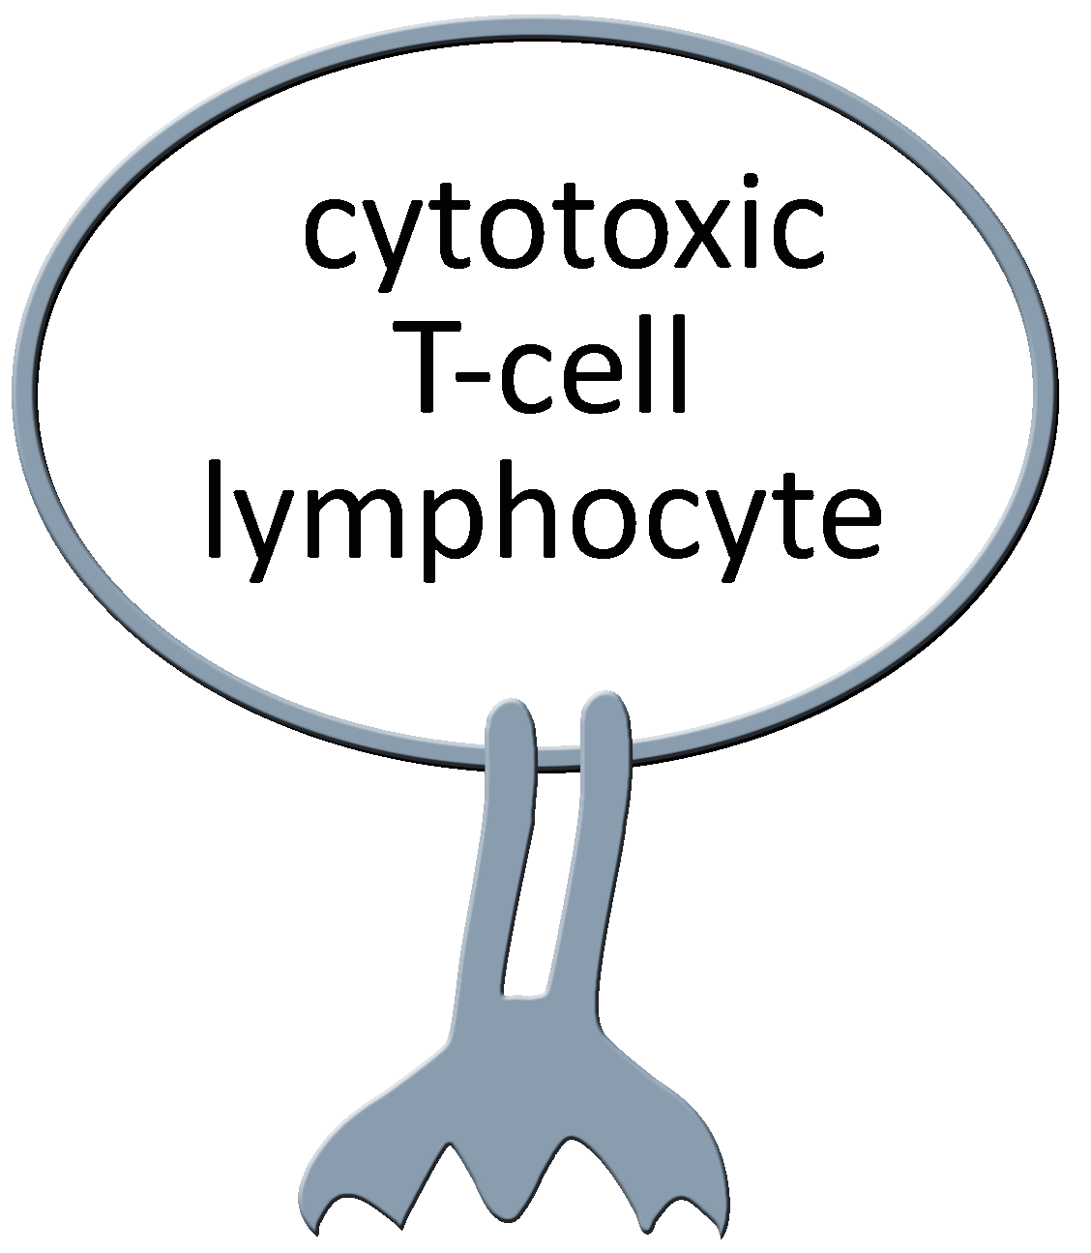
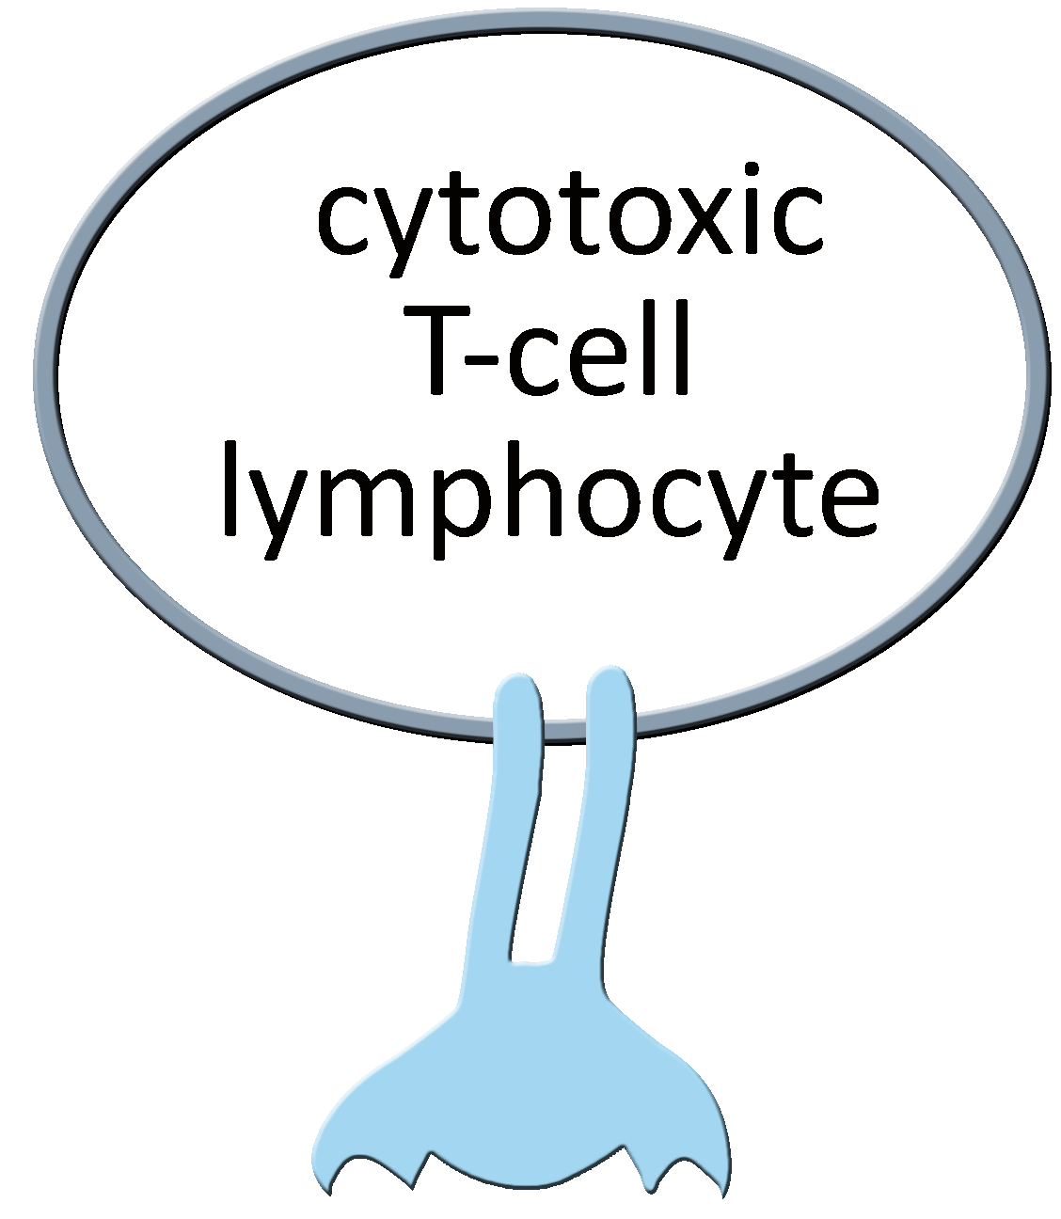
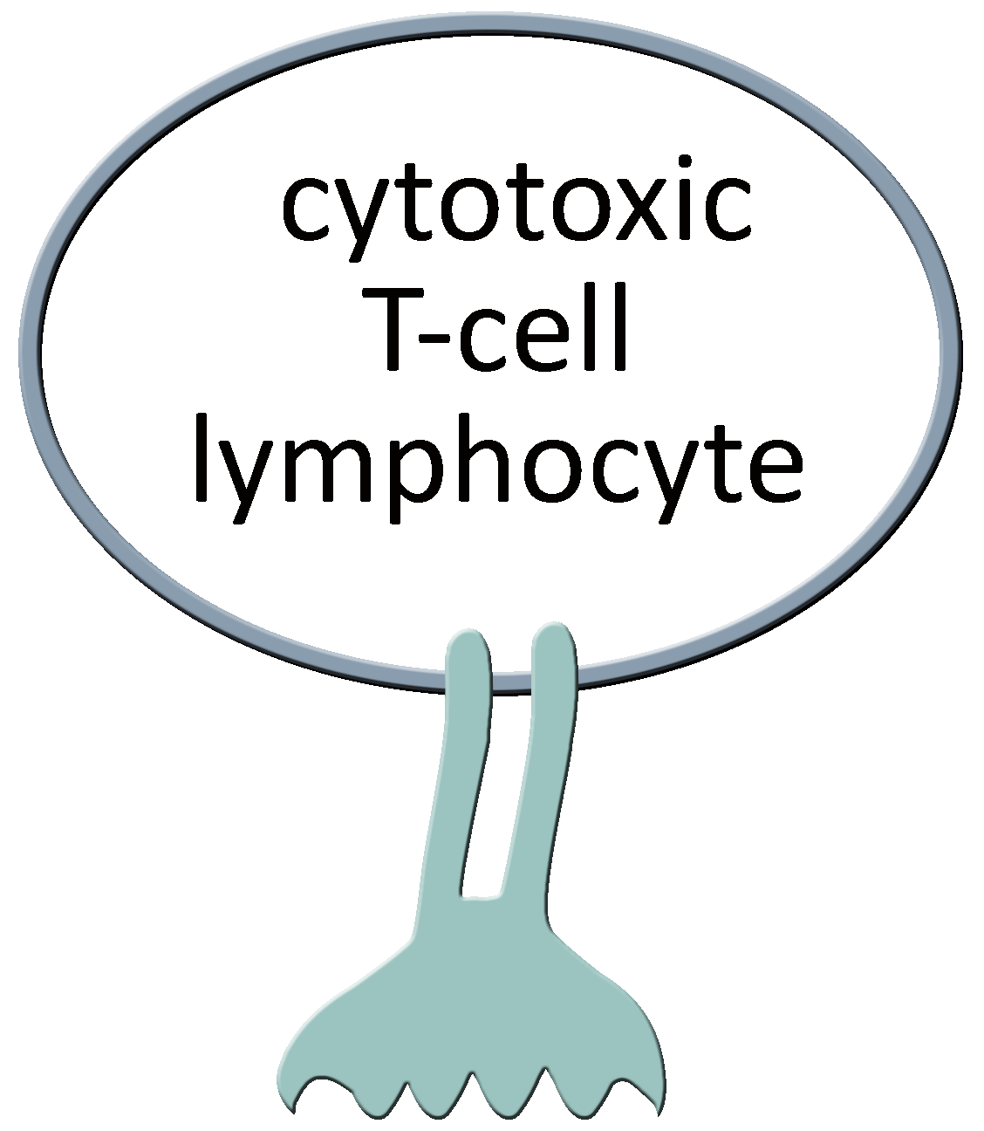
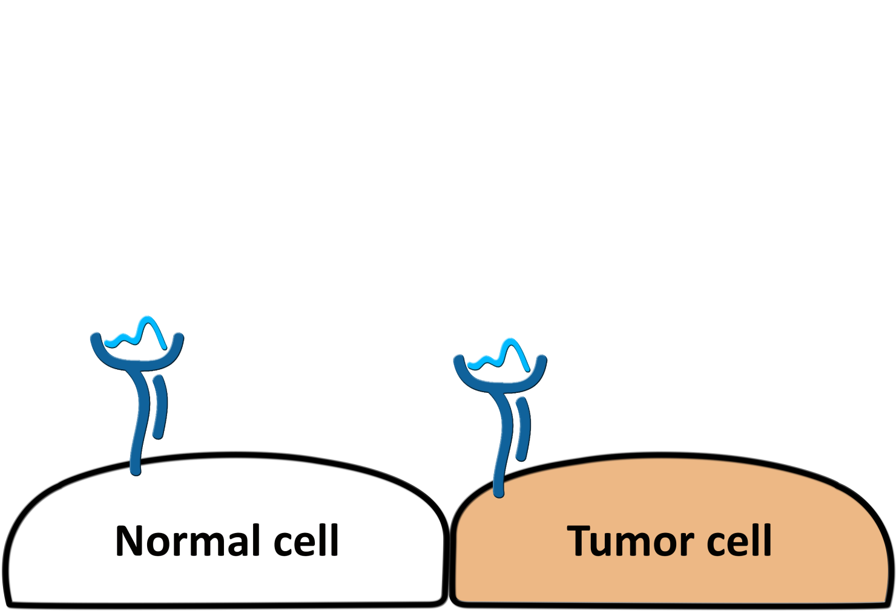
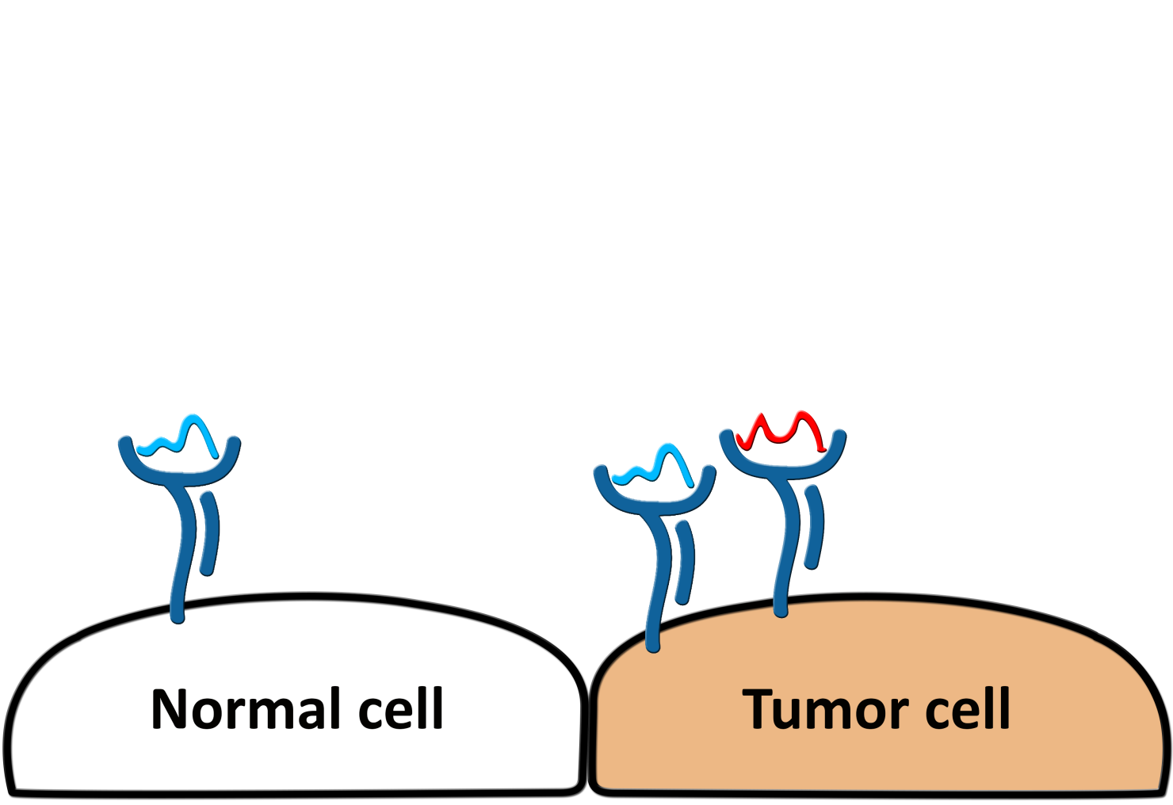
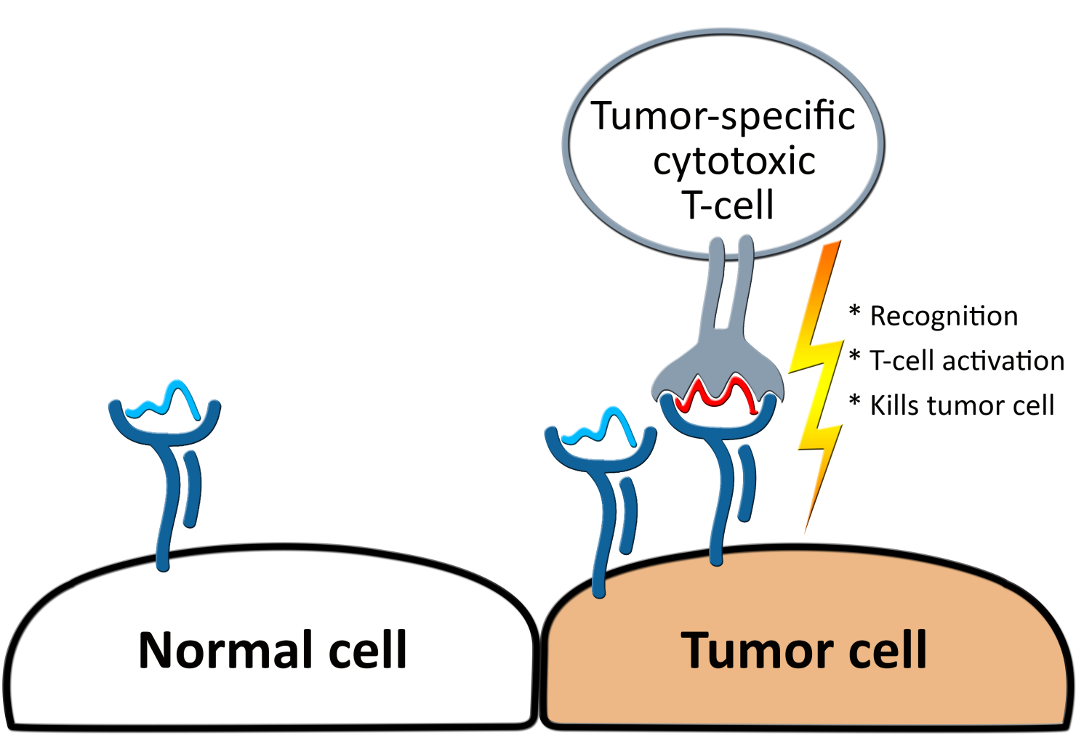
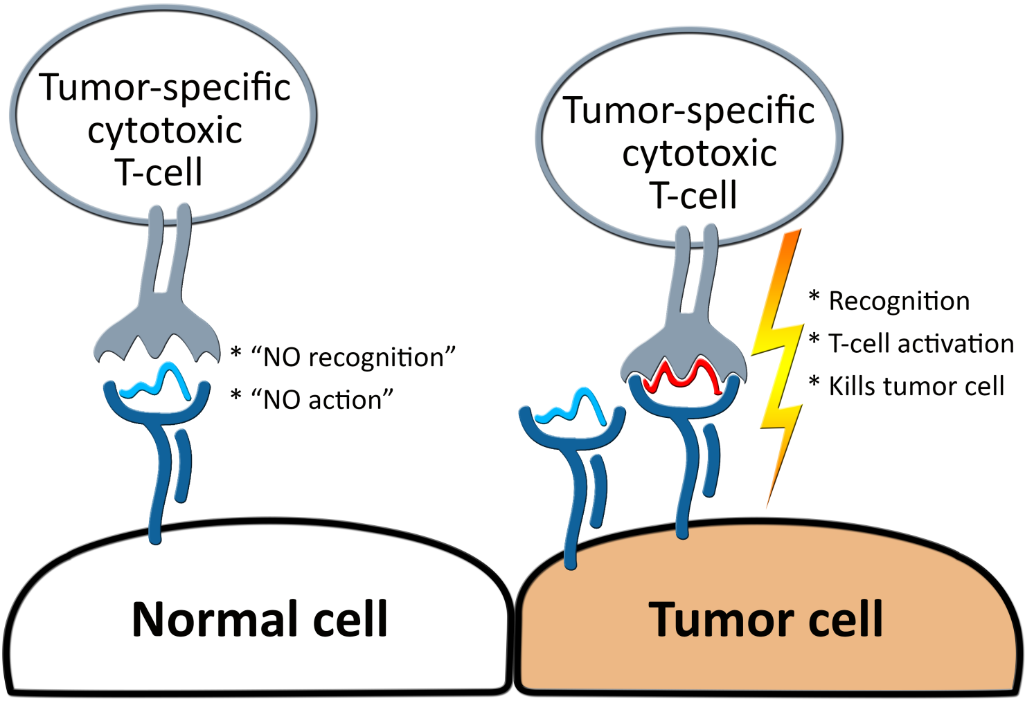
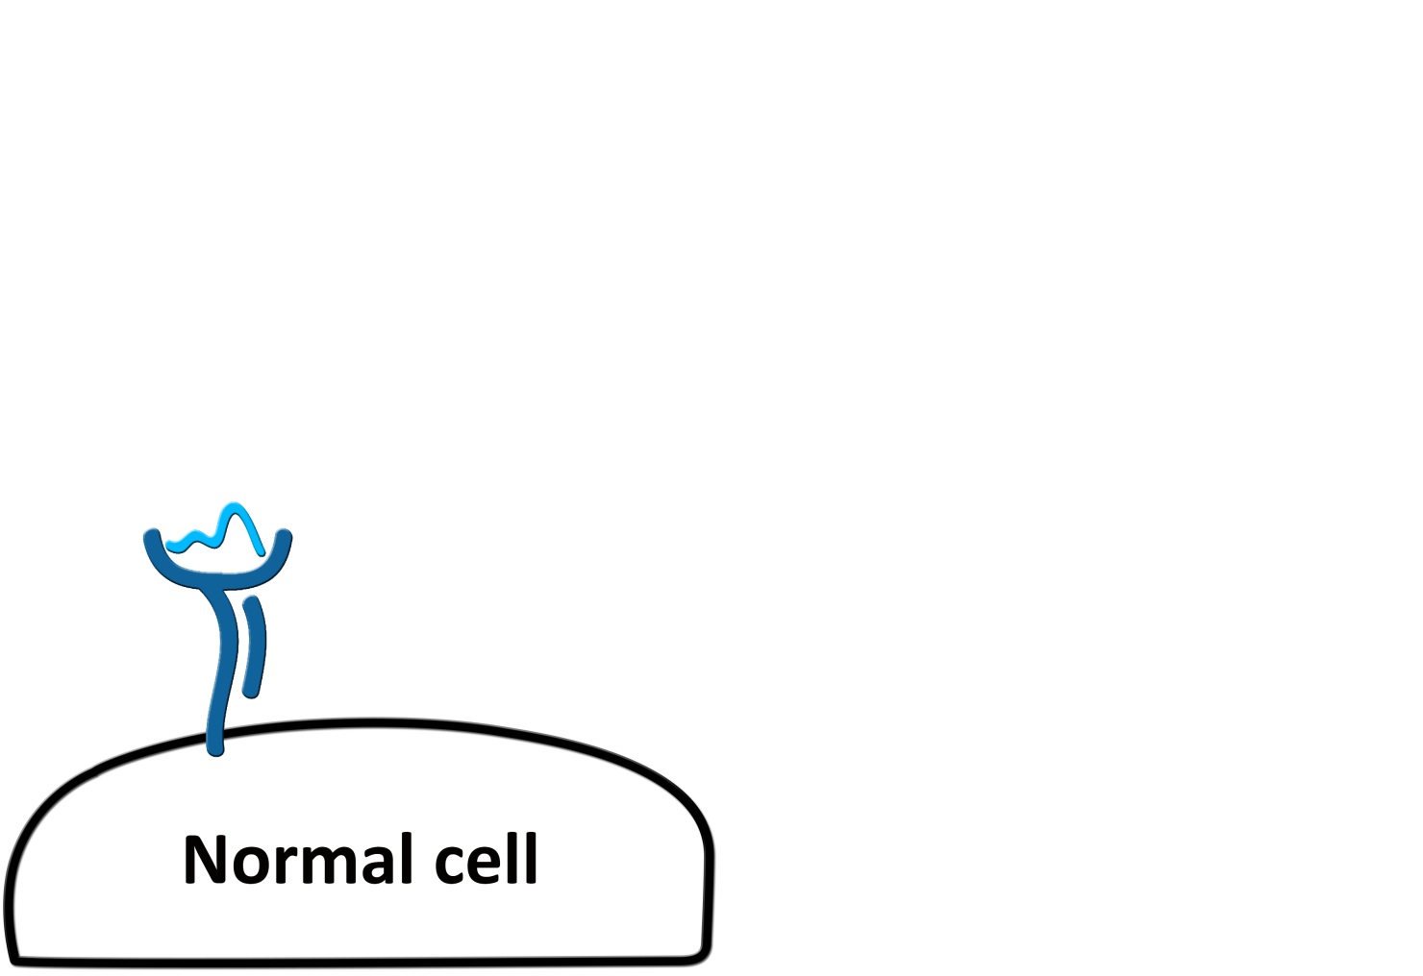
Cellular immunity to cancer
Intracellular peptides are displayed at the cell surface by HLA receptors
Cytotoxic T-cells perform surveillance against diseased cells
Cancer cells naturally present tumor-specific peptides (Lizeé et al., 2012)
TCR
peptide
peptide-HLA (pHLA) complex
Class I HLA receptor
(Human Leukocyte Antigen)
Notes:
So let’s start by the key role of the HLA molecules in cellular immunity.
There is a sort of “quality control” mechanism that is present in almost every cell, through which a sample of intracellular proteins is cleaved into small peptides, which are in turn bound to a specific family of receptors (known as Human Leukocyte Antigens, or HLAs), and the resulting peptide-HLA complexes are displayed at the cell surface.
Through this mechanism, these intracellular peptides are now exposed to immune cells, such as tumor-specific cytotoxic T cell, which which can distinguish between self and foreign peptides. This is a pathway that evolved to identify and eliminate cells infected by viruses.
However, the same pathway is also present in tumor cells, which among regular self-peptides will also present some tumor-specific peptides (red). This unusual peptides will be recognized by tumor-specific T-cells, activating the T-cell that will kill the cancer cell.
And I refer to this particular T-cell as being “tumor-specific” in the sense that in a normal situation, this cell would not recognize any self peptide. Of course things are always more complicated, you have tumor evasion mechanisms, you might have off-target recognition, but the main point is that we can leverage this natural mechanism of tumor immunity, to have a treatment that is targeting only tumor cells, and that will find them, wherever they are.
A remarkable aspect of this mechanism is that a lot of the consequences of this molecular interaction, in terms of the level of activation of the T-cell, the specificity of this recognition and so on, is highly determined by structural features of the peptide-HLA complex.
REFs:
[1] Siegel RL, Miller KD, Jemal A. Cancer statistics, 2015. CA: a cancer journal for clinicians. 2016;66(1):7–30. doi:10.3322/caac.21332.
[2] A. Rotte, M. Bhandaru, Y. Zhou, and K. J. McElwee. Immunotherapy of melanoma: present options and future promises. Cancermetastasisreviews, 34(1):115–28, mar 2015. ISSN 1573-7233. doi: 10.1007/s10555- 014-9542-0. URL: http://www.ncbi.nlm.nih.gov/pubmed/25589384. [3] G. Lizée, W. W. Overwijk, L. Radvanyi, J. Gao, P. Sharma, and P. Hwu. Harnessing the power of the immune system to target cancer. Annual review of medicine, 64:71–90, 2013. ISSN 1545-326X. doi: 10.1146/annurev-med-112311-083918. URL: http://www.ncbi.nlm.nih.gov/pubmed/23092383

Slide 3
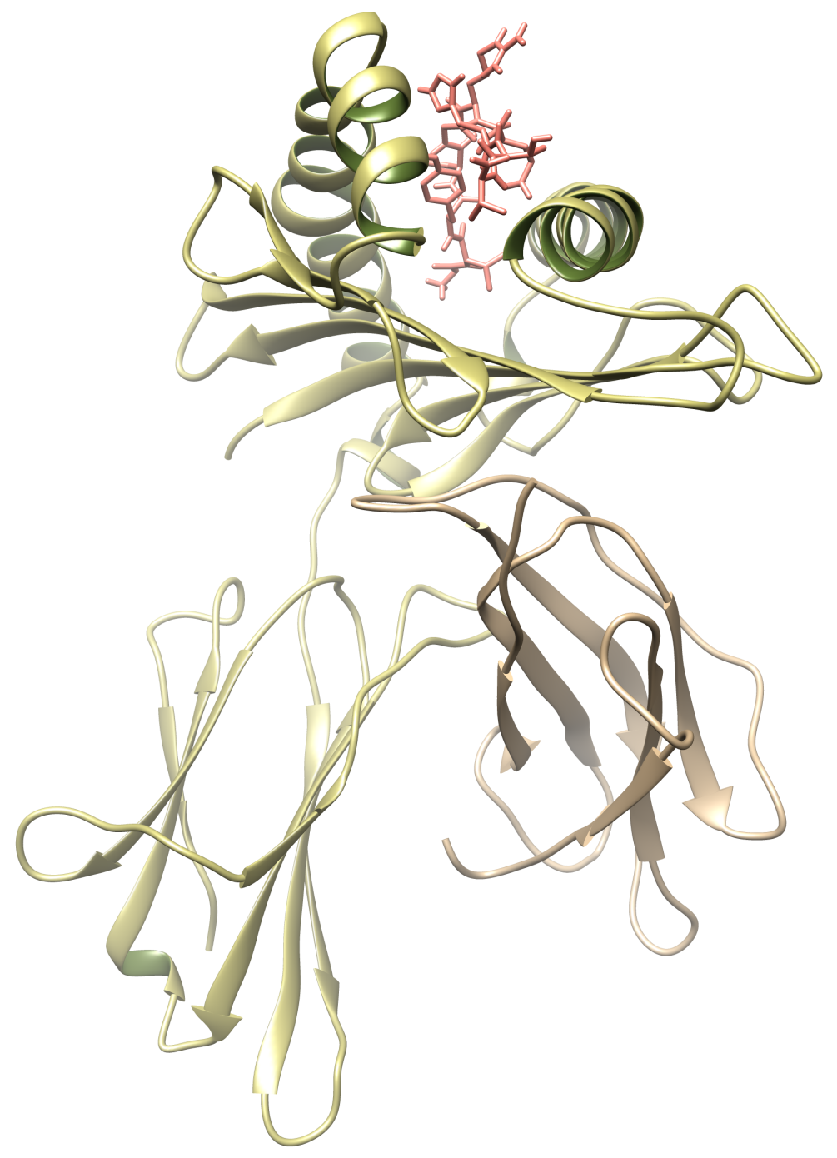
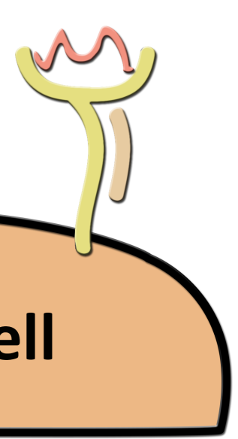

Structure of the pHLA complex (front view)
peptide
Heavy chain
(α chain)
Light chain
(β2-microglobulin)
peptide + HLA
(pHLA)
Notes:
To give you a better idea of the structure of this complex, here you have a cartoon representations of the two chains that form the HLA receptor, and a sticks representation of the peptide ligand bound to the HLA cleft.

Slide 4
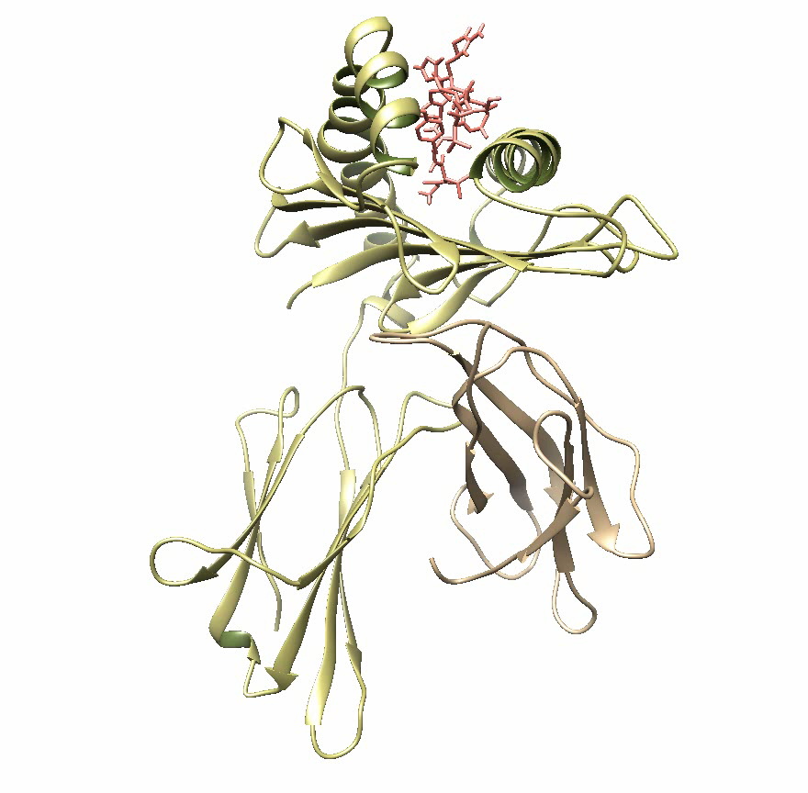
Structure of the pHLA complex
Notes:
This is the front view of the complex.
If we rotate the structure, to have a better look at the side view, we can observe the shape adopted by the ligand upon binding, or its binding mode.
And if we rotate again we can have a top view of the complex. Which can be represented in a way to show computed surface of the receptor and the exposed surface of the ligand.

Slide 5
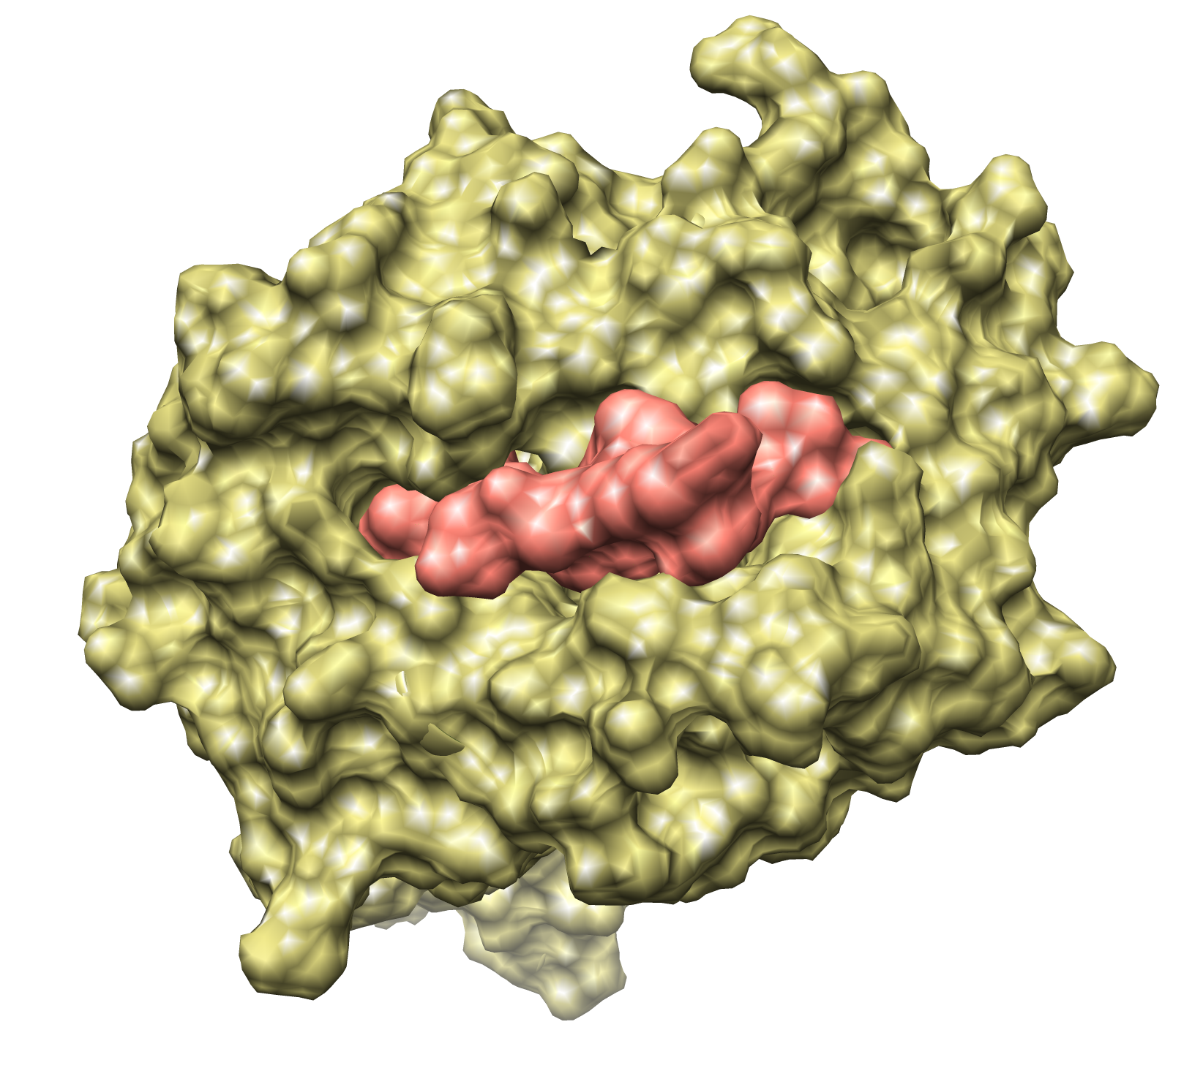
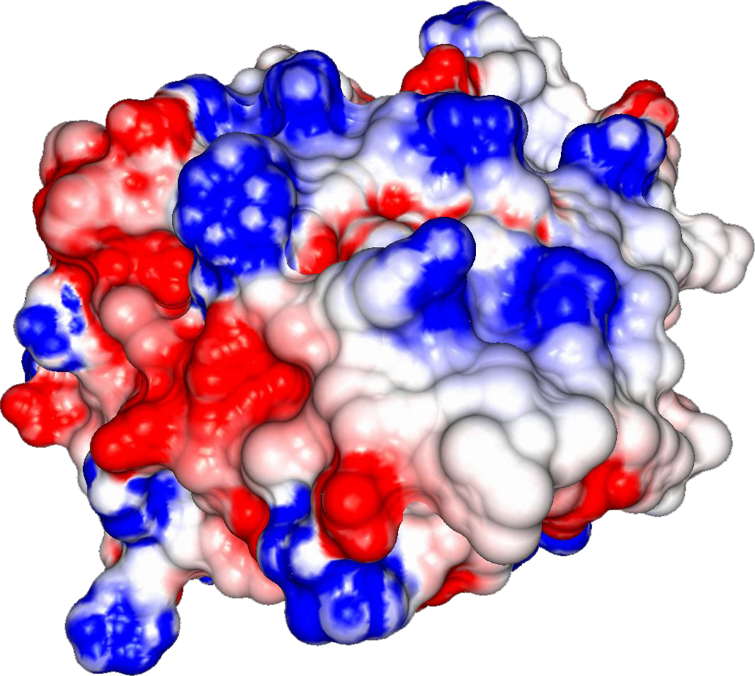
Structure of the pHLA complex (top view)
Notes:
Going one step forward, we can compute the electrostatic potential over this surface, here represented by colors (negatively charged regions in red, positive regions in blue).
This is the surface exposed for interaction with the T-cell receptor. And as you can see, there is no boundaries between ligand and receptor, it is actually one combined surface.
And this is a very important point, because each individual has a different subset of HLAs.

Slide 6
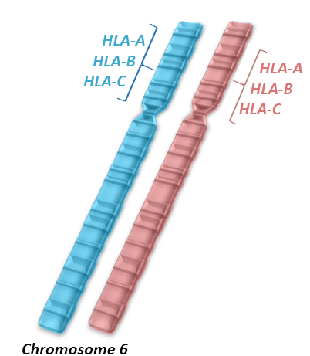
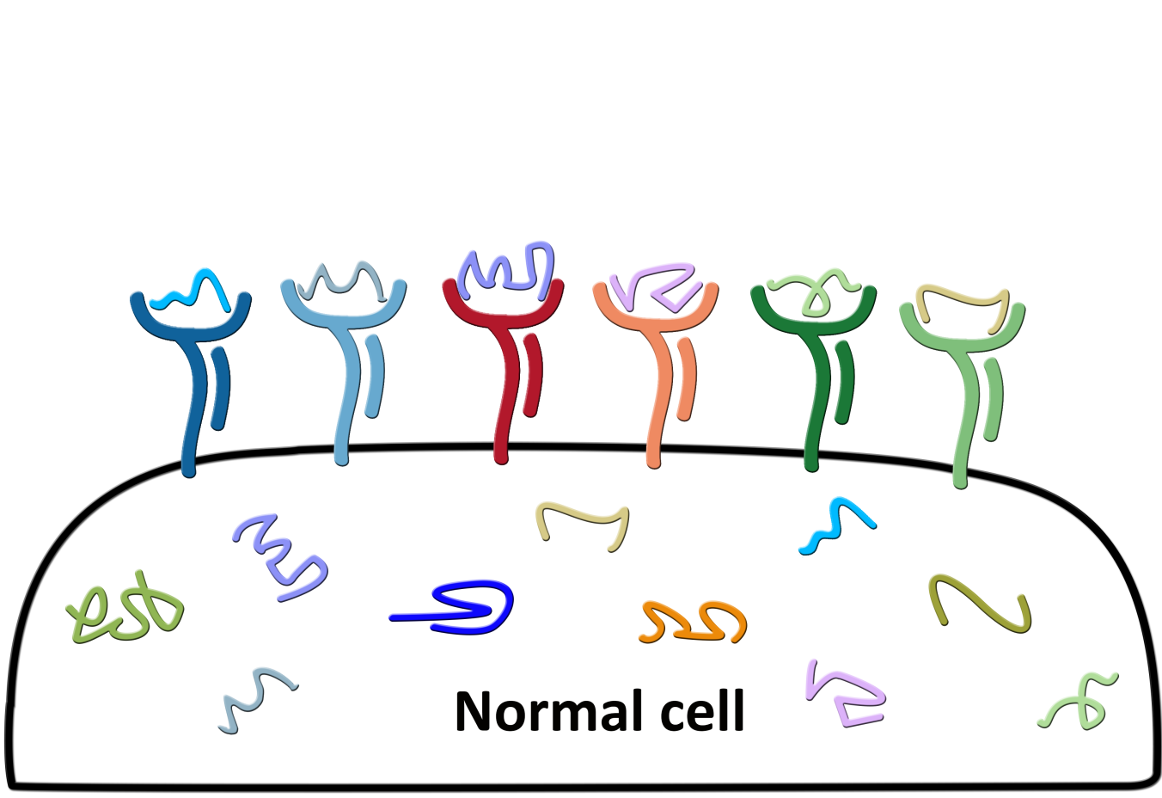
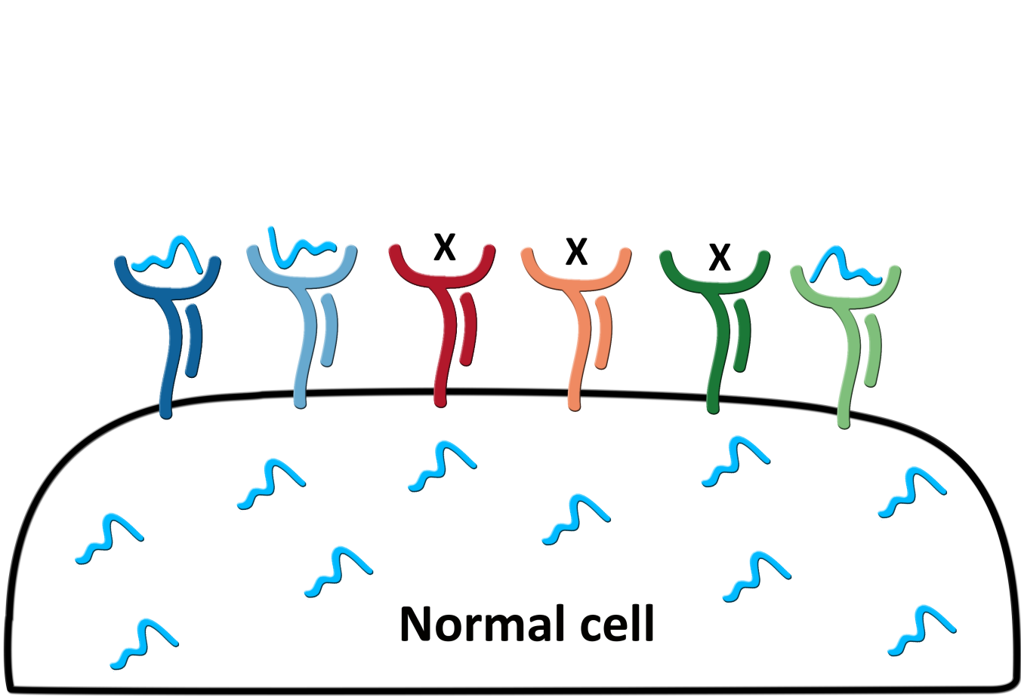
HLA diversity
More than 10,000 known alleles of class I HLAs in the human population!!!
Different HLAs display different pools of peptides
Notes:
These receptors are encoded by the most polymorphic genes in the human genome, and there are more than 10,000 alleles of the so called class I HLA genes (referred to as HLA-A, HLA-B, HLA-C). And each person will have two sets of these genes, therefore up to 6 different class I HLA receptors.
And each different HLA receptor will bind different subsets of peptides, they have affinity for different sequences. And even if you some overlap, that two HLAs can bind to the same peptide, they likely to present them in a different way.

Slide 7
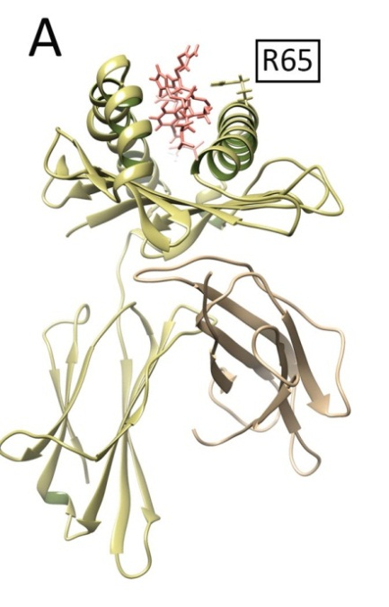
Need for personalized approaches
More than 10,000 known alleles of class I HLAs in the human population!!!
tumor-derived peptide
patient-specific HLA
T-cell-based Immunotherapy requires
personalized analyses of peptide-HLA complexes
Notes:
So if we are considering structural analyses of these complexes for immunotherapy applications, we must do it in a personalized fashion.
We must consider the HLAs of the patient and predict the tumor peptides that bind to these specific HLAs.
And this challenge is not suited for experimental methods, given the costs and time needed to perform experimental structural analyses of proteins.

Slide 8
The Problem
Perform accurate structural prediction of the binding modes of tumor-derived peptides to patient-specific HLA molecules, using computational methods
Notes:
Therefore, our goal is to use computational methods to perform…

Slide 9
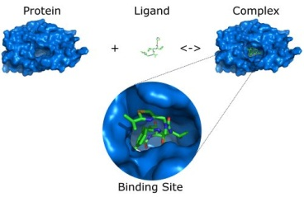
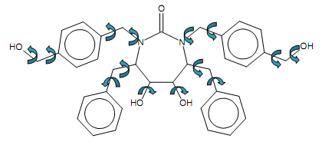
Molecular Docking
Rotation & Translation
Internal Degrees of Freedom (DoFs)
Molecular Docking Applications:
* Binding mode prediction/geometry Optimization
* Structure-based virtual screening of potential binders
Drug-like ligands DoFs.: Up to 10 DoFs
Notes:
The most obvious choice for this task is Molecular Docking, which is a computational tool to predict the binding mode of protein-ligand complexes. Besides exploring alternative orientations of the ligand, these tools also account for ligand flexibility, exploring different arrangements of all internal degrees of freedom.
These tools are commonly used to predict the structure (or geometry) of unknown complexes, and also to perform fast virtual screening of large datasets of potential ligands.
But as you might expect, the number of combinations that must be tested increases with the number of degrees of freedom. And current docking methods are mostly recommended for small drug-like ligands with up to 10 DoFs.

Slide 10
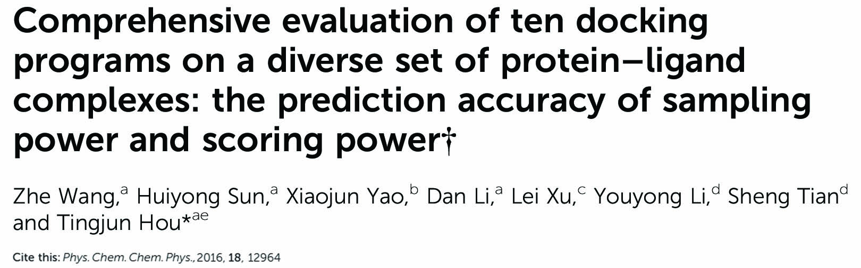
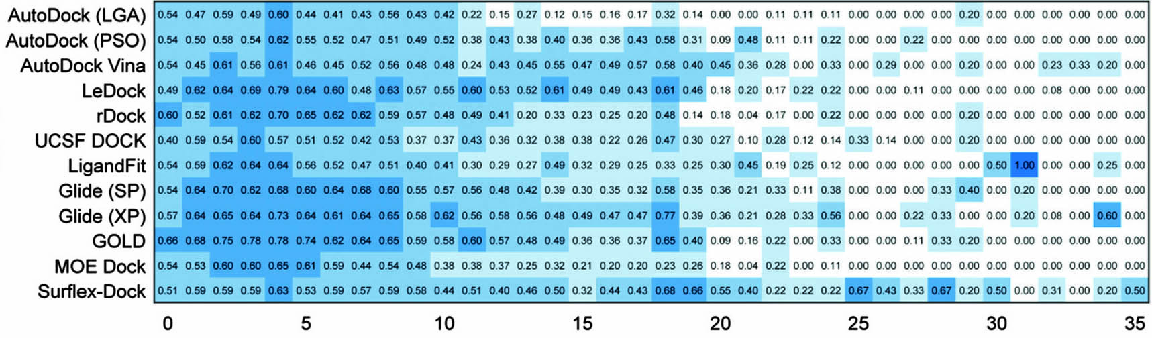
The open challenge of docking large ligands
Docking Approaches
Number of DoFs
Notes:
To give you an updated picture, this work from last year evaluated some well known docking methods (listed in the rows) using ligands of different sizes (sorted in the columns). And here you can see their results as a hitmap, the darker blue the better.
You can clearly see the performance decay after 10 DoF and after 25 DoF you have almost no good results.

Slide 11

HLA receptors bind large peptide ligands
Length.: 8 – 11 aa DoFs.: >29
Notes:
And now you can appreciate the challenge of peptide-HLA prediction, since the ligands in this context are peptides usually 8 to 11 aa long, which usually means more than 29 DoFs.

Slide 12
Docking-based prediction of pHLA complexes
* Tong et al., 2004.
* Antes et al., 2004.
* Bordner et al., 2006.
* Todman et al., 2007.
* Antunes et al., 2010.
* Bordner et al., 2010.
* Khan et al., 2010.
* Liu et al., 2014.
* Rigo et al., 2015.
ICM + loop closure
DynaPred
ICM + monte carlo
MHCSim (crystal template)
D1-EM-D2 (crystal template)
ICM + monte carlo + machine learning
ICM + monte carlo + homology modeling
FlexPepDock (crystal template)
DockTope (crystal template)
Ways to reduce dimensionality:
Use of Ad hoc approaches
Use of crystal templates
Use of HLA-specific constraints
Limited to specific HLAs
and requiring expert
guided constraints
Notes:
During the last 13 years or so, many groups have tackled this challenge
But since the flexibility of peptides is such a strong barrier for most docking-based approaches, the best alternative so far has been to provide ad hoc solutions.
Using information from crystal structures or using expert-knowledge to somehow constrain or bias the search.
Which means that these solutions only work for a few HLAs for which we have enough data. And if you remember the 10,000 HLA alleles that I have mentioned before, you will understand that a general solution is needed if we hope to provide personalized predictions

Slide 13
Docking INCrementally (DINC)
From here on was talking about DINC…
Notes:
Looking for an alternative solution, our group has developed an incremental meta-docking approach. Instead of docking the entire peptide at once, like this 8-mer with 30 DoFs, we select a small fragment of this ligand, with a small number of DoFs (indicated in green), and we run a molecular docking using a standard docking tool, such as AD4

