Slide 1
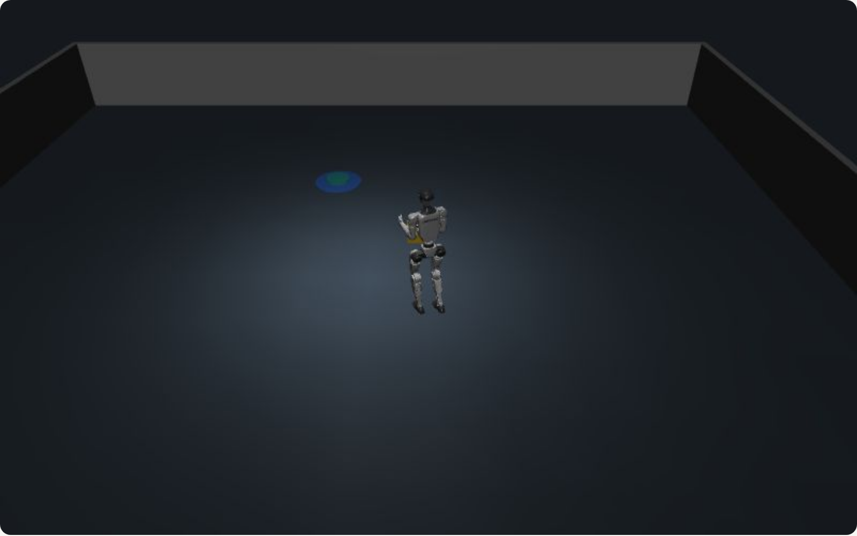
Skill progress monitoring
Catching robot failures while they happen
Pinhas Nehoray Aburmad
Ben-Gurion University of the Negev
Supervisor: Prof. Ronen Brafman
Notes:
- Robots fail in the middle of a task and don't know it.
- I build a watcher that catches the failure when it happens.
- About 10 minutes. Backup slides are hidden at the end.

Slide 2
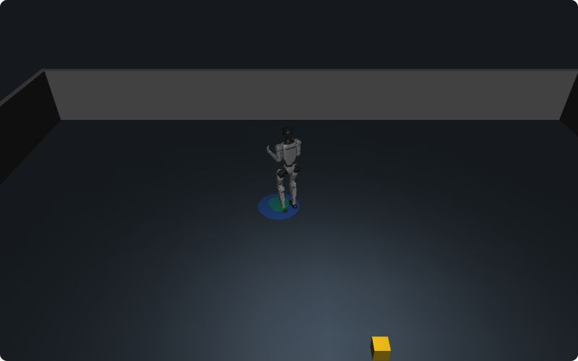
The problem
Robots often fail in the middle of a task.
They often do not notice.
They report "done" anyway.
Goal: notice the failure the moment it happens.
The robot says "done" at the drop-off (blue). The box (yellow) is still on the floor.
Notes:
- Real run: the box slipped, the robot walked on and reported success.
- The robot knows what it commanded, not what happened.
- Finding out at the end is late: the time is gone.

Slide 3
Research question
RQ: Does giving the monitor the stages of a skill make it catch failures earlier, and does that improve success?
H1: stage failures are caught earlier.
H2: with a deadline, more tasks succeed; without one, no change.
H3: it catches failures that hand-written checks miss.
H0: falls (every stage checks them): no change.
alarm, with stages
alarm, no stages
time
fault
deadline
Re-planning must finish before the deadline.
Notes:
- Do stages catch failures earlier, and does that improve success?
- H1 earlier. H2 more success with a deadline. H3 beats hand-written checks.
- H0, said in advance: falls show no change.

Slide 4
Related work: two streams
1. Skill description
2. Skill monitoring
Natural language
State machines (automata)
Formal logic (LTL, STL)
LLM reasoning
Our bridge
an LLM writes
LTL rules + stages
Videos, demos
VLM / learned detectors
Hand-written code
Hybrid (logic + images)
Most work improves one stream. Ours connects them: the description produces the monitor.
Notes:
- Two streams: how to describe a skill, and how to watch it run.
- Most work improves one stream.
- Ours: words -> LLM writes stages + rules -> monitor on the robot's sensors.
- Details per paper: hidden backup slides.
TIME CHECK: about 3 minutes here.
If asked "nothing new": nl2spec stops at a formula; ROSMonitoring needs hand-written rules. New = generated monitor with stages, on sensors.

Slide 5
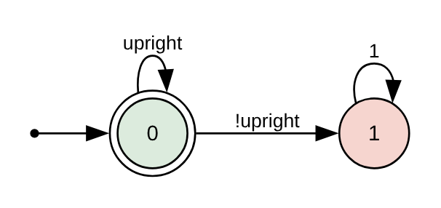
Background: what is a monitor?
A program that watches the robot's messages.
It checks rules over time, written in LTL (a logic of time).
Example: "always stay upright".
Each rule becomes a small state machine.
Problem: "eventually deliver" never fails early.
"Always upright" as a state machine. One fall moves it to state 1 (red), forever.
Notes:
- LTL: G = always, F = eventually. Each rule becomes a small automaton.
- "Always upright" fails the moment the robot falls.
- "Eventually deliver" can never fail early. That's the gap.

Slide 6
Our idea: the stages of the task
Each stage has its own rules and its own time limit.
Walk to box
≤ 45 s
Grasp
≤ 10 s
Carry
≤ 60 s
must hold box
Place
≤ 10 s
Done
Failure: a rule broke, too slow, or stuck
While carrying, the robot must hold the box. A drop is caught at once.
Notes:
- Each stage: must-hold rules, a time limit, progress.
- Carry: "holding" must stay true, so a drop is caught the next second.
- Without stages you can't say "must hold": it is false at the start.
- Written by the LLM from plain words.

Slide 7
Formal model: specification and monitor
Labelling: each tick, σₜ = L(oₜ) ⊆ AP (true facts from sensors).
Spec: S = ⟨AP, Φ, M, Π, succ, fail⟩: LTL task rules Φ, safety rules M, phases Π.
Phase: πᵢ = ⟨enterᵢ, invᵢ, progᵢ, exitᵢ, Tᵢ, kᵢ⟩.
Monitor state: m = ⟨i, c, v, q₁…qₙ⟩ (phase, time in it, progress misses, rule states).
Update on σ: every rule steps, qⱼ ← δⱼ(qⱼ, σ); fault if σ ⊭ invᵢ or c ≥ Tᵢ or v ≥ kᵢ; next phase if σ ⊨ exitᵢ.
robot messages oₜ
labels σₜ = L(oₜ)
phase check: invᵢ, Tᵢ, kᵢ
rules: qⱼ ← δⱼ(qⱼ, σₜ)
verdict → action
One tick of the monitor (1 Hz).
Notes:
- Each second: sensors -> facts -> every rule takes one step.
- A stage fails if a must-hold rule breaks, time runs out, or no progress (3 misses).
- This is exactly what the code does.
If asked "one automaton?": no, one monitor: a stage machine beside separate small automata.
If asked "P1 is a tautology": yes, by design. The rule exists only with stages. LTL alone 14 s, stages 1 s.

Slide 8
The decision view: a POMDP
Hidden s: what really happens (stage, box held?).
Seen o: the robot's messages.
Belief b: our best guess of s.
Action a: continue, stop, or re-plan.
Hidden s
true stage, box held?
Z
Seen o
noisy robot messages
T
update
Belief b
stage + rule states
b′(s′) ∝ Z(o | s′) · Σₛ T(s′ | s, a) · b(s)
decide
Today: a point belief (stage + rule states).
Value of information: on time only if latency + recovery ≤ time left.
Action a
continue / stop / re-plan
[Planning and Acting in Partially Observable Stochastic Domains, Kaelbling, Littman, Cassandra, 1998]
Notes:
- The stage is hidden state: "not holding" is normal while walking, a failure while carrying.
- Early detection helps only with a deadline. Predicted, then measured: 64/36 with, 82/84 without.
- Say first: today the belief is a single point.
TIME CHECK: about 6 minutes here.
If asked "decorative?": I don't solve it; it predicted the deadline effect, including no effect without one.

Slide 9
Method: how the monitor is built and run
Task in words
"walk to the box, pick it up"
An LLM
writes the stages and rules
Spot (a tool)
rules → state machines
Monitor
checks once a second
Alarm
report, stop or re-plan
Robot messages (ROS 2): position, laser, box position
The rules are written automatically, from the task in words.
The monitor uses only sensors. It never asks the planner.
Notes:
- The LLM writes the spec once; it is checked and frozen before any run.
- Checks: it loads, and every fact maps to a real sensor.
- The monitor reads only sensors, never the planner.
If asked "why trust the LLM?": checked, readable, frozen. Gap: rules that run but are wrong (3 false alarms of 40). Fix: accept a spec only after clean runs.

Slide 10
Experiment: fetch and deliver (3360 runs)
G1 humanoid in MuJoCo, over ROS 2.
Box dropped: caught after 1 s with stages, 14 s without.
Grasp failed: 4 s vs. 19 s.
Earlier in all 20 runs.
Middle value (median) of 20 runs for each failure.
Notes:
- G1 in MuJoCo, ROS 2, failures caused on purpose.
- Drop: 1 s vs 14 s, because Carry requires holding.
- Grasp: 4 s vs 19 s. Earlier in all 20 runs.
If asked "flat is a straw man": true, an expert could write it in LTL; flat is an ablation. The claim is who writes it: hand-written checks missed 40 of 40.
If asked about statistics: the claim comes from the model; the runs confirm it, 20 of 20. No p-values.

Slide 11
Does catching early matter?
No time limit: all monitors ≈ 82–84%.
With a time limit: 64% with stages, 36% without.
Hand-written checks: 81%, but someone must predict every failure.
160 runs per bar. Early knowledge pays when time matters.
Notes:
- No deadline: everyone about 83%, because a late re-plan still works.
- Deadline: 64% vs 36%. LTL alone: 36%.
- Hand-written checks 81%, but only for failures someone foresaw: they missed 40 of 40 unplanned ones.

Slide 12
Hypotheses and results
Hypothesis | Result | Verdict
H1: earlier detection | drop 1 vs. 14 s; grasp 4 vs. 19 s; 20 of 20 runs | supported
H2: more on-time success | 64% vs. 36% with a deadline; 82% vs. 84% without | supported
H3: beyond hand-written checks | 40 of 40 missed → 0 of 40 | supported
H0: falls unchanged | 1 s in every version | as predicted
Not caught | too slow, detours, skipped pick-up | reported
Notes:
- Each hypothesis was written down before the run.
- H1, H2, H3 supported. H0 as predicted.
- Missed: slowness, detours. I report them.
TIME CHECK: about 9 minutes here.
If asked "circular?": the spec came from words, not the faults; unplanned failures 40 -> 0; I report misses.

Slide 13
To be done
Continuous MiniGrid
+ MAAOS (done)
MuJoCo G1
(now)
Isaac Sim
(next)
Real G1
+ TRAV navigation
Fix what we found: better time limits; progress toward each stage's goal.
More tests: more tasks, more rule sets, specs from several LLMs.
The full POMDP: camera, real probabilities, best decisions.
Limits today: grasp and camera are simulated; thresholds not tuned.
Notes:
- MiniGrid + MAAOS (done) -> MuJoCo (now) -> Isaac Sim -> real G1.
- Calibrate limits; specs from several LLMs; full POMDP with a camera.
- Stop: "Thank you. Questions?"
If asked "weakest part?": one spec per skill from one LLM; next, several LLMs. The stages work even if a person writes them.
If asked "1 Hz is too slow": not reflex safety; the balance controller handles falls. Task decisions take seconds.
If asked "who chose 0.3/0.5?": not the LLM; "holding" is in the robot dictionary, once per robot. The LLM's own thresholds aren't calibrated yet.

Slide 14
Backup slides
Hidden. Jump here only to answer a question.
Notes:
Hidden slides: related work, model predictions, unplanned failures, one run, Experiment 1, test beds, demo, references, Q&A cheat sheet.

Slide 15
Stream 1: describing a skill
Way | Examples | What is missing
Natural language | [Grounding Complex Natural Language Commands for Temporal Tasks in Unseen Environments, Liu et al., 2023] [nl2spec: Interactively Translating Unstructured Natural Language to Temporal Logics with LLMs, Cosler et al., 2023] [NL2TL: Transforming Natural Languages to Temporal Logics using LLMs, Chen et al., 2023] [NL2LTL: A Python Package for Converting Natural Language Instructions to LTL Formulas, Fuggitti, Chakraborti, 2023] [GinSign: Grounding Natural Language Into System Signatures for Temporal Logic Translation, English et al., 2025] | Made for planning or writing specs; no stages; words must be tied to sensors
Formal logic (LTL, STL) | [Runtime Verification for LTL and TLTL, Bauer, Leucker, Schallhart, 2011] [RTAMT: Runtime Robustness Monitors with Application to CPS and Robotics, Yamaguchi, Hoxha, Ničković, 2024] | An expert writes every rule; flat rules, no stages
Videos / demos | [Learning Task Specifications from Demonstrations, Vazquez-Chanlatte et al., 2018] [RoboCLIP: One Demonstration is Enough to Learn Robot Policies, Sontakke et al., 2023] | Need examples; the result is hard to read or edit
Hand-written code | Our baseline: checks written inside the robot program | Someone must foresee every failure
Notes:
- Words to logic (Lang2LTL, nl2spec, NL2TL): stop at a formula, for planning or spec writing. No stages, nothing running on a robot.
- nl2spec: 16 of 36 alone, 31 of 36 with a human fixing it.
- Logic by experts: precise, but a person writes every rule, and the rules are flat.
- Videos/demos: need examples; hard to read or edit.
- Hand-written checks: 81% on foreseen failures, silent on unforeseen ones (40 of 40).

Slide 16
Stream 2: monitoring a skill
Way | Examples | What is missing
State machines | [Runtime Verification for LTL and TLTL, Bauer, Leucker, Schallhart, 2011] [ROSMonitoring: A Runtime Verification Framework for ROS, Ferrando et al., 2020] [RTAMT: Runtime Robustness Monitors with Application to CPS and Robotics, Yamaguchi, Hoxha, Ničković, 2024] [Reelay: Online Temporal Logic Monitoring Framework, Ulus, 2026] [Runtime Verification with State Estimation, Stoller et al., 2011] | No stages: "eventually" waits to the end; rules by hand
LLM reasoning | [REFLECT: Summarizing Robot Experiences for Failure Explanation and Correction, Liu, Bahety, Song, 2023] | Slow; can be wrong; says "wrong", not "where"
VLM / learned | [AHA: A Vision-Language-Model for Detecting and Reasoning Over Failures in Robotic Manipulation, Duan et al., 2025] [FailSafe: Reasoning and Recovery from Failures in VLA Models, Lin et al., 2025] [Foresight: Failure Detection for Long-Horizon Robotic Manipulation, Zhang et al., 2026] | Need training data; black box
Hybrid | [Runtime Monitoring of Perception-Based Autonomous Systems via Embedding Temporal Logic, Kapoor et al., 2026] | Facts not human-readable
Notes:
- Bauer 2011: LTL3 (true / false / ?), which we build on. ROSMonitoring, RTAMT: engines for hand-written rules. None knows the task's stages.
- REFLECT explains a failure after the fact. In our MiniGrid pilot a free-text LLM judge gave +0.
- AHA, FailSafe, Foresight: need failure data, give no readable reason.
- Our gap: rules from plain words + task stages + only the robot's own sensors.

Slide 17
Model predictions vs. measurements
Property (from the model) | Prediction | Measured
P1. A broken stage rule fails at the tick it is seen. | Drop caught at once. | 1 tick (20 of 20)
P2. "Eventually" rules have no failing state. | LTL alone misses the drop until the end. | LTL only: 14 ticks
P3. A stuck stage fails within its time limit. | Failed grasp caught by Grasp's 10 s. | 4 ticks vs. 19
P4. "Holding" can't be a whole-task rule. | Flat spec sees the drop only at the end. | Flat: 14 ticks
P5. Rules every stage shares are in the flat spec too. | Falls: no difference. | 1 tick, all versions
The results follow from the model; they are not a lucky outcome.
Notes:
- P1: the rule is checked every tick and fails on the first false tick.
- P2: any unfinished run can still finish, so LTL3 says "?". Spot's automaton: 6 states, no rejecting state.
- P3: the time counter grows each tick; the stage fails at its limit.
- Say it yourself: stages add no expressiveness. G(grasped -> (holding U near_dropoff)) is LTL. The LLM writes it because stages ask "what must stay true here?"

Slide 18
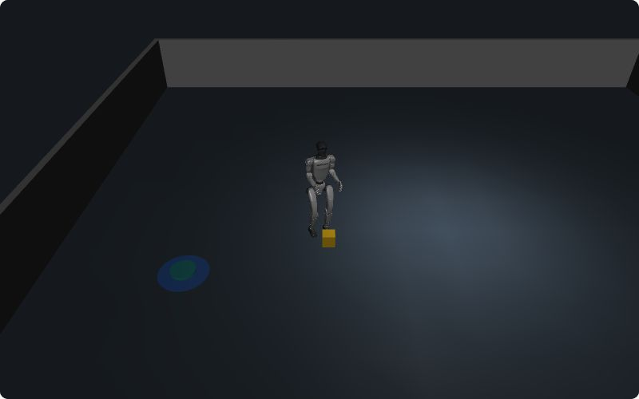
Failures nobody planned for
Box left at the wrong place; robot too close to a wall.
Hand-written checks: 40 of 40 missed.
With our monitor: 0 of 40 missed.
Missed by all: too slow, or a long detour.
The box is far from the drop-off (blue), yet the robot says "done". Our monitor catches it.
Notes:
- New failures, not covered by the hand-written checks; predictions written before the run.
- Wrong drop-off: the robot's own idea of the drop-off is wrong, so its own check passes.
- 40 of 40 silent -> 0 of 40, no cost elsewhere.
- Missed by everyone: slowness, detours. My "slow" prediction was wrong; say so.

Slide 19
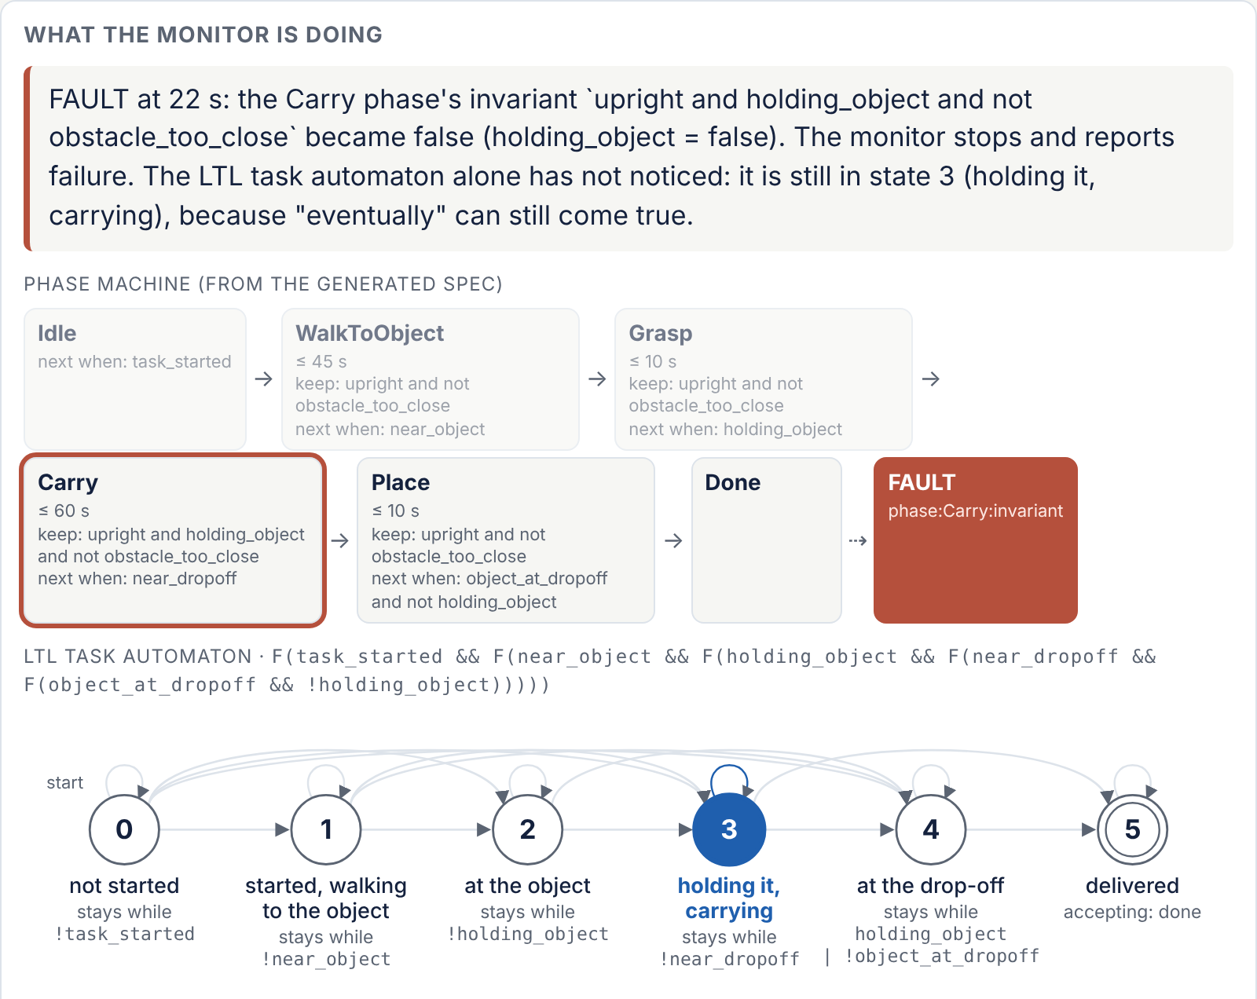
One run, second by second
21.6 s: the box drops.
22 s: the Carry rule breaks. Alarm.
The plain LTL rule still waits: "maybe later".
The stage caught it.
From the live demo (one run). The current stage and state are lit.
Notes:
- One run from the live demo page (seed 0).
- Top: stages, Carry in red. Bottom: the 6-state automaton, still in state 3: it has no failing state.
- The stage catches what LTL alone can't.

Slide 20
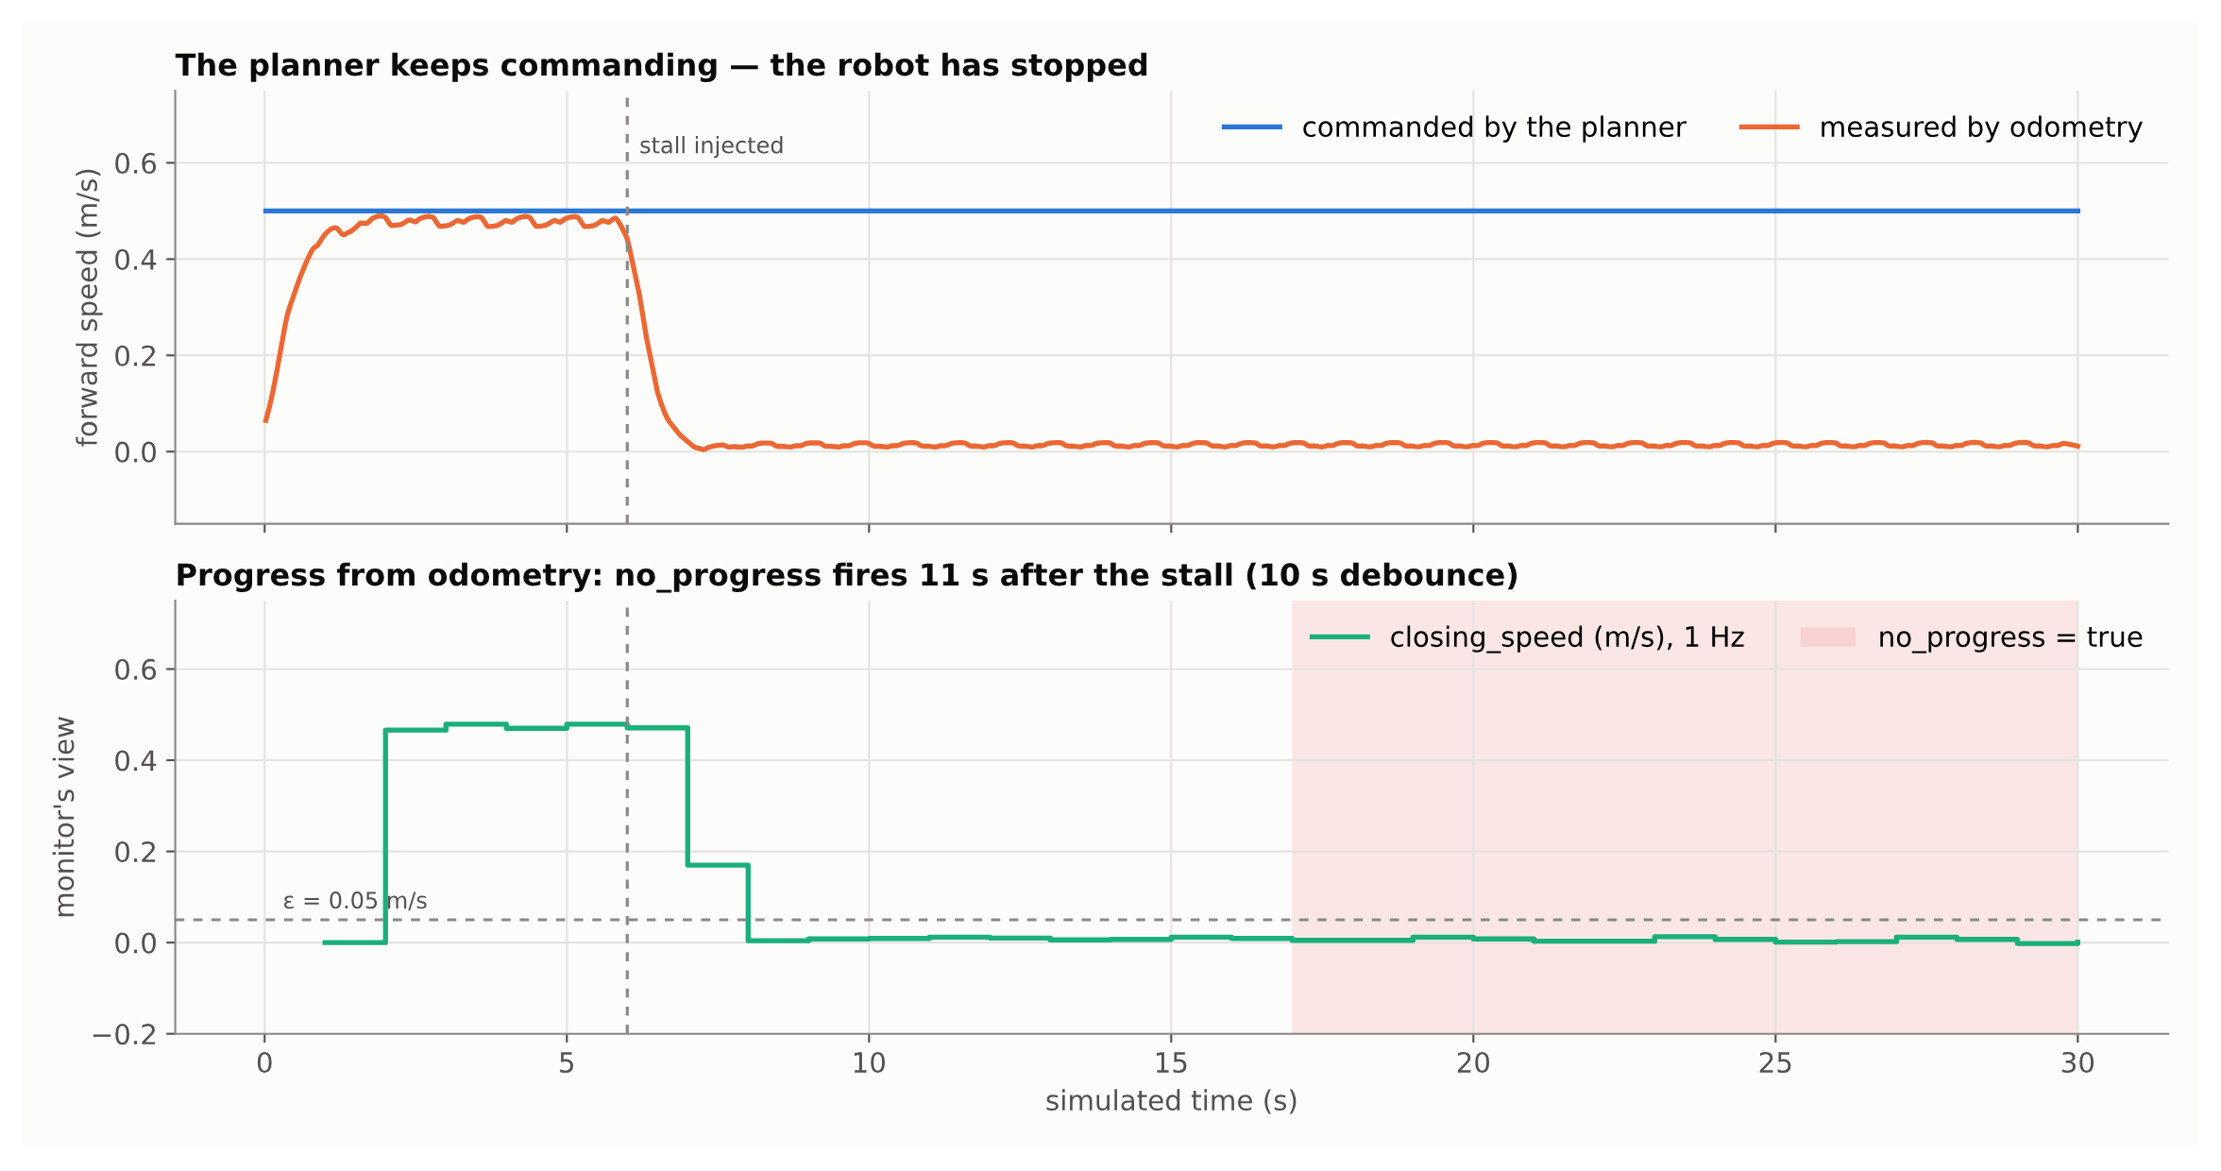
Experiment 1: a short walk (1800 runs)
Stages helped little here: 15 vs. 14 of 15 stalls caught.
What mattered: measure progress from the robot's sensors.
Without that: only 1 of 15 caught.
The planner still says "go". The robot has stopped. The monitor sees no progress.
Notes:
- 10 failure types x 20 seeds x 3 versions x 3 reactions = 1800 runs.
- Falls caught in 1-7 s by every version.
- Stalls: with progress check 15/15, flat 14/15, without progress 1/15.

Slide 21
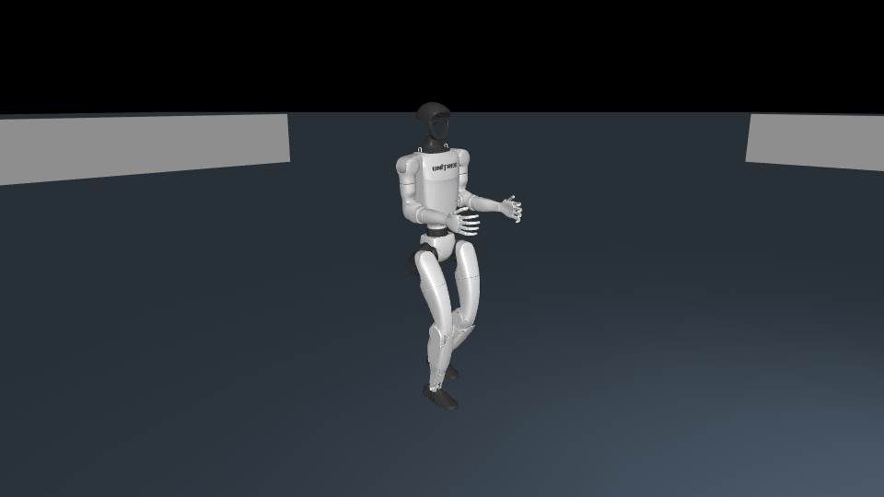
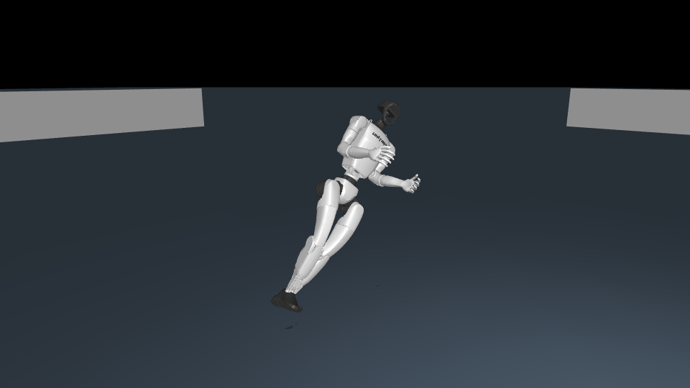
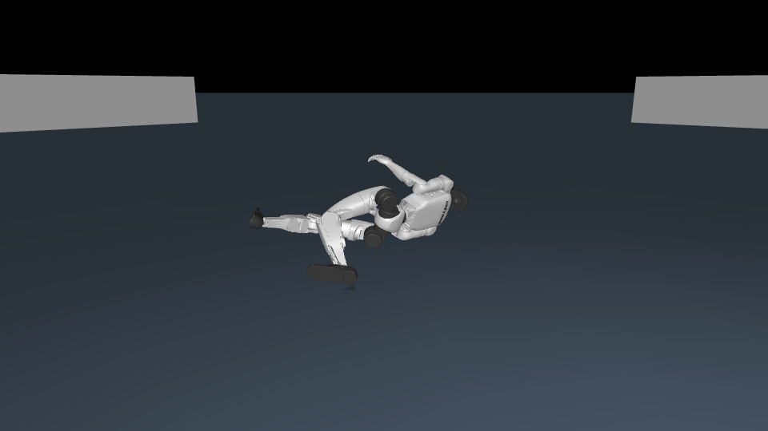
Test bed: a humanoid robot in MuJoCo
Unitree G1 robot in the MuJoCo physics simulator.
We cause failures on purpose: push, stall, drop, failed grasp.
We compare the monitor with stages and without.
Walking → pushed → fallen. The simulator knows the truth; the monitor does not.
Notes:
- The G1 walks with Unitree's own controller.
- "Without stages" = same spec, stages merged into one: same facts, same rules.
- Success is judged by the simulator's truth, which the monitor never sees.

Slide 22
First test bed: continuous MiniGrid + MAAOS
Box pushing in a continuous MiniGrid, with MAAOS (Fouzi's multi-agent planner; I integrated it).
One agent, or two agents pushing together.
Wrong plan or deadlock: monitor + re-plan fixed every seed.
A free-text LLM judge: no gain. It says "wrong", not where.
No false alarms on clean runs.
A
B
Two agents (A, B) push a heavy box to the goal (green) and avoid lava (red).
Notes:
- Pilot, now frozen. Continuous MiniGrid with MAAOS (Fouzi's multi-agent project).
- Corrupted plan: re-plan fixes every seed (+1.00). Deadlock: LTL + re-plan recovers every seed (~45 steps).
- Detect only: +0. Free-text LLM judge: +0. Clean runs: no false alarms.
- Say it yourself: scripted plans, not the live MAAOS planner; one rule I wrote was too strict, and I fixed it.

Slide 23
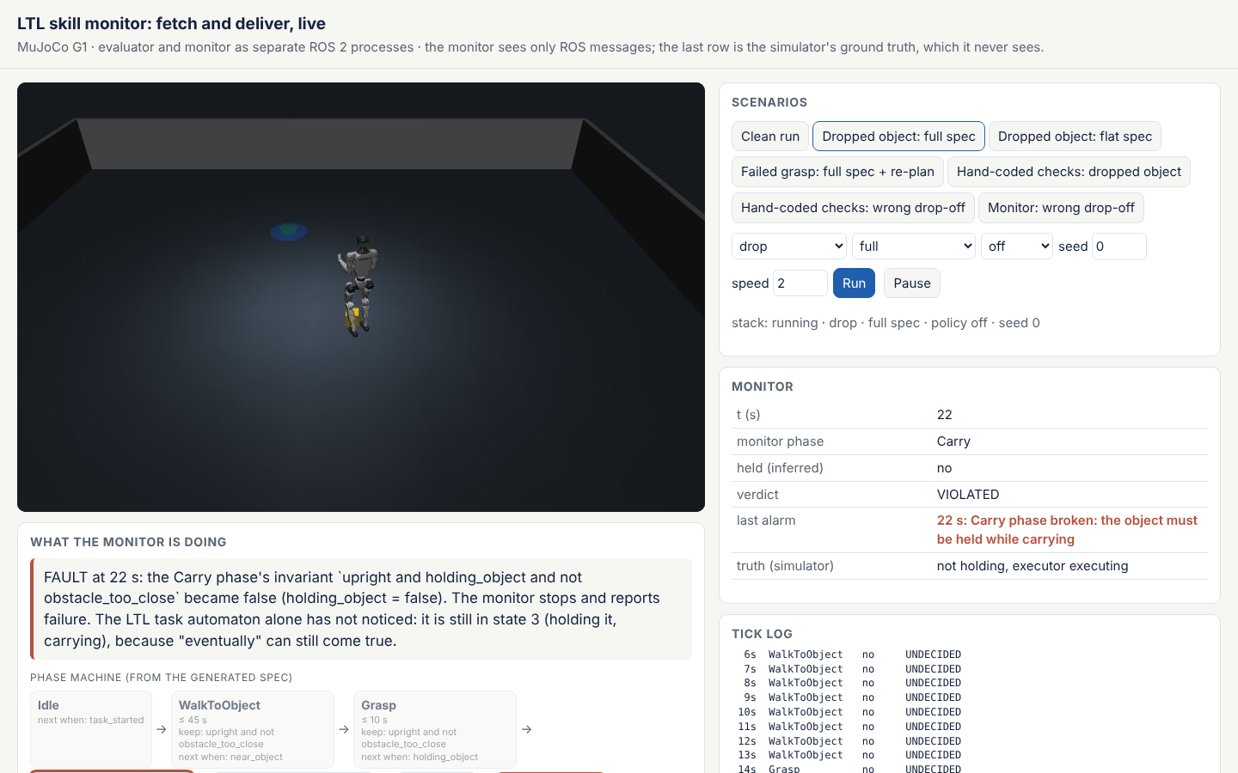
What we learned, and the live demo
Stages catch failures when they happen.
Early alarms help when time matters.
Rules come from words, so failures nobody planned for are caught too.
Use the robot's own sensors, not the planner.
Live demo, one command:
docker run -p 8080:8080 ghcr.io/pinhas019/ltlmonitor-demo
Notes:
- Demo: open localhost:8080, click "Dropped object: full spec", press Pause at 22 s.
- The page draws the stages and the automaton live, from the monitor's own ROS 2 messages.

Slide 24
References
[Runtime Verification for LTL and TLTL, Bauer, Leucker, Schallhart, 2011]
[NL2TL: Transforming Natural Languages to Temporal Logics using Large Language Models, Chen, Gandhi, Zhang, Fan, 2023]
[nl2spec: Interactively Translating Unstructured Natural Language to Temporal Logics with Large Language Models, Cosler, Hahn, Mendoza, et al., 2023]
[AHA: A Vision-Language-Model for Detecting and Reasoning Over Failures in Robotic Manipulation, Duan et al., 2025]
[GinSign: Grounding Natural Language Into System Signatures for Temporal Logic Translation, English, Walker, Simon, Ewetz, 2025]
[ROSMonitoring: A Runtime Verification Framework for ROS, Ferrando, Cardoso, Fisher, Ancona, et al., 2020]
[NL2LTL: A Python Package for Converting Natural Language Instructions to LTL Formulas, Fuggitti, Chakraborti, 2023]
[Planning and Acting in Partially Observable Stochastic Domains, Kaelbling, Littman, Cassandra, 1998]
[Runtime Monitoring of Perception-Based Autonomous Systems via Embedding Temporal Logic, Kapoor, Hammer, Kapoor, et al., 2026]
Notes:
Every entry is a link. Don't read them out.

Slide 25
References (cont.)
[FailSafe: Reasoning and Recovery from Failures in Vision-Language-Action Models, Lin, Duan, Fang, Fox, et al., 2025]
[Grounding Complex Natural Language Commands for Temporal Tasks in Unseen Environments, Liu, Yang, Idrees, Liang, et al., 2023]
[REFLECT: Summarizing Robot Experiences for Failure Explanation and Correction, Liu, Bahety, Song, 2023]
[RoboCLIP: One Demonstration is Enough to Learn Robot Policies, Sontakke, Zhang, Arnold, et al., 2023]
[Runtime Verification with State Estimation, Stoller, Bartocci, Seyster, Grosu, Havelund, Smolka, Zadok, 2011]
[Reelay: Online Temporal Logic Monitoring Framework, Ulus, 2026]
[Learning Task Specifications from Demonstrations, Vazquez-Chanlatte, Jha, Tiwari, Ho, Seshia, 2018]
[RTAMT: Runtime Robustness Monitors with Application to CPS and Robotics, Yamaguchi, Hoxha, Ničković, 2024]
[Foresight: Failure Detection for Long-Horizon Robotic Manipulation with Action-Conditioned World Model Latents, Zhang, Lu, Wang, Kang, et al., 2026]
Notes:
Every entry is a link. Don't read them out.

Slide 26
Committee questions (1 of 2)
Q1. "P1 is a tautology"
Yes, by design: the rule exists only with stages. LTL alone 14 s, stages 1 s; deadline 64% vs 36%.
Q2. "Flat is a straw man"
True, an expert could write it in LTL; flat is an ablation. The claim is who writes it: hand-written checks missed 40 of 40.
Q3. "The POMDP is decorative"
I don't solve it. It predicted the deadline effect: 64/36 with a deadline, 82/84 without.
Q4. "Why trust the LLM?"
Checked, readable, frozen before runs. Gap: rules that run but are wrong (3 false alarms of 40). Fix: accept only after clean runs.
Q5. "Circular experiment?"
The spec came from words, not the faults. Unplanned failures 40 → 0. I report misses: slowness, detours.
Notes:
Cheat sheet. Hidden: never shown unless you choose to.

Slide 27
Committee questions (2 of 2)
Q6. "Statistics?"
The claim comes from the model; the runs confirm it, 20 of 20. If pushed: "clearly significant; it's in my backup notes."
Q7. "Nothing new"
New: an LLM-generated monitor with stages, on the robot's sensors. nl2spec stops at a formula; ROSMonitoring needs hand-written rules.
Q8. "Who chose 0.3 / 0.5?"
Not the LLM: "holding" is in the robot dictionary, once per robot. The LLM's own thresholds aren't calibrated yet.
Q9. "1 Hz is too slow"
Not reflex safety: the balance controller handles falls. Task decisions take seconds.
Q10. "Weakest part?"
One spec per skill from one LLM; next, several LLMs. The stages work even if a person writes them.
Notes:
Cheat sheet. Hidden: never shown unless you choose to.

