Slide 1
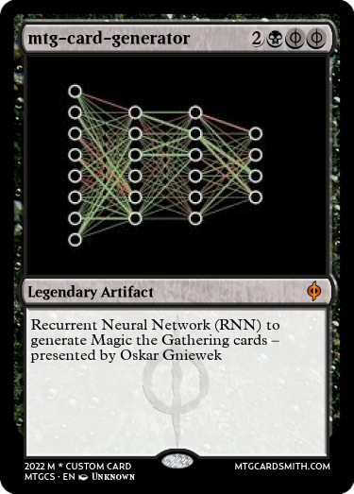
mtg-card-generator
Final project of Machine Learning course 2021/2022, Jagiellonian University, Cracow

Slide 2
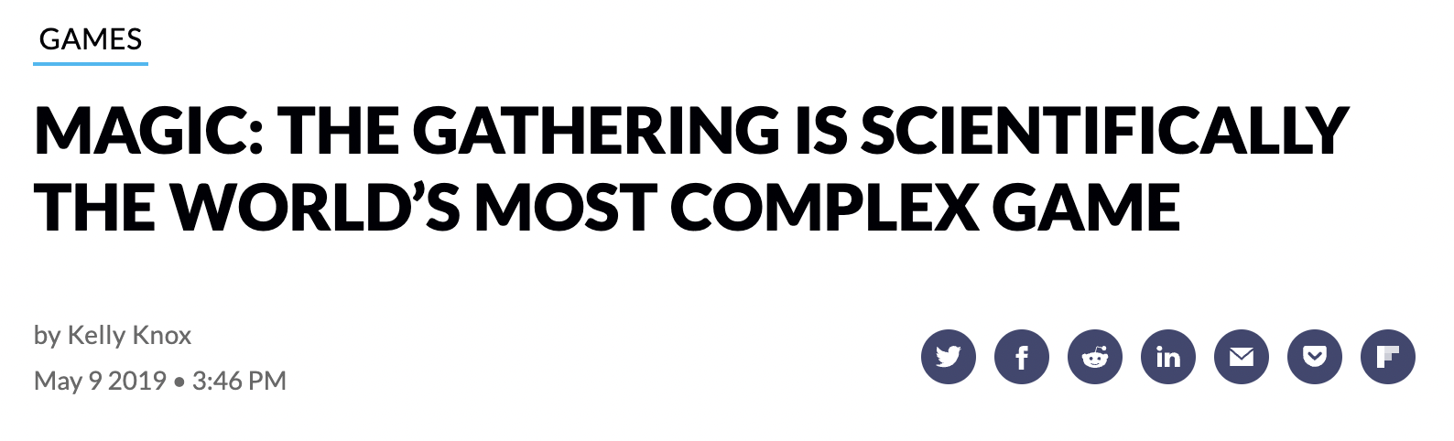
AIM OF THIS PROJECT
Magic the gathering (MTG) is the first trading card game with more than 20 billlion cards in existence.^{[1]}
MTG complexity allows to build even a Turing Machine in the game.^{[2]}
The aim of this project was to wirte a card generator based on RNN inspired by roborosewater ^{[3]}

Slide 3
Distribution of work – Oskar Gniewek
Getting familiar with the database https://mtgjson.com/ - download – prepare data cleaning
Description Generator based on LSTM
Implementing classifier models for the
Color Classifier
Type Classifier
Title Generator
Renderer with artwork and card design
Investigating the final result

Slide 4
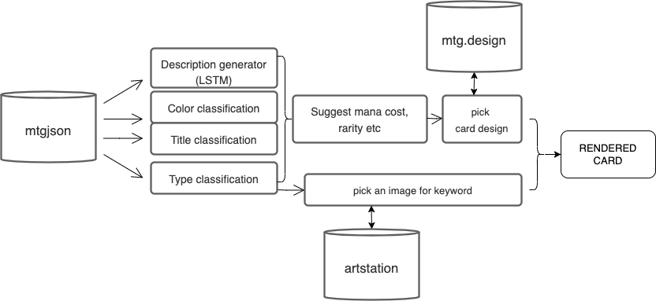
WORKFLOW

Slide 5
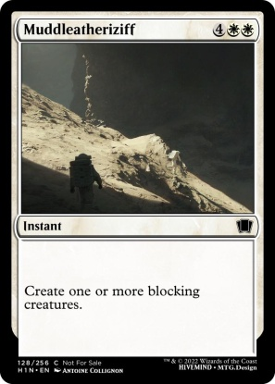
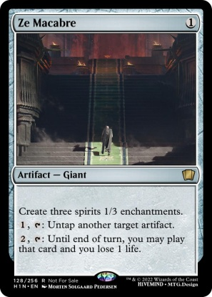
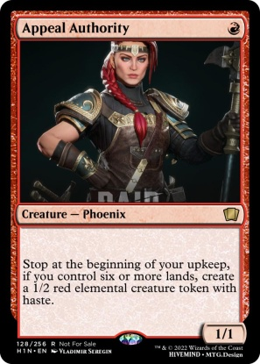
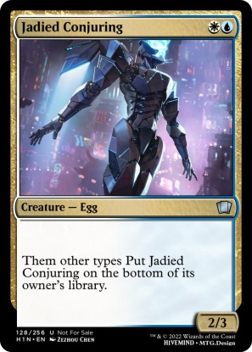
Examples of generated cards

Slide 6
Technical depth
DATABASE mtgjson:
Total number of unique words: 2053
Total number of unique subtypes: 229
Total number of unique chars: 59 Among 17777 cards listed.

Slide 7
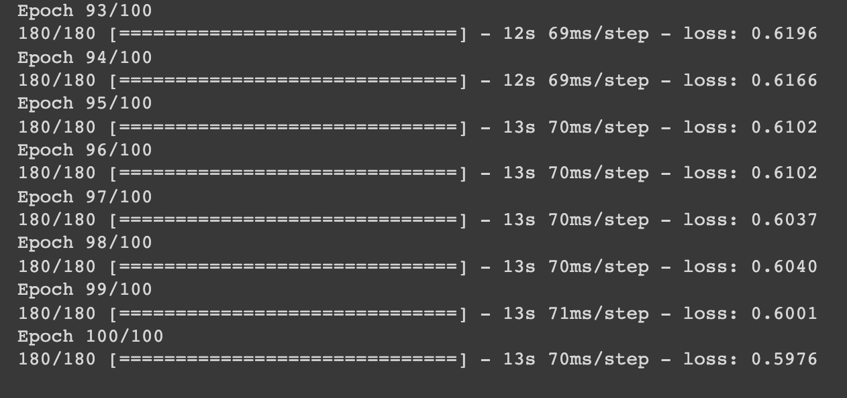
Description classificator

Slide 8
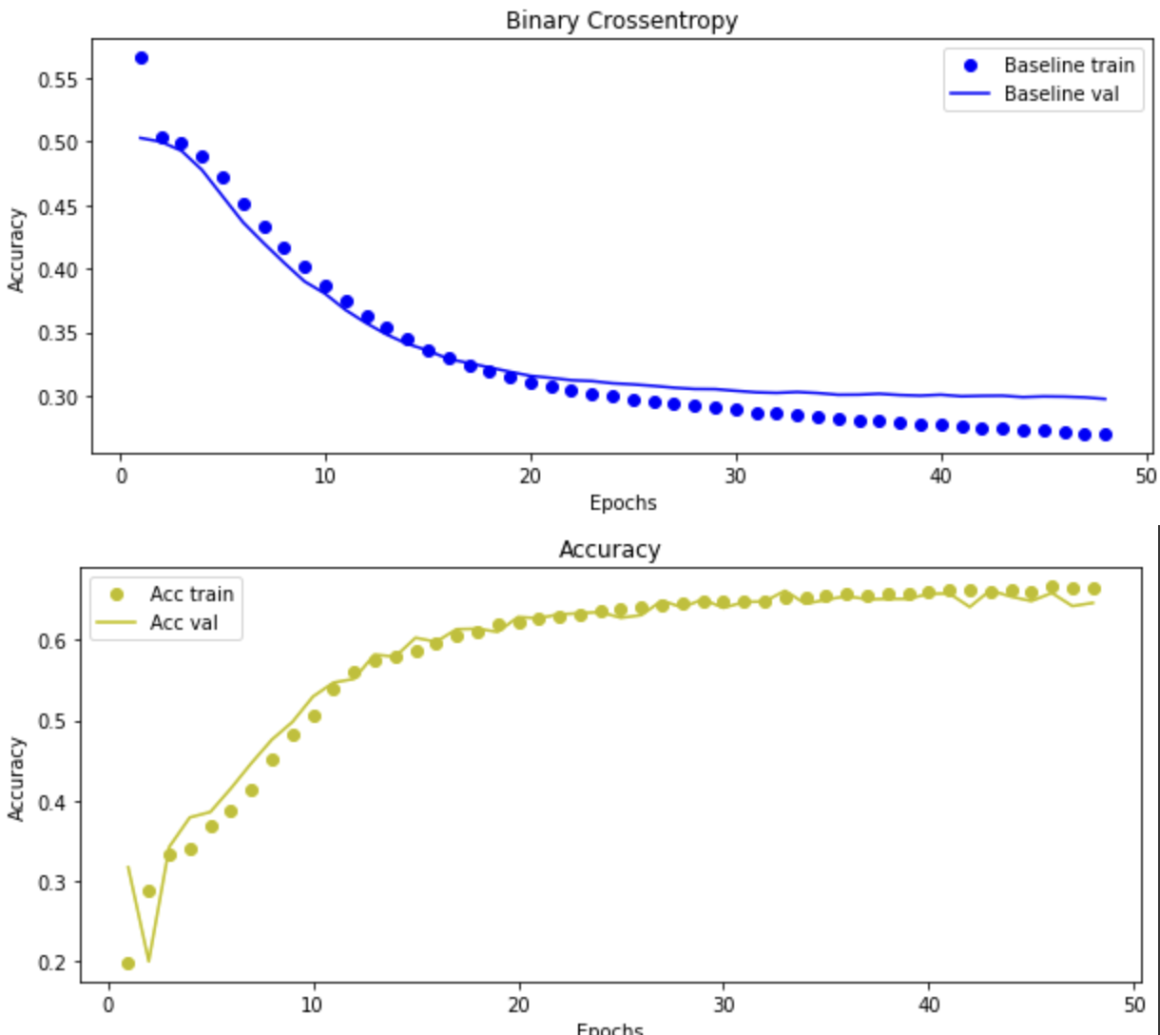
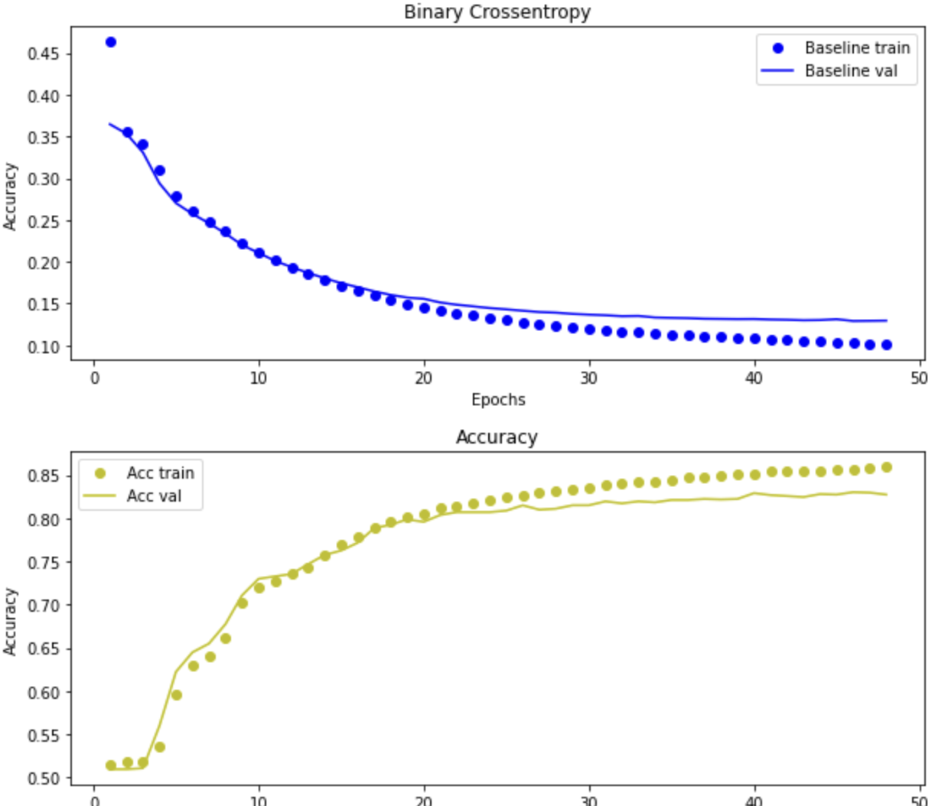
Color classifiactor
Type classificator

Slide 9
Problems that occured
Artworks are repeatable and offen do not match with the type
Data cleaning for the description classifier is though to manage. This results with cards that does not make sens. Example: the card with type „creature” can not have mechanic called ”flashback”
There are to many dependecies for mechanics. For example the mechanic „ sacrifice” is only seen in colors black, red and green but the blue cards generated by the model have it too.
Errors between tensorflow versions could not be solved:
WARNING:tensorflow:Unresolved object in checkpoint: (root).optimizer's state 'v' for (root).layer_with_weights-1.cell.recurrent_kernel

Slide 10
Literature References Code
Documentation sites from used packadges like tensorflow etc
https://github.com/wanqizhu/mtg-python-engine
https://www.w3schools.com/PYTHON/ref_requests_head.asp
https://github.com/wanqizhu/mtg-python-engine/tree/master/MTG
https://mtg.design/
https://github.com/cclagodna/MTG-Proxy-Generator?ref=pythonawesome.com

Slide 11
Presentation references
[1] https://en.wikipedia.org/wiki/Magic:_The_Gathering
[2] https://www.youtube.com/watch?v=pdmODVYPDLA
[3] https://twitter.com/roborosewater

