Slide 1
Python To Java
Pini shlomi

Slide 2
Syntax
All commands must be inside class.
Class name always start with an uppercase first letter
Case-sensitive
Class name must be same as filename
Every program must contain main method
Curly braces {} marks the beginning and the end of a block of code
Each code statement must end with a semicolon (;).
Comments
Single-line comments start with two forward slashes (//).
Multi-line comments start with /* and ends with */.

Slide 3
Variables
Variables are containers for storing data values.
Declaring or Creating Variables
type variableName; Or type variableName = value; => int myNum = 15;
Names can contain letters, digits, underscores, and dollar signs
Names must begin with a letter
Names should start with a lowercase letter, and cannot contain whitespace
Names can also begin with $ and _
Names are case-sensitive ("myVar" and "myvar" are different variables)
Java keywords cannot be used as names

Slide 4
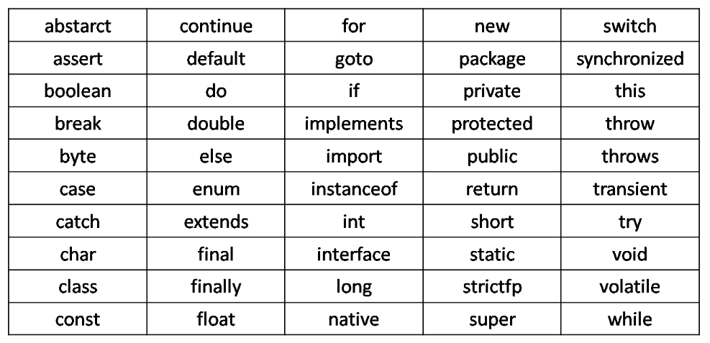
Java Keywords

Slide 5
Primitive Data Types
Data Type | Size | Description
byte | 1 byte | Stores whole numbers from -128 to 127
short | 2 bytes | Stores whole numbers from -32,768 to 32,767
int | 4 bytes | Stores whole numbers from -2,147,483,648 to 2,147,483,647
long | 8 bytes | Stores whole numbers from -9,223,372,036,854,775,808 to 9,223,372,036,854,775,807
float | 4 bytes | Stores fractional numbers. Sufficient for storing 6 to 7 decimal digits
double | 8 bytes | Stores fractional numbers. Sufficient for storing 15 decimal digits
boolean | 1 bit | Stores true or false values
char | 2 bytes | Stores a single character/letter or ASCII values

Slide 6
Non-Primitive Data Types
Called also reference types because they refer to objects.
The main difference :
Non-Primitive Data Types | Primitive Data Types
not defined by Java (except for String | predefined
call methods to perform certain operations | cannot
can be null | has always a value
starts with an uppercase letter. | starts with a lowercase letter

Slide 7
Variable Examples
// Integer (whole number)
int myNum = 5;
// Floating point number
float myFloatNum = 5.99f;
// Character
char myLetter = 'D’;
// Boolean
boolean myBool = true;
// String
String myText = "Hello";

Slide 8
Java Type Casting
Widening Casting (automatically) - converting a smaller type to a larger type size
byte -> short -> char -> int -> long -> float -> double
Narrowing Casting (manually) - converting a larger type to a smaller size type
double -> float -> long -> int -> char -> short -> byte

Slide 9
Output - print () function
Print everything as strings.
Prints strings in between double quotes or variables
Not appends a newline to output.
To print with a newline, use println().
System.out.println("Hello World!");
System.out.println(3 + 3);
System.out.println(firstName + " " + lastName);

Slide 10
Input
input() function is to read input from the standard input (the keyboard, by default)
It accepts all user input as a string and converting them depend the methods.
Scanner s = new Scanner(System.in); System.out.println("Enter integer number: "); int int_num = s.nextInt(); System.out.println("int number is " + int_num); s.close();
Enter integer number:
25
int number is 25

Slide 11
Input
Scanner s = new Scanner(System.in); System.out.println("Enter your name: "); String st = s.next(); System.out.println("Enter char: "); char ch = s.next().charAt(0); System.out.println("your name is " + st); System.out.println("char is " + ch);
s.close();
Enter your name:
pini
Enter char:
S
your name is pini
char is S

Slide 12
Arithmetic operators
Operator | Name | Example
+ | Addition | x + y
- | Subtraction | x - y
* | Multiplication | x * y
/ | Division | x / y
% | Modulus | x % y
++ | Increment | x++
-- | Decrement | x--

Slide 13
Assignment operators
Operator | Example | Same As
= | x = 5 | x = 5
+= | x += 3 | x = x + 3
-= | x -= 3 | x = x - 3
*= | x *= 3 | x = x * 3
/= | x /= 3 | x = x / 3
%= | x %= 3 | x = x % 3

Slide 14
Comparison Operators
Operator | Name | Example
== | Equal | x == y
!= | Not equal | x != y
> | Greater than | x > y
< | Less than | x < y
>= | Greater than or equal to | x >= y
<= | Less than or equal to | x <= y

Slide 15
Logical Operators
Operator | Name | Example
&& | And | x && y
|| | Or | x || y
! | Not | !(x > y)

Slide 16
Condition
if (condition) {
// block of code to be executed if the
// condition is true
}else {
// block of code to be executed if the
// condition is false
}
Shorthand If...Else
variable = condition ? expressionTrue : expressionFalse;
String result = time < 18 ? "Good day." : "Good evening.";

Slide 17
Switch
switch(expression) {
case x:
// code block break;
case y:
// code block break;
default:
// code block
}

Slide 18
Traditional Switch
switch (errorCode) { case 404, 405: System.out.println("Not found!"); System.out.println("Please correct your request."); break; case 418: System.out.println("I am a teapot!"); break; case 500: System.out.println("Internal server error!"); break; default: System.out.println("Unknown code!"); }

Slide 19
Enhanced Switch
switch (errorCode) { case 404, 405 -> { System.out.println("Not found!"); System.out.println("Please correct your request."); } case 418 -> System.out.println("I am a teapot!"); case 500 -> System.out.println("Internal server error!"); default -> System.out.println("Unknown code!"); }

Slide 20
While Loop
while (condition) {
// code block to be executed
}
int i = 0;
while (i < 5) {
System.out.println(i);
i++;
}

Slide 21
Do While Loop
Will always be executed at least once, even if the condition is false.
int i = 0;
do {
System.out.println(i);
i++;
} while (i < 5);

Slide 22
For Loop
for (statement 1; statement 2; statement 3) {
// code block to be executed
}
Statement 1 : is executed (one time) before the execution of the code block.
Statement 2 : defines the condition for executing the code block.
Statement 3 : is executed (every time) after the code block has been executed.
for (int i = 0; i < 5; i++) {
System.out.println(i);
}

Slide 23
For-Each Loop
for (type variableName : collection) {
// code block to be executed
}
String[] cars = {"Volvo", "BMW", "Ford", "Mazda"};
for (String i : cars) {
System.out.println(i);
}

Slide 24
String
Immutable sequences of ordered characters
Enclosed in double "quotes".
String txt = "ABCDEFGHIJKLMNOPQRSTUVWXYZ"; System.out.println("The length of the txt string is: " + txt.length());
String txt = "Hello World"; System.out.println(txt.toUpperCase());
// Outputs "HELLO WORLD“
System.out.println(txt.toLowerCase());
// Outputs "hello world"

Slide 25
Array
Store multiple values in a single variable
Declaration:
type [] varibaleName;
int[] arr1; arr1 = new int[4]; int[] arr2 = {1,2,3};

Slide 26
Array
Access the Elements of an Array
Array indexes start with 0
String[] cars = {"Volvo", "BMW", "Ford", "Mazda"}; System.out.println(cars[0]); // Outputs Volvo
Change an Array Element
cars[0] = "Opel"; System.out.println(cars[0]); // Now outputs Opel instead of Volvo
Array Length
System.out.println(cars.length); // Outputs 4

Slide 27
Array
Arrays Loop with for
String[] cars = {"Volvo", "BMW", "Ford", "Mazda"}; for (int i = 0; i < cars.length; i++) { System.out.println(cars[i]); }
Arrays Loop with for-each
for (String car : cars) { System.out.println(car); }

Slide 28
Multi-Dimensional Arrays
int[][] myNumbers = { {1, 2, 3, 4}, {5, 6, 7} }; System.out.println(myNumbers[1][2]); // Outputs 7 myNumbers[1][2] = 9; System.out.println(myNumbers[1][2]); // Outputs 9 instead of 7
for (int i = 0; i < myNumbers.length; ++i) { for(int j = 0; j < myNumbers[i].length; ++j) { System.out.println(myNumbers[i][j]); } }

Slide 29
Function
<access-modifier> <return-type> <function-name>(<parameter-list>)
throws <exception-list> {
// function body }
Return type
access modifier
Parameter list
name
public void myFunc(int num, String st) {
// function body
}

Slide 30
Function Parameters
public static void main(String[] args) { myMethod("Yael", 35); myMethod("Mor", 28); myMethod("Dan", 31); }
static void myMethod(String firstname, int age) { System.out.println(firstname + " is " + age); }
Calling function with arguments
Function Parameters
Yael is 35
Mor is 28
Dan is 31

Slide 31
Function Overloading
Define multiple functions with the same name but different parameter lists or types
public static void main(String[] args) { int sum1 = add(5, 10); System.out.println("Sum of two integers: " + sum1); int sum2 = add(5, 10, 15); System.out.println("Sum of three integers: " + sum2);
} public static int add(int a, int b) { return a + b; } public static int add(int a, int b, int c) { return a + b + c; }
Sum of two integers: 15
Sum of three integers: 30

Slide 32
main Function
Entry point of Java program
Name must be ‘main’.
args parameter for command-line arguments
return type is void
public static void main(String[] args) { // Method body }

Slide 33
Package
Used for organizing classes into namespaces.
provide a way to group related classes together.
provide access control mechanisms through their visibility modifiers (public, protected, package-private, private).
Classes within the same package can access each other's members with default (package-private) or no visibility modifiers.
package com.example.app;
public class Main {
// class definition }

Slide 34
Package
Summary of Access modifier.
Access Modifier | Visibility within the Package | Visibility outside the Package | Visibility within Subclasses | Example
public | Visible | Visible | Visible | public class MyClass { ... }
protected | Visible | Not Visible | Visible | protected void myMethod() { ... }
Package-private | Visible | Not Visible | Not Visible | void myMethod() { ... }
private | Not Visible | Not Visible | Not Visible | private int myField;

Slide 35
Package - Example
package com.example.superclass; public class Superclass { protected void superClassMethod() { System.out.println("Superclass method"); } }
package com.example.subclass; public class Subclass extends Superclass { public void subclassMethod() { System.out.println("Subclass method"); superClassMethod(); // Accessing protected method from superclass } }

