Slide 1

“Make In India” - Initiative Impact on Indian Exports/Imports and the future outlook on the same
by Prakash Injnani(CXO – Bharti(ya))

Slide 2
Problem Statement
Introduction
Data Source and Data-Set
Data profiling
Initial Observations
Data Normalization
Feature Engineering
Analysis & Inferences

Slide 3
Problem Statement
To understand the impact of “Make in India” Initiative on the Exports & Imports of India using the Import and Export data available by principle commodity and country wise for 3 years from Apr'2014 to Mar'2017.
**Current Scope – Doing Exploratory Data Analysis(EDA) on sample data, which will drive machine learning model creation on population of data.

Slide 4
Data profiling
Number of variables | 8
Number of observations | 62445
Total Missing (%) | 6.5%
Total size in memory | 3.8 MiB
Average record size in memory | 64.0 B
country_name has a high cardinality: 243 distinct values Warning
pc_code has a high cardinality: 168 distinct values Warning
pc_description has a high cardinality: 168 distinct values Warning
quantity has 1323 / 2.1% zeros Zeros
quantity has 32464 / 52.0% missing values Missing
quantity is highly skewed (γ1 = 54.037) Skewed
value is highly skewed (γ1 = 36.909) Skewed
EXPORT
Number of variables | 8
Number of observations | 28995
Total Missing (%) | 0.0%
Total size in memory | 906.2 KiB
Average record size in memory | 32.0 B
country_name has a high cardinality: 236 distinct values Warning
pc_description has a high cardinality: 166 distinct values Warning
value is highly skewed (γ1 = 26.979) Skewed
IMPORT
Column Descriptions
pc_code: Integer, Principal Commodity Code
pc: String, Principal Commodity Name
unit: String, measurement of quantity
country code: Integer, country code
country_name: String, country name
quantity: Integer, quantify of export or import
value: Integer, monetary value of the quantity (in million USD)
Ministry of Commerce and Industry, Govt of India has published these datasets in Open Govt Data Platform India portal under Govt. Open Data License - India.

Slide 5



Data Normalizing
Standardize column headers to lower case
Convert timestamp to date-time
Missing data and its imputation
Outlier Treatment
Handling NaN data in categorical variables
Grouping
Skewness Handling

Slide 6
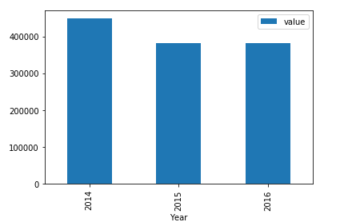
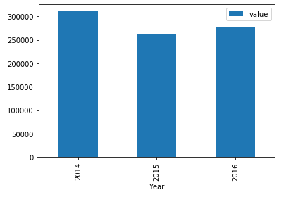
Objectives & Graphs – Insight1(Impact on overall Exports/Imports by value in USD)
There is a decline of 11% in Exports from 2014 to 2016
There is a decline of 15% in Imports from 2014 to 2016

Slide 7
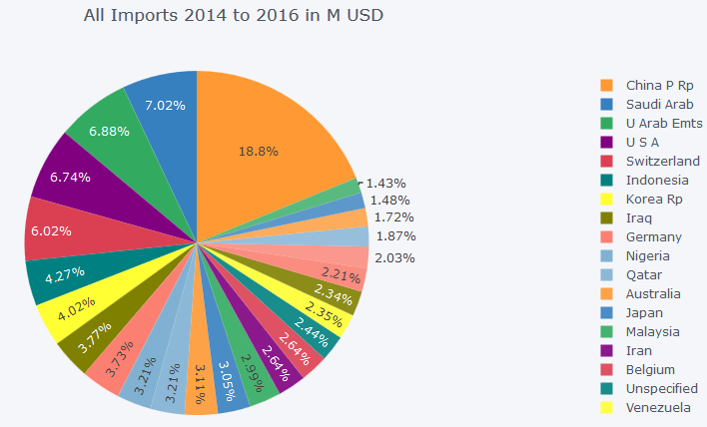
Objectives & Graphs – Insight2(3 Year All Imports Top 25 Countries share)
0 China P Rp
1 Saudi Arab
2 U Arab Emts
3 USA
4 Switzerland
5 Indonesia
6 Korea Rp
7 Iraq
8 Germany
9 Nigeria
Top 10 Countries we are importing from

Slide 8
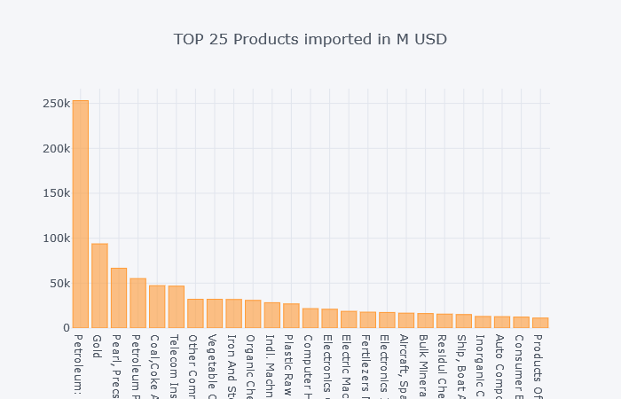
Objectives & Graphs – Insight3(What are we importing more ?? - Top 25 Products and Share)

Slide 9
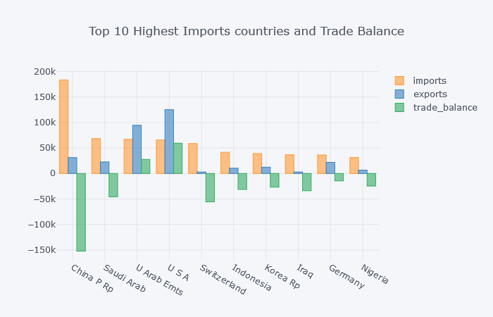
Objectives & Graphs – Insight4(Whom to reduce Import with, to positively drive trade balance)

Slide 10
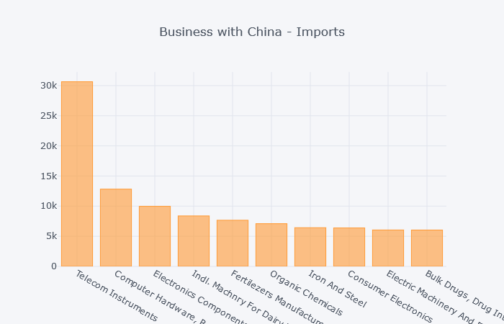
Objectives & Graphs – Insight5(Overall What to avoid in Imports)

Slide 11
Conclusion
Final Observations and Conclusions based on the imports and exports data 2014 -2016
Highest imported product is ' Petroleum-Crude' - 253 B USD
Highest exported product is 'Petroleum-Products' - 118 B USD
Second Highest imported product is 'Gold' - Total Imports - 93 B USD
Three year Cumulative Trade Deficit is - 362 B USD
With China India has the highest Trade deficit - 152 B USD
With USA India has the highest Trade surplus - 59 B USD
USA is the second highest trading country after China Trade Value - 190 B USD
Gold is the second highest commodity India imports from USA - 6 B USD
Second highest commodity exported to Saudi is 'Basmati Rice' - 2.7 B USD
Highest commodity exported to china is 'cotton yarn' - 30 B USD
Singapore is the second highest importing country of Petroleum products from India 13 B USD

Slide 12

The Next Steps
Phase 1 - Sample
Start
Descriptive Analysis on Sample Data
Model Creation on Sample Data
Evaluation of
Model
Phase 2 – Population
Start
Inferential Analysis on Population Data
Model Tuning on Population Data
Evaluation of
Model
Phase 3 – Production Deployment
Start
Building Data Pipelines
Data Lake Creation
Machine Learning
This is very simplistic view of each phase to make it easier to understand

