Slide 1
Secondary Structure Prevention in the ADS Codex
Alina Li
Institute for Computing in Research
Summer 2022

Slide 2
Our Data Problem
Amount of digital data is projected to reach 181 zettabytes of data
(181000000000000000000000 bytes)
https://imgur.com/gallery/vzYgVUx

Slide 3
Data Centers
Most of our data is stored in data centers
Google, Microsoft, etc.
Power-intensive
  40% power = cooling
  ~1% of global electricity demand
Noise pollution
Expensive

Slide 4
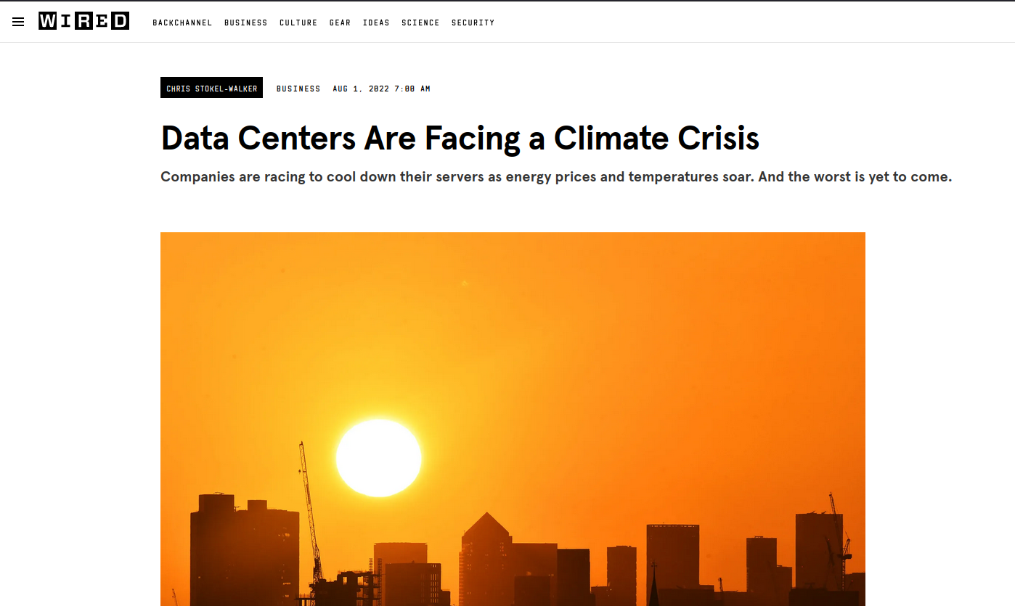
It’s getting hot! Rising temps? Underwater data centers?
https://www.wired.com/story/data-centers-climate-change/

Slide 5
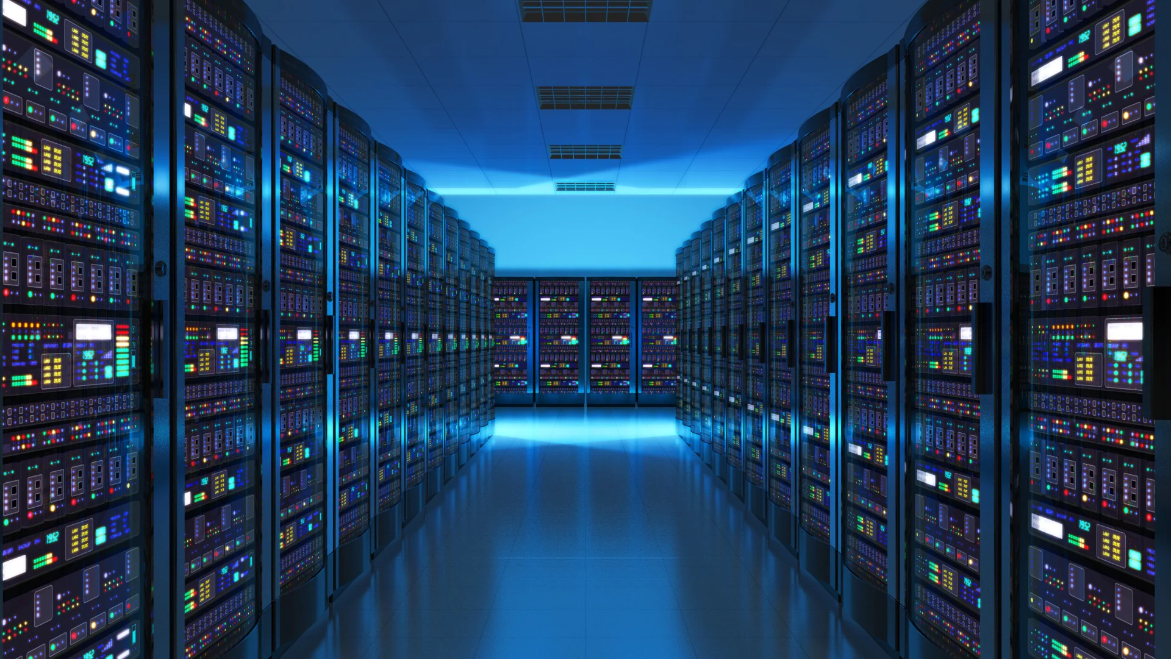
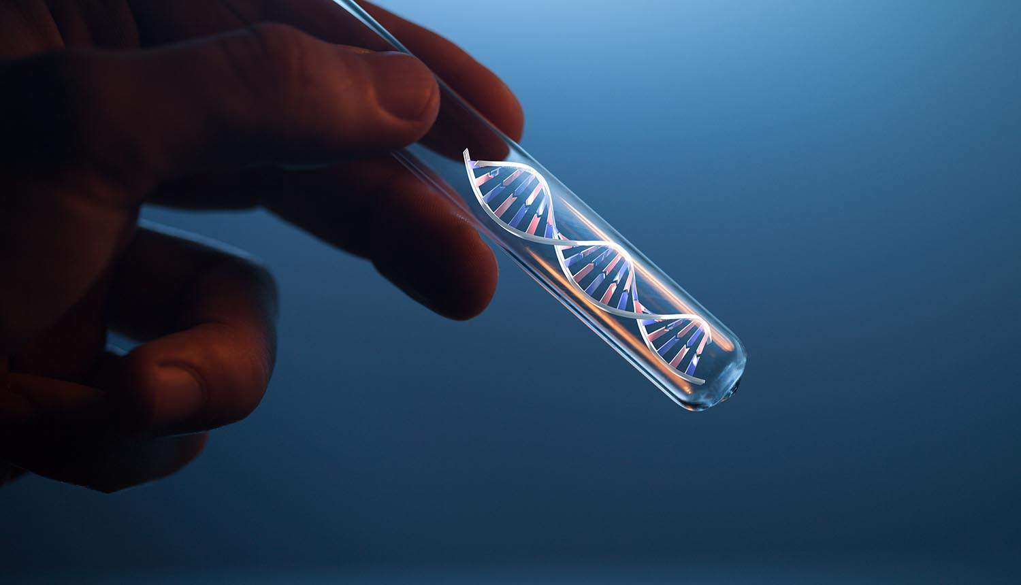
The Future?
https://www.racksolutions.com/news//app/uploads/AdobeStock_87909563.jpg
https://sociable.co/wp-content/uploads/2019/04/dna-test-tube-750x450.jpg

Slide 6
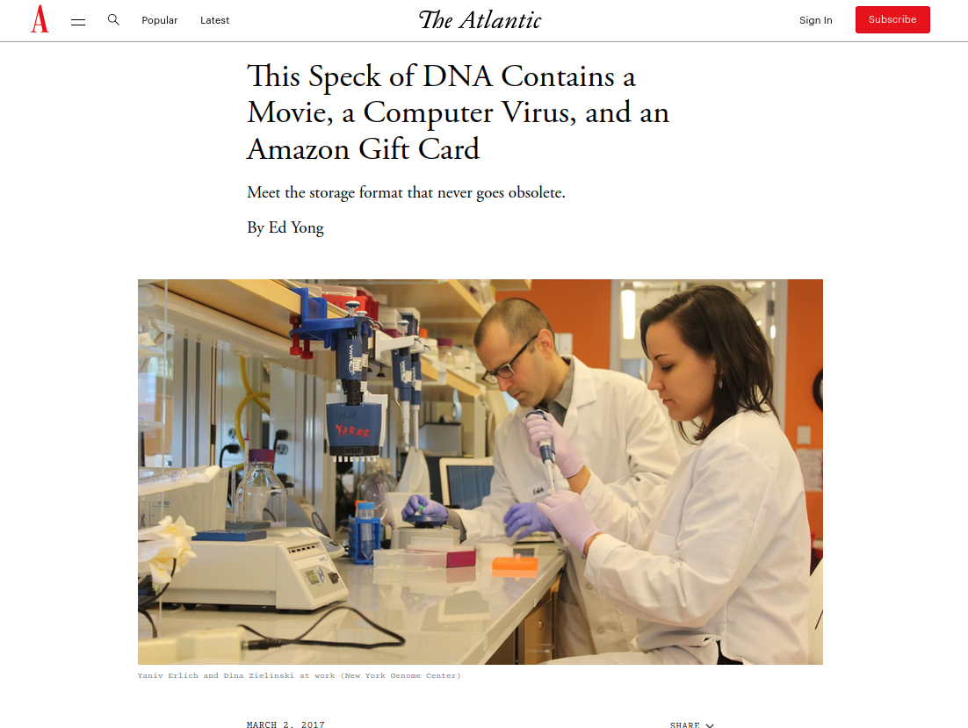

Slide 7
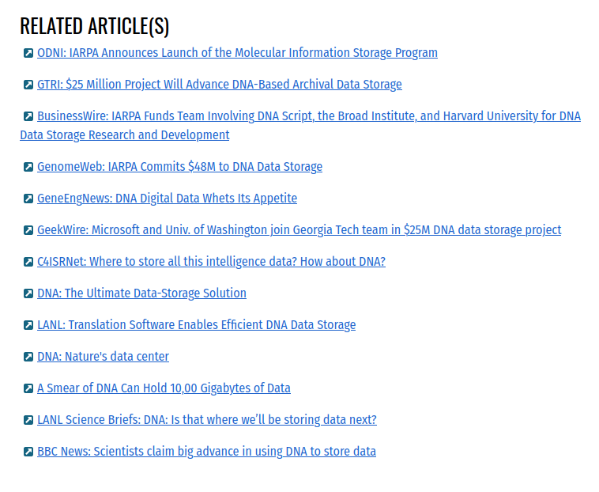
There’s a lot of funding going into this...
https://www.iarpa.gov/research-programs/mist
  Georgia Tech
  The US Army
  Los Alamos
  Harvard
  UW

Slide 8
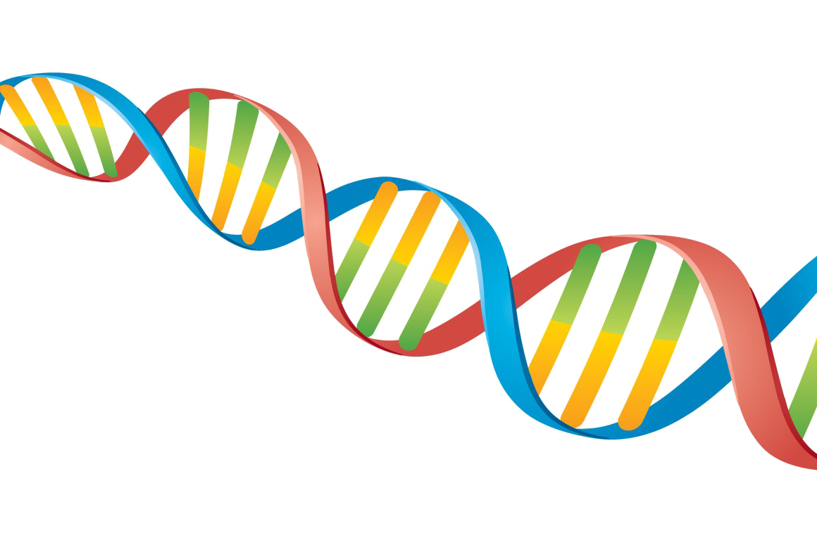
What’s so special about DNA?
It’s scalable
  Cells perform DNA synthesis/replication all the time
  330 billion cells replicated per day
  Sequencers always will exist; CD players…? Not so much
It’s very dense
  “all the DNA in your cells put together would be about twice the diameter of the Solar System”
  “215 petabytes in 1 gram of DNA” (2017, Columbia University)
It can last a long time
It’s less resource intensive
https://www.pngmart.com/files/7/DNA-PNG-Transparent-Image.png

Slide 9
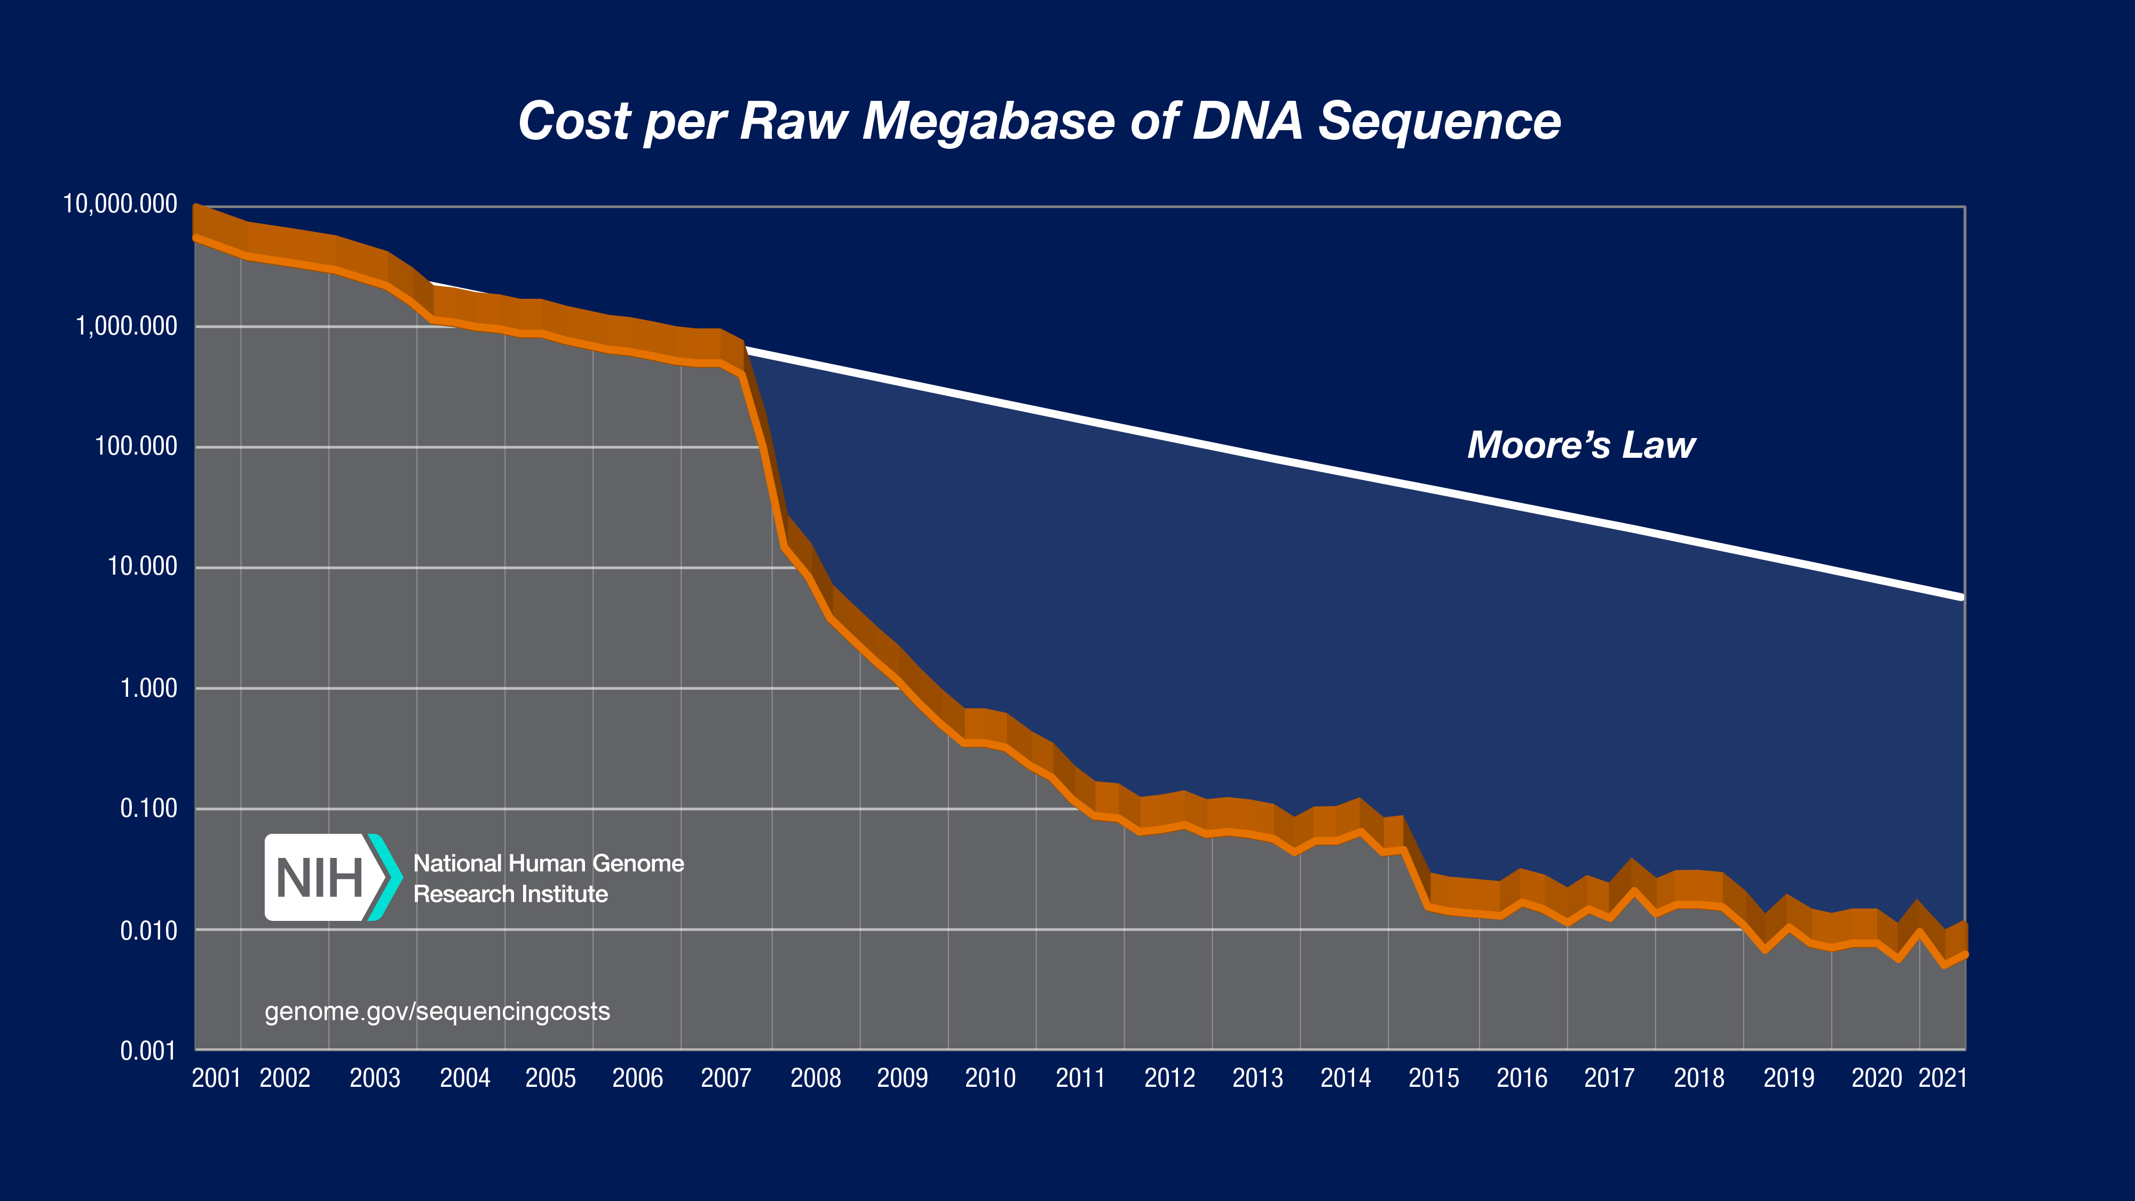
Obstacles
High costs to synthesize & sequence
https://www.genome.gov/about-genomics/fact-sheets/DNA-Sequencing-Costs-Data

Slide 10
Obstacles
Slow process
High error rates
  Substitution, insertion, deletion errors
  How do we avoid them? Fix them?

Slide 11
Before we go on…
DNA is a molecule composed of smaller units, called nucleotides
Nucleotides = sugar, phosphate group, and a base
4 types of bases
  Adenine
  Cytosine
  Guanine
  Thymine
A-T, C-G

Slide 12
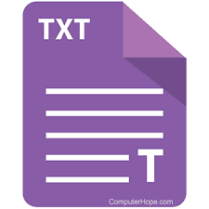
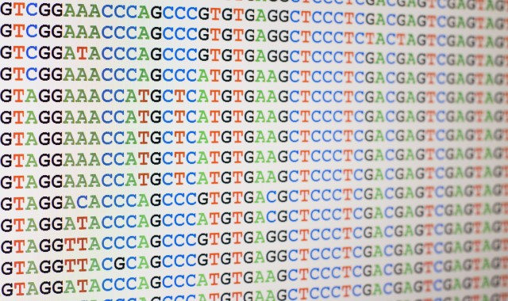
Current Research - DNA Codecs
Encoder
Synthesis
DNA molecules
Sequencing
Decoder
https://inside.battelle.org/images/default-source/default-album/gettyimages-504037029.jpg?sfvrsn=e2e36fd6_0
https://www.computerhope.com/jargon/t/text-file.png

Slide 13
“Bad” Biological Signatures
High GC content
Homopolymers
Proteins, enzymes, toxins, etc.
Secondary structures

Slide 14
ADS Codex
Open-source DNA encoder and decoder
Encoder utilizes a lookup table
  During encoding, the codec addresses high GC content & homopolymers
  Goal: contribute to the codec by determing how to avoid prominent secondary structure encodings
Bit sequence (0’s and 1’s) | DNA sequence (A, C, G, T)
0000000 | AAAACA
0000001 | AAAACA
0000011 | AAAACG
0000100 | AAACCG

Slide 15
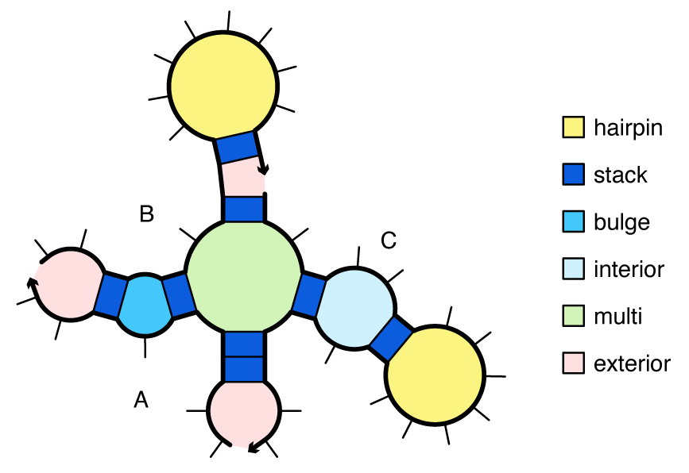
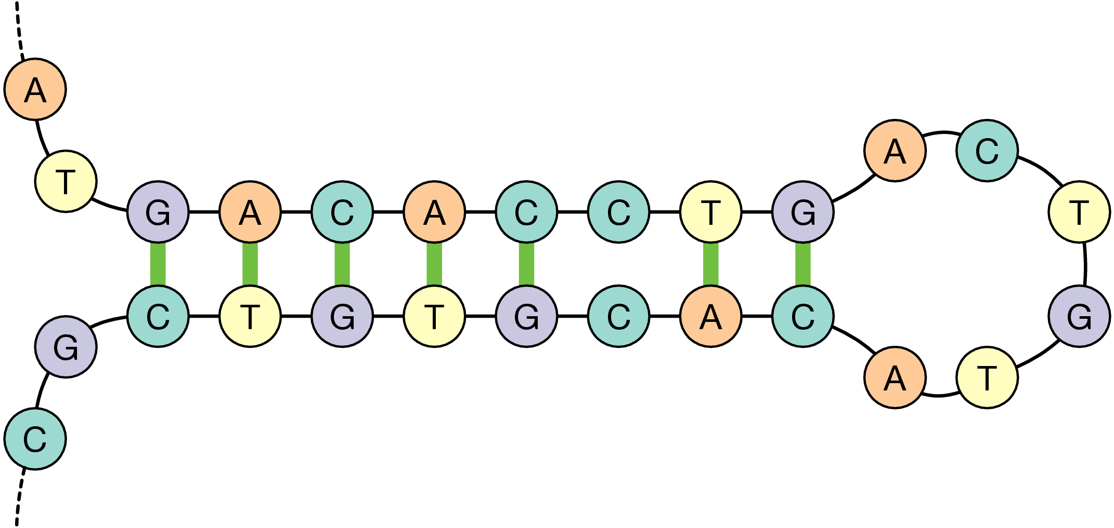
Secondary Structures and Problems
Base pair interactions; complementary sections pair up
Synthesis, sequencing, and replication problems
  Sequencing by synthesis; nanopore
https://docs.nupack.org/figs/looptypes.png
https://www.cs.utexas.edu/~bornholt/dnastorage-asplos16/figs/hairpin.png

Slide 16
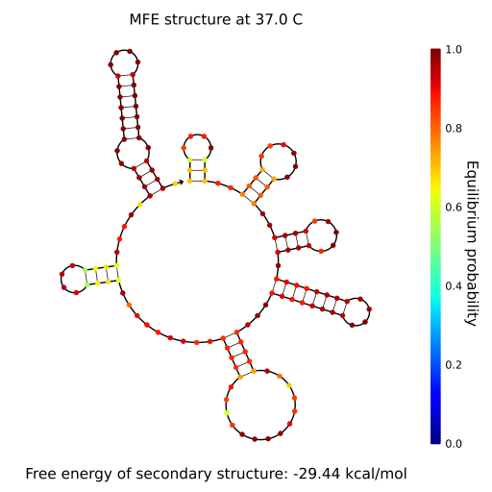
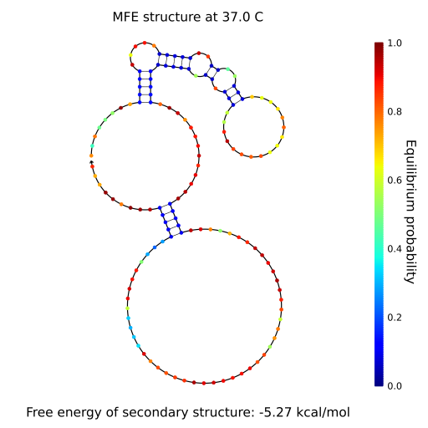
DNA Analysis Using NUPACK
Free energy: capacity to do work
  The smaller the free energy, the more prominent the structure is
The MFE (minimum free energy) of a DNA strand tells us how promiment the secondary structure is
Strand 1’s MFE structure
Strand 2’s MFE structure

Slide 17
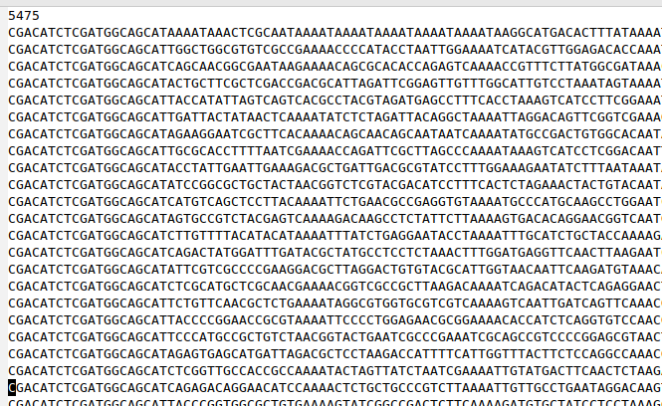
Secondary Structures Analysis Integration
Change the lookup table? Would require lots of MFE analysis.
Instead: randomize data, run MFE analysis for 4 random seeds, select the “best” random seed
seed
XOR
PRNG
10, 4, 101, 12, 273, ...

Slide 18
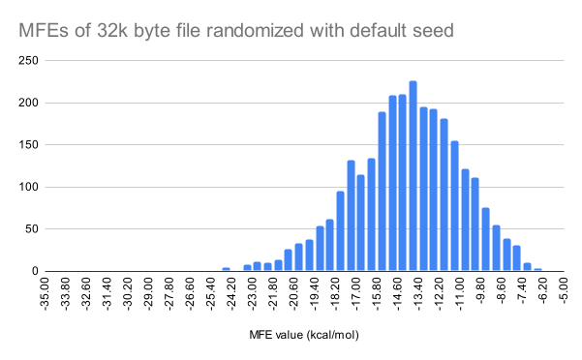
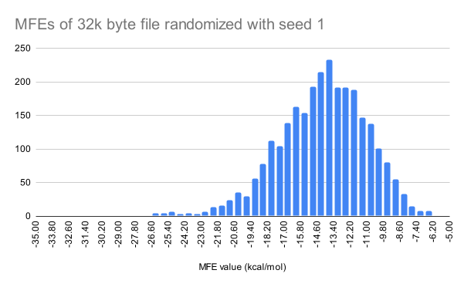
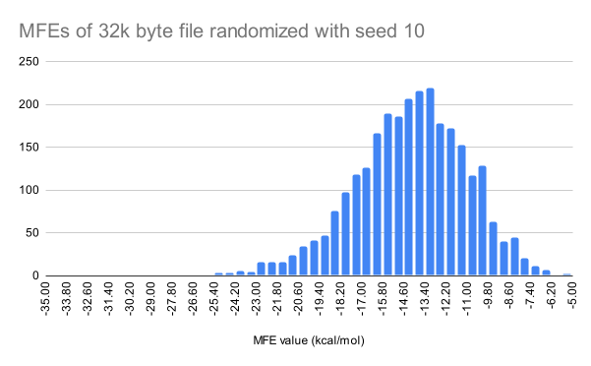
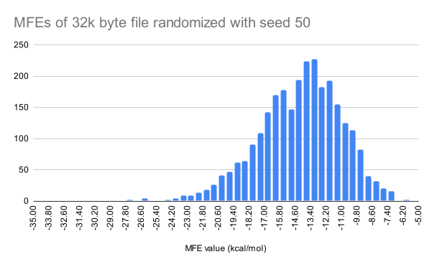
Results

Slide 19
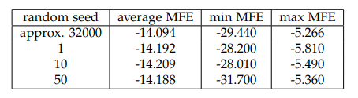
Results
Very little difference in average, min, and max MFE
Average: 0.115 kcal/mol difference

Slide 20
What does this mean?
Using average/min/max MFE to compare random seeds may not be particularly effective
Alternatives?
  Determine the “bad” strands
  Percentage of strands that are “bad”?
  Consider if the “bad” strands are disposable?

Slide 21
Future Work
Refine random seed selection
Goal: full integration + testing with real DNA
Does secondary structure analysis affect sequencing/synthesis error rates?

Slide 22
References
https://www.scientificamerican.com/article/our-bodies-replace-billions-of-cells-every-day/
https://www.forbes.com/sites/forbestechcouncil/2021/05/03/renewable-energy-alone-cant-address-data-centers-adverse-environmental-impact/?sh=3a9324075ddc
https://www.scientificamerican.com/article/dna-the-ultimate-data-storage-solution/
DNA Storage with ADS Codex: the Adaptive Codec for Organic Molecular Archives
https://docs.nupack.com

