Slide 1
Swerve Drivetrain
Alina Li
Institute for Computing in Research

Slide 2
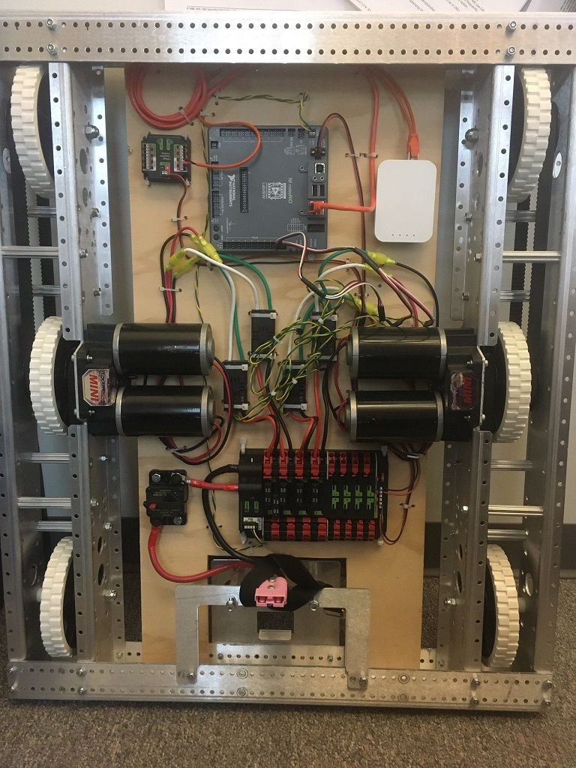
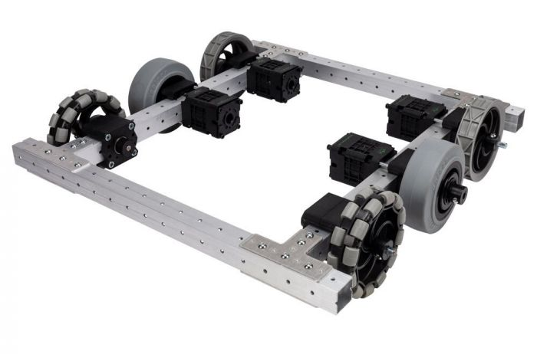
Drivetrains
Movement
Motors power wheels
https://www.vexrobotics.com/versachassis-mini.html
https://docs.wpilib.org/en/stable/docs/software/hardware-apis/motors/wpi-drive-classes.html

Slide 3
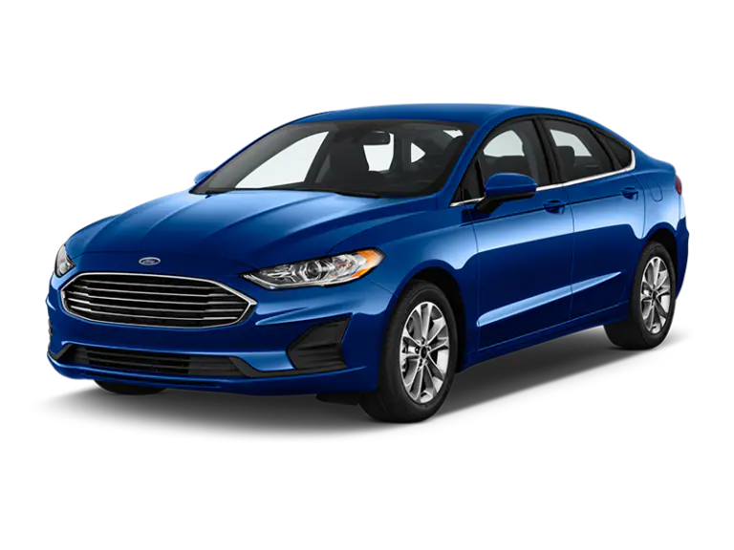
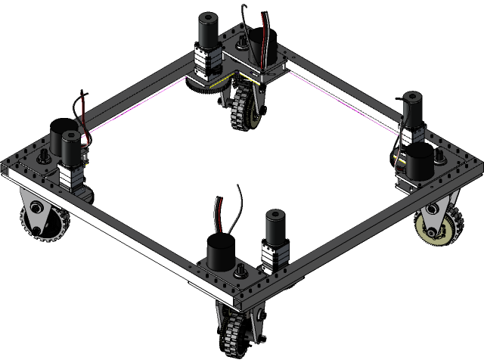
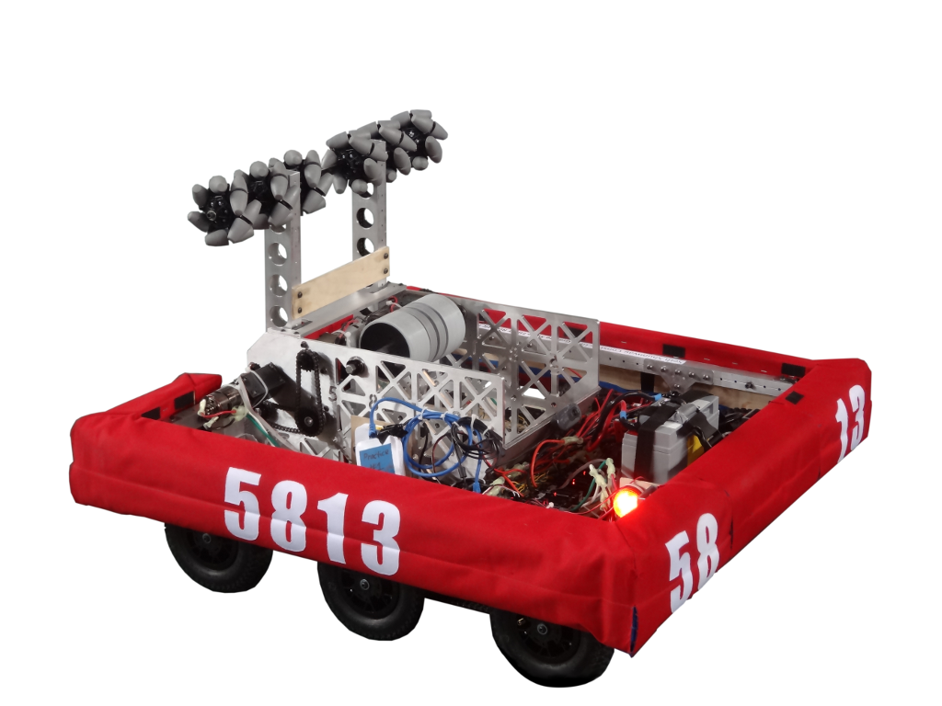
Types of Drivetrains
https://www.enterprise.com/en/car-rental/vehicles/us.html
https://5813.frc.team/about/robots/
https://grabcad.com/library/4926-off-season-swerve-drive-1
Notes:
Car - front two steer; back two power
4-wheel/6-wheel tank drive: all wheels chained together; motor powers wheel. How does it rotate; 2 degrees of freedom (forward/back; rotate)
Swerve drive: wheels can rotate; three degrees of freedom (f/b; r/L; rotate)

Slide 4
What/Why Swerve?
https://www.youtube.com/watch?v=FLnUZBHBczM

Slide 5

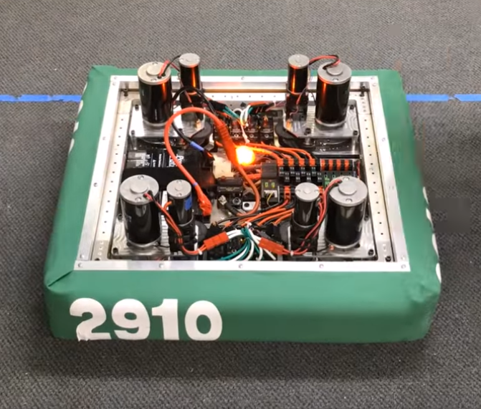
Driving Swerve
Contrast xbox control between swerve and tank
Left joystick – translation (tank – only Y); (swerve – both X and Y)
Right joystick - rotation

