Slide 1
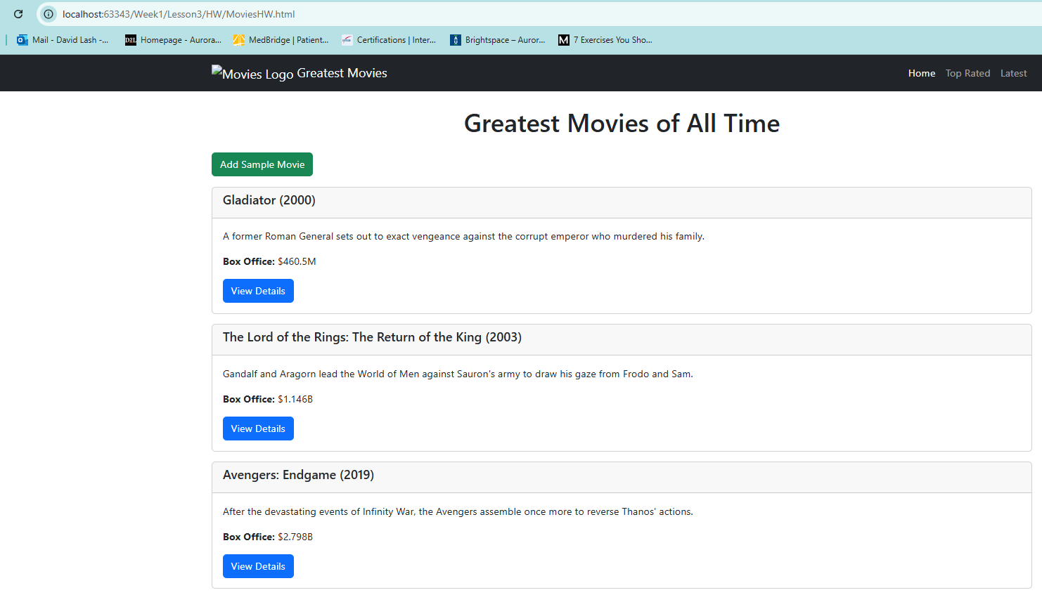
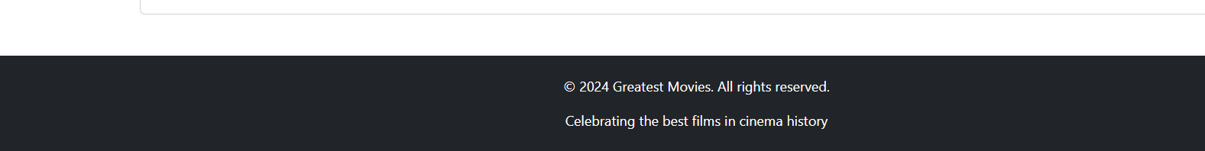
Build this site
R1 - Use cards instead of a table each should include
- Title, 1 line description, box office and button
R4 – Onclick of button show a details page (see next slide)
R2 – Create nav item for header that is properly responsive
R3 – Include a proper footer

Slide 2
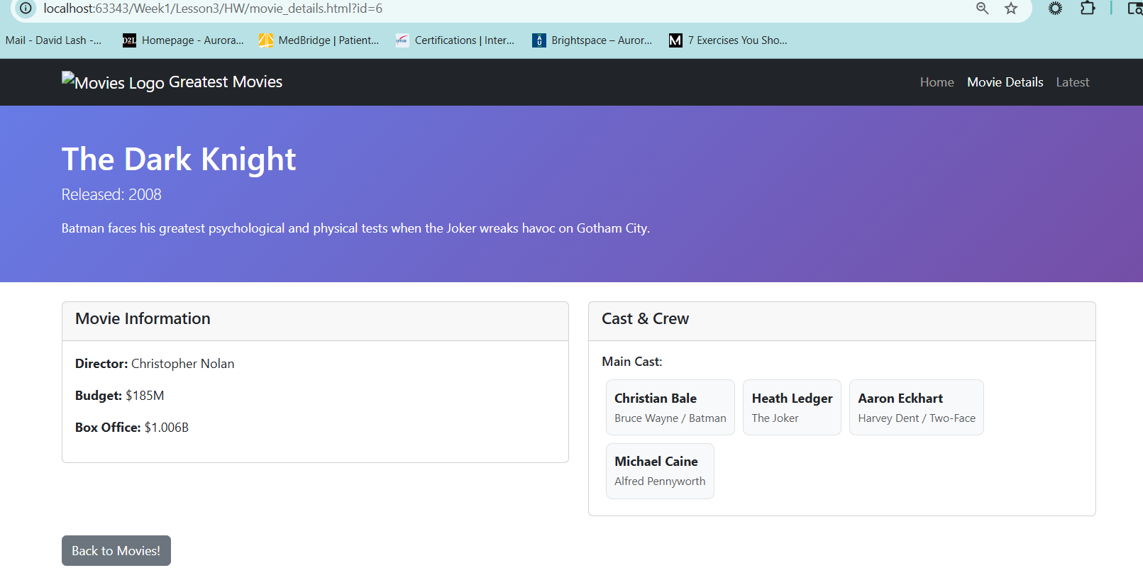
RD1 – details page has same header but this is highlighted
RD2- Show title here
And 2 cards 1 for info and 1 for cast and cred
RD3 these links works and goes back
RD4 – support the common footer

Slide 3
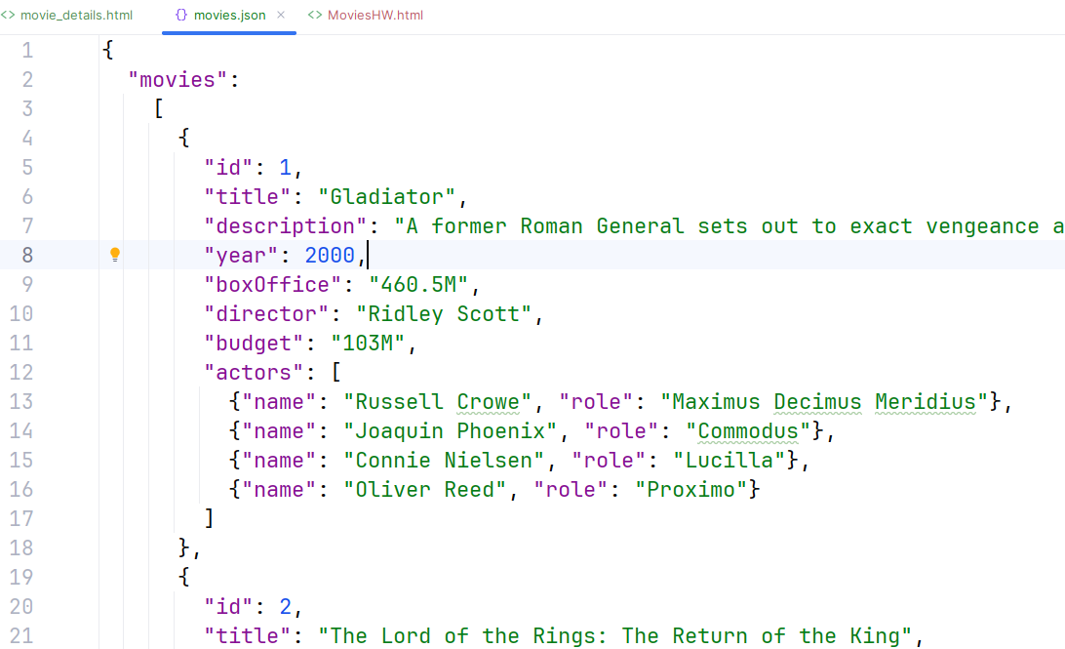
Use this JSON file for input --- attached to assignment
You need to use JSON WEBSERVER to start the webserver
Use fetch to access the webserver
DO NOT just uses this as a JS data structure instead load it from JSON web server

Slide 4
What to hand in
2 code files moviesHW.html and movie_details.html
A screen shot showing:
moviesHW.html showing all movies
A screen show of movie_details when
Gladiator is clicked
Pulp Fiction is clicked
Learning Objectives:
How to load an external file via JS with fetch
How to parse the JSON file
JSON string format is and how to convert into a JS data structure
Basic Terminal commands in windows or mac to find file and kill existing processes
How to create a proper bootstrap grid
How to update a DOM element in JS
How to deal with loading errors

